Slide 1
Teratogenicity
Dr. Nayira A. Abdel Baky
Associate Professor
Pharmacology and Toxicology

Slide 2
What is Teratogenicity
Teratology is the study of environmentally induced congenital malformations. Congenital malformations are non-reversible functional or morphological defects present at birth. They may not be detectable at birth and only become evident later in life.
A teratogen is an agent, which by acting on the developing embryo or fetus can cause a structural anomaly.
To date, very few drugs are proven teratogens. However, malformations induced by drugs are important because they are potentially preventable.
Teratogenesis is a prenatal toxicity characterized by structural or functional defects in the developing embryo or fetus. It also includes intrauterine growth retardation, death of the embryo or fetus, and transplacental carcinogenesis (in which chemical exposure of the mother initiates cancer development in the embryo or fetus, resulting in cancer in the progeny after birth).

Slide 3
History about Teratogenicity
 In 1928 : Exposure to therapeutic radiation during pregnancy microcephaly baby.
 In 1933 : Deficiency of vitamin A in the 1st month before pregnancy & during pregnancy anophthalmia (deficiency in eye)
 In 1941 : German measles ( rubella ) infection in pregnancy cause teratogenicity (blindness, deafness, mental retardation and death).
 In 1944 : Malformation due to nutritional deficiency.
In 1961 : Correlation between
Thalidomide ( used as sedative , hypnotic
and antiemetic) ingestion in pregnancy
& phocomelia ( phoco= seal , melia= extremities).

Slide 4
Sensitivity to teratogens is according to the stage of development
1-Embryonic Stage
a.Pre-implantation Stage (All or Non)
-From fertilization till implantation
-During this stage : toxic chemical can kill some of the cells in the blastocyst, resulting in the death of the embryo the embryo (embryolethality), or have no effect at all.
b.Post-implantation (stage of organogenesis )
from the 3rd to the 8th week of gestation .
6-7 days after gestation ,implantation occurs followed by gastrulation ( formation of ectoderm, mesoderm & endoderm). It is characterized by differentiation and organization. During this stage, the embryo is highly susceptible to the effect of teratogens. Chemical-induced cell death leads to one of two outcomes. If death is restricted to those cells undergoing active cell division at the moment, the corresponding organs are affected, resulting in malformation. If the cell death is generalized without significant replication by the remaining cells to sustain life, the embryo dies. Usually major morphological changes ( especially face) occur in these stage.
The attack by the teratogen could be at any stage of development as follows
Notes:
Because organogenesis is a tightly programmed sequence of events, each organ system has a critical period during which it is sensitive to chemical injury. Chemical exposure in a critical period is likely to produce malformations of that organ and not others; however, because there is some overlapping of critical periods of organ development and because chemicals frequently remain in the embryo for a period of time, malformations of more than one organ usually occur. Since organogenesis occurs mostly in the embryonic stages, chemical exposure in the first trimester should be minimized, if possible. Drugs that reach the embryo at this point may produce abortion, no effect at all, an anatomic defect (teratogenesis), or a metabolic or functional defect that may not be detected until later in life.

Slide 5
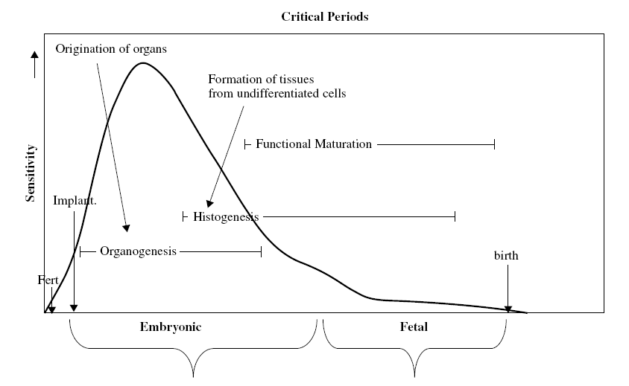
Teratogenesis
Critical periods graph including embryonic and fetal periods. Note the increased sensitivity to teratogenic events during organogenesis.

Slide 6
2-The fetal stage (Fetogenesis Stage=stage of histogenesis )
-It begins from the 9th week of gestation till birth
-It is characterized by growth and functional maturation. During this stage, the fetus is less sensitive to morphologic changes (not associated with major malformations);
The teratogen affects mainly neurologic development, growth, physiologic and biochemical functioning, mental development, and reproduction. (e.g. intelligence, reproduction).
Studies have shown that nearly 50% of pregnant women have been exposed to at least one medication during gestation. An additional study found that of 200 individuals referred for genetic counseling for a teratogenic exposure, 52% were exposed to more than one potential teratogen.
Causes of malformations
40% Unknown
12-25% Genetic defects (Down’s syndrome is the most common of this group)
20% Interactions between hereditary factors and environmental factors
5%-9% Maternal disease (diabetes and seizure) or infection (German measles) , chemicals, X-ray and drugs.

Slide 7
^{Dose-effect relationship}
Teratogens may demonstrate a dose-effect relationship. At low doses there can be no effect, at intermediate doses the characteristic pattern of malformations will result, and at high dose the embryo will be killed.
A dose-response may be considered essential in establishing teratogenicity in animals, but is uncommonly demonstrated in sufficient data among humans. A threshold teratogenic dose is the dosage below which the incidence of adverse effects is not statistically greater than that of controls. With most agents, a dose threshold for teratogenic effects has not been determined; however they are usually well below levels required to cause toxicity in adults.
Teratogens must reach the developing fetous in sufficient amounts to cause their effects. Large molecules with molecular weights greater than 1,000 do not easily cross the placenta into the embryonic-foetal bloodstream to exert potential teratogenic effect. Other factors influencing the rate and extent of placental transfer of xenobiotics include polarity, lipid solubility and the existence of a specific protein carrier.

Slide 8
FDA Classifications of Drug Risk
-Animal studies cannot be true predictors of teratogenicity due to wide inter- and intraspecies variations in the pharmacokinetic properties of drugs, including placental transfer.
-Only controlled epidemiological studies can detect a relationship between environmental factors such as drug exposure and pregnancy outcomes.
Drug Risk Category
A----No fetal risk shown in controlled human studies in all trimesters.
B----Animal studies show risk that is not confirmed in human studies during all trimesters.
C----Fetal risk shown in controlled animal studies but no controlled human studies are available (OR ) studies in humans are not available. Drugs only
given if the potential benefit outweighs the potential risk to the fetus
D----Studies show fetal risk in humans
(Use of drug may be acceptable even with risks, such as in life-threatening illness or where safer drugs cannot be used or are ineffective)
X----Risk to fetus clearly outweighs any benefits from these drugs The drug is contraindicated in women who are or may become pregnant.

Slide 9
^{Examples of teratogenic agents}
A wide range of different chemicals and environmental factors are suspected or are known to be teratogenic in humans and in animals. A selected few include:
Thalidomide (X) is a drug originally marketed to prevent nausea and vomiting in pregnancy. Thalidomide was not shown to be teratogenic in rats however; it is greatest danger during days 34-56 of pregnancy in humans. It was discovered in the 1960s in West Germany to cause rare limb defects, among other congenital anomalies as phocomelia and Amelia, deafness anomalies of teeth, eyes, intestines, heart and kidney. The discoveries about thalidomide triggered legislation requiring teratogenicity testing for drugs.
Chronic alcohol ingestion (D) during pregnancy is the most common cause of congenital problems especially mental development. Ingestion of more than 30 millilitres (1 ounce)
of ethyl alcohol per day during pregnancy can lead to the development
of fetal alcohol syndrome, characterized by intrauterine growth retardation
and subsequent learning disabilities, such as distractibility, and language
disorders. Heavier consumption of alcohol, more than 60 millilitres per day,
by a pregnant woman can result in malformations of the fetal brain
^{and in spontaneous abortions.}

Slide 10
Carbamazepine (C). Craniofacial abnormalities, growth retardation, neural tube defects, fingernail hypoplasia.
Cocaine (C). Premature birth, abruption (the placental lining has separated from the uterus of the mother), perinatal morbidity, growth retardation, in utero stroke, bowel atresias, defects of genitourinary system, heart, limb, face.
Iodides (D). Goiter, fetal hypothyroidism.
Lithium (D). Ebstein’s anomaly (tricuspid valve defect) and other cardiac defects.
Tetracyclines (D). Weakened fetal bone and tooth enamel dysplasia, permanent tooth discoloration.
Diethylstilbestrol (DES) (x) is a drug used primarily from the 1940s to the ’50s
to prevent miscarriage. The drug is an example of a chemical that can
produce transplacental carcinogenesis. It was discovered in the early
1970s that exposures to diethylstilbestrol before the ninth week of
gestation could lead to the formation of rare vaginal and cervical cancers in
^{female progenies.}
Notes:
Craniofacial abnormalities تشوهات فى الوجة و الجمجمة
tooth enamel dysplasia النمو الشا\ لمينا الاسنان
Fingernail hypoplasia نقص نمو الاظافر

Slide 11
Fetal warfarin syndrome (D). The anomalies is characterized mainly by skeletal abnormalities, which include nasal hypoplasia, a depressed or narrowed nasal bridge, scoliosis, and calcifications in the vertebral column, femur, and heel bone which show a peculiar stippled appearance on X-rays. Limb abnormalities, such as brachydactyly (unusually short fingers and toes) or underdeveloped extremities, can also occur (seen with first trimester exposure). A distinctly different pattern is seen with second- and third-trimester exposure to coumarins, featuring optic atrophy, cataracts, mental retardation, microcephaly, microphthalmia, deafness, growth retardation, scoliosis (curvature of the spine), seizures and hemorrhage.
Aminoglycosides (C) (high dose). VIII cranial nerve damage
Androgens (X). Masculinization of female fetus
ACE inhibitors (D) as captopril and enalapril. Renal tubular dysplasia (abnormality in maturation of cells), skull hypoplasia oligohydramnios (deficiency of
amniotic fluid), pulmonary hypoplasia.
Antineoplastics (D). Alkylating agents cause growth retardation, cleft palate,
microphthalmia (small eyes), cloudy cornea, agenesis of kidney
(failure to develop), cardiac defects. Antimetabolite agents cause
growth retardation, malformation of ear, eye, nose, cleft palate,
malformation of extremities, fingers, brain and skull
Notes:
scoliosis (abnormal lateral curvature of the spine)
4-Hydroxycoumarins are a class of vitamin K antagonist (VKA) anticoagulant drug molecules derived from coumarin (chromen-2-one)

Slide 12
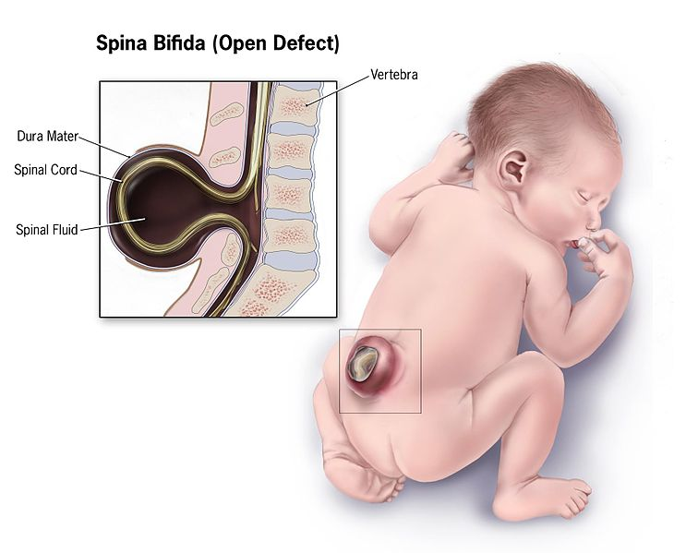
Retinoids (X) isotretinoin and etretinate cause heart defect, spontaneous abortion, microtia (small external ears), microcephalus, hydrocephalus, cognitive defects. Isotretinoin, which is often used to treat severe acne, is such a strong teratogen that just a single dose taken by a pregnant woman may result in serious birth defects. Because of this effect, most countries have systems in place to ensure that it is not given to pregnant women, and that the patient is aware of how important it is to prevent pregnancy during and at least one month after treatment.
Vallproic acid (D) causes SPINA BIFIDA (incomplete closure of the embryonic neural tube, this allows a portion of the spinal cord to stick out through the opening in the bones), facial anomalies, slow development.
Vitamin A (>18000-25000 lU/day) (X) causes Microtia, craniofacial, CNS and cardiac anomalies,
bowel atresia, limb reductions and urinary tract defects. Medical guidelines also suggest
that pregnant women should limit vitamin A intake to about 700 μg/day, as it has
teratogenic potential when consumed in excess.
Notes:
➢صغر صيوان الأذنMicrotia
Bowel atresia narrowing or absence of a portion of the bowel

Slide 13
Other teratogenic agents as Ionizing radiation: atomic weapons, radioiodine, radiation therapy, Infections: cytomegalovirus, herpes virus, parvovirus B-19, rubella virus (German measles), syphilis, toxoplasmosis, Venezuelan equine encephalitis virus, Metabolic imbalance: alcoholism, endemic cretinism, diabetes, folic acid deficiency, iodine deficiency, hyperthermia, phenylketonuria, rheumatic disease andcongenital heart block, virilizing tumors, temazepam (Restoril; Normisson), nitrazepam (Mogadon), nimetazepam (Ermin), aminopterin, busulfan, chlorobiphenyls (PCBs), Dioxin, cyclophosphamide, diphenylhydantoin (Phenytoin, Dilantin, Epanutin), ethidium bromide, lithium, methimazole, organic mercury, penicillamine, trimethadione, uranium, methoxyethyl ethers, Flusilazole, and many more.
The status of some of the above substances (e.g. diphenylhydantoin) is subject to debate, and many other compounds are under varying degrees of suspicion. These include Agent Orange, nicotine,
aspirin and other NSAIDs. Other compounds are known as severe teratogens based on
veterinary work and animal studies, but aren't listed above because they have not
been studied in humans, e.g. cyclopamine.
Teratogenic effects help to determine the pregnancy category assigned by regulatory
toxicologists; a pregnancy category of X, D, or C may be assigned if teratogenic
effects (or other risks in pregnancy) are documented or cannot be excluded.
Notes:
Cyclopamine is currently being investigated as a treatment agent in basal cell carcinoma, medulloblastoma, and rhabdomyosarcoma, however, it can prevent the fetal brain from dividing into two lobes (holoprosencephaly) and cause the development of a single eye (cyclopia) in animals.

Slide 14
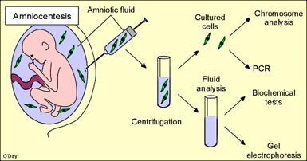
Detection of Teratogenesis
Common methods of chromosomal evaluation during pregnancy ^{are :}
^{Amniocentesis (Amniotic fluid)}
Chorionic villus tissue (Placenta)
Amniocentesis is a procedure performed usually in the beginning of pregnancy to examine a baby's chromosomes. During this procedure, amniotic fluid is removed for testing. Cells within the amniotic fluid are examined in the lab to test for specific fetal disorders. The entire amniocentesis appointment lasts approximately 45 minutes - most of which involves a detailed ultrasound examination.
Amniocentesis is offered for: a woman who will be 35 years old or more at time of delivery, a couple with a child or other family member with a chromosome abnormality or a neural tube defect, a woman with a positive screening test result ,a couple in which one partner has a chromosome rearrangements, a couple with an increased risk of having a child with a genetic disease for which testing is available.
Nearly all chromosome disorders can be detected through an Amniocentesis, including Down’s
syndrome as well as sex chromosome abnormalities (such as Turner’s syndrome)..
Several hundred genetic disorders, such as cystic fibrosis and sickle cell disease. Neural tube defects such as spina bifida can also be detected

Slide 15
Chorionic villus sampling (CVS).
Chorionic villi are villi that grow from the chorion in order to give a maximum area of contact with the maternal blood. Embryonic blood is carried to the villi by the branches of the umbilical arteries, and after circulating through the capillaries of the villi, is returned to the embryo by the umbilical veins. Thus, the villi are part of the border between maternal and fetal blood during pregnancy.
Villi cells have the same genetic makeup as the growing fetus so it is easy to analyze and identify genetic & chromosomal abnormalities.
CVS is the removal of a small piece of chorionic villi (placenta) from the uterus during early pregnancy to screen the baby for genetic defects.
30-40 mg ideal for cytogenetic and other direct molecular and biochemical tests.
Two types of sampling can be done to isolate the villi cells which are;
1-Trans-cervical sampling (A) is performed by inserting a thin plastic tube
through vagina & cervix to reach placenta with the help of ultrasound
^{guided images.}
2-Trans-abdominal (B) sampling is performed by inserting a needle through
the abdomen utreus to reach placenta with the help of ultrasound guided images.
Notes:
المشيمه chorion

Slide 16
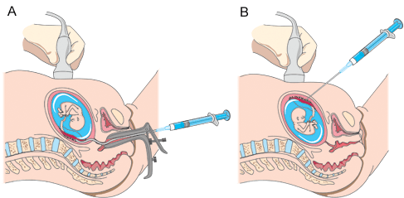
Sample collected are sent to lab for direct preparation (examines the trophoblast cells of the placenta)or culture in special fluids (examines the fibroblast like cells of the villus stroma or mesenchymal core).
The sample is used to study the DNA, chromosomes, and certain signs (called chemical
markers) of disease in the developing baby.
It can be done sooner than amniocentesis, about 10 to 12 weeks after last menstrual
period. Test results take about 2 weeks.
\
\

Slide 17
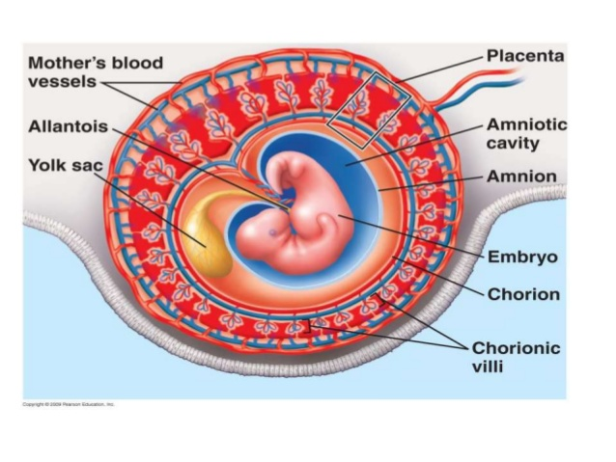
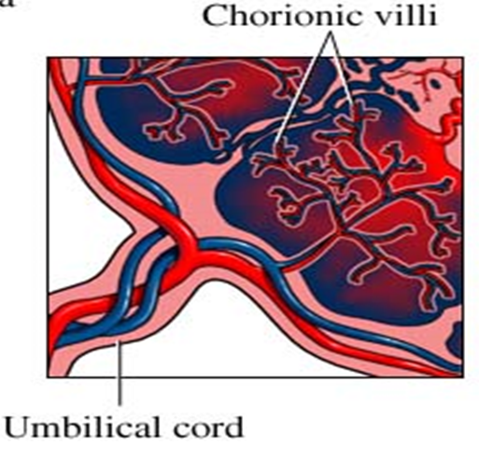

Slide 18
Mechanism of action of teratogens
1-Interference with nucleic acids
Replication , transcription or RNA translation
* The antimetabolite : methotrexate.
* alkylating agents : Chlorambucil, cyclophosphamide.
*Active metabolites of Thalidomide
2-Inhibition of enzymes
a.Methotrexate (dihydrofolate reductase inhbitor = DHFRI) prevents formation of folinic acid from folic acid which is essential for embryo.
b.5-flurouracil inhibits thymidylate synthase leading to
inhibition of deoxythymidine monophosphate( DTMP )synthesis
inhibition of DNA synthesis .
c.6- aminonicotinamide ( G6PD inhibitor) decrease energy production.

Slide 19
3- Deficiency of energy supply needed to build organs
a- Glucose deficiency :
- Deficiency of glucose in diet
- G6PD inhibitors ( 6- aminonicotinamide) interfer with glycolysis.
- Drugs affecting Kreb’s cycle ( fluroacetate)
b-Interference with O2 s supply or utilization:
-CN toxicity : cytochrome oxidase inhibitor.
c- Hypoxia:
-CO toxicity (Decrease in both O2 delivery + osmotic pressure to fetus)
- Drug induced ( phenytoin). This can induce edema and hematomas, which in turn can cause mechanical distortion and tissue ischemia.
4-Lack of substrates
1-Decrease of vitamines or minerals intake.
2-Failiur of absorbtion from GIT as in GIT infection e.g. diarrhea or bile acid deficiency.
Osmolar imbalance.
E.g: ethylene thiourea exposure causing lower osmolality of exocoelomic fluid
(ECF) surrounding the embryo that causes water to move in of the ECF. ECF will
accumulate in the embryo which leads to localized edema in the embryo
resulted in inhibition of growth/differentiation and increased incidences of malformations.
Notes:
Ethylene thiourea is used in the rubber industry and in the production of some fungicide

Slide 20
6.Genetic mutation
Mutations are heritable changes in the genome of a cell or an organism. These changes may be expressed, for example, as a change in the structure of a protein, which alters or abolishes its enzymic properties.
Mutations occur spontaneously or may be induced by physical and chemical agents. Spontaneous mutations occur under "normal" conditions with a certain probability. The rate for them, however, varies individually. In contrast, induced mutations arise through the effects of physical, chemical or viral infection.
In general, mutations are detrimental because in most cases they lead to defects in gene function.
There are three different levels at which mutation takes place, namely at the DNA sequence level (gene mutations), at the chromatin structure level (structural chromosome aberrations) and at the chromosome number level (numerical chromosome aberrations).
^{1-Gene mutations}
They are changes in base pair sequence within a gene. Mutations in a gene's DNA sequence can alter the amino acid sequence of the protein encoded by the gene.
Polymorphism; are variation in the DNA sequences. There are million of different polymorphisms in human genome.
Gene mutations can occur by base substitutions (one base is substituted by another), or by
deletion or addition of one or more bases from one or more codons. Additions or deletions
change the reading frame and are known as frameshift mutations.
Gene mutations arise either through the exchange of bases, through alteration of
a nucleotide base (through deamination, tautomeric transposition, among others) or
through the deletion or insertion of a base, leading to a mispairing in the replication and
^{transcription.}

Slide 21
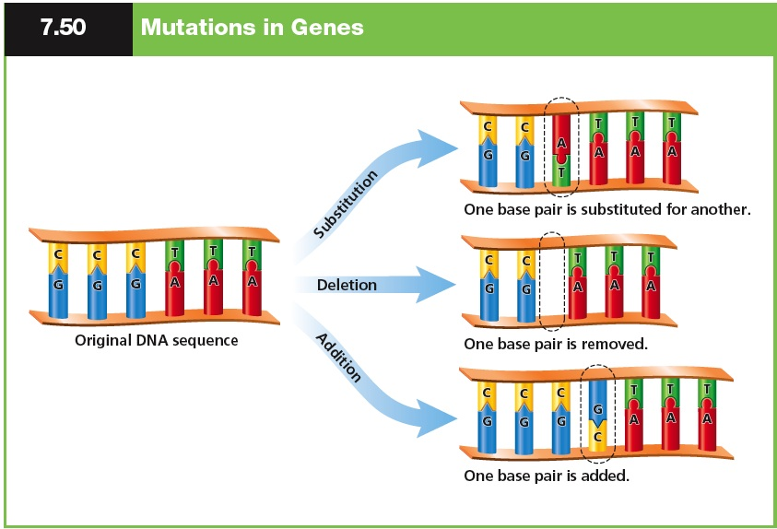

Slide 22
^{The consequences can be:}
^{Missense:}
Through the exchange of a base (substitution) the code of an amino acid is altered into the code of another amino acid, which specifies the insertion of the “wrong” amino acid into a polypeptide. A missense mutation may lead to the production of a defective protein if it occurs at a critical site in a polypeptide (e.g., at the active centre of an enzyme, or at the site at which a ploypeptide should fold). In general, missense mutations are expressed as decreases in function (such as partial growth, or increased temperature sensitivity) rather than by total loss, and can often be identified by this leaky property.
^{Nonsense:}
Through a base substitution the code of an amino acid is changed into a termination code (a “full stop” in the genetic code), causing a premature transcription termination and a shortened (truncated) protein. Because gene mutation are caused by very slight DNA changes they are usually detectable only by the effects of their expression in the mutant cell or individual, that is by a change in phenotype (e.g. a change in an easily determined by biochemical function).
Most of these mutations lead to missing gene products or products that are unable to function. In rare cases, however, a mutation can also bring about the synthesis of a "better" protein, i.e., one that is better suited for the environmental conditions. This organism has an advantage and, via natural selection, the modified gene will ultimately replace the original gene in the majority of the population.
Notes:
➢Natural “mutants” among athletes have been documented, among them an Olympic gold medalist. Eero Mantyranta, a Finnish cross-country skier who won two gold medals in the 1964 Olympics, was born with a mutation in the erythropoietin receptor gene that allows his blood to carry significantly more oxygen than the average person's.

Slide 23
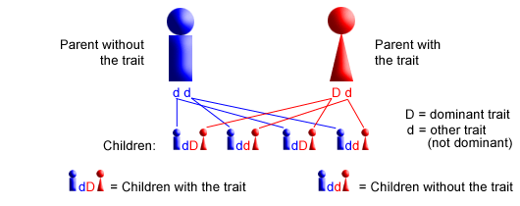
Examples of single gene defect or mutation
If the changes in a genome are restricted to a single gene, a single-gene defect arises. Usually this involves a gene mutations and leads to an altered amino acid sequence in the proteins that are coded in this section of the DNA. A human being has ≈ 40-60,000 genes that directly influence characteristics such as hair, skin and eye coloration as well as the development and growth of our bodies. In addition, regulatory regions and the intron sequences also play important roles in turning genes on and off as well as in their correct transcriptions and translations.
Normally, every child obtains half of its genetic material from each parent. The inheritance of monogenetic diseases occurs in accordance with Mendel's laws. In this, one distinguishes among dominant and recessive genes.
A. Autosomal dominant inheritance
Autosomal dominant inheritance means that the gene in question is located on one of the autosomes. These are numbered pairs of chromosomes, 1 through 22. (These chromosomes do not determine an offspring's gender.) Dominant means that only one gene from one parent is necessary to pass down a trait or a disorder. When a parent has a dominant trait or disorder, there is a 50 percent chance that any child he or she has will also inherit the trait or disorder:

Slide 24
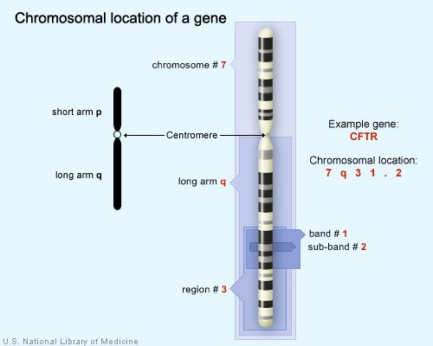
Marfan's syndrome (abnormalities in connective tissues, such as abnormal enlargement of the aortic root of the heart, dislocated lenses of the eyes, and a tall, thin body with increased joint mobility, scoliosis, long flat feet, and long fingers). The gene for Marfan syndrome, called fibrillin-1, is localized to chromosome #15 on the long arm (q) at (at the region 2 band 1 sub-band 1) = ^{15q21.1.}
Aniridia (congenital eye condition causing incomplete formation of the iris. This can cause loss of vision, usually affecting both eyes). Aniridia is due to mutations in the PAX6 gene on 11p13
von Recklinghausen's disease or neurofibromatosis (Neurofibromatosis is a condition characterized by changes in skin coloring and the growth of tumors along nerves in the skin, brain, and other parts of the body). Neurofibromatosis due to mutations in the neurofibromin gene on chromosome 17.
Notes:
The chromosome on which the gene can be found. The first number or letter used to describe a gene’s location represents the chromosome. Chromosomes 1 through 22 (the autosomes) are designated by their chromosome number. The sex chromosomes are designated by X or Y.The arm of the chromosome. Each chromosome is divided into two sections (arms) based on the location of a narrowing (constriction) called the centromere. By convention, the shorter arm is called p, and the longer arm is called q. The chromosome arm is the second part of the gene’s address. For example, 5q is the long arm of chromosome 5, and Xp is the short arm of the X chromosome.The position of the gene on the p or q arm. The position of a gene is based on a distinctive pattern of light and dark bands that appear when the chromosome is stained in a certain way. The position is usually designated by two digits (representing a region and a band), which are sometimes followed by a decimal point and one or more additional digits (representing sub-bands within a light or dark area). The number indicating the gene position increases with distance from the centromere. For example: 14q21 represents position 21 on the long arm of chromosome 14. 14q21 is closer to the centromere than 14q22.
Sometimes, the abbreviations “cen” or “ter” are also used to describe a gene’s cytogenetic location. “Cen” indicates that the gene is very close to the centromere. For example, 16pcen refers to the short arm of chromosome 16 near the centromere. “Ter” stands for terminus, which indicates that the gene is very close to the end of the p or q arm. For example, 14qter refers to the tip of the long arm of chromosome 14. (“Tel” is also sometimes used to describe a gene’s location. “Tel” stands for telomeres, which are at the ends of each chromosome. The abbreviations “tel” and “ter” refer to the same location.)

Slide 25
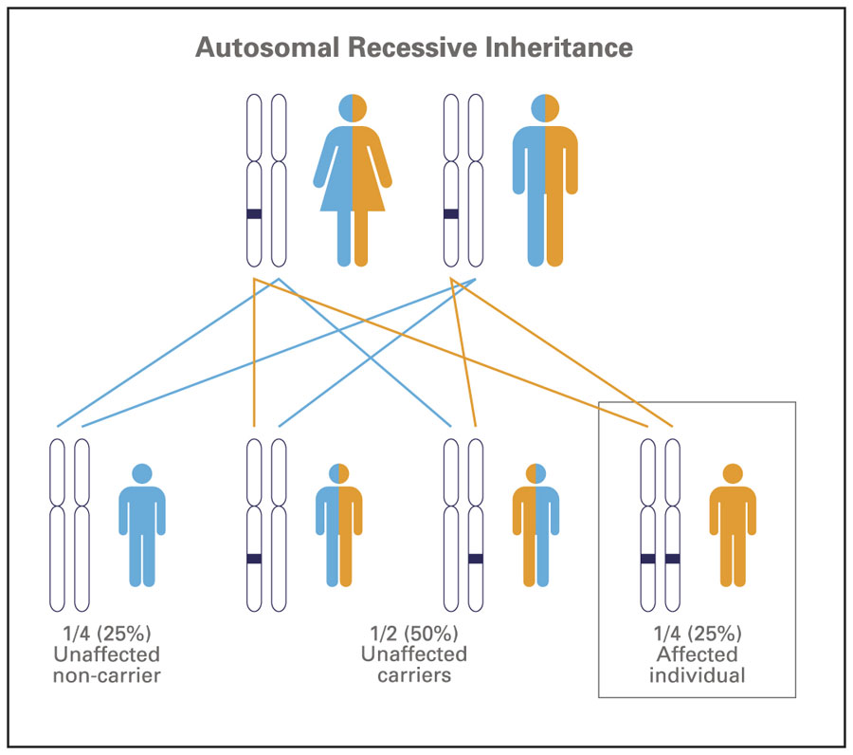
B. Autosomal recessive inheritance
Used to describe a characteristic or condition that appears only in individuals who have received two copies of an altered gene, once copy from each parent. People with two copies of the altered gene are called homozygotes. Their parents, each with a single copy of the altered gene, appear normal and are called heterozygotes or carriers of the altered gene.

Slide 26
B. Autosomal recessive inheritance
Cystic fibrosis an inherited disease of the mucus glands that affects many body systems due to mutations in the CFTR gene on chromosome 7q31.2.
Hereditary Hemochromatosis a condition in which the body accumulates excess iron, Build-up of iron over years results in excess iron deposited in the cells of the liver, heart, pancreas, joints, and pituitary gland, leading to diseases such as cirrhosis of the liver, liver cancer, diabetes, heart disease, and joint disease. Hemochromatosis is due to mutations in the HFe gene on short arm of chromosome 6 at location 6p22.2.
Sickle cell anemia (atypical hemoglobin molecules called hemoglobin S, which can change red blood cells into a sickle, or curved shape. RBCs will be break down prematurely, which can lead to anemia). It is due to mutations in the β-globin chain of haemoglobin, which results in glutamic acid being substituted by valine at position 6. The β-globin gene is found on chromosome 11, more specifically 11p15.
Tay-Sachs disease an inherited disorder that progressively destroys nerve cells in the brain and spinal cord). Infants with this disorder typically appear normal until the age of 3 to 6 months, when their
development slows and muscles used for movement weaken. Affected infants lose motor skills
such as turning over, sitting, and crawling. They also develop an exaggerated startle reaction
to loud noises. As the disease progresses, children with Tay-Sachs disease experience seizures,
vision and hearing loss, intellectual disability, and paralysis. An eye abnormality called a cherry-
red spot, which can be identified with an eye examination, is characteristic of this disorder.
Children with this severe infantile form of Tay-Sachs disease usually live only into early
childhood). Tay-Sachs disease is due to mutations in the HEXA gene.
Notes:
^{Cystic fibrosis} genetic disorder( in the cystic fibrosis transmembrane conductance regulator (CFTR) gene ) that affects mostly the lungs but also the pancreas, liver, kidneys and intestine. Long term issues include difficulty breathing and coughing up sputum as a result of frequent lung infections. Other symptoms include sinus infections, poor growth, fatty stool, clubbing of the finger and toes, and infertility in males among others.
startle reaction رد فعل الإجفال

Slide 27
^{C. X chromosomal inheritance.}
With X chromosomal-linked recessively inherited diseases the affected gene is transferred by phenotypically healthy female carriers.
Duchenne's muscular dystrophy The disorder is caused by a mutation in the gene DMD, located in humans on the X chromosome (Xp21). The DMD gene codes for the protein dystrophin, an important structural component within muscle tissue. Dystrophin provides structural stability to the dystro-glycan complex (DGC), located on the cell membrane. Symptoms usually appear in male children before age 6 and may be visible in early infancy. Progressive proximal muscle weakness of the legs and pelvis associated with a loss of muscle mass is observed first. Eventually this weakness spreads to the arms, neck, and other areas. Early signs may include pseudo-hypertrophy (enlargement of calf foot muscles), low endurance, and difficulties in standing unaided or inability to ascend staircases. As the condition progresses, muscle tissue experiences wasting and is eventually replaced by fat and fibrotic tissue (fibrosis). By age 10, braces may be required to aid in walking but most patients are wheelchair dependent by age 12. Later symptoms may include abnormal bone development that lead to
skeletal deformities, including curvature of the spine. Due to progressive deterioration of
muscle, loss of movement occurs eventually leading to paralysis. Intellectual impairment
may or may not be present but if present, does not progressively worsen as the child
ages. The average life expectancy for patients afflicted with DMD varies from early teens to
age mid 30s. There have been reports of DMD patients surviving past the age of 40 and even 50).
Notes:
X-chromosome recessive inheritance is a mode of inheritance in which a mutation in a gene on the X chromosome causes the phenotype to be expressed (1) in males (who are necessarily homozygous for the gene mutation because they have only one X chromosome) and (2) in females who are homozygous for the gene mutation (i.e., they have a copy of the gene mutation on each of their two X chromosomes).
Some scholars have suggested discontinuing the terms dominant and recessive when referring to X-linked inheritance due to the multiple mechanisms that can result in the expression of X-linked traits in females

Slide 28
Hemophilia A and B (bleeding disorders caused by deficiencies of clotting factor VIII and factor IX, respectively). Hemophilia B is caused by Variants (mutations) in the F9 gene which codes for coagulation factor IX.
Red-green blindness. It is the inability or decreased ability to see color, or perceive color differences, under normal lighting conditions. In a family with red-green blindness and hemophilia, based on their family tree, it was seen for the first time that genes, although they lie near each other and normally are transmitted together (= linkage ), can just as well be inherited separately by descendents. This phenomenon is termed a linkage break. Here the linked genes are torn apart during the "crossing over" process and can be transmitted separately to the offspring. The two genes in which mutation is associated with red-green color vision defects are OPN1LW (opsin 1 long wave), encoding the red pigment and OPN1MW (opsin 1 middle wave), encoding the green pigments. Approximately 75% of all red-green color vision defects
(100% of protans and about 65% of deutans) can be diagnosed by
molecular genetic testing for these genes.
Notes:
Cone cells, or cones, are one of the two types of photoreceptor cells that are in the retina of the eye which are responsible for color vision as well as eye color sensitivity;three types of cone pigments (referred to as L for long wavelengths, M for medium wavelengths and S for short wavelengths.The terms protan, deutan, and tritan are used to refer to the absence of functional L-cone, M-cone, and S-cone pigments, respectively.

Slide 29
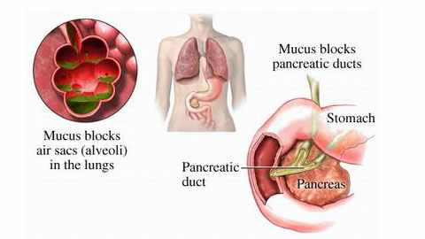
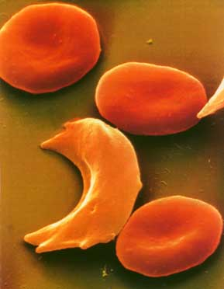
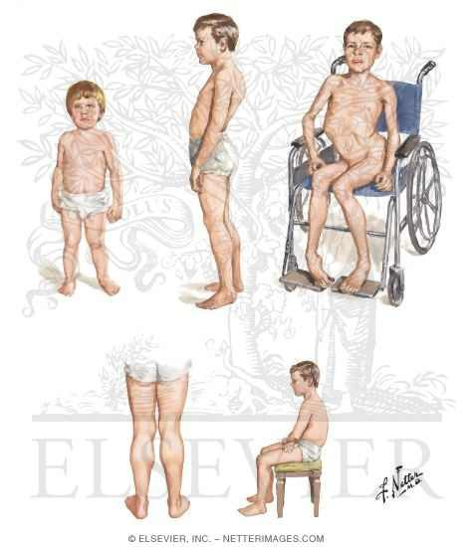

^{Cystic fibrosis}
^{Sickle cell anemia}
Duchenne's muscular dystrophy
Hemophilia A and B

Slide 30
^{7. Chromosome Aberrations}
1-Structural Chromosome Aberrations
Chromosome aberrations are changes in chromosome structure or number. Structural chromosome aberrations involve gross alteration of the genetic material and are detected by light microscopy in appropriately prepared cells during cell division, when DNA is condensed by chromosomal proteins to form chromosomes (stainable element).
Most chromosomal aberrations arise randomly as the gametes are formed. Following fertilization such embryos mostly do not develop correctly and result in a spontaneous miscarriage. Examinations of embryos from miscarriages have shown that 50% exhibit chromosomal aberrations.
A small portion of chromosomal deviations occur after the fertilization in a cell line. Those thus affected can for this reason exhibit a mosaic form (some cells with deviations and some without).
Chromosomal mutations can also, though, be handed down from the parents to the offspring even though the parents are phenotypically healthy, i.e., they have balanced genetic material. An example of this is translocation.
Structural aberrations are the result of chromosomal breaks that occur during cell division. Here deletion and duplication lead to an abnormal phenotype, while insertion, inversion as well as translocation can
be balanced. This means that the carrier of this structural chromosome aberration can escape
notice phenotypically, because the entire genetic material is present.
Major classes of chromosomal rearrangements that can be transmitted in populations of
cells or organisms are deletions, duplications, inversions, and balanced translocations.
Many of these rearrangements can be detected with staining techniques (e.g. trypsin-giemsa
banding) that reveal banding patterns on chromosomes but cannot be detected with routine
cytogenetic analysis of un-banded chromosomes.

Slide 31
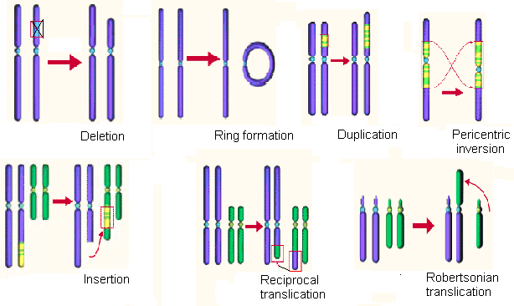

Slide 32
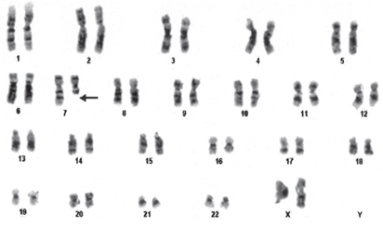
With banding techniques one can recognize the chromosomes as striped cords and display them in a karyogram, after they have been ordered according to their size and the positions of the centromeres. Various groups of similar chromosomes are created in this way.
Each chromosome in a karyotype has a banding pattern, which is characteristic for the individual chromosome of the given species. In recent years, molecular cytogenetic staining procedure with fluorescence-labelled DNA probes (chromosome painting such M-FISH, comparative genomic hybridization) opened a new area of chromosome diagnostics.

Slide 33
Examples of structural chromosome aberrations are
Cri du chat syndrome (cry of the cat) is due to the deletion of part of the short arm of chromosome 5. The "cri du chat" syndrome manifests itself through cat-like crying of the newborn. This disorder is accompanied by microcephaly, severe psychosomatic and mental retardation and cardiac defects.
Wolf-Hirshchhorn syndrome (mental and growth retardation) is due to the partial deletion of part of the short arm of chromosome 4.
CATCH 22 syndrome. The CATCH 22 syndrome is probably the most frequently encountered micro-deletion syndrome with an incidence of 1: 4'000 to
5'000. It exhibits a large spectrum and a large variability in its
^{features. CATCH 22 stands for:}
C = cardiac (frequently Fallot tetralogy), A = abnomal faces, T = thymic
hypoplasia, C = cleft palate, H = hypocalcemia and 22: 22q11 deletion.
Notes:
^{Fallot tetralogy i}s a congenital heart defect involve four anatomical abnormalities of the heart (although only three of them are always present). It is the most common cyanotic heart defect, and the most common cause of blue baby syndrome. it is usually a right-to-left shunt, in which higher resistance to right ventricular outflow results in more severe cyanosis symptoms

Slide 34

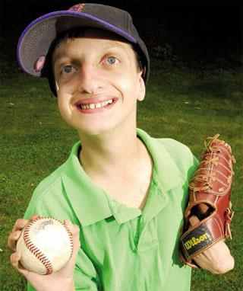
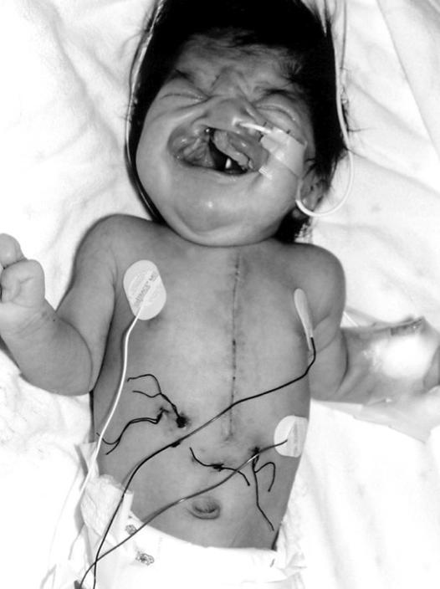
Examples of Structural Chromosome Aberrations
Cri du chat syndrome (cry of the cat) due to the deletion of part of the short arm of chromosome 5.
Wolf-Hirshchhorn syndrome (mental and growth retardation) is due to the partial deletion of part of the short arm of chromosome 4.
CATCH 22 syndrome (cardiac, abnomal faces, thymic hypoplasia, cleft palate, hypocalcemia) is due to the deletion of the q11.13 region on chromosome 22.

Slide 35
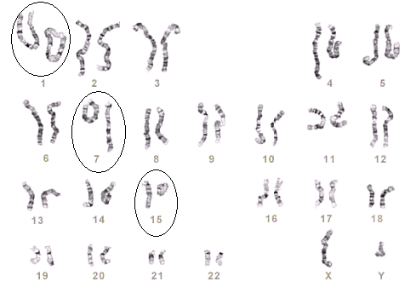
Detection of Structural Chromosome Aberrations
Many of Structural Chromosome Aberrations can be detected with staining techniques such as
Banding techniques.
In this karyogram ring formations of chromosomes 1, 7 & 15 can be seen.
Karyogram of the baby demonstrating deletion in chromosome 7 (arrow).
Fluorescence in situ hybridization (FISH) techniques
2 translocations between chromosomes 1 and 8.
Translocation between chromosomes 3 and 21.
Aberrant chromosome 14 with an additional part derived from the same chromosome on the short arm.
Trisomy of chromosome 13 was identified.

Slide 36
2- Numerical Chromosome Aberrations
These are changes in the number of chromosomes in the genome.
When mutations change the number of whole chromosome sets present, polyploid cells result. When mutations change parts of chromosome sets, aneuploid cells result.
Polyploidy such as triploidy (3n) and tetraploidy (4n) are common in the plant kingdom and are even represented in the animal kingdom.
Triploidy happens when either two sperm cells fertilize the oocyte or when a diploid oocyte is fertilized. This results in various anomalies.
Tetraploidy arises mostly through a disturbance during a mitotic division. Physiologically, tri- and tetraploidies occur in liver and bone marrow cells. Children with a triploid or tetraploid chromosome set can not survive.
Allopolyploid plants are obtained by crossing two related species and then doubling the
progeny chromosomes through the use of colchicine or through somatic cell fusion.
These techniques have important applications in crop breeding, because allopolyploids
combine the useful features of the two parental species into one type.
Polyploidy can result in an organism of larger dimensions; this discovery has permitted
important advances in horticulture and in crop breeding.
The normal species-specific diploid genome is euploid, and contains a complete set of
chromosomes from each parent, e.g. 2n = 46 for humans.

Slide 37
Aneuploid and ployploid cells have chromosome numbers that differ from the normal number for the species. In aneuploidy, the deviation in chromosome number involves one or a few chromosomes, whereas in ployploidy, the alteration involves complete sets of chromosomes. For example, in humans, where the normal diploid (2n) chromosome number is 46, cells with 45 or 47 chromosomes would be described as aneuploid, whereas cells with 69 chromosomes would be described as ployploid, in this case triploid (3n).
Aneuploid nomenclature is based on the number of copies of the specific chromosome in the aneuploid state. For example, the aneuploid condition 2n-1 is called monosomic (meaning “one chromosome loss”) because only one copy of a specific chromosome is present instead of the usual two found in its diploid progenitor. For autosomes in diploid organisms, the aneuploid 2n+1 is called trisomic,2n-1 is monosomic, and 2n-2 (where the -2 represents homologs) is nullisomic.
Special symbolism has to be used to describe sex-chromosome aneuploids, because we are dealing with two different chromosomes (X and Y) and the homogametic and heterogametic sexes have different sex-chromosome compositions even in euploid individuals. The symbolism simply lists the copies
of each sex chromosome, such as XXY, XYY, XXX, or XO (the “O” stands for absence of
a sex chromosome and is included to show that the symbol is not a typographical error).
Trisomies of the sex chromosomes (XXX, XXY or XYY) occur relatively frequently and
can be lived with, whereas mono-somies are generally lethal, those with Turner's syndrome
^{forming the single exception.}

Slide 38
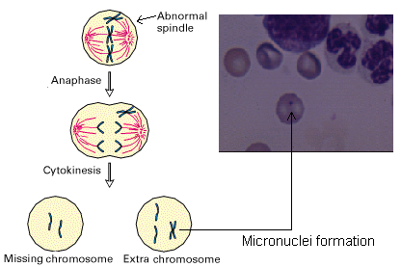

Slide 39
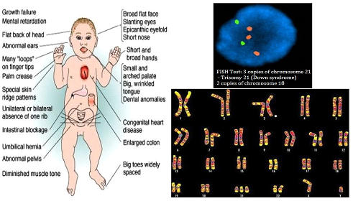

Examples of numerical Autosomal chromosome aberrations are
Trisomy 21 (Down syndrome is the most well known. The occurrence of trisomy 21, as well as many other chromosomal aberrations caused by non-disjunctions, is highly correlated with the age of the mother. The probability of bearing a child with trisomy 21 increases exponentially with age. If a young mother apparently gives birth to a child bearing a trisomy 21, however, a differential diagnosis of an inherited chromosomal aberration must by all means be considered (compare robertsonian translocation).

Slide 40
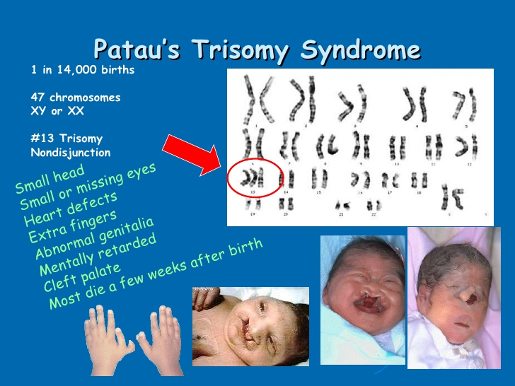
Trisomy 13 (Patau's syndrome). The following symptoms are present: Mental and motor retardation, Tightened hands and overlapping fingers, Cardiac and renal abnormalities, Microcephaly with diminishing forehead, holoprosencephaly, aplasia of the corpus callosum, Microphthalmus and coloboma, Cleft palate, lip and jaw, Polydactyly and 80-90% lethality in the first year of life.
Notes:
^{aplasia} the failure of an organ or tissue to develop or to function normally

Slide 41
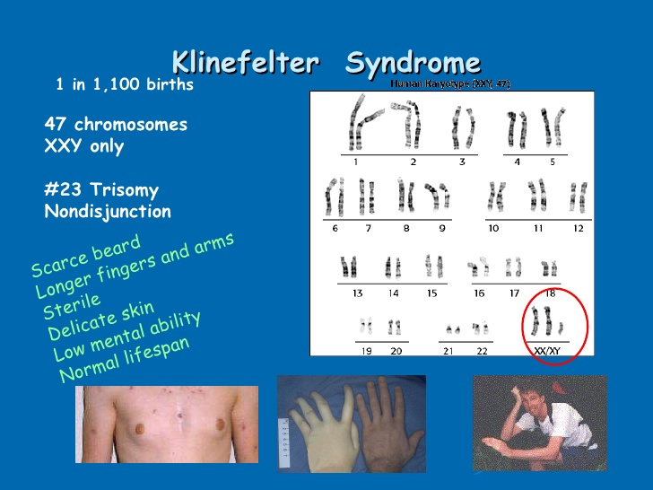
Examples of numerical Sex chromosome aberrations are
Klinefelter's syndrome is the most frequent disorder of the sex chromosomes (1:500 to 1:1,000 of all men). The affected men have a spare X chromosome. The following symptoms indicate such a clinical diagnosis: Un-proportionate growth in height, tall, Gynecomastia, hypogonadism, Small, hard testicles (testicular atrophy), Sparse body hair, Infertility and Frequent diabetes mellitus. Today the definitive diagnosis is made based on a karyogram. The therapy consists in the substitution of testosterone.

Slide 42
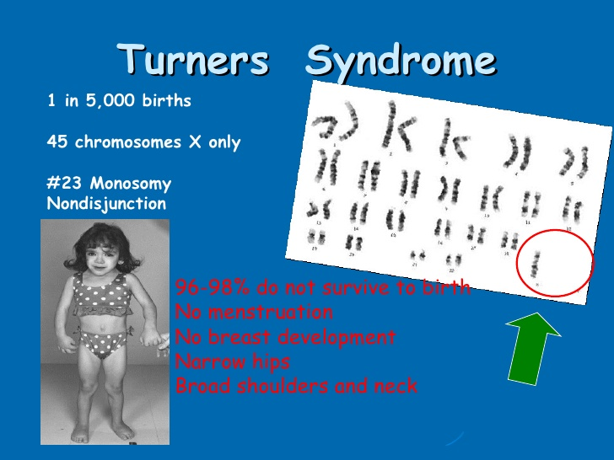
Turner's syndrome is the only viable monosomy (45, XO). The prevalence amounts to 1: 2'500-5'000. The XO genotype leads to a female phenotype, accompanied by stunted growth and the development of dysfunctional ovaries. Clinical picture: Dysgenesis of the gonads (at birth), Retarded growth, Lymphatic oedema on the backs of the hands and feet, Wide, shield-shaped thorax, Wide, webbed neck (pterygium colli), Low hairline Typical face (sphinx), Frequent aortic coarctation, pulmonary stenosis and Renal abnormalities.
Notes:
خلل تكون^{Dysgenesis}

Slide 43
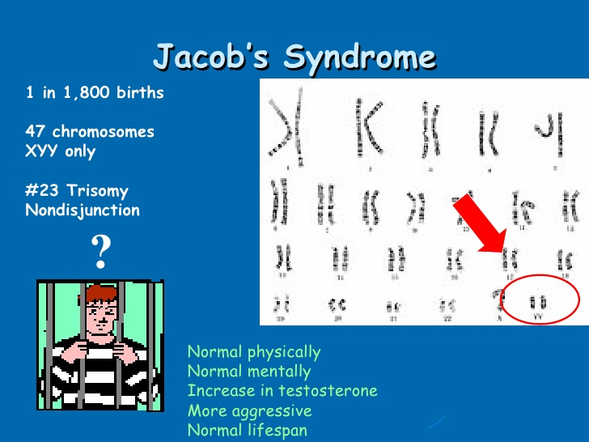
Examples of Numerical Chromosome Aberrations (cont.)
Notes:
Prevelance is 1;1000
It results from nondisjunction during cell division during a post-zygotic mitosis in early embryonic development.
They have an increased growth velocity from early childhood, with an average final height approximately 7 cm above expected final heigh

Slide 44
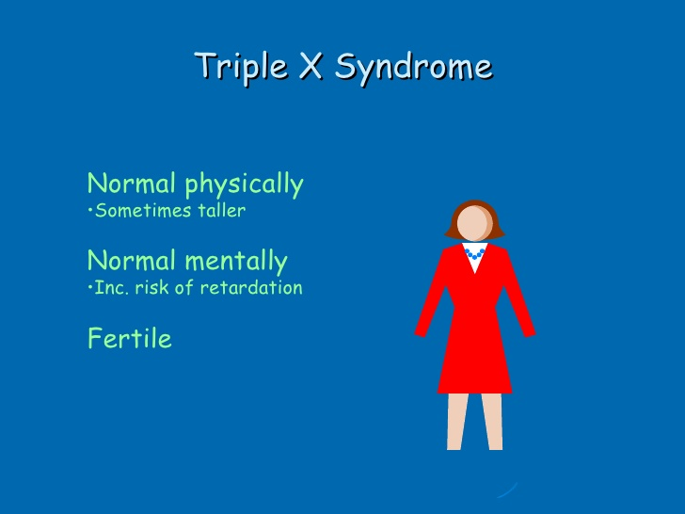
Examples of Numerical Chromosome Aberrations (cont.)
Notes:
triple X syndrome, Prevelance is 1;1000
a female has three X chromosomes — hence, the name. Triple X syndrome usually results from an error in the formation of a mother's egg cell or a father's sperm cell. Sometimes, triple X syndrome occurs as a result of an error early in the embryo's development. Many girls and women with triple X syndrome have no symptoms or only mild symptoms. In other cases, symptoms may be more pronounced — possibly including developmental delays

