Slide 1
Synovial fluid (SF)

Slide 2
Synovial fluid (SF)
Synovial fluid (joint fluid) (synovia):
Synovial fluid is a plasma dialysate modified by constituents secreted by the joint tissues.
Joint fluid is called synovial fluid because of its resemblance to egg white.
(Syn : like , ovia : egg)
It is a viscous, mucinous substance that lubricates most joints.

Slide 3
Human joints are lined with a tissue called synovium.
Synovium produces synovia, also called synovial fluid.
This fluid capsule cushions diarthrotic joints allowing the bones to freely articulate.
The inner membrane of synovial joints is called the synovial membrane and secretes synovial fluid into the joint cavity which is formed by ultrafiltration of plasma across the synovial membrane
This fluid forms a thin layer at the surface of cartilage.
Normal synovial fluid contains 3-4 mg/ml of (hyaluronic acid)

Slide 5
a: Hyaluronic acid
Normal synovial fluid contains 3-4 mg/ml of (hyaluronic
acid), a polymer of disaccharides composed of D-glucuronic
acid and D-N-acetyl glucosamine joined by alternating beta-1,4
and beta-1,3 glycosidic bond.
Hyaluronan is synthesized by the synovial membrane and
secreted into the joint cavity thus,
providing the synovial fluid with its characteristic; viscous and
elastic properties
lubricating the surfaces between synovium and cartilage
This high content of hyaluronic acid is a distinctive
feature of the synovial fluid.

Slide 6
It is secreted by synovial cells , which also has a lubricating role.
B: lubricin

Slide 7
Function of the synovial fluid
Synovial fluid forms a thin layer (roughly 50 µm) at
the surface of cartilage and performing the following
functions:
1) reduction of friction - synovial fluid lubricates the
articulating joints thus reducing friction during joint
movement .
2) shock absorption.
3) The fluid supplies oxygen and nutrients and removes
carbon dioxide and metabolic wastes
4) It also contains phagocytic cells that remove microbes
and the debris that results from normal wear and tear
in the joint.

Slide 8
Collection of the synovial fluid
Synovial fluid can be collected in a procedure termed arthrocentisis .
Arthrocentisis:
It is the method for obtaining synovial fluids by using a needle aspiration synovial fluid.

Slide 9
Laboratory testing
• Volume:
The amount of fluid contained in joints is usually small.
The knee joint normally contains up to 4 ml of fluid.
• Color and clarity:
Synovial fluid: colorless – pale yellow
Apearance: clear.
Other appearances may indicate various disease
states:
yellow/cloudy fluids usually involve an inflammatory processes.
A white/cloudy synovial fluid may contain crystals
red, brown SF indicates hemorrhage into the joint.

Slide 10
•Viscosity:
Synovial fluid is very viscous due to its high concentration of polymerized hyaluronate.
•Clotting:
- Clotting of synovial fluid can result when fibrinogen is present.
Fibrinogen may have entered into the synovial capsule during damage to the synovial membrane or as a result of a traumatic tap.

Slide 11
•The mucin clot :
The mucin clot test, also known as Rope’s test,
is an estimation of the integrity of the hyaluronic
acid–protein complex (mucin).
Normal synovial fluid forms a tight ropy clot upon the addition of acetic acid.
A good mucin clot indicates good integrity of the hyaluronate . A poor mucin clot, one that breaks up easily, is associated with destruction or dilution of hyaluronate.

Slide 12
Chemical examination:
1. Proteins:
The normal range for synovial fluid protein is 1-3 g/dl.
Increased synovial fluid protein levels are seen in arthritis.
2. Glucose:
Normally, synovial fluid glucose levels are less
than 10 mg/dL lower than serum levels.
- Joint disorders that are classified as infectious demonstrate decreases in synovial fluid glucose and can be as much as 20-100 mg/dl less than serum levels.

Slide 13
• Uric acid:
Synovial fluid uric acid normally ranges from
6 to 8 mg/dL.
The presence of uric acid in synovial fluid is helpful in diagnosis of gout.
• Lactate dehydrogenase:
. Lactate dehydrogenase (LD) can be elevated in synovial fluid, while serum levels remain normal.
- Synovial fluid LD levels are usually increased in (rheumatoid arthritis )RA, infectious arthritis, and gout.

Slide 16
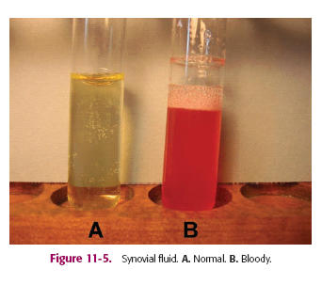

Slide 17
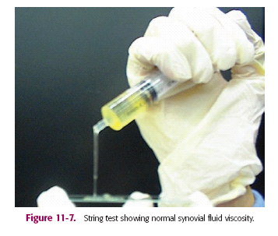

Slide 18
Sputum
Sputum:
It is mucus-like secretion, from lungs, bronchi, trachea and can be coughed up, spit out or swallowed.
Contaminated with
Epithelial cells
Nasal secretions
Saliva
Bacteria

Slide 19
It is produced by surface epithelial cells and submucous glands.
Mucus layer covers the airways and protects bronchial epithelium against inhaled noxious substances.

Slide 20
- This mucus-like secretion may become infected, blood stained, or contain abnormal cells that may lead to a diagnosis.
- Irritation of the respiratory system causes both inflammation of the air passages and a notable increase in mucus secretion.

Slide 21
Chemical composition:
95% water
5 % solids including:
- Carbohydrates
- Proteins ( enzymes, immunoglobulins),
- Lipids
- DNA from broken WBC
- Macrophages
- Bronchial epithelial cells

Slide 22
A sputum culture is done to:
Detect and identify bacteria or fungi that are causing an infection (such as pneumonia or tuberculosis) of the lungs or the airways leading to the lungs.
- Symptoms of a lung infection may include difficulty breathing, pain when breathing, or a cough that produces bloody or greenish brown sputum.

Slide 23
Normal sputum is colorless and clear.
Yellow color if puss is present as in pneumonia.
Rusty color may be due to decomposed heamoglobin
Red color if there was recent haemorrhage as in pulmonary infection, or tuberculousis.

Slide 24
Pneumonia
Pneumonia occurs when the lungs become inflamed and infected.
Because the lungs are infected, pneumonia makes
it difficult to breath.
- It often follows a common cold or the flu.
Pneumonia can be caused by either bacteria, fungi, parasites or a virus.
The air sacs may fill with fluid .

Slide 25
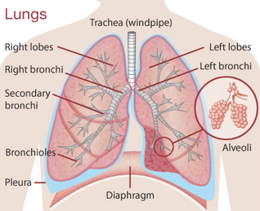

Slide 27
https://www.youtube.com/watch?v=-hZ8OGpWBrY&list=PLfk7Z-Egnx6XQeRf2KKXDrYKtjXy375AH

