Slide 1
Evolve
What is a Component?
A component is a unit of software that can be instantiated, and uses interfaces to describe which services it provides and requires.
In other words, a component is separated from its environment by interfaces. A component
instance can then be connected up to other instances which offer compatible interfaces. It really
is that simple!

Slide 2
Evolve
1. A Leaf Component:
A component which cannot be further decomposed into others. An
atomic unit, implemented by a class.
2. Provided interface:
A service provided by a component. Mapped onto the implemented interfaces of the class or onto an instance of an anonymous inner class.

Slide 3
Evolve
3. Required interface:
A service required by a component. Mapped onto a field of the class, with a setter only.
4. Port :
A named “gate” insulating the component from its environment. All provided and required interfaces must be via ports.

Slide 4
Evolve
5. Attribute :
A configurable field of the component.
6. Port :
A named “gate” insulating the component from its environment. All provided and required interfaces must be via ports.

Slide 5
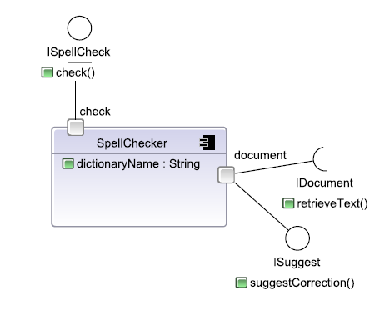
Evolve
A Leaf Component: Example

Slide 6
Evolve
A Leaf Component Mapping onto java class/Bean: Example
public class SpellChecker implements ISpellCheck
{
// the attribute
private String dictionaryName;
public String getDictionaryName() { return dictionaryName; }
public void setDictionaryName(String name) { dictionaryName = name; }
// the required port
private IDocument document;
public void setDocument(IDocument doc) { document = doc; }
// the provided port for document
private ISuggest document_Provided = new ISuggest {
// methods for ISuggest implementation...
}
public ISuggest getDocument_Provided()
{ return document_Provided; }
// methods for ISpellCheck...
...
}

Slide 7
Evolve
A Composite Component?
A composite component connects up instances of other components to make a new component.
A component created by wiring together instances of other
components (parts) using connectors, and selectively exposing ports
of internal parts.

Slide 8
Evolve
1. Part?
Another name for a component instance. [intance=part]
2. Connector:
A wire joining together two ports of component instances.
3. Constituent:
A general name for a port, part, connector or attribute.

Slide 9
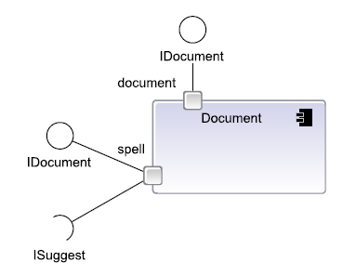
Evolve
2. SpellChecker provides an ISuggest implementation, and requires an IDocument implementation.
3. Document requires an ISuggest implementation and provides an IDocument one.
1. Note how the interfaces of the spell port of Document are the opposites of the interfaces provided and required by the document port of SpellChecker.

Slide 10
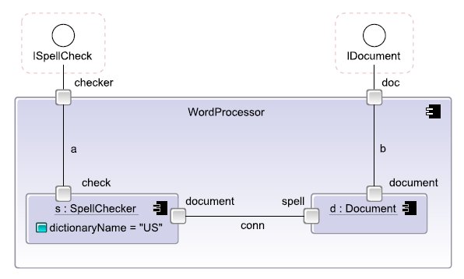
Evolve
A WordProcessor composite component: Example
As these are complementary/Opposite, we can connect an instance of each of these together, joining them via a connector conn as shown in figure.

Slide 11
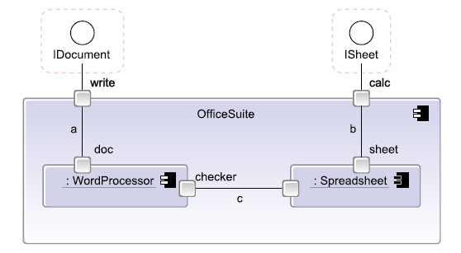
Evolve
Compositional Hierarchy
An OfficeSuite composite, made up of a wordprocessor and spreadsheet instance

Slide 12
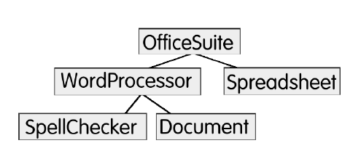
Evolve
The compositional hierarchy of OfficeSuite

Slide 13
Evolve [Creating, Reusing and Executing Components]
The Backbone Component Language
Backbone is a component language and a runtime engine
The Backbone definition for WordProcessor is as follows.
component WordProcessor
{
ports:
checker,
doc;
parts:
s: SpellChecker
slots:
dictionaryName = "US",
d: Document;
connectors:
conn joins document@s to port@d,
a joins check@s to checker,
b joins document@d to doc;
}

Slide 14
Installing and Using Evolve
Evolve is written in Java and runs on any system with Java 1.6
Download Evolve from
http://www.instrinsarc.com/evolve/download
Unzip the distribution into a directory and you should see the following set of files

Slide 15
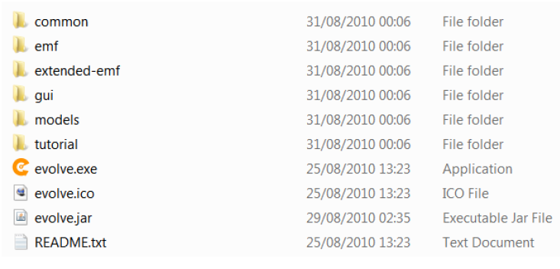
Evolve directory

Slide 16
Using Evolve
There are several ways to run Evolve
If you are using Windows, you can double-click evolve.exe or create a shortcut, drag it to the desktop, and double-click that
If you are using Linux or MacOS, then you may be able to double-click the executable evolve.jar file.
Evolve from the command line
java -jar evolve.jar

Slide 17
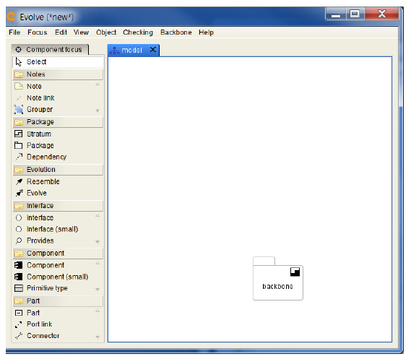
Evolve on startup
The startup diagram shows a stratum containing the Backbone definitions. Every model builds on this.
You may like to change the Swing look and feel used for Evolve:

Slide 18
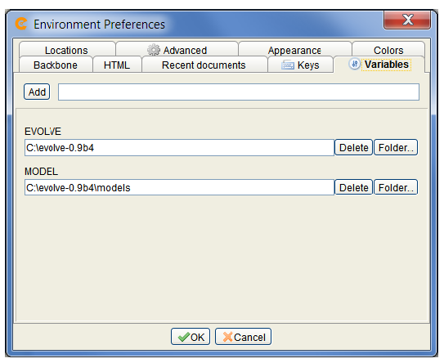
Setting Up The Environment
Evolve environment variables

Slide 19
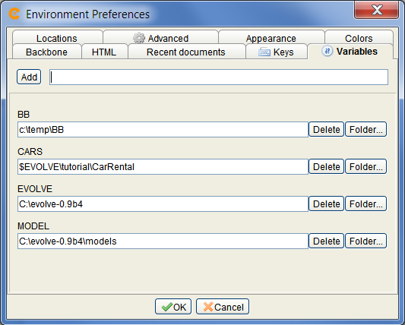
Setting Up The Environment
We first need to add a variable BB, which will be where Evolve writes the Backbone files to
Add the variable
CARS and point it to the tutorial\CarRental directory of the installation
Test Java using Backbone Tab
Setting up the BB and other variables

Slide 20
Navigating Around the Tutorial Model
File→Open→Existing model
Navigate to the tutorial directory of the installation, and select the car-rental.evolve file.

Slide 21
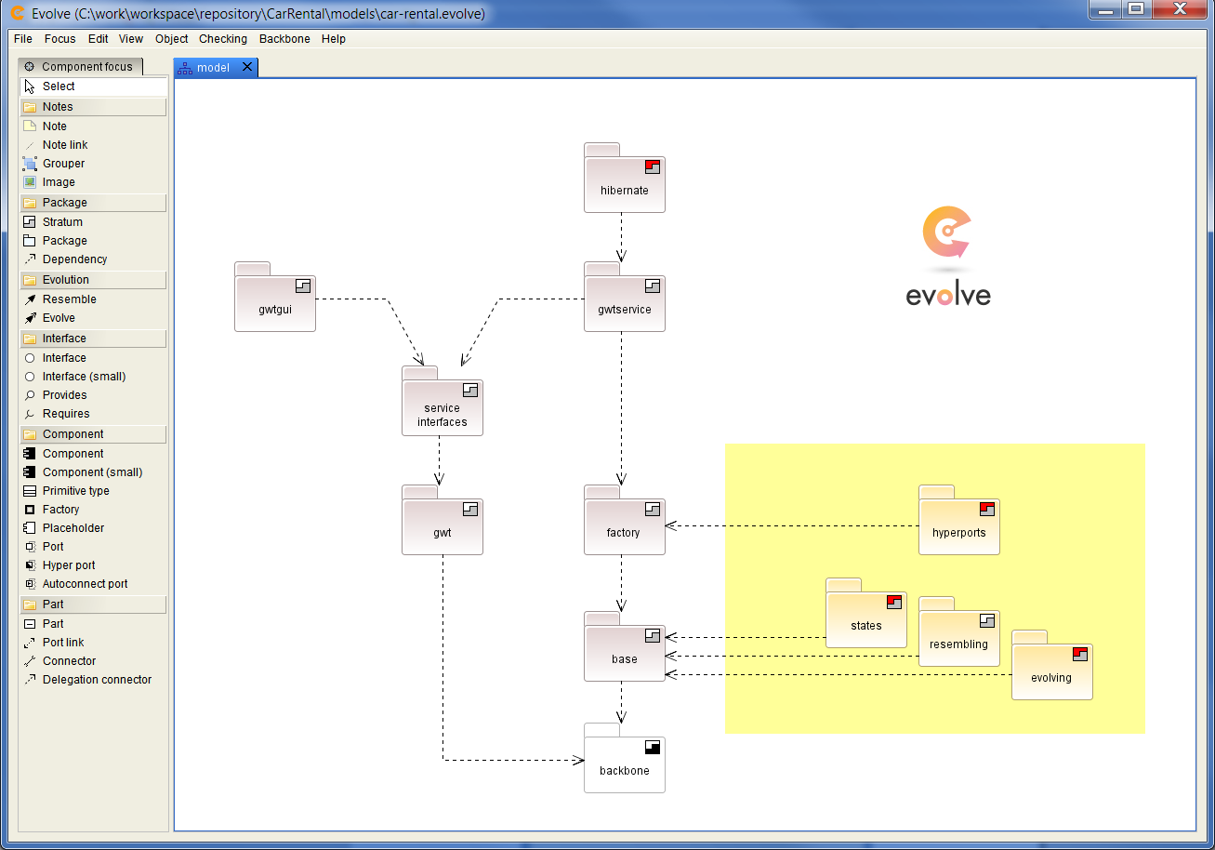
Evolve models are XML files. Files with a .evolve extension are uncompressed. To create a compressed model choose the .evolvez extension when saving.

Slide 22
Navigating Around the Tutorial Model
Navigating into Strata
To visit into a stratum, double-click it, or alternatively middle-click it
To go backwards or forwards in the diagram history
View→Open previous diagram or View→Open next diagram

Slide 23
Navigating Around the Tutorial Model
Tabs: Evolve uses a tabbed graphical interface
View→Open current in new tab
The Tool Palette: the tools used to define components
The Size of a Diagram: To enlarge the diagram simply drag a figure to the edge of the diagram
Keys: File→Preferences→Edit Environment Preferences
Pasting into a Wordprocessor: control C and pasted control V
Full Screen Mode: File→Toggle full screen OR F11

Slide 24
Subjects and Views and the Subject Browser
Evolve is a powerful and versatile CASE tool, and adopts common CASE tool conventions
A subject is the underlying data of a component or other model element. Deleting a subject, however, will delete all its views.
A view is the graphical presentation of this shown on a diagram. Deleting a view will not delete the subject.

Slide 25
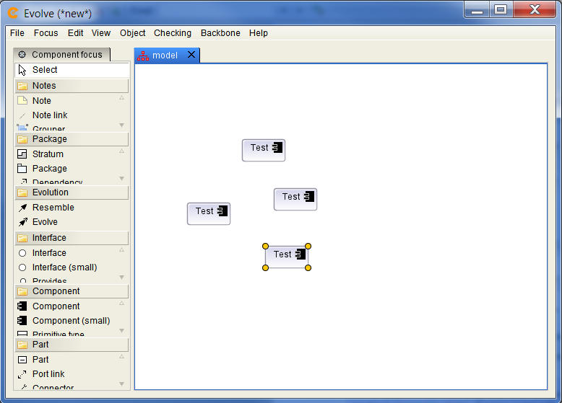
Subjects and Views and the Subject Browser
We can delete views by selecting them and invoking Edit→Delete views only.
To remove
a subject and all its views, however, we need to press delete or invoke Edit→Delete

Slide 26
The Subject Browser
Diagrams allow us to see graphical views of subjects.
To look at the subjects directly, however, we instead use the subject browser
Select an item on the screen and invoke Object→Browse element

Slide 27
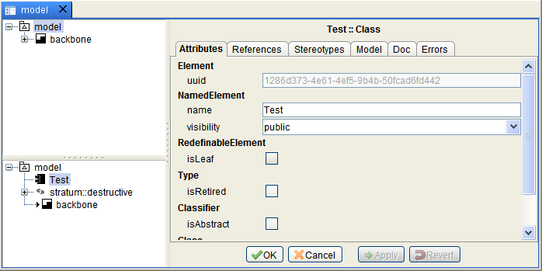
The Subject Browser
The top
left tree shows the strata of the model
The bottom left tree shows the elements in the currently
selected strata
The right hand pane shows the details of the selected element

Slide 28
Running A Backbone Program
Load the car-rental.evolve model
Middle-click on the base stratum to navigate into it
First, “tag” the current stratum to indicate that we want to run it (Backbone→Tag current stratum)
Then choose the (Backbone→Run Backbone) menu option

Slide 29
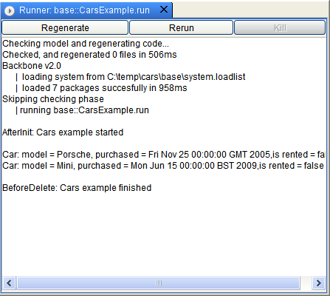
The Backbone runner window
If this all works, your installation is correct

