Slide 1
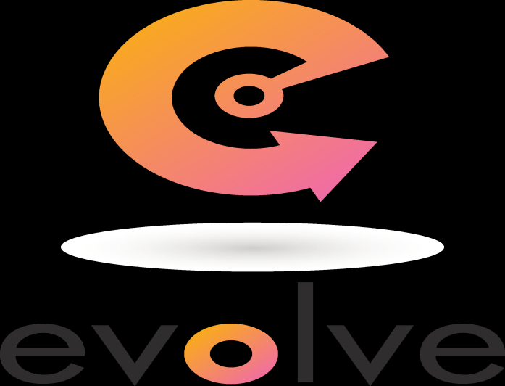
SwE 455
Tutorial

Slide 2
What is Evolve?
Evolve is a tool for defining components and connecting them together to form new components.
Also provides a runtime engine to execute these configurations.
Use it to create applications out of plain classes, using an interface-centric approach.
Evolve is a convenient and powerful way to connect together classes to create a program.
Also features innovative reuse and evolution facilities, allowing you to quickly customize an application for new requirements, without destroying the old version.

Slide 3
Key Features
• Components are defined using standard UML2 diagrams.
• JavaBeans can be treated as full components.
• Java code can be generated for new JavaBeans, and existing JavaBeans can be quickly imported.
• Extensive facilities are provided for the reuse and evolution of components, giving the benefits of dependency injection, aspects and much more.
• State machines are fully supported, along with their reuse and evolution.
• A single model can hold and execute many variants of a system.
• Full error checking guarantees all components will connect correctly at runtime.
• Full support for renaming and restructuring parts of the model.

Slide 4
• Sections of a model can be exported and imported for collaborative
development.
• Component programs can be executed. Two runtime options are available:
1. The Backbone runtime engine can be used. This is <350kb, including a full parser. It is fully open-source and has very little performance overhead.
2. A simple Java program can be created directly from the model, removing any runtime overhead. In this mode, a library of 15kb is used, consisting mainly of interfaces.

Slide 5
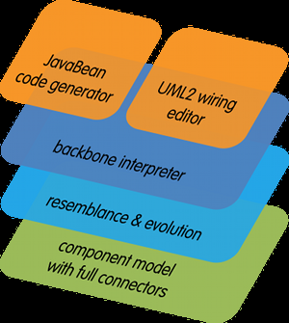
The diagram below shows the internal makeup of Evolve.

Slide 6
1. A component model with full connectors.
At the heart of Evolve is a hierarchical component model with full connectors
Connectors act like wires between components.
Making it simple and intuitive to express detailed structures that are difficult or impossible in other approaches such as dependency injection.

Slide 7
2. Resemblance and evolution
Provide unique levels of support for component reuse.
Resemblance is a form of component inheritance.
Evolution allow the structure of an existing system to be remodeled without destroying the original definition.
These facilities can be used to create variants of a system, or to switch in test components.

Slide 8
3. The Backbone interpreter
Executes the programs created in Evolve.
Backbone is a simple textual domain-specific language
Allows plain-vanilla JavaBeans to act as full components
Wired up according to the component model.
The interpreter reads in the text files, and uses the instructions to instantiate and connect up the beans.
JavaBeans have a representation in Backbone and also in Java code.
Composite components formed by wiring together JavaBean instances
Backbone is fully open source.

Slide 9
4 A. UML2 wiring editor
A graphical editor for connecting up and evolving components.
Industry standard UML2 component diagrams and state charts are used.

Slide 10
4B. JavaBean code generator
Help you define and generate setter / getter code for JavaBeans.
Makes it easy to import and wire together existing beans.
Notes:
Getter A getter method have its name start with "get", take 0 parameters, and returns a value.
Setter A setter method have its name start with "set", and takes 1 parameter.

