Slide 1
Studio 6. Human Factors Engineering
GE105
Introduction to Engineering Design College of Engineering
King Saud University
Fall 2017

Slide 2
Before we Start
You will be watching a number of documentary movies on Human Factors
Make sure to take notes
An open discussion will follow
You will be asked to identify human factors applicable to your final design project

Slide 3
Videos:
“Ergonomics and Design”
https://youtu.be/LAKlmdMHpdE
(00:00 – 16:31)
“Human Factors in Aviation”
https://youtu.be/4VIYlxTowq8
https://youtu.be/c5fGOP5Jo1o
Entertaining/Practical Examples:
https://youtu.be/1KEse_x1Sko
https://youtu.be/syFev-ojRnQ

Slide 4
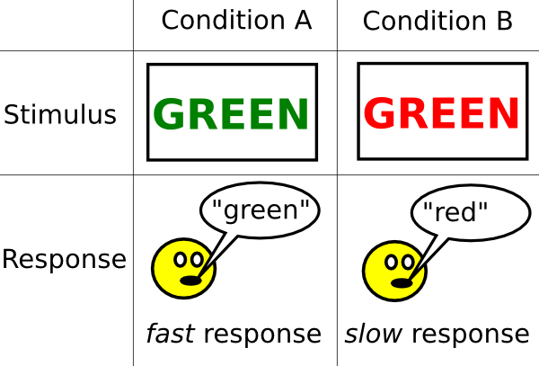
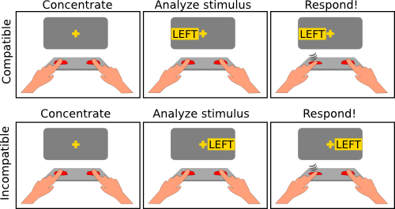
Fun Human Factors Exercises:
Stroop Test (test for color compatibility):
The Simon Task: (stimulus-response compatibility)
Q: why are there tests important?*
Notes:
* Compatibility is an essential psychological-HFE part of any successful design (see the lecture slides that are relevant to psychological HFE)
More fun psychological tests are available here: http://www.psytoolkit.org/lessons/

