Slide 1
C++ String Class

Slide 2

string
The string is any sequence of characters
To use strings, you need to include the header <string>
The string is one of the C++ built-in classes.
C++ strings allow you to directly initialize, assign, compare, and reassign with the intuitive operators, as well as printing and reading (e.g., from the user).

Slide 3
Declaring string Objects
Use the class name string and then list object names.
Example:
string str; // declaring one object called str
string str1, str2, str3; // str1, str2, and str3
// would be string objects

Slide 4
Initializing string Objects
The string objects can be an initialize with the = operator.
  C++ automatically reserves sufficient memory
string str1 = "This is an example.";
string str2 = str1; /* create a string object called str2 and initialize it with a copy of str1*/

Slide 5
Reading a string input
string str1
To read a single word:
cin >> str1;
  Reads characters until whitespace typed
  Whitespace includes space and "Enter" key
  To read a single line of input:
  getline (cin, str1);

Slide 6
Example
string name;
cout << "Enter your name: " << endl;
cin >> name;
cout << “Welcome " << name <<“\n Have a nice day \n”;
Enter your name:
Majed Ali
Welcome Majed
Have a nice day

Slide 7
Example
string name;
cout << "Enter your name: " << endl;
getline (cin, name);
cout << “Welcome " << name <<“\n Have a nice day \n”;
Enter your name:
Majed Ali
Welcome Majed Ali
Have a nice day

Slide 8
strings concatenation with the + operator
C++ strings also provide many string manipulation facilities. The simplest string manipulation that we commonly use is concatenation, or addition of strings. In C++, we can use the + operator to concatenate (or “add”) two strings, as shown below:
string result;
string s1 = "hello ";
string s2 = "world";
result = s1 + s2;
// result now contains "hello world"
Notice that both s1 and s2 remain unchanged!

Slide 9
strings concatenation with the + operator
You can also use two or more + operators to concatenate several (more than 2) strings.
string firstname, lastname, fullname;
cout << "First name: ";
getline (cin, firstname); // if firstname = “Bader”
cout << "Last name: ";
getline (cin, lastname); // if lastname = “Yasser”
fullname = lastname + ", " + firstname;
// fullname = “Yasser, Bader”
cout << "Fullname: " << fullname << endl;

Slide 10
strings concatenation with the + operator
We can also use the + to concatenate multiple strings to be printed as one string.
fullname = lastname + ", " + firstname;
cout << "Fullname: " << fullname << endl;
cout << "Fullname: "+lastname+ ", " + firstname <<endl;
cout <<"Fullname:"+lastname+ ", " + firstname + ”\n”;

Slide 11
strings concatenation with the += operator
The += operator can also be used. In that case, one string is appended to another one:
After execution of the above statements,
result contains the string "hello world".
Note += Concatenates and stores
string result;
string s1 = "hello";
// without the extra space at the end
string s2 = "world";
result = s1;
result += ' '; // append a space at the end
result += s2;

Slide 12
Comparing string Objects
Equality and relational operators perform comparisons using the numerical values of the characters in each string.
Operator Action
== True if strings identical
!= True if strings not identical
> True if first string greater than second
< True if first string is less than second
>= True if first string greater or equal than second
<= True if first string less or equal than second

Slide 13
Example
string s1 = "abc def abc";
string s2 = "abcde uvwxyz";
s1< s2 ??
Uses ASCII code to determine which string is smaller.
Here the condition is true because a space comes before letter d

Slide 14
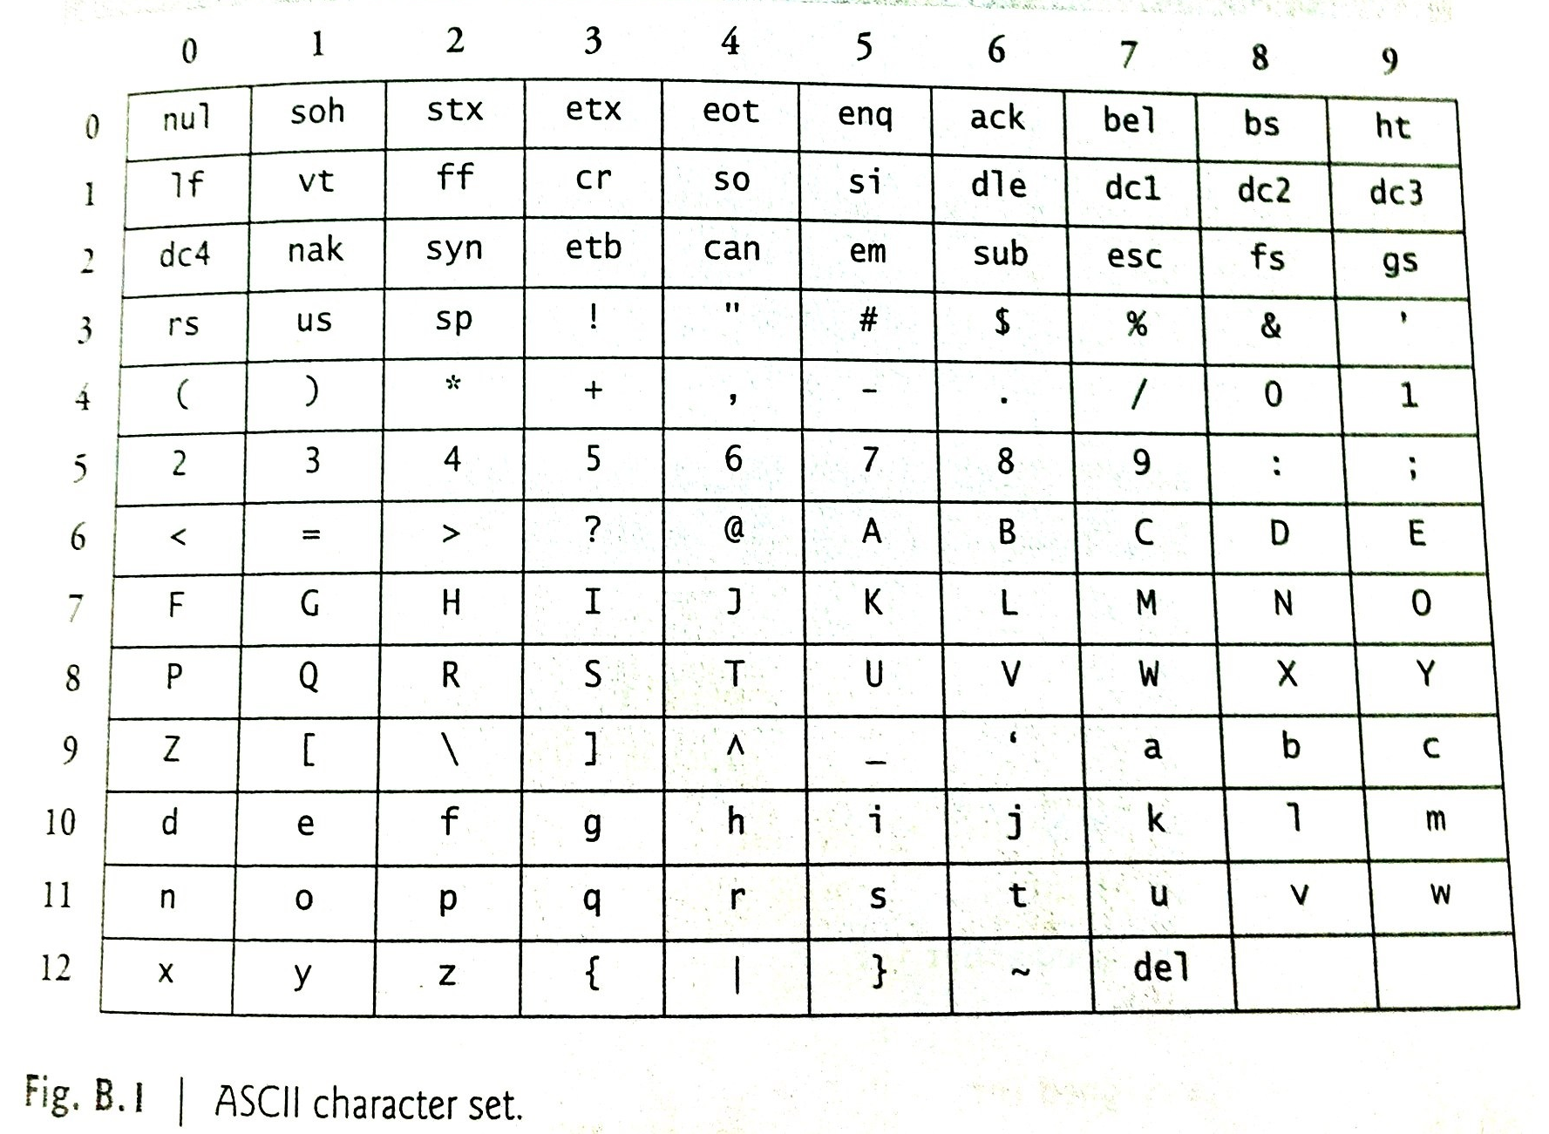

Slide 15
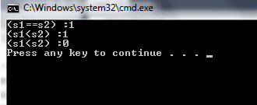
Examples
#include <iostream>
#include <string>
using namespace std;
int main () {
string s1,s2;
s1="abc" ; s2="abc";
cout<< "(s1==s2) :"<<(s1==s2)<<endl;
s1="abc " ; s2="abcd";
cout<< "(s1<s2) :" <<(s1<s2)<<endl;
s1="{abc}"; s2="abc";
cout<< "(s1<s2) :"<<(s1<s2)<<endl;
return 0; }

Slide 16

ASCII code
char let='a';
cout<<"let :"<<let <<endl;
cout<<"ASCII code for let : "<<(int)let<<endl;

Slide 17
Access a character of string
The subscript operator, [ int ], can be used with strings to access and modify individual characters.
The strings have a first subscript of 0.
0
1
2
3
4
X
h
e
l
l
o
string x = “hello”;
char c = x[0]; // c is ‘h’
c = x[1]; // c is ‘e’
c = x[2]; // c is ‘l’

Slide 18
Operators on string Objects
Type Operator Action
Assignment = Stores string
+= Concatenates and stores
Comparison == True if strings identical
!= True if strings not identical
> True if first string greater than second
< True if first string is less than second
>= True if first string greater or equal than second
<= True if first string less or equal than second
Input/Output >> For input and string objects
<< For output and string objects
Character [ ] To access individual characters
access
Concatenation + Connects two strings

Slide 19
Some string Functions
More actions needed than operators can be provided by using string class’s functions
- Examples: length, find, substr , empty , insert .
Calling member function involves using object name with dot operator and function name

Slide 20
length Function
To obtain the length of a string object, call the method length()
ob. length()
- it return the length of the ob.
int n;
string str = "exam";
n = str.length(); //n=4

Slide 21
find Function
Searches for a string within a string
Basic form of call to find
ob1.find (ob2);
  finds first occurrence of string ob2 within ob1
Returns position
int n ;
string s1,s2
0 1 2 3 4 5 6 7 89 10 11
s1 = "This is an example.";
s2 = "exam";
n = s1.find(s2); \\ n =11
n = s1.find(‘ ‘); \\ n =4

Slide 22
find Function
Another version has two arguments
Basic form: ob1.find (ob2, index);
  index represents integer value for beginning of search
String not found returns -1
string s ="Hi! How are you? ";
int n= s.find(‘H’, 1); //n =4

Slide 23
substr Function
We can extract one portion of a string with the method substr.
This does not remove the portion from the original string; instead, it creates a new string that contains the specified portion of the original string.

Slide 24
substr Function
The required substring is specified by the starting position and the number of characters, taking into account that the position of the first character in the string is 0. ob.substr( int, int)
position
Number of character
string text = "hello world, this is a test";
string fragment = text.substr(6, 5);
// start at 6, take 5 characters
// fragment = “world”

Slide 25
substr Function
When the second argument is not specified, substr returns the remainder of the string on which it’s called.
ob.substr( int)
string text = "hello world";
string subs = text.substr(3);
// subs = “lo world”

Slide 26
empty Function
the empty function determines whether a string object is empty or not.
ob.empty();
The function empty returns true if the string is empty; otherwise, it returns false.
Str = “ Hi “;
bool flag = Str.empty(); // flag = False
cout<< flag <<end; // output: 0

Slide 27
insert Function
Adds characters (string) to a string object
ob1.insert(index, ob2);
  index is beginning position
  ob2 represents what is to be inserted
Returns reference to the invoking function
s1 = "This is an example.";
s1.insert (8,"just ");
\\s1 = "This is just an example.“

Slide 28
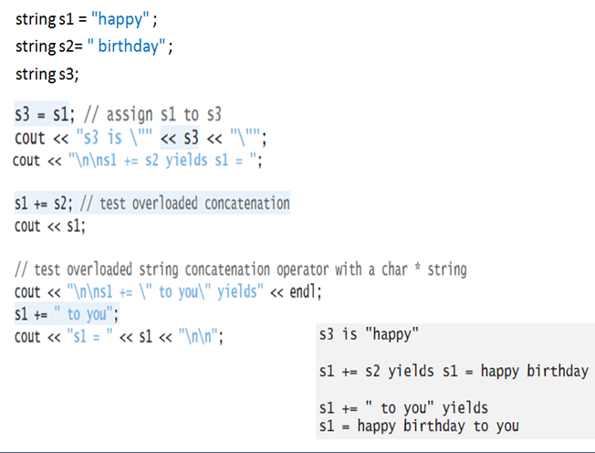
Example

Slide 29
Conditional operator
The ? operator is called a conditional operator and has the following general form
Exp1 ? Exp2 : Exp3;
where Exp1, Exp2, and Exp3 are expressions.
Exp1 is evaluated. If it is true, then Exp2 is evaluated and becomes the value of the entire ? expression. If Exp1 is false, then Exp3 is evaluated and its value becomes the value of the expression.

Slide 30
Conditional operator
The ? is called a ternary operator because it requires three operands.
int var , y;
var = (y < 10) ? 30 : 40;
// if y = 5 → var =30
//if y = 10 → var =40

Slide 31
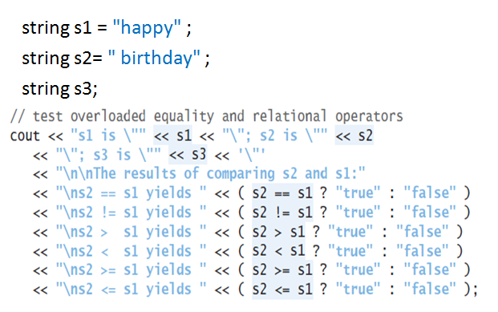
Example

Slide 32
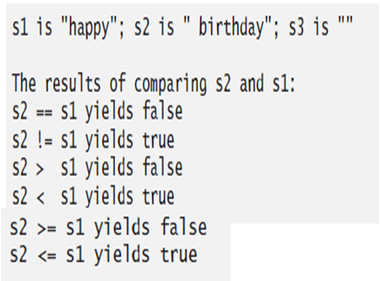
Example

Slide 33
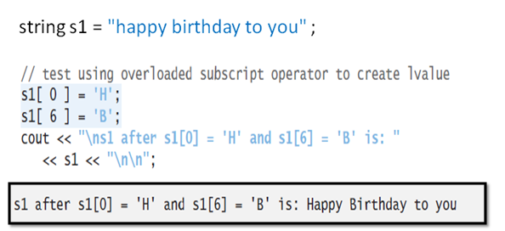
Example

Slide 34
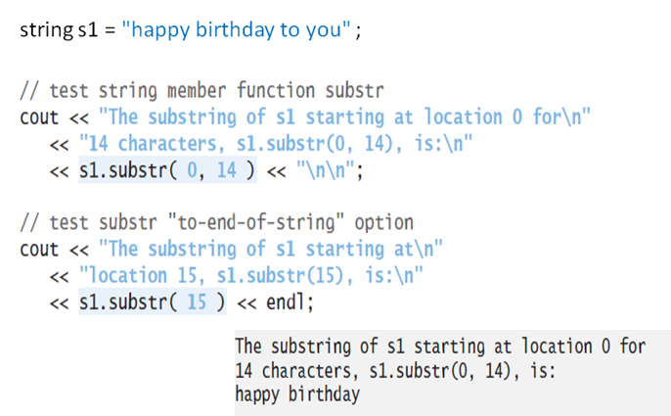
Example

Slide 35
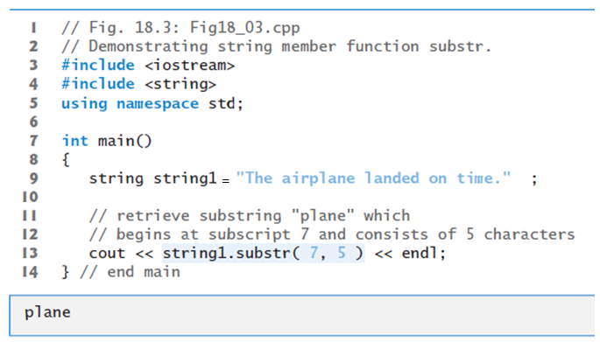
Example

