Slide 1
E-Marketing/7E Chapter 4
Global E-Markets 3.0

Slide 2
Chapter 4 Objectives
After reading Chapter 4, you will be able to:
Discuss overall trends in internet access, usage, and purchasing around the world.
Define emerging economies and explain the vital role of information technology in economic development.
Outline how e-marketers apply market similarity and analyze online purchase and payment behaviors in planning market entry opportunities.

Slide 3
Chapter 4 Objectives, cont.
Describe how e-marketing strategy is influenced by computer and telephone access, credit card availability, attitudes toward internet use, Web site design, and infrastructure issues.
Review the special challenges of e-marketing on the wireless internet in the context of emerging economies.
Discuss the controversy related to the digital divide.
Explain how e-marketing is being used with very low income consumers.

Slide 4
Idol Goes Global
American Idol is broadcast in over 100 countries, often 48 hours after the show has been aired in the U.S.
Its popularity has spawned 39 national versions in countries such as Ethiopia, the Philippines, Russia, and Kazakhstan.
Georgians can follow the season’s music contestants by searching the YouTube key word: Geostari.

Slide 5
Idol Goes Global, cont.
Indian viewers vote for singers and apply to be a contestant on Indian Idol through short message services, SMS.
Over 5 billion votes were cast worldwide for Idol contestants in 2010.
The sharing of popular culture has been enhanced by the convergence of TV, internet, mobile phones, and SMS.
Freemantle Media, which markets Idol abroad, generates over $1B/year.

Slide 6
Overview of Global E-Marketing Issues
Users from other countries, speaking languages other than English, will dominate the Web.
By May 2011 there were approximately 565 million English-speaking and 510 million Chinese-speaking Web users.
Global e-marketers must understand that a country’s e-readiness profile significantly influences marketing strategy and tactics.

Slide 7
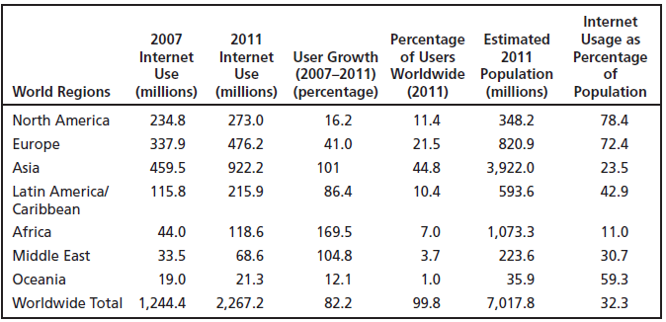
Worldwide internet Usage and Population Statistics

Slide 8
Global Markets
Exhibit 4.1 shows that worldwide internet usage increased more than 82% between 2007 and 2009. There are over 2 billion internet users.
Asia has the most internet users: 922M.
The Middle East saw the greatest growth in internet use: 104.8%.
North America has the highest internet penetration rate: 78.4%.

Slide 9
Emerging Economies
Emerging economies are characterized by a rapidly developing middle class, which creates demand for products and services.
Four countries represent the power and opportunity in emerging markets: Brazil, Russia, India and China (BRIC).
The next group of emerging market economies includes Colombia, Indonesia, Vietnam, Egypt, Turkey and South Africa (CIVETS).

Slide 10
Importance of Information Technology
The internet and its supporting technologies can jump-start national economies.
Bangalore, India is the center of India’s explosive growth in software and IT services.
E-marketers in emerging economies confront marketing issues and unique challenges related to the conditions of operating within a still developing nation.

Slide 11
Country & Market Opportunity Analysis
Market Similarity: Marketers often choose foreign markets that have characteristics similar to their home market for initial entry.
A U.S. company might first target Canada, UK, and Australia before targeting France, Japan or Germany, for example.
CAGE (culture, administration, geography, economic) framework helps e-marketers evaluate similarities and differences between markets.

Slide 12
Diaspora Communities
When people leave their home country they may become part of a diaspora community and want to maintain relationships with their homeland.
E-businesses can target diaspora communities.
Tortas Peru offers homemade, traditional Peruvian cakes online.
Shop.muncha.com offers products to Nepalis living overseas can send to individuals in Nepal.
Market convergence, in which markets become more similar over time, can be expedited by the Web.

Slide 13
E-Commerce Payment and Trust Issues
E-commerce in emerging markets is often hampered by limited use of credit cards and lack of trust in safely conducting online transactions.
In Egypt, Senegal and Pakistan less than 2% of the population owns a credit card.
Most credit card usage in Nepal is by young professionals, upper-income Nepalis and tourists.
Credit card use is virtually non-existent in Ethiopia.

Slide 14
E-Commerce Payment and Trust Issues, cont.
E-marketers working in emerging economies should also understand buyer behavior and attitudes toward online purchasing.
A 2007 study in Lithuania found that 51% of internet users had not made an online purchase because they thought it was too risky.
To overcome trust issues in the Czech Republic, eBanka, an internet bank, was established in 1998 to handle secure online purchases.

Slide 15
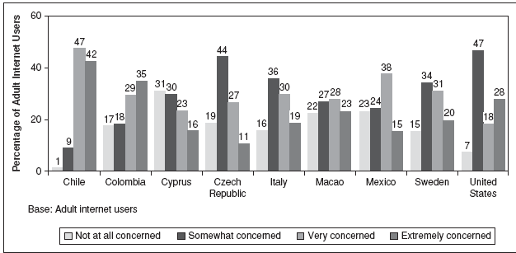
Consumer Concern About Online Use Of Credit Cards In Selected Countries

Slide 16
Technological Tipping Points
E-marketers must understand the seismic changes occurring in consumer access to online content.
Computer and mobile phone technology.
Rapid development of broadband.

Slide 17
Computers & Telephones
Global computer ownership and access is unevenly distributed, according to a global survey.
Ownership in Latin America ranged from 43% in Venezuela to 22% in Mexico.
Ownership was 2% in Bangladesh.
Telecenters, small shops that offer internet connections to the public, are popular means of accessing the Web in many countries.
Peru has one of the highest usage rates of telecenters in the world.

Slide 18
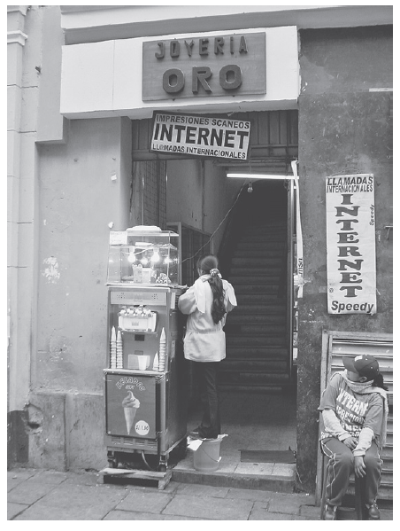
Entrance to a Telecenter in Peru

Slide 19
Wireless internet Access: Mobile Phones
In 2012, over half of the world’s population had at least one handset (4.3B users).
Challenges of wireless e-marketing:
Modification of content for small screens
Text entry using tiny keypads
Content development
Pricing and secure payments
E-marketers must also understand that mobile consumer behavior differs from desktop or laptop consumer behavior.

Slide 20
Smartphones
Marketers must understand how smartphones are influencing consumer purchase behavior in various countries.
36% Egyptian consumers with a smartphone changed their minds about buying a product because of real-time, online research.
37% of smartphone users in Argentina make an in-store purchase after online research with their smartphones.

Slide 21
Broadband
There will be over 740 million broadband lines worldwide by 2014.
Exhibits 4.5 and 4.6 provide broadband usage and growth rates for various countries.
Global prices continue to decline as more individuals and firms subscribe to broadband.

Slide 22
The Digital Divide
E-marketers must consider the social environment in which e-business operates.
The division between those who have access to information and those who don’t is termed “digital divide.”
Disparities with regard to technology access can create a digital divide between countries or populations, such as urban and rural consumers in China.
The digital divide raises challenging questions for global policy, international business, and entrepreneurship: what are their responsibilities, if any, for narrowing the gap?

Slide 23
Building Inclusive E-Markets
Explosive growth of mobile phones has enabled e-marketers to reach base of the pyramid consumer segments.
Mobile banking is one of the most successful e-marketing efforts in LDCs.
In heavily agricultural countries, mobile applications for farmers are making them more productive.

Slide 24
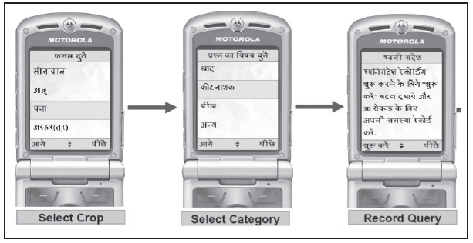
M-KRISHI® For Rural Indian Farmers

Slide 25
Social Networking
82% of the world’s 1.2 billion online consumers reported using at least one social networking site when online.
Latin America, Israel and Russia, where the social network Vkontakte dominates, have some of the world’s heaviest and most engaged users of social media.
Facebook is a market follower, not leader, in South Korea, Japan, China, Brazil and Vietnam.

Slide 26
All rights reserved. No part of this publication may be reproduced, stored in a retrieval system, or transmitted, in any form or by any means, electronic, mechanical, photocopying, recording, or otherwise, without the prior written permission of the publisher. Printed in the United States of America.
Copyright © 2014 Pearson Education, Inc.
Publishing as Prentice Hall

