Slide 1
E-Marketing/7E Chapter 1
Past, Present, and Future

Slide 2
Chapter 1 Objectives
After reading Chapter 1, you will be able to:
Explain how advances in internet and information technology offer benefits and challenges to consumers, businesses, marketers, and society.
Distinguish between e-business and e-marketing.
Explain how increasing buyer control is changing the marketing landscape.
Understand the distinction between information or entertainment as data.
Identify several trends that may shape the future of e-marketing, including the semantic Web.

Slide 3
The Barack Obama Campaign Story
President Obama made history by his use of e-marketing to win the 2008 election.
Obama’s internet strategies targeted 18-29- year-old voters because 93% are online.
His 2012 efforts added higher levels of sophistication, including the use of social media and mobile marketing.
Facebook displayed over 33 million “likes.”
The Obama YouTube channel had over 286,000 subscribers and 288 million upload views.

Slide 4
Internet 101
The internet is a global network of interconnected networks.
Data move over phone lines, cables and satellites.
There are three types of access to the internet:
Public internet
Intranet: network that runs internally in an organization
Extranet: two or more joined networks that share information

Slide 5
E-business, E-commerce, E-marketing
E-business is the optimization of a company’s business activities using digital technology.
E-commerce is the subset of e-business focused on transactions.
E-marketing is the result of information technology applied to traditional marketing.

Slide 6
E-Marketing Is Bigger than the Web
The Web is the portion of the internet that supports a graphical user interface for hypertext navigation with a browser.
The Web is what most people think about when they think of the internet.
Electronic marketing reaches far beyond the Web.

Slide 7
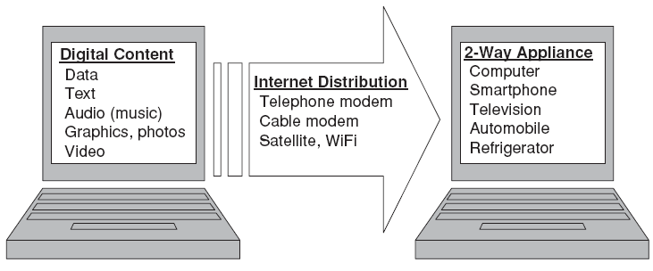
The Web Is Only One Aspect of E-Marketing

Slide 8
E-Marketing Is Bigger than Technology
Individuals: The internet provides individual users with convenient and continuous access to information, entertainment, networking, and communication.
Communities form around shared photos (Flickr), videos (YouTube), and individual or company profiles (Facebook).
Businesses: The digital environment enhances processes and activities for businesses.
Societies and economies are enhanced through more efficient markets, more jobs, information access, communication globalization, and more.

Slide 9
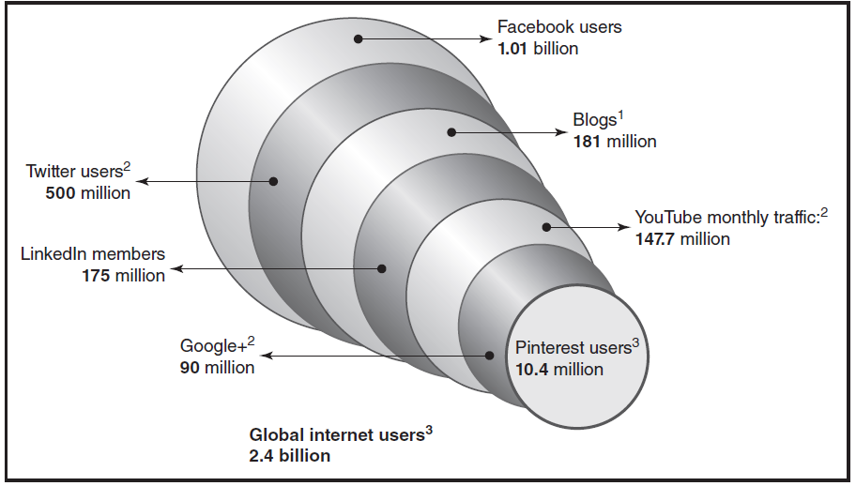
Global Internet Users

Slide 10
E-Marketing’s Past: Web 1.0
The internet started in 1969 as the ARPANET, a network for academic and military use.
Web pages and browsers appeared in 1993.
The first generation of e-business was like a gold rush.
Companies quickly attracted sales and market share, but negative profits.
Between 2000 and 2002, more than 500 internet firms shut down in the U.S.
By Q4 2003, almost 60% of public dot-coms were profitable.

Slide 11
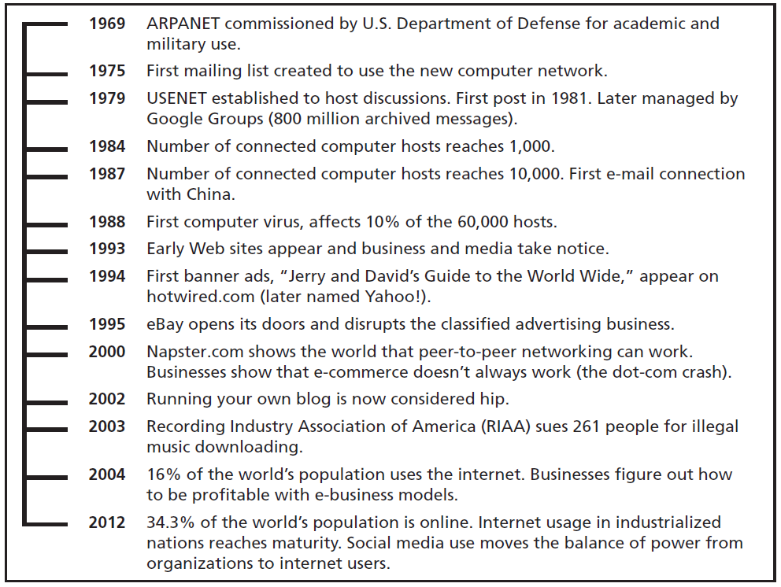
Internet Timeline

Slide 12
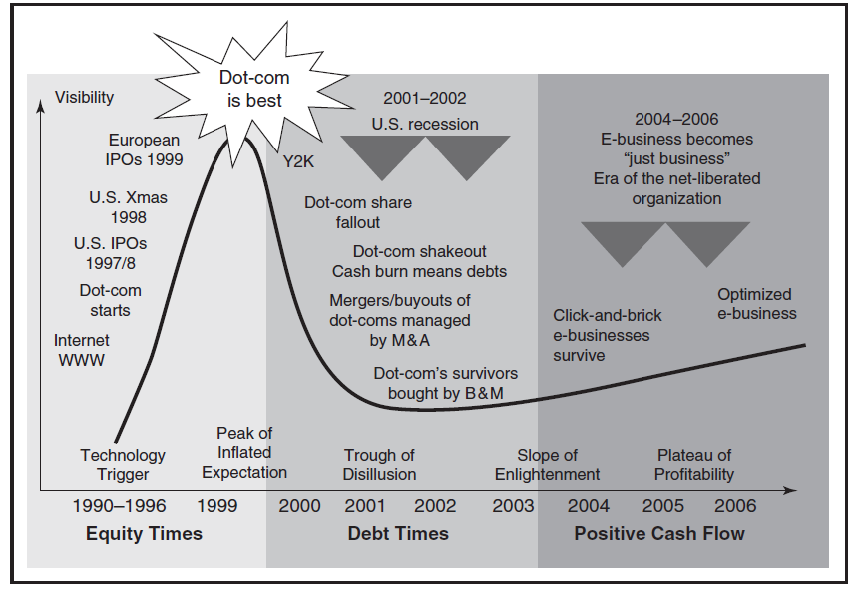
2001 Garner Hype Cycle

Slide 13
The E Drops from E-Marketing
Gartner predicted that the e would drop, making e-business just business and e-marketing just marketing.
Nevertheless, e-business will always have its unique models, concepts, and practices.
The e-marketing landscape is changing rapidly due to consumer-generated content, mobile internet access, social media and disruptive technologies.

Slide 14
E-Marketing Today: Web 2.0
Web 2.0 technologies connect people with each other through social media, which have created opportunities and challenges for marketers.
Power shift from sellers to buyers.
Consumers trust each other more than companies.
Market and media fragmentation.
Online connections are critical.
Everyone is a content producer.
Information transparency.
Social commerce.

Slide 15
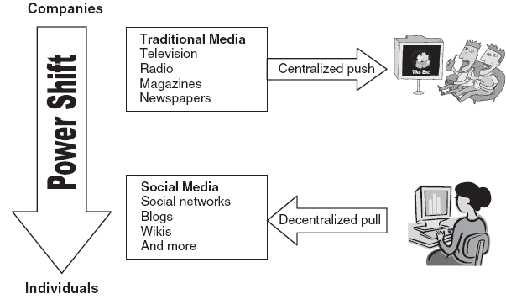
Power Shift From Companies To Individuals

Slide 16
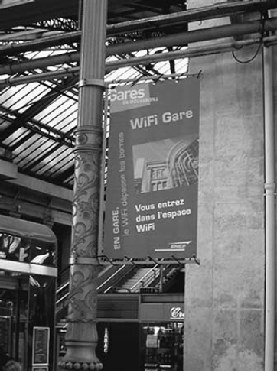
New Technologies
Wireless networking and mobile computing.
4G is a fourth-generation high speed wireless technology.
Appliance convergence.
LG internet refrigerator is many digital appliances in one.
Voice navigation.

Slide 17
Other Opportunities And Challenges In Web 2.0
Internet adoption matures.
Online retail sales equal 4%+ of all sales.
Search engines are now reputation engines.
Image recognition takes root.
Improved online and offline strategy integration.
Intellectual capital rules.
Decline of print media.
Online fundraising increases.
Location-based services.
The long tail.
Everything is “FSTR.”

Slide 18
The Future: Web 3.0
Sir Tim Berners-Lee, coinventor of the World Wide Web, has been working on technology to organize online data for greater user convenience, i.e., the semantic Web.
Users can easily find information based on its type.
The value of the semantic Web is information on demand.
Experts believe the semantic Web will become a reality over the next decade.

Slide 19
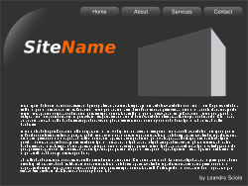
Evolution from Web 1.0 to Web 3.0
Web 1.0
Content creator (cc)
Consumer (c)
cc & c
Web 2.0
cc & c
cc & c
cc & c
cc & c
Web 3.0
Semantic Web
@
agent
cc & c

Slide 20
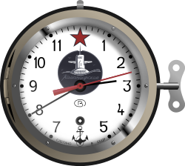
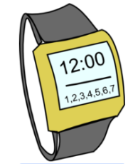
Internet-time Analogy
3500 BC Sundial
1583 AD Pendulum
1600’s Mechanical
1929 Quartz Crystal
1949 Atomic
Internet is
here in 2013

Slide 21
Stepping Stones to Web 3.0
Higher bandwidth
Faster connection speeds
Artificial intelligence
Seamless social networking
Modular Web applications

Slide 22
All rights reserved. No part of this publication may be reproduced, stored in a retrieval system, or transmitted, in any form or by any means, electronic, mechanical, photocopying, recording, or otherwise, without the prior written permission of the publisher. Printed in the United States of America.
Copyright © 2014 Pearson Education, Inc.
Publishing as Prentice Hall

