Slide 1
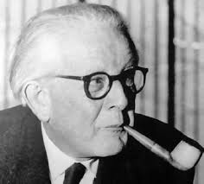
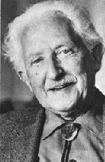
Stage Theories of Development
Developmental Psychology
Piaget – Kohlberg - Erikson

Slide 2
Stage Theories of Development
Developmental Psychology
Stages:
series of abrupt changes from one period to another.
All children must pass through in same order

Slide 3
Piaget’s Developmental Theory
Developmental Psychology
Identified 4 stages of cognitive development
Sensorimotor stage – infant experiences world in sensory information and motor activities
Preoperational stage – children sometimes think illogically by adult standards
Concrete operational stage – increased abilities
Formal operational stage – use of full adult logic

Slide 4
Developmental Psychology
Piaget’s cognitive development theory
Birth to 2 yrs | Sensorimotor | Uses senses and motor skills, items known by use; Object permanence
2 - 7 yrs | Pre-operational | Symbolic thinking, language used; egocentric thinking, imagination/ experience grow, child de-centers
7 - 11 yrs | Concrete operational | Logic applied, objective/rational interpretations; conservation, numbers, ideas, classifications
11 yrs on | Formal operational | Thinks abstractly, hypothetical ideas; ethics, politics, social/moral issues explored

Slide 5
Kohlberg’s Theory
Developmental Psychology
Moral development
Three level, six stage theory
Level I
Pre conventional moral reasoning
Level II
Conventional moral reasoning
Level III
Post conventional moral reasoning

Slide 6
Developmental Psychology
Kohlberg’s theory of moral development
Level I: Pre conventional moral reasoning مستوى ما قبل الاتفاق على العرف والقانون | Stage 1 | “might makes right” | Punishment/obedience orientation: self-interest
 | Stage 2 | “look out for number one” | Instrumental/relativist orientation: quid pro quo
Level II: Conventional moral reasoning مستوى الاتفاق على العرف والقانون | Stage 3 | “good girl, nice boy” | Proper behavior for the social approval
 | Stage 4 | “law and order” | Proper behavior of the dutiful citizen, obey laws
Level III: Post conventional moral reasoning مستوى ما بعد الاتفاق على العرف والقانون | Stage 5 | “social contract” | Mutual benefit to all, obey society’s rules
 | Stage 6 | “universal ethical principles” | Defend right/wrong, not just majority, all life is sacred (reflective)

Slide 7
Erikson’s theory of Social - emotional development
Developmental Psychology
Focuses on the individual’s developing relationships with others in social world
Eight stages - development continues over life span
Crisis at each stage of development

Slide 8
Developmental Psychology
Trust vs. Mistrust
Autonomy vs. Shame/doubt
Initiative vs. Guilt
Industry vs. Inferiority
Identity vs. Role confusion
Erikson’s psychosocial theory
Intimacy vs. Isolation
Generativety vs. Stagnation
Integrity vs. Despair

Slide 9
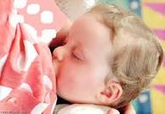
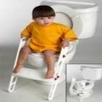
Developmental Psychology
Stages of Erikson’s Psychosocial Theory
Description | Age | Stage
The feeling of self-confidence and optimism grows at this stage if the lactation process had done well. And also if the child found love and desire in his presence ... but if a crisis occurred at this stage, the child loses self-confidence and safety. | Birth to 2 yrs | Trust vs. Mistrust | 1
The feeling of autonomy, happiness and the pride grow at this stage if the training on some behaviors are normal and perfect, such as toilet training... but if a crisis occurred at this stage, the child will feel ashamed and become dependent on others. | 2 - 4 yrs | Autonomy vs. Shame/doubt | 2

Slide 10
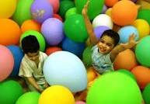
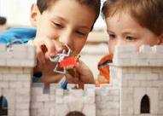
Developmental Psychology
Stages of Erikson’s Psychosocial Theory
Description | Age | Stage
Child learns the imagination and his skills grow through active play. Including fantasy play, and to learn cooperating with others. But if he hampered by a sense of guilt (Oedipus complex); he would became frightened and to continue depending on adults without a real need for it. As a results his ability to play and imagine would be hampered . | 4 – 6 yrs | Initiative vs. Guilt | 3
Child mastered the skills necessary for life such as, dealing with groups according to the rules, Organized play instead of free play, mastered reading and math, and feels that the work of household chores necessary. A child who doesn’t have self-confidence or feel guilty as a result of crisis in the previous stages will feel inferiority. | 6 – 12 yrs | Industry vs. Inferiority | 4

Slide 11
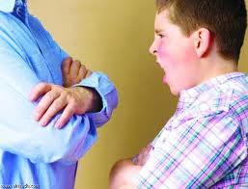
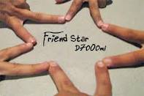
Developmental Psychology
Stages of Erikson’s Psychosocial Theory
Description | Age | Stage
Teenager suffers from some minor disturbances such as, rebellion, disobedience, shame and self-doubt. But soon sought to get some achievements instead of the doubt. At the end of this stage teenager acquires identity (masculinity - femininity), and develop a role model, and plays several roles until achieving to the appropriate role. If a crisis occurred at this stage teenager passes role confusion. | 13 – 18 or 20 yrs | Identity vs. Role confusion | 5
The feeling of intimate friendships grow. Which can be the basis for a successful marriage or continuously friendship, but if a crisis occurred at this stage may lead to isolation and introversion. | 18 or 20 – 25 yrs | Intimacy vs. Isolation | 6

Slide 12
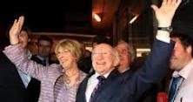
Developmental Psychology
Stages of Erikson’s Psychosocial Theory
Description | Age | Stage
The individual seeks to productivity, whether in the family or work, and creativity and innovation. But if a crisis occurred at this stage; it would lead the individual to Stagnation. | 25 – 59 yrs | Generativety vs. Stagnation | 7
Mature reaches to the top of the social adjustment and growth. The feeling of independence, self-confidence, and becoming friendly and proud of his achievements. But if he fails to solve any of this crises; it will make him feel despair and disgust. | 60 yrs on | Integrity vs. Despair | 8

