Slide 1
Spectrophotometry

Slide 2
Spectrophotometry
Spectrophotometry
is the measurement of light absorption or transmission .
It is an analytical technique that is applied to obtain valuable information , such as the identity of an unknown compound by their characteristic absorption spectra (qualitative analysis ) , and determination of the unknown concentration of an analyte (quantitative analysis ) .
Spectrophotometry is used for both and quantitative and qualitative analysis .
Enzyme catalyzed reactions can be followed by measuring the absorption of the substrate or product .

Slide 3
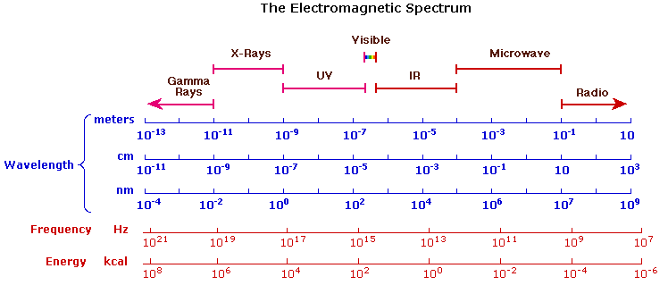
Regions of the electromagnetic spectrum

Slide 4
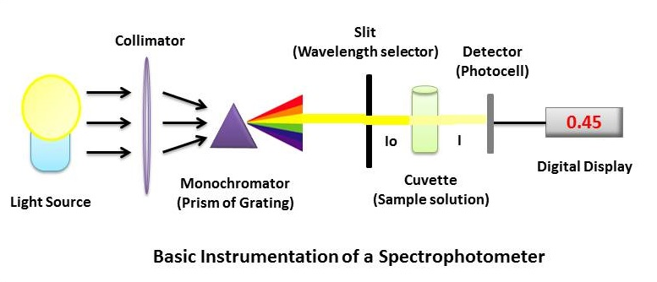
Spectrophotometer
A Spectrophotometer is an instrument used to measure the amount of light transmitted or absorbed by a sample .
Components of the Spectrophotometer include :
1- a light source .
2- a collimator or focusing device , that transmits an intense beam of light .
3- a monochromator , that divides the light beam into its component wave-lengths .
4-A selector device for selecting the desired wavelength .
5- A compartment in which the sample is placed (cuvette).
6- A photodetector .
7-An electrical meter to record the output of the detector .

Slide 5
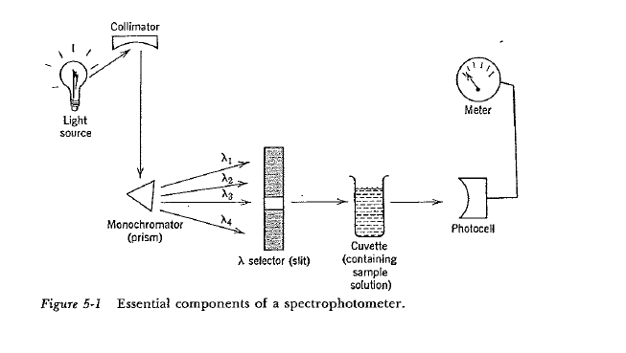
Spectrophotometer

Slide 6
Beer – Lambert Law
The fraction of the incident light that is absorbed by a solution depends on
the thickness of the sample (path length l ).
The concentration of the absorbing compound (C) .
The chemical nature of the absorbing compound .
The relationship between the concentration C , path length of light l , and the light absorbed by a substance is expressed mathematically in the Beer – Lambert law .
Log I° / I = A , Log I° / I = A = a c l .
I = Transmitted light .
I° = Incident light .
A = Absorbance or optical density O.D.
a= Absorption coefficient or extinction coefficient for a particular absorbing compound .
Light absorption follows an exponential rather than a linear law .
If the concentration is expressed in Molarity “ a “ becomes the molar absorption coefficient a_{m}, or Molar extinction coefficient ε .

Slide 7
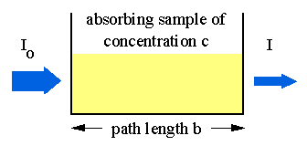
Beer – Lambert Law
If the concentration is expressed in g/l “ a” becomes the specific absorption coefficient
a_{m} = a_{s} x mw .
a_{m} is most commonly used in biochemistry ,and the path length l is almost always 1cm , thus the units for a_{m} is M⁻¹ cm⁻¹ .
The absorption coefficient varies in different substances , it also varies with varying wave-lengths also .
a_{m340} refers to the molar absorption coefficient at 340nm .

Slide 8
Beer – Lambert Law
Blank solution:
Blank ; is a solution that is necessary in all spectrophotometry studies . It should contain all components of the assay or test solution except the component who’s absorbance is being measured .
Purpose of the Blank :
The blank will cancel out the absorbance of the substances in the background so that the absorbance of the tests will be that of the compound under study only .
Note : Glass cuvettes are not to be used in the U.V region , since the glass itself will absorb light thus leading to a false high result .
In the U.V region Quartz cuvettes are to be used .

Slide 9
Solutions Containing One Absorbing Substance
Example : A solution containing 2g/l of a light absorbing substance in a 1cm cuvette transmits 75% of the incident light at 260nm . Calculate the transmission of a solution containing
4g/l ,
6g/l .
c) If the mw is 250 calculate a_{m} , and calculate the absorbance in case a and b ,
d) What type of cuvette should you use here ? Why ?
Since A = Log I° / I
A = log 1.0 /0.75 = 0.124
Since A = a_{s} c l , thus a_{s} = A /c l = 0.124/2 = 0.06 , so a_{s} = 0.06 .
a)Since log I° / I = a_{s} c l
Log 1.0 – logI = 0.06 x c x l .
0 – log I = 0.06 x c x l .
- log I = 0.06 x 4 x 1 = - 0. 24
I = antilog - 0. 24 = 0.57 , 57%
b) log I° / I = a_{s} c l
Log 1.0 – logI = 0.06 x 6 x1.

Slide 10
Solutions Containing One Absorbing Substance
-log I = 0.36
Log I = - 0.36
I = antilog - 0.36 = 0.436 .
a_{m} = a_{s} x mw = 0.06 x 250 = 15 .
d) quartz cuvettes should be used at the U.V range .
Absorbance in case b
A = 0.06 x 6 x 1 = 0.36 .

Slide 11
Solutions Containing One Absorbing Substance
Example : A solution containing 10⁻⁵ M ATP , has a transmission 0.702 (70.2% )at 260 nm in a 1cm cuvette . Calculate a) the transmission of the solution in a 3cm cuvette .
b)the absorbance of the solution in a 1cm and 3cm cuvette .
c) The absorbance if the concentration increased to 5x 10⁻⁵ M of ATP , in a 1cm cuvette .
A = Log I° / I = a_{m} c l
A = log 1.0 / 0.702 = 0.152
0.152 = a_{m} x 10⁻⁵ x 1
a_{m} = 0.152 / 10⁻⁵ = 15200 M⁻¹ cm⁻¹
A = 15200 x 10⁻⁵ x 3 = 0.456
Since A = Log I° / I , 0.456 = log 1.0 / I
0.456 = log1 – log I = 0 – log I = - log I
Thus I = antilog - 0.456 = 0.349 . 34.9%
b) A in a 1 cm cuvette .
A = 15200 x 10⁻⁵ x 1 = 0.15
c) A = 15200 x( 5x 10⁻⁵ ) x 1 = 0.76

Slide 12
Solutions Containing One Absorbing Substance
Protein determinations :
Proteins in solutions can be determined spectrophotometricaly by several methods for example :
a)Colorimetrical method such as :
Biuret metohd : The biuret method is based on the reaction of Cu²⁺ with peptides in an alkaline solution producing a purple complex that has an absorption maximum at 540nm.
Proteins + Biuret reagent ----- ^{alkaline media} ------> purple complex ( max absorbance at 540nm) .
b) Direct spectrophotomety :
The absorbance at 280nm can be used to determine protein concentration in solutions .
(since proteins have a distinct absorbance maximum at 280nm due to their aromatic amino acids ).

Slide 13
Solutions Containing One Absorbing Substance
Example : A protein solution (0.3ml) was diluted with 0.9ml of water . To 0.5ml of this diluted solution , 4.5ml of biuret reagent was added and the color was allowed to develop . The absorbance of the mixture at 540nm was 0.18 in a 1cm diameter tube . A standard solution (0.5ml containing 4mg of protein/ml )plus 4.5 ml of biuret reagent gave an absorbance of 0.12 in the same size test tube . a)Calculate the protein concentration in the undiluted unknown solution .b) What is the composition of the blank here ?
A) Concentration of standard C_{st} = 4mg/ml .
Thus C_{st} = 4g/L .
A_{standard} = a_{s} x C x l ,
0.12 = a_{s} x 4 x 1 ,
So a_{s} = 0.12 / 4 = 0.03
A_{test} = a_{s} x C x l ,
0.18 = 0.03 x C x1
So C_{test} = 0.18 / 0.03 = 6g/l = 6mg/ml
The concentration of protein in the undiluted solution ,
C_{undiluted} = 6 x 1.2/0.3 = 24mg/ml .
b)The blank should contain 4.5ml of biuret and 0.5ml of distilled water only .

Slide 14
Solutions Containing Two Absorbing Substance
Example : a solution containing NAD⁺ and NADH had an absorbance of 0.311 in a 1cm cuvette at 340nm , and 1.2 at 260nm . Calculate the concentration of the oxidized and reduced forms of the coenzyme in the solution . Both NAD⁺ and NADH absorb at 260nm , but only
NADH absorbs at 340nm .
Absorbance at 340nm represents the absorbance of NADH only since NAD⁺ does not absorb at that wavelength . So the concentration of NADH can be obtained .
A_{340nm} = A_{NADH} = a_{m} x C x l
0.311 = 6220 x C x 1
So C_{NADH} = 0.311/6220 = 5x 10⁻⁵ M.
A_{260nm} = A_{NADH} + A_{NAD+} ( since both absorb at this wavelength )
a_{m}
Compound | 260nm | 340nm
NAD⁺ | 18000 | 0.0
NADH | 15000 | 6220

Slide 15
Solutions Containing Two Absorbing Substance
A_{NADH} = a_{m} x C x l = 15000 x 5 x 10⁻⁵ x1 = 0.75 .
Thus A_{NAD+} = A _{total} - A_{NADH} = 1.2 – 0.75 = 0.45
Since A_{NAD+} = a_{m} x C_{NAD+} x l
0.45 = 18000 x C_{NAD+} x 1
C_{NAD+} = 0.45 / 18000 = 2.5 x 10⁻⁵ M
Example : Ten grams of butter were saponified , the non-saponifiable fraction was extracted into 25ml of chloroform . The absorbance of the chloroform solution in a 1cm cuvette was 0.53 at 328nm and 0.48 at 458nm . Calculate the carotene and vitamin A content of the butter .
a _{1%} = absorption coefficient when concentration expressed in 1g/100ml .
a _{1%}
Compound | 328nm | 458nm
Carotene | 340 | 2200
Vitamin A | 1550 | 0.0

Slide 16
Solutions Containing Two Absorbing Substance
The absorbance at 458nm represents the absorbance of Carotene only , thus its concentration can be obtained .
A_{458nm} = A_{carotene}
A_{458nm} = a _{1%} x C_{carotene} x1 = 2200 x C_{carotene} x1
C_{carotene} = 0.48/2200 = 2.1 x 10⁻⁴ g/100ml
Thus the carotene content in the 25ml of chloroform extract is
2.1 x 10⁻⁴ --------> 100ml
? --------> 25ml
the carotene content in the 25ml of chloroform extract = 25 x( 2.1 x 10⁻⁴ ) / 100
= 5.2 x 10⁻⁵ g
= 5.2 x 10⁻² mg .
The carotene content per gram of butter = 0.052 / 10 = 5.2 x 10⁻³ mg carotene / g of butter
Absorbance at 328nm is the absorbance of A_{carotene} + A _{vitamin A}
A_{carotene} = a _{1%} x C x l = 340 x 2.1 x 10⁻⁴ x1 = 0.0714 .
A _{vitamin A} = A _{Total} - A_{carotene}

Slide 17
Solutions Containing Two Absorbing Substance
A _{vitamin A} = 0.53 – 0.0714 = 0.458
C _{vitamin A} = A / a _{1%} x 1 = 0.458/1550 = 2.9 x 10⁻⁴ g/100ml
the vitamin A content in the 25ml of chloroform extract = 25 x 2.9 x 10⁻⁴ / 100
= 7.25x10⁻⁵ g
= 0.073mg
The vitamin A content of the butter /g
= 0.073/10 = 0.0073mg / g of butter
= 7.3µg / g of butter .

