Slide 1
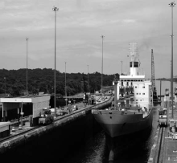
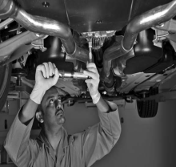
Chapter 15:
Striving for
Service Leadership

Slide 2
Overview of Chapter 15
The Service-Profit Chain
Integrating Marketing, Operations, and Human Resources
Creating a Leading Service Organization
In Search of Human Leadership

Slide 3
The Service-Profit Chain

Slide 4
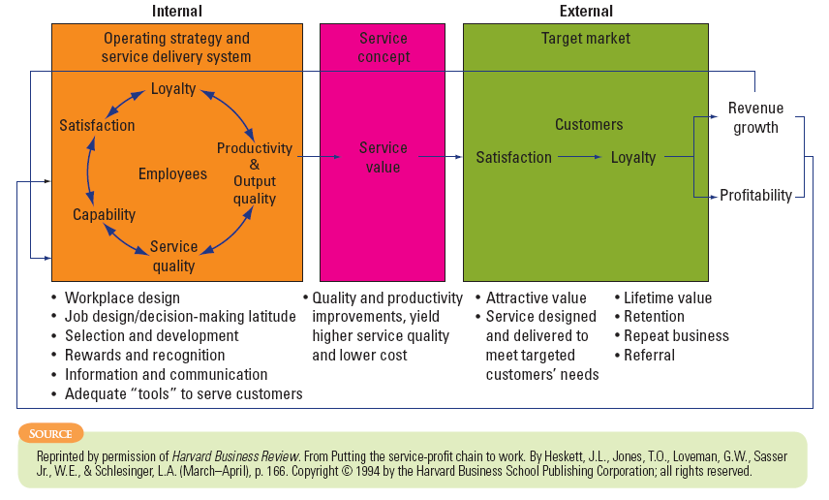
The Service-Profit Chain

Slide 5
Links in the Service-Profit Chain
1. Customer loyalty drives profitability and growth
2. Customer satisfaction drives customer loyalty
3. Value drives customer satisfaction
4. Quality and productivity drives value
5. Employee loyalty drives service quality and productivity
6. Employee satisfaction drives employee loyalty
7. Internal quality drives employee satisfaction
8. Top management leadership underlies the chain’s success

Slide 6
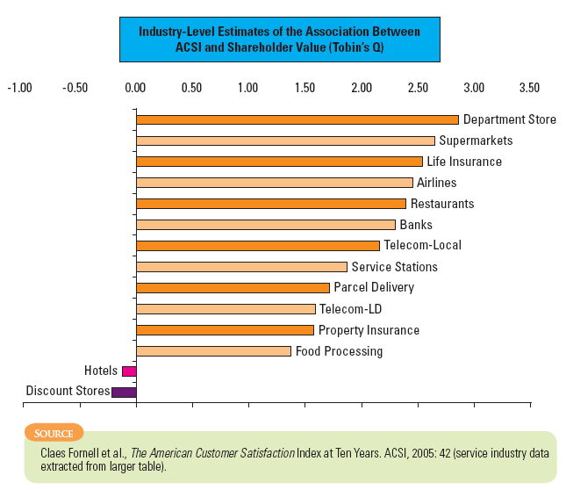
Firm Value Created by Customer Satisfaction

Slide 7
Qualities Associated with Service Leaders
Understands mutual dependency among marketing, operations, and human resource functions of the firm
Has a coherent vision of what it takes to succeed
Strategies are defined and driven by a strong, effective leadership team
Responsive to various stakeholders
Value created through customer satisfaction

Slide 8
Integrating Marketing, Operations, and
Human Resources

Slide 9
Defining the Three Functions
Marketing Function
Operations Function
Human Resource Function
Target “right” customers and build relationships
Offer solutions that meet their needs
Define quality package with competitive advantage
Create, deliver specified service to target customers
Adhere to consistent quality standards
Achieve high productivity to ensure acceptable costs
Recruit and retain the best employees for each job
Train and motivate them to work well together
Achieve both productivity & customer satisfaction

Slide 10
Reducing Interfunctional Conflict
One challenge is to avoid creating “functional silos”
High-value creating enterprises should be thinking in terms of activities, not functions
Top management needs to establish clear imperatives for each function that defines how a specific function contributes to the overall mission
Interfunctional transfers will provide a holistic perspective for individuals
Establishing integrated project teams
Having interfunctional service delivery teams
Appointing formally designated individuals to integrate objectives
Internal marketing and training
Commitment of top management

Slide 11
Creating a Leading
Service Organization

Slide 12
From Losers to Leaders: Four Levels of Service Performance
Service Losers
Service Professionals
Patronized because there is no viable alternative
New technology introduced only under duress; uncaring workforce
Service Nonentities
Dominated by a traditional operations mindset
Unsophisticated marketing strategies
Consumers neither seek out nor avoid them
Clear market positioning strategy such that customers within target segment(s) seek them out
Proactive, investment-oriented approach to HRM
Service Leaders
The crème da la crème of their respective industries
Names synonymous with outstanding service, customer delight
Employees are empowered and committed
Bottom of the barrel

Slide 13
Four Hurdles for Moving up the Performance Ladder
Cognitive Hurdles
People cannot agree on causes of current problems and the need for change
Resource Hurdles
Firm is constrained by limited funds
Motivation Hurdles
Prevent rapid execution when employees are reluctant to change
Political Hurdles
Organized resistance forces in forms from powerful vested interests seeking to protect their positions

Slide 14
Leading Change in a Service Organization Involves 8 Stages
1. Creating a sense of urgency to develop the impetus for change
5. Empowering employees to act on that vision
2. Putting together a strong enough team to direct the process
3. Creating an appropriate vision of where the organization needs to go
4. Communicating that new vision broadly
6. Producing sufficient short-term results to create credibility and counter cynicism
7. Building momentum and using that to tackle tougher change problems
8. Anchoring new behaviors in organizational culture
Source: John Kotter

Slide 15
In Search of
Human Leadership

Slide 16
Leadership vs. Management
Setting direction
Planning
In terms of what it should become over long term and articulating feasible way of achieving goal
Creating visions and strategies that describe a business, technology, or corporate culture
Leadership
Keeps current situation operating through planning, budgeting, organizing, staffing, controlling, and problem solving
Development of vision and strategies, and empowerment of people to overcome obstacles, make vision happen
Works through people and culture
Produces useful change, especially non-incremental change
Management
Emphasizes physical resources
Works through hierarchy and systems
Keeps current system functioning
Emphasis on emotional and spiritual resources
Setting direction
Creating visions and strategies that describe a business, technology, or corporate culture
In terms of what it should become over long term and articulating feasible way of achieving goal
Planning
A management process designed to produce orderly results, not change

Slide 17
Individual Leadership Qualities
Love for the business
See service quality as foundation for competing
Recognize key role of employees
Driven by a set of core values they pass on
Make communication a priority
Work with a team on decision-making
Know when to change when necessary
Walk the talk

Slide 18
Leadership, Culture, and Climate
Leadership
Leadership traits are needed of everyone in supervisory or managerial positions, including those heading teams
Organization Culture
Represents the shared
Perceptions/themes regarding what is important
Values, beliefs, and assumptions
Shares understanding about what works and what doesn’t work
Styles of working and relating to others
Organizational Climate
The tangible surface layer on top of the organization’s underlying culture that requires radical rethinking of:
HRM activities
Operational procedures
Firm’s reward and recognition policies

Slide 19
Summary
Service profit chain provides summary of relationships between key variables that explain service leadership
Four levels of service performance
Service losers
Service nonentities
Service professionals
Service leaders
Service leadership must cut across marketing, operations, and human resources
Leaders need to understand the difference between leadership vs. management, as well as setting direction vs. planning
Leaders play a big part in nurturing an effective organizational culture that moves an organization towards service leadership

