Slide 1
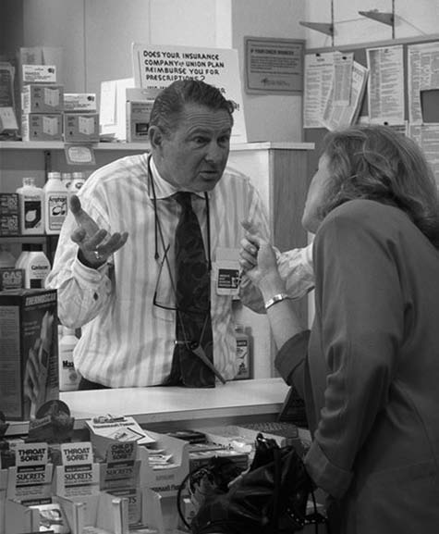
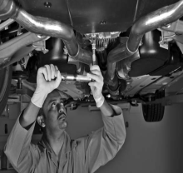
Chapter 13:
Complaint Handling
and Service Recovery

Slide 2
Overview of Chapter 13
Customer Complaining Behavior
Customer Responses to Effective Service Recovery
Principles of Effective Service Recovery Systems
Service Guarantees
Discouraging Abusive and Opportunistic Customer Behavior

Slide 3
Customer Complaining Behavior

Slide 4
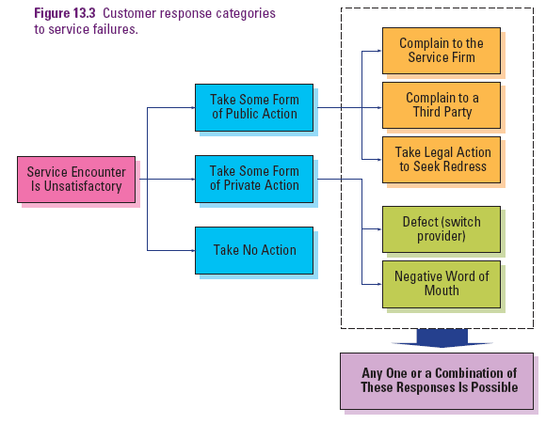
Customer Response Categories to Service Failures

Slide 5
Understanding Customer Responses to Service Failure
Why do customers complain?
Obtain compensation
Vent their anger
Help to improve the service
Altruistic reasons
What proportion of unhappy customers complain?
Why don’t unhappy customers complain?

Slide 6
Understanding Customer Responses to Service Failure
Who is most likely to complain?
Where do customers complain?
What do customers expect once they have made a complaint?
Procedural, interactional, and outcome justice

Slide 7
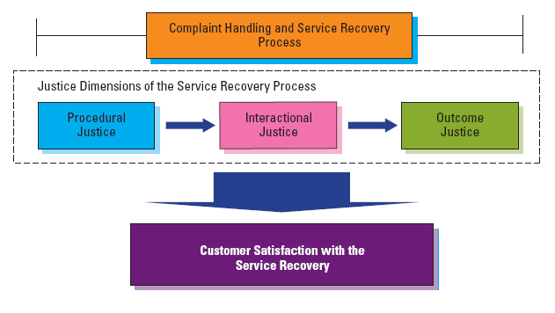
Three Dimensions of Perceived Fairness in Service Recovery

Slide 8
Customer Responses to Effective Service Recovery

Slide 9
Service Recovery
Service Recovery
Plays a crucial role in achieving customer satisfaction by testing a firm’s commitment to satisfaction and service quality
Impacts customer loyalty and future profitability
Severity and “recoverability” of failure (e.g., spoiled wedding photos) may limit firm’s ability to delight customer with recovery efforts
Service Recovery Paradox: Customers who experience a service failure that is satisfactorily resolved may be more likely to make future purchases than customers without problems
If second service failure occurs, the paradox disappears
Best Strategy: Do it Right the First Time

Slide 10
Principles of Effective
Service Recovery Systems

Slide 11
Components of an Effective Service Recovery System
Do the job right the first time
Effective Complaint Handling
Increased Satisfaction and Loyalty
+
=
Conduct research
Monitor complaints
Develop “Complaints as Opportunity” culture
Identify Service Complaints
Resolve Complaints Effectively
Develop effective system and training in complaint handling
Learn from the Recovery Experience
Conduct root cause analysis
Close the loop via feedback

Slide 12
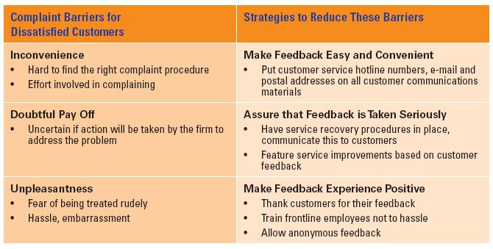
Strategies to Reduce Customer Complaint Barriers

Slide 13
How to Enable Effective Service Recovery
Methods: (See Service Perspectives 13.1)
Be proactive—on the spot, before customers complain
Plan recovery procedures
Teach recovery skills to relevant personnel
Empower personnel to use judgment and skills to develop recovery solutions
Rules of Thumb for Adequate Compensation:
What is positioning of our firm?
How severe was the service failure?
Who is the affected customer?

Slide 14
Service Guarantees

Slide 15
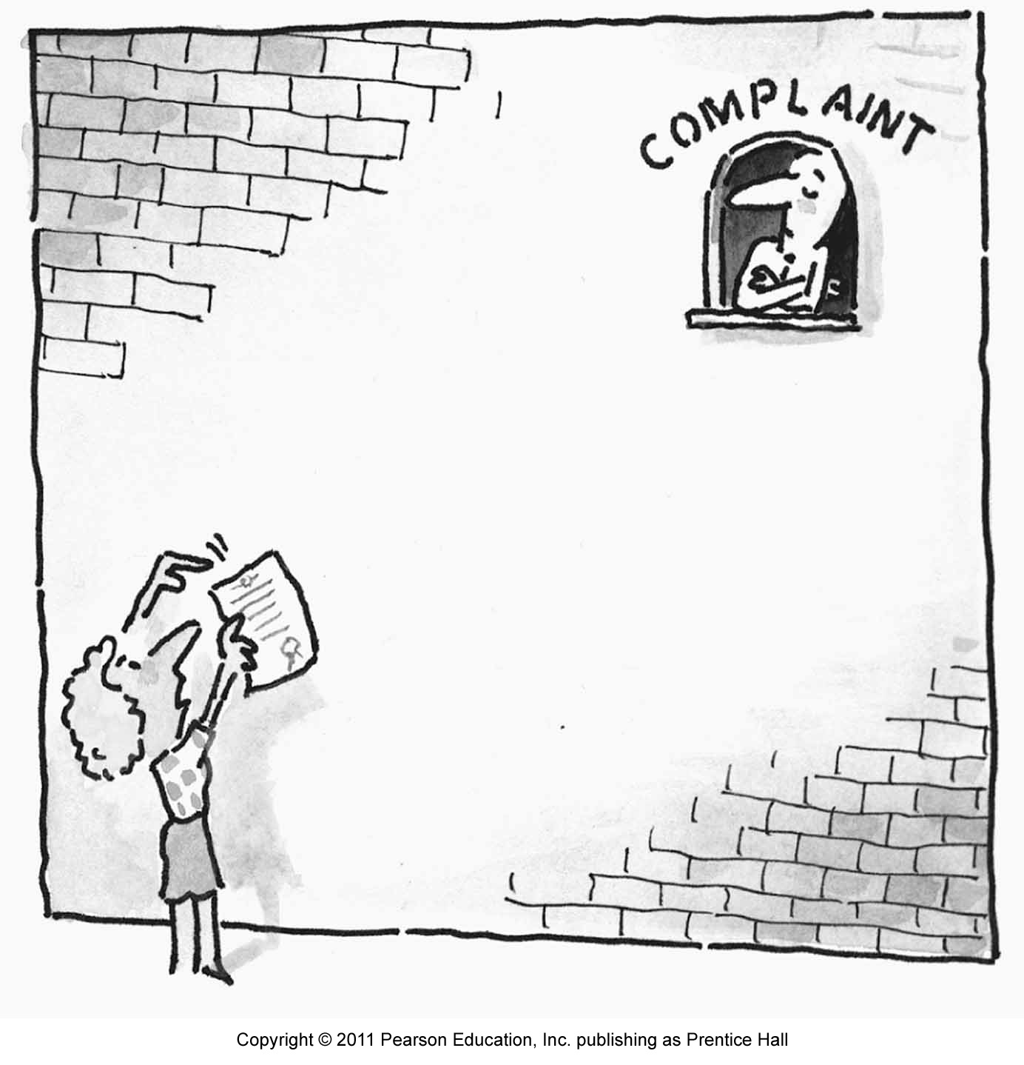
Service Guarantees Help Promote and Achieve Service Loyalty
Force firms to focus on what customers want
Set clear standards
Highlight cost of service failures
Help firm identify and overcome fail points
Reduce the risk of purchase decision and build long-term loyalty

Slide 16
How to Design Service Guarantees
Unconditional
Easy to understand and communicate
Meaningful to the customer
Easy to invoke
Easy to collect on
Credible

Slide 17
Types of Service Guarantees
Single attribute-specific guarantee
Explicit minimum performance standard on one important attribute is guaranteed (e.g., delivery by noon the next day)
Multi-attribute-specific guarantee
Explicit minimum performance standard on a few important attributes is guaranteed
Full-satisfaction guarantee
All service aspects are guaranteed to be delivered to the full satisfaction of the customer with no exceptions or conditions attached
Combined guarantee
All service aspects are guaranteed (as for full-satisfaction guarantee)
Explicit minimum performance standards on important attributes are guaranteed (as for multi-attribute-specific guarantee)

Slide 18
Is it Always Suitable to Introduce a Guarantee?
It may not be appropriate to introduce guarantees when
Companies have a strong reputation for service excellence
Company does not have good quality level
Quality cannot be controlled because of external forces
Consumers see little financial, personal, or physiological risk associated with the purchase

Slide 19
Discouraging Abusive and Opportunistic Customer Behavior

Slide 20
Addressing the Challenge of Jaycustomers
Jaycustomer: A customer who behaves in a thoughtless or abusive fashion, causing problems for the firm, its employees, and other customers
More potential for mischief in service businesses, especially when many customers are present
No organization wants an ongoing relationship with an abusive customer

Slide 21
Seven Types of Jaycustomers
The Cheat:
Thinks of various ways to cheat the firm
The Thief
No intention of paying — sets out to steal or pay less
Services lend themselves to clever schemes to avoid payment
e.g., bypassing electricity meters, circumventing TV cables, riding free on public transportation
Firms must take preventive actions against thieves, but make allowances for honest but absent-minded customers

Slide 22
Seven Types of Jaycustomers
The Rulebreaker
Rules guide customers safely through the service encounter
Government agencies may impose rules for health and safety reasons
Some rules protect other customers from dangerous behavior
e.g., ski patrollers issue warnings to reckless skiers by attaching orange stickers on their lift tickets
Ensure company rules are necessary, should not be too much or inflexible

Slide 23
Seven Types of Jaycustomers
The Belligerent
Shouts loudly, maybe mouthing insults, threats, and curses
Service personnel are often abused even when they are not to be blamed
Confrontations between customers and service employees can easily escalate
Firms should ensure employees have skills to deal with difficult situations

Slide 24
Seven Types Of Jaycustomers
Family Feuders
People who get into arguments with other customers – often members of their own family
The Vandal
Service vandalism includes pouring soft drinks into bank cash machines, slashing bus seats, breaking hotel furniture
Sources: bored and drunk young people, and unhappy customers who feel mistreated by service providers take revenge
Prevention is the best cure

Slide 25
Seven Types Of Jaycustomers
The Deadbeat
Customers who fail to pay (as distinct from “thieves” who never intended to pay in the first place)
Preventive action is better than cure — e.g., insisting on prepayment; asking for credit card number when order is taken
Customers may have good reasons for not paying
If the client's problems are only temporary ones, consider long- term value of maintaining the relationship

Slide 26
Consequences of Dysfunctional Customer Behavior
Employees:
Mood or temper negatively affected
Long-term psychological damage
Staff morale will fall, affecting productivity
Other Customers:
Positive – rally to support an employee who is perceived to be abused
Negative – Contagious bad behavior might escalate the situation

Slide 27
Dealing with Customer Fraud
Treating all customers with suspicion is likely to alienate them
TARP found only 1-2% of customer base engages in premeditated fraud— so why treat remaining 98% of honest customers as potential crooks?
But, records need to be kept to investigate repeat claimers
Insights from research on guarantee cheating:
Amount of a guarantee payout had no effect on customer cheating
Repeat-purchase intention reduced cheating intent
Customers are reluctant to cheat if service quality is high

Slide 28
Summary
When customers are dissatisfied, they can
Take some form of public action, private action, or no action
Firms then need to understand customer complaining behaviors and motivations to handle the complaint along the three dimensions of fairness
Effective service recovery can lead to customer loyalty via the service recovery paradox
It does not always hold true—better to get it right the first time

Slide 29
Summary
Guiding principles for effective service recovery include
Make it easy for customers to give feedback
Enable effective service recovery
Focusing on how generous compensation should be
Dealing with complaining customer
Service guarantees are power tools in delivering satisfaction but discretion should be used
To discourage abuse and opportunistic behavior, we need to deal with customer fraud

