Slide 1
Services Marketing 7e, Global Edition
Chapter 11:
Managing People for
Service Advantage

Slide 2
Overview of Chapter 11
Service Employees Are Crucially Important
Factors Contributing to the Difficulty of Frontline Work
Cycles of Failure, Mediocrity, and Success
Human Resources Management – How To Get It Right?
Service Leadership and Culture

Slide 3
Service Employees Are Crucially Important

Slide 4
Service Personnel(staff): Source of Customer Loyalty & Competitive Advantage
Customer’s perspective: encounter with service staff is most important aspect of a service
Firm’s perspective: frontline is an important source of differentiation and competitive advantage
Frontline is an important driver of customer loyalty
Anticipating(do in advance) customer needs
Customizing(modifying) service delivery
building personalized relationships

Slide 5
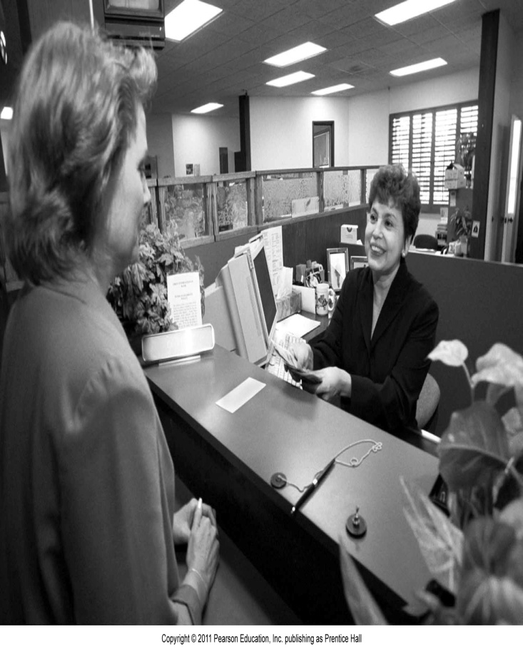
Frontline in Low-Contact Services
Many routine transactions are now conducted without involving frontline staff, e.g.,
ATMs (Automated Teller Machines)
IVR (Interactive Voice Response) systems
Websites for reservations/ordering, payment, etc.
However, frontline employees remain crucially important

Slide 6
Factors Contributing to the Difficulty of Frontline Work

Slide 7
Role Stress in Frontline Employees
Organization vs. Client : whether to follow company rules or to satisfy customer demands
This conflict is especially serious in organizations that are not customer- oriented
Person vs. Role: Conflicts between what jobs require and what employee’s own personality and beliefs
Client vs. Client: Conflicts between customers that demand service staff interference i.e (service staff needs to be there if there is any conflict between clients.

Slide 8
Cycles of Failure, Mediocrity, and Success

Slide 9
Cycle of Failure
The employee cycle of failure
Narrow job design for low skill levels. (complicated job for non skilled worker)
Emphasis(focus) on rules rather than service
Use of technology to control quality
Bored employees who lack ability to respond to customer problems
Customers are dissatisfied with poor service attitude
Low service quality
High employee turnover ( more than the employee skills)

Slide 10
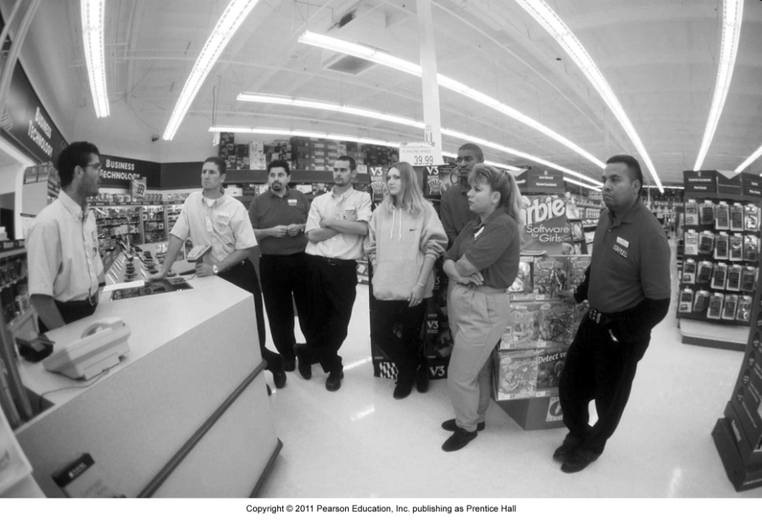
Cycle of Failure
The customer cycle of failure
Repeated emphasis(focusing) on attracting new customers
Customers dissatisfied with employee performance
Customers always served by new faces
Ongoing search for new customers to maintain sales volume

Slide 11
Cycle of Failure
Costs of short-sighted policies are ignored:
Constant expense of recruiting, hiring, and training
Lower productivity of inexperienced new workers
Higher costs of winning new customers to replace those lost—more need for advertising and promotional discounts
It’s a big loss of revenue from dissatisfied customers who turn to alternatives
It's a loss of potential customers who are turned off by negative word-of-mouth

Slide 12
Cycle of Success
Longer-term view of financial performance; firm seeks to prosper by investing in people
Attractive pay and benefits attract better job applicants
More focused recruitment, intensive training, and higher wages make it more likely that employees are:
Happier in their work
Provide higher quality, customer-pleasing service

Slide 13
Cycle of Success
Broadened job descriptions with empowerment practices enable frontline staff to control quality, facilitate service recovery
Regular customers more likely to remain loyal because they:
Appreciate continuity in service relationships
Have higher satisfaction due to higher quality

Slide 14
Human Resources Management –
How to Get it Right?

Slide 15
Hire the Right People
The old saying ‘People are your most important asset’ is wrong.
The RIGHT people are your most important asset.
Jim Collins

Slide 16
Be the Preferred Employer
Create a large pool: “Compete for Talent Market Share”
Select the right people:
Different jobs are best filled by people with different skills, styles, or personalities
Hire candidates that fit firm’s core values and culture
Focus on recruiting naturally warm personalities for customer-contact jobs

Slide 17
Tools to Identify Best Candidates
Employ multiple, structured interviews
Use structured interviews built around job requirements
Use more than one interviewer to reduce “similar to me” biases
Observe behavior
Hire based on observed behavior, not words you hear
Best predictor of future behavior is past behavior
Consider group hiring sessions where candidates are given group tasks

Slide 18
Tools to Identify Best Candidates
Conduct personality tests
Willingness to treat co-workers and customers with courtesy, consideration, and tact
Perceptiveness) feeling of understanding( regarding customer needs
Ability to communicate accurately and pleasantly
Give applicants a realistic preview of the job
Chance for candidates to “try on the job”
Assess how candidates respond to job realities
Allow candidates to self select themselves out of the job

Slide 19
Train Service Employees
Service employees need to learn:
Organizational culture, purpose, and strategy
Promote core values, get emotional commitment to strategy
Get managers to teach “why,” “what,” and “how” of job
Interpersonal and technical skills
Product/service knowledge
Staff’s product knowledge is a key aspect of service quality
Staff must explain product features and position products correctly

Slide 20
Motivate and Energize the Frontline
Use full range of available rewards effectively, including:
Job content
People are motivated knowing they are doing a good job
Feedback and recognition
People derive a sense of identity and belonging to an organization from feedback and recognition
Goal accomplishment
Specific, difficult but attainable, and accepted goals are strong motivators

Slide 21
Service Leadership
and Culture

Slide 22
Service Leadership and Culture
Charismatic/transformational leadership:
Change frontline personnel’s values and goals to be consistent with the firm
Motivate staff to perform at their best
Service culture can be defined as:
Shared perceptions of what is important , shared values , beliefs of why they are important.
A strong service culture focuses the entire organization on the frontline, with the top management informed and actively involved

Slide 23
Internal Marketing
Necessary in large service businesses that operate in widely dispersed sites
Effective internal marketing helps to:
Ensure efficient and satisfactory service delivery
Achieve harmonious and productive working relationships
Build employee trust, respect, and loyalty

Slide 24
Summary
Service employees are crucially important to firm’s success
Source of customer loyalty and competitive advantage
Frontline work is difficult and stressful; employees are boundary spanners, undergo emotional labor, face a variety of conflicts
Understand cycles of failure, mediocrity, and success

Slide 25
Summary
Know how to get HRM aspect right
Hire the right people
Identify the best candidate
Train service employees actively
Empower the frontline
Build high-performance service delivery teams
Motivate and energize people
Unions have a role to play
Understand role of service culture and service leadership in sustaining service excellence

