Slide 1
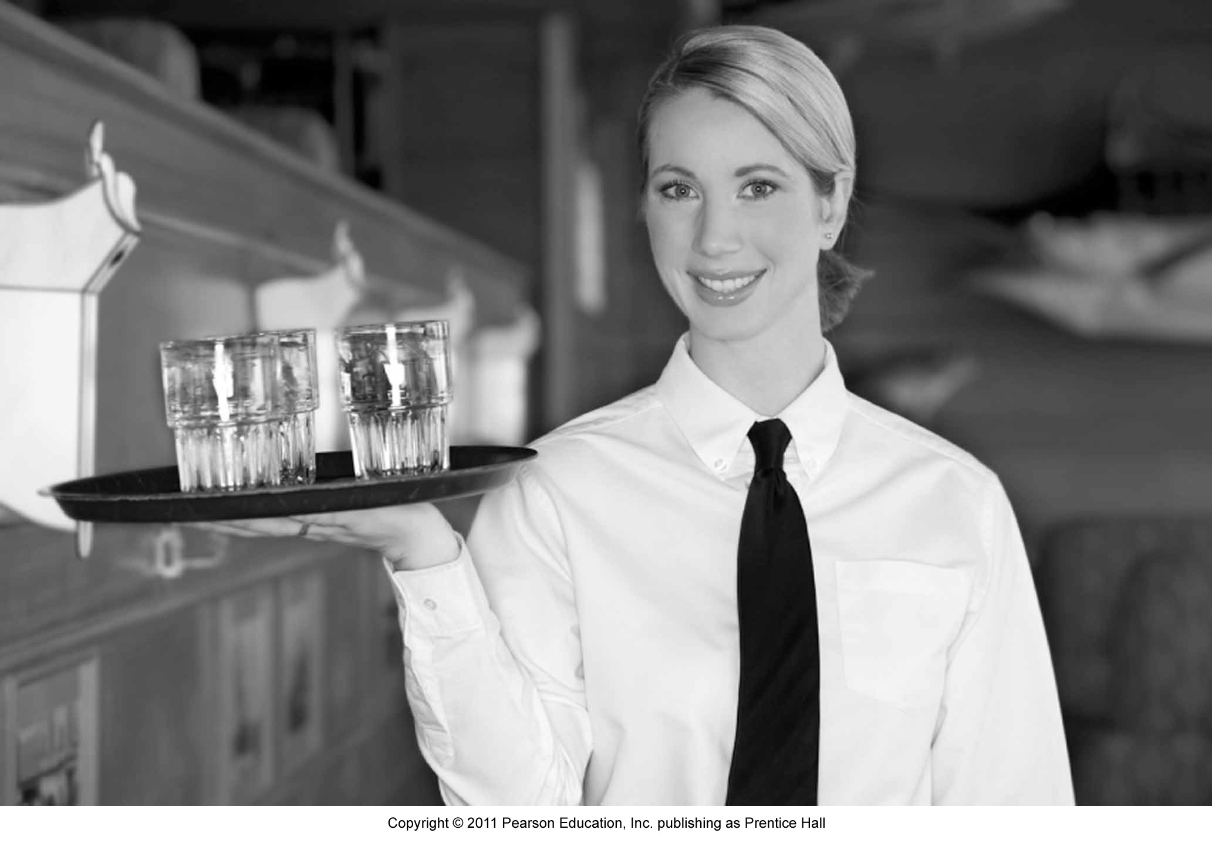
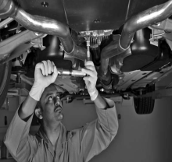
Chapter 11:
Managing People for
Service Advantage

Slide 2
Overview of Chapter 11
Service Employees Are Crucially Important
Factors Contributing to the Difficulty of Frontline Work
Cycles of Failure, Mediocrity, and Success
Human Resources Management – How To Get It Right?
Service Leadership and Culture

Slide 3
Service Employees Are Crucially Important

Slide 4
Service Personnel: Source of Customer Loyalty & Competitive Advantage
Customer’s perspective: encounter with service staff is most important aspect of a service
Firm’s perspective: frontline is an important source of differentiation and competitive advantage
Frontline is an important driver of customer loyalty
anticipating customer needs
customizing service delivery
building personalized relationships

Slide 5
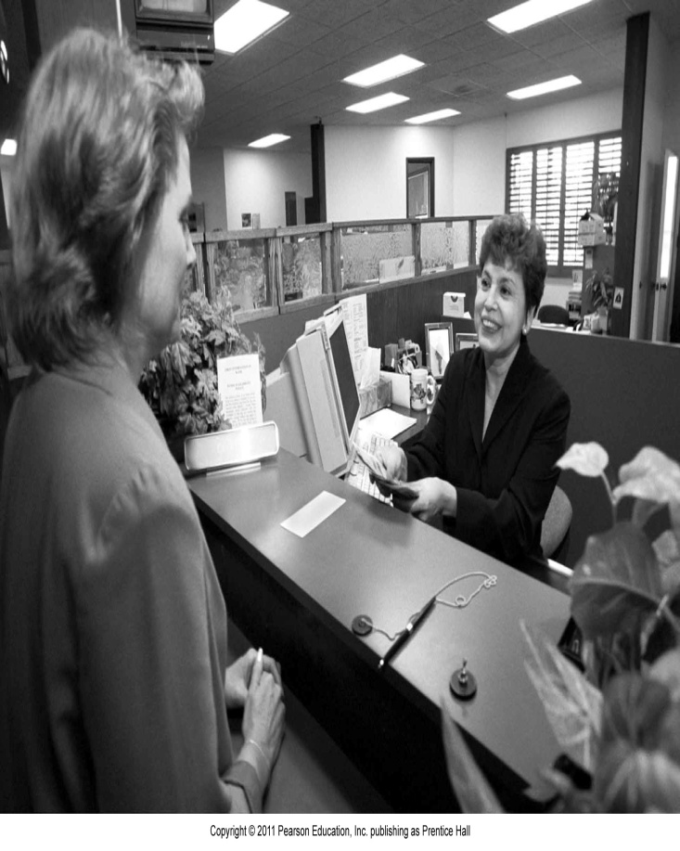
Frontline in Low-Contact Services
Many routine transactions are now conducted without involving frontline staff, e.g.,
ATMs (Automated Teller Machines)
IVR (Interactive Voice Response) systems
Websites for reservations/ordering, payment, etc.
However, frontline employees remain crucially important
“Moments of truths” drive customer’s perception of the service firm

Slide 6
Factors Contributing to the Difficulty of Frontline Work

Slide 7
Boundary Spanning Roles
Boundary spanners link the organization to outside world
Multiplicity of roles often results in service staff having to pursue both operational and marketing goals
Consider management expectations of service staff:
delight customers
be fast and efficient in executing operational tasks
do selling, cross selling, and up-selling
enforce pricing schedules and rate integrity

Slide 8
Role Stress in Frontline Employees
Organization vs. Client: Dilemma whether to follow company rules or to satisfy customer demands
This conflict is especially acute in organizations that are not customer- oriented
Person vs. Role: Conflicts between what jobs require and employee’s own personality and beliefs
Organizations must instill ‘professionalism’ in frontline staff
Client vs. Client: Conflicts between customers that demand service staff intervention

Slide 9
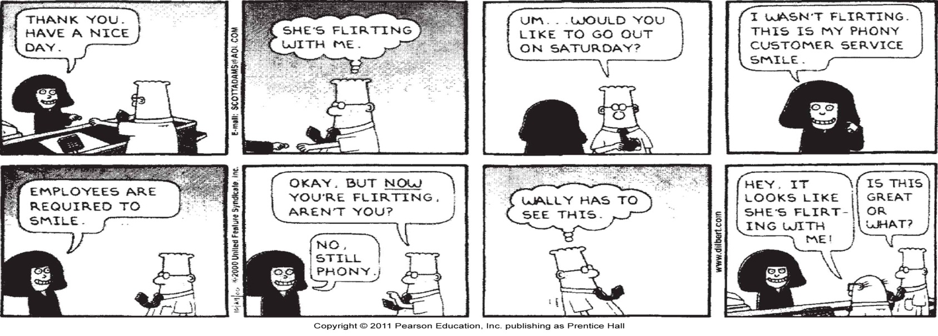
Emotional Labor
“The act of expressing socially desired emotions during service transactions” (Hochschild, The Managed Heart)
Performing emotional labor in response to society’s or management’s display rules can be stressful
Good HR practice emphasizes selective recruitment, training, counseling, strategies to alleviate stress

Slide 10
Cycles of Failure, Mediocrity, and Success

Slide 11
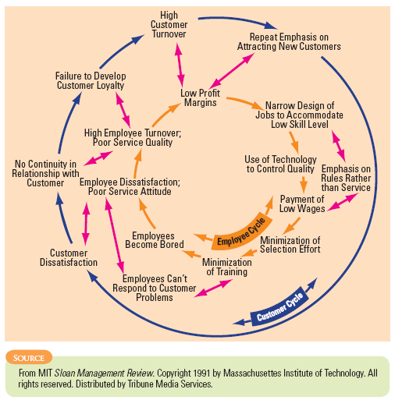
Cycle of Failure

Slide 12
Cycle of Failure
The employee cycle of failure
Narrow job design for low skill levels
Emphasis on rules rather than service
Use of technology to control quality
Bored employees who lack ability to respond to customer problems
Customers are dissatisfied with poor service attitude
Low service quality
High employee turnover

Slide 13
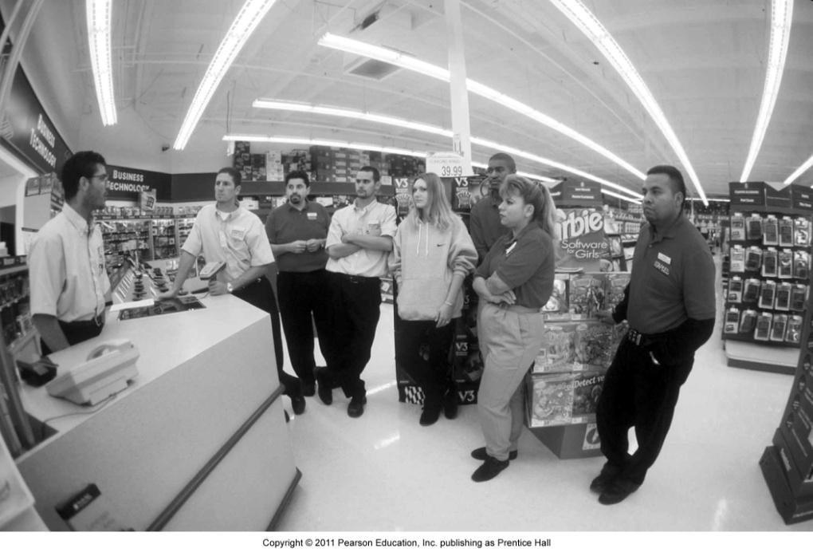
Cycle of Failure
The customer cycle of failure
Repeated emphasis on attracting new customers
Customers dissatisfied with employee performance
Customers always served by new faces
Fast customer turnover
Ongoing search for new customers to maintain sales volume

Slide 14
Cycle of Failure
Costs of short-sighted policies are ignored:
Constant expense of recruiting, hiring, and training
Lower productivity of inexperienced new workers
Higher costs of winning new customers to replace those lost—more need for advertising and promotional discounts
Loss of revenue stream from dissatisfied customers who turn to alternatives
Loss of potential customers who are turned off by negative word-of-mouth

Slide 15
Service Sabotage
“Openness” of Service Sabotage Behaviors
Covert
Overt
Routine
Customer-Private Service Sabotage
Customer-Public Service Sabotage
e.g., Waiters serving smaller servings, bad beer, or sour wine
e.g., Talking to guests like
young kids and putting them down
“Normality” of Service Sabotage Behaviors
Sporadic-Private Service Sabotage
Sporadic-Public Service Sabotage
e.g., Chef occasionally
purposefully slowing down orders
e.g., Waiters spilling soup onto
laps, gravy onto sleeves, or hot plates into someone’s hands
Intermittent

Slide 16
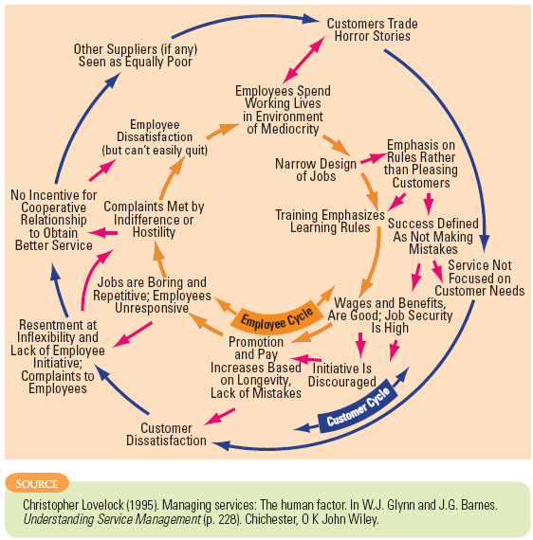
Cycle Of Mediocrity

Slide 17
Cycle Of Mediocrity
Most commonly found in large, bureaucratic organizations that are frustrating to deal with
Service delivery is oriented towards
Standardized service
Operational efficiencies
Promotions with long service
Rule-based training
Narrow and repetitive jobs
Successful performance measured by absence of mistakes
Little incentive for customers to cooperate with organizations to achieve better service
Complaints are often made to already unhappy employees
Customers often stay because of lack of choice

Slide 18
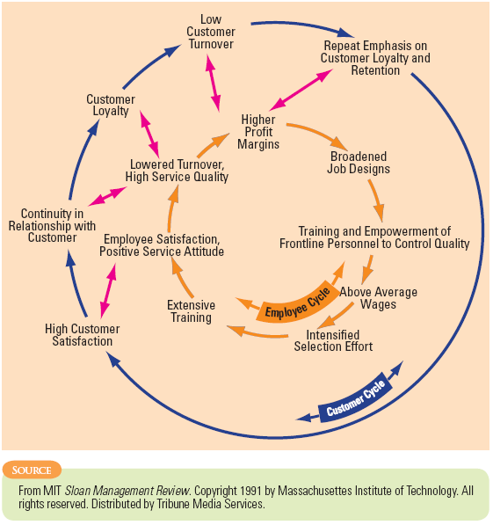
Cycle of Success

Slide 19
Cycle of Success
Longer-term view of financial performance; firm seeks to prosper by investing in people
Attractive pay and benefits attract better job applicants
More focused recruitment, intensive training, and higher wages make it more likely that employees are:
Happier in their work
Provide higher quality, customer-pleasing service

Slide 20
Cycle of Success
Broadened job descriptions with empowerment practices enable frontline staff to control quality, facilitate service recovery
Regular customers more likely to remain loyal because they:
Appreciate continuity in service relationships
Have higher satisfaction due to higher quality

Slide 21
Human Resources Management –
How to Get it Right?

Slide 22
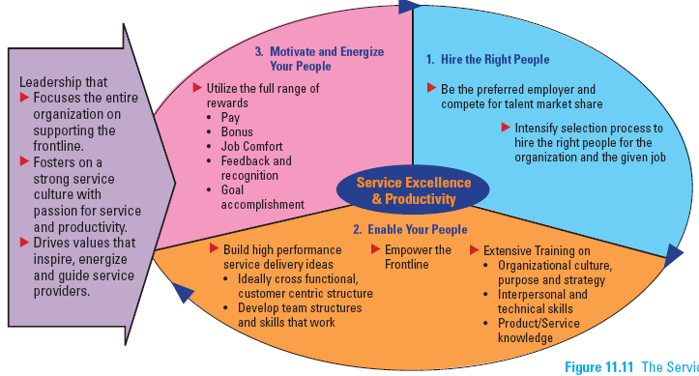
The Service Talent Cycle

Slide 23
Hire the Right People
The old saying ‘People are your most important asset’ is wrong.
The RIGHT people are your most important asset.
Jim Collins

Slide 24
Be the Preferred Employer
Create a large pool: “Compete for Talent Market Share”
Select the right people:
Different jobs are best filled by people with different skills, styles, or personalities
Hire candidates that fit firm’s core values and culture
Focus on recruiting naturally warm personalities for customer-contact jobs

Slide 25
Tools to Identify Best Candidates
Employ multiple, structured interviews
Use structured interviews built around job requirements
Use more than one interviewer to reduce “similar to me” biases
Observe behavior
Hire based on observed behavior, not words you hear
Best predictor of future behavior is past behavior
Consider group hiring sessions where candidates are given group tasks

Slide 26
Tools to Identify Best Candidates
Conduct personality tests
Willingness to treat co-workers and customers with courtesy, consideration, and tact
Perceptiveness regarding customer needs
Ability to communicate accurately and pleasantly
Give applicants a realistic preview of the job
Chance for candidates to “try on the job”
Assess how candidates respond to job realities
Allow candidates to self select themselves out of the job
Manage new employees’ expectation of job

Slide 27
Train Service Employees
Service employees need to learn:
Organizational culture, purpose, and strategy
Promote core values, get emotional commitment to strategy
Get managers to teach “why,” “what,” and “how” of job
Interpersonal and technical skills
Product/service knowledge
Staff’s product knowledge is a key aspect of service quality
Staff must explain product features and position products correctly

Slide 28
Is Empowerment Always Appropriate?
Empowerment is most appropriate when:
Firm’s business strategy is based on personalized, customized service, and competitive differentiation
Emphasis on extended relationships rather than short-term transactions
Use of complex and non-routine technologies
Service failures are non-routine
Business environment is unpredictable
Managers are comfortable letting employees work independently for benefit of firm and customers
Employees seek to deepen skills and have good interpersonal and group process skills

Slide 29
Control vs. Involvement
Empowerment systematically redistributes the following:
Information about operating results and measures of competitive performance
Knowledge/skills that enable employees to understand and contribute to organizational performance
Power to influence work procedures and organizational direction (e.g., quality circles, self-managing teams)
Rewards based on organizational performance (e.g., bonuses, profit sharing, stock ownership)
The Control model concentrates these elements at the top of the organization whereas the Involvement model pushes these features throughout the organization

Slide 30
Levels of Employee Involvement
Suggestion involvement
Employee makes recommendation through formalized program
Job involvement
Employees retrained, supervisors reoriented to facilitate performance
High involvement
Information is shared for participation in management decisions
Employees skilled in teamwork, problem solving, etc.
Profit sharing and stock ownership

Slide 31
Build High-Performance Service Delivery Teams
The Power of Teamwork in Services
Facilitate communication among team members and knowledge sharing
Higher performance targets
Pressure to perform is high
Creating Successful Service Delivery Teams
Emphasis on cooperation, listening, coaching, and encouraging one another
Understand how to air differences, tell hard truths, ask tough questions
Management needs to set up a structure to steer teams toward success

Slide 32
Motivate and Energize the Frontline
Use full range of available rewards effectively, including:
Job content
People are motivated knowing they are doing a good job
Feedback and recognition
People derive a sense of identity and belonging to an organization from feedback and recognition
Goal accomplishment
Specific, difficult but attainable, and accepted goals are strong motivators

Slide 33
Role of Labor Unions
Challenge is to work jointly with unions, reduce conflicts, and create a service climate
Labor unions and service excellence are sometimes seen as incompatible, yet many of the world’s most successful service businesses are highly unionized (e.g., Southwest Airlines)
Management consultation and negotiation with union representatives are essential if employees are to accept new ideas

Slide 34
Service Leadership
and Culture

Slide 35
Service Leadership and Culture
Charismatic/transformational leadership:
Change frontline personnel’s values and goals to be consistent with the firm
Motivate staff to perform at their best
Service culture can be defined as:
Shared perceptions of what is important
Shared values and beliefs of why they are important
A strong service culture focuses the entire organization on the frontline, with the top management informed and actively involved

Slide 36
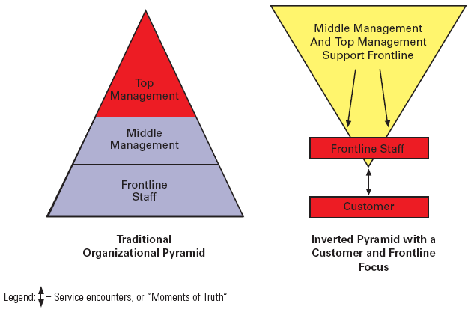
The Inverted Organizational Pyramid

Slide 37
Internal Marketing
Necessary in large service businesses that operate in widely dispersed sites
Effective internal marketing helps to:
Ensure efficient and satisfactory service delivery
Achieve harmonious and productive working relationships
Build employee trust, respect, and loyalty

Slide 38
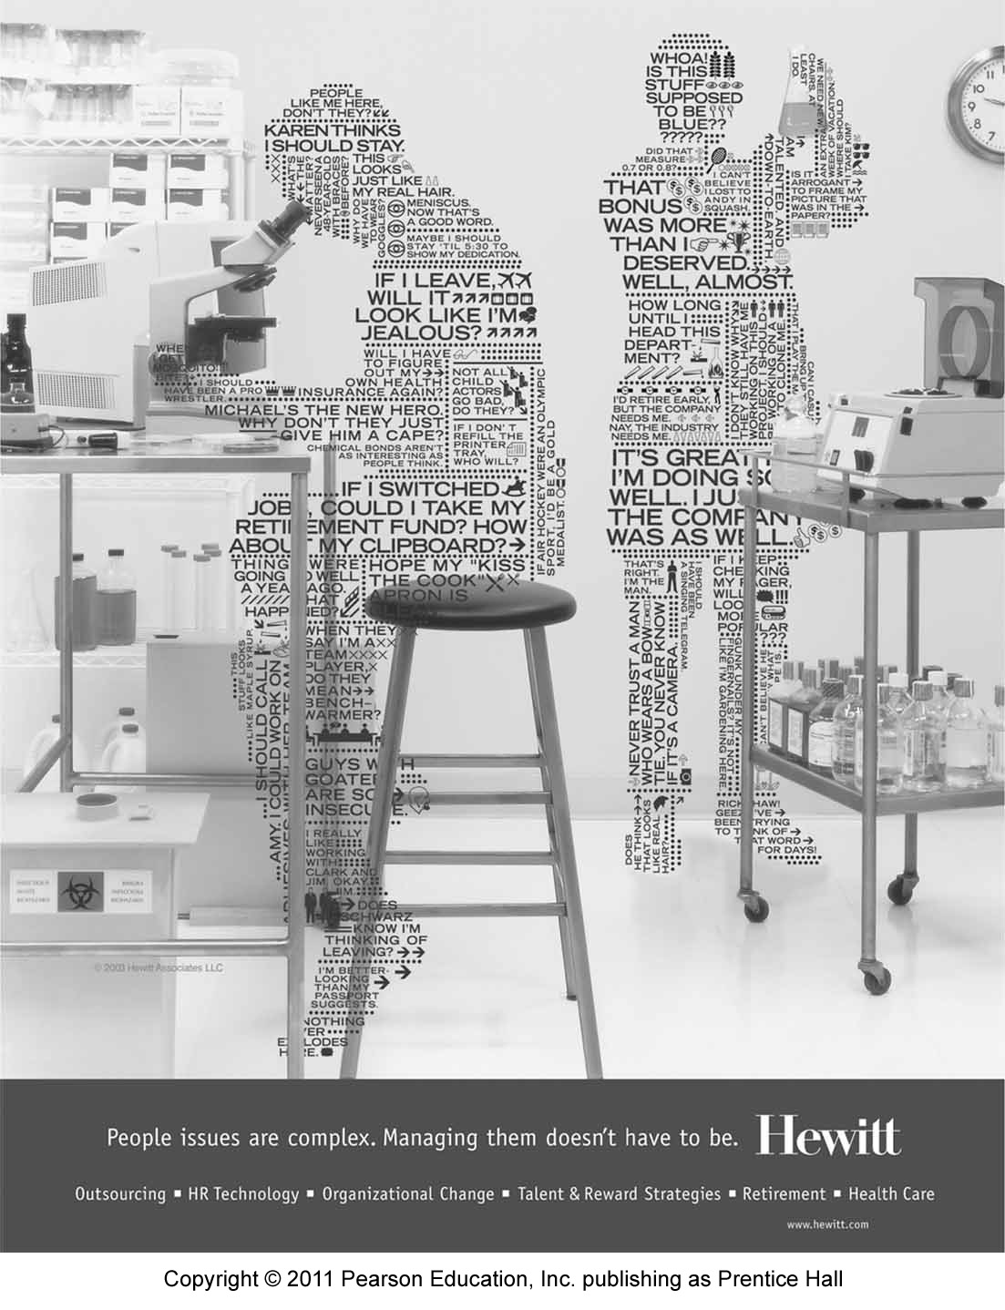
Summary
Service employees are crucially important to firm’s success
Source of customer loyalty and competitive advantage
Frontline work is difficult and stressful; employees are boundary spanners, undergo emotional labor, face a variety of conflicts
Understand cycles of failure, mediocrity, and success

Slide 39
Summary
Know how to get HRM aspect right
Hire the right people
Identify the best candidate
Train service employees actively
Empower the frontline
Build high-performance service delivery teams
Motivate and energize people
Unions have a role to play
Understand role of service culture and service leadership in sustaining service excellence

