Slide 1
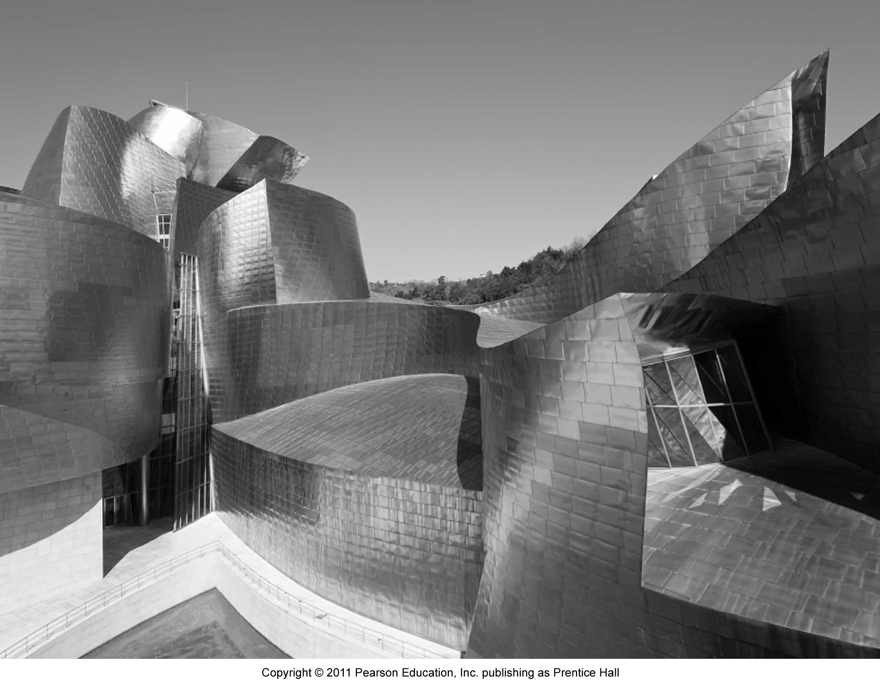



Chapter 10:
Crafting the Service
Environment

Slide 2
Overview of Chapter 10
What is the Purpose of Service Environments?
Understanding Consumer Responses to Service Environments
Dimensions of the Service Environment
Putting It All Together

Slide 3
What is the Purpose of
Service Environments?

Slide 4
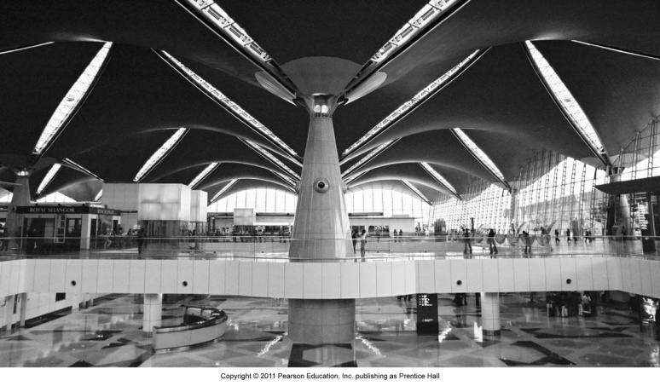
Purpose of Service Environments
Shape customers’ experience and their behaviors
Support image, positioning, and differentiation
Part of the value proposition
Facilitate service encounter and enhance productivity

Slide 5
Shape customers’ experience and their behaviors
Message-creating medium
  symbolic cues to communicate the distinctive nature and quality of the service experience
Attention-creating medium
  make servicescape stand out from competition and attract customers from target segments
Effect-creating medium
  use colors, textures, sounds, scents, and spatial design to enhance desired service experience

Slide 6
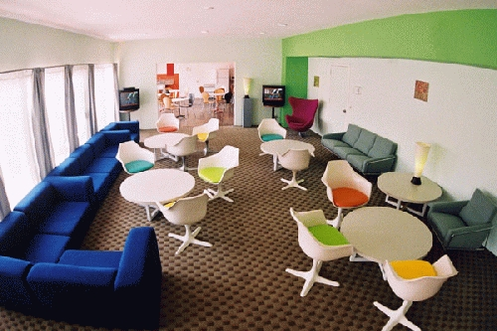
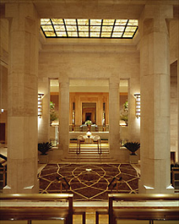
Support Image, Position, and Differentiation
Orbit Hotel and Hostel, Los Angeles
Four Seasons Hotel, New York

Slide 7
Servicescape as Part of Value Proposition
Physical surroundings help shape appropriate feelings and reactions in customers and employees
  e.g., Disneyland, Denmark’s Legoland
Servicescapes form a core part of the value proposition
  Las Vegas: repositioned itself to a somewhat more wholesome fun resort, visually striking entertainment center
  Florida-based Muvico: builds extravagant movie theatres and offers plush amenities. “What sets you apart is how you package it.” (Muvico’s CEO, Hamid Hashemi)
The power of servicescapes is being discovered

Slide 8
Understanding Consumer Reponses to
Service Environments

Slide 9
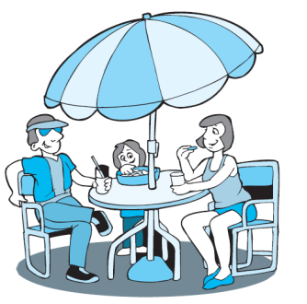
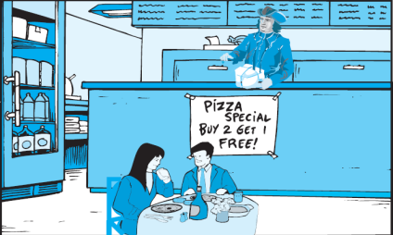

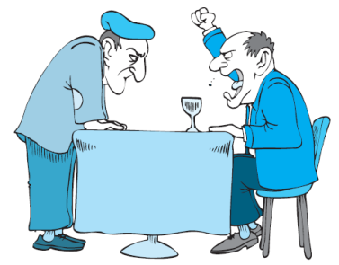
The Mehrabian-Russell
Stimulus-Response Model
Feelings Are a Key Driver of Customer Responses to Service Environments
Dimensions of Affect:
Pleasure and Arousal
Response/Behaviors:
Approach Avoidance & Cognitive Processes
Environmental Stimuli and Cognitive Processes

Slide 10
Insights from Mehrabian-Russell
Stimulus-Response Model
It is a simple yet fundamental model of how people respond to environments that illustrates:
The environment, its conscious and unconscious perceptions, and interpretation influence how people feel in that environment
Feelings, rather than perceptions/thoughts drive behavior
Typical outcome variable is ‘approach’ or ‘avoidance’ of an environment, but other possible outcomes can be added to model

Slide 11
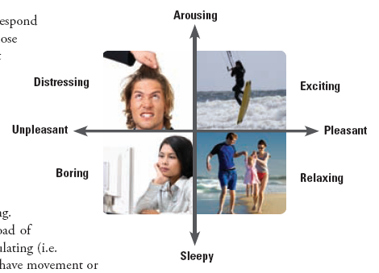
The Russell Model of Affect

Slide 12
Insights from Russell’s Model of Affect
Emotional responses to environments can be described along two main dimensions:
  Pleasure: subjective, depending on how much individual likes or dislikes environment
  Arousal: how stimulated individual feels, depends largely on information rate or load of an environment
Separates cognitive emotions from emotional dimensions
Advantage: simple, direct approach to customers’ feelings
  Firms can set targets for affective states

Slide 13
Drivers of Affect
Caused by perceptions and cognitive processes of any degree of complexity
Determines how people feel in a service setting
If higher levels of cognitive processes are triggered, the interpretation of this process determines people’s feelings
The more complex a cognitive process becomes, the more powerful its potential impact on affect

Slide 14
Behavioral Consequence of Affect
Pleasant environments result in approach, whereas unpleasant ones result in avoidance
Arousal amplifies the basic effect of pleasure on behavior
  If environment is pleasant, increasing arousal can generate excitement, leading to a stronger positive consumer response
  If environment is unpleasant, increasing arousal level will move customers into the “distressed” region
Feelings during service encounters are an important driver of customer loyalty

Slide 15
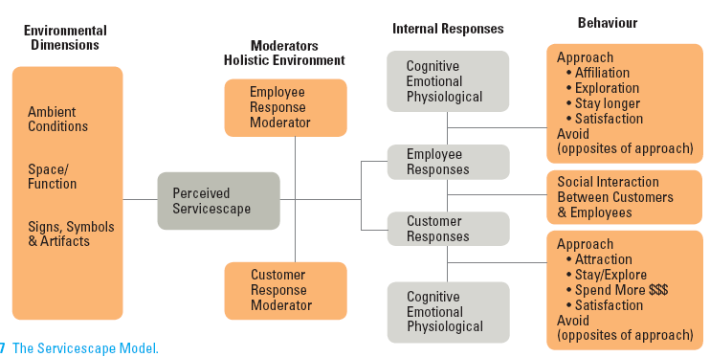

An Integrative Framework:
The Servicescape Model

Slide 16
An Integrative Framework:
The Servicescape Model
Identifies the main dimensions in a service environment and views them holistically
Internal customer and employee responses can be categorized into cognitive, emotional, and psychological responses, which lead to overt behavioral responses towards the environment
Key to effective design is how well each individual dimension fits together with everything else

Slide 17
Dimensions of the
Service Environment

Slide 18
Main Dimensions in
Servicescape Model
Ambient Conditions
  Characteristics of environment pertaining to our five senses
Spatial Layout and Functionality
  Spatial layout:
    - floorplan
    - size and shape of furnishings
  Functionality: ability of those items to facilitate performance
Signs, Symbols, and Artifacts
  Explicit or implicit signals to:
    - help consumers find their way

Slide 19
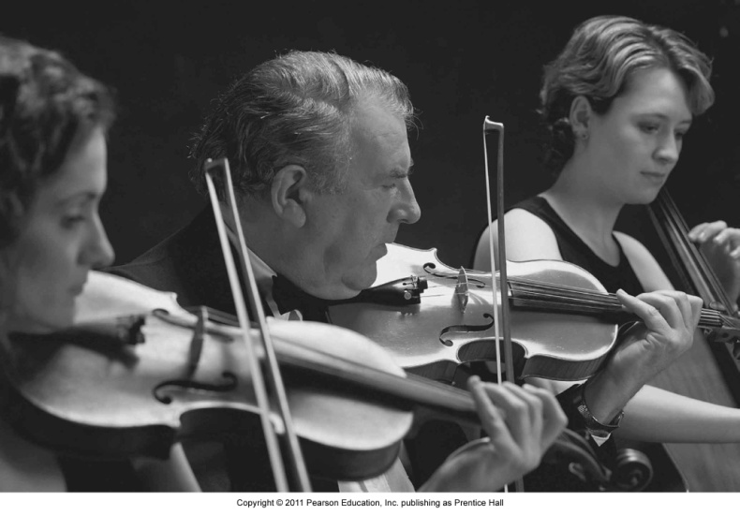
Ambient Conditions
Ambient conditions are perceived both separately and holistically, and include:
  Lighting and color schemes
  Size and shape perceptions
  Sounds such as noise and music
  Temperature
  Scents
Clever design of these conditions can elicit desired behavioral responses among consumers

Slide 20
Music
In service settings, music can have powerful effect on perceptions and behaviors, even if played at barely audible levels
Structural characteristics of music―such as tempo, volume, and harmony―are perceived holistically
  Fast tempo music and high volume music increase arousal levels
  People tend to adjust their pace, either voluntarily or involuntarily, to match tempo of music
Careful selection of music can deter wrong type of customers

Slide 21
Scent
An ambient smell is one that pervades an environment
  May or may not be consciously perceived by customers
  Not related to any particular product
Scents have distinct characteristics and can be used to solicit emotional, physiological, and behavioral responses
In service settings, research has shown that scents can have significant effect on customer perceptions, attitudes, and behaviors

Slide 22
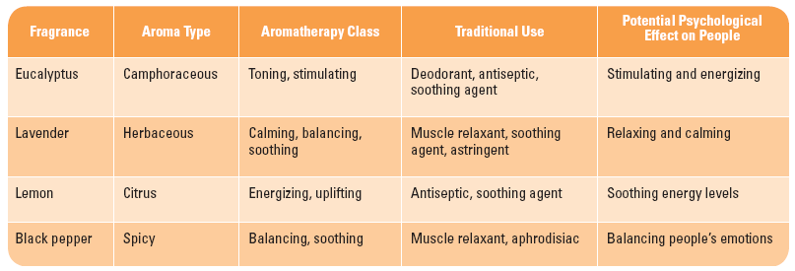
Aromatherapy: Effects of Selected Fragrances on People

Slide 23
Color
Colors can be defined into three dimensions:
  Hue is the pigment of the color
  Value is the degree of lightness or darkness of the color
  Chroma refers to hue-intensity, saturation, or brilliance
People are generally drawn to warm color environments
  Warm colors encourage fast decision making and are good for low-involvement decisions or impulse buys
  Cool colors are preferred for high-involvement decisions

Slide 24
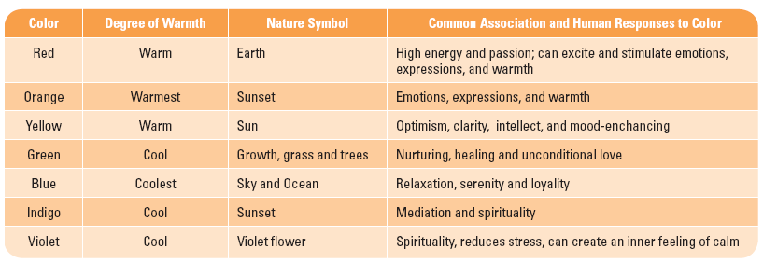
Common Associations and
Human Responses to Colors

Slide 25
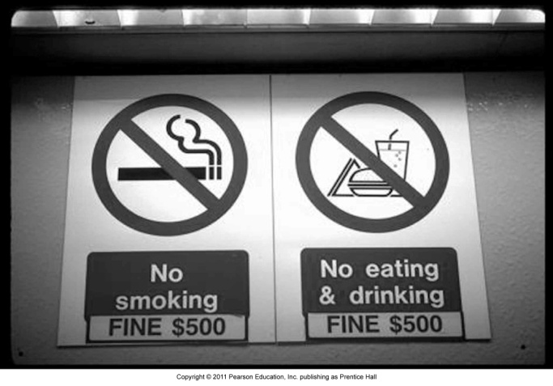
Signs, Symbols, and Artifacts
Communicates the firm’s image and helps customers find their way
  First time customers will automatically try to draw meaning from the signs, symbols, and artifacts
Challenge is to guide customer through the delivery process
  Unclear signals from a servicescape can result in anxiety and uncertainty about how to proceed and obtain the desired service

Slide 26
Putting It All Together

Slide 27
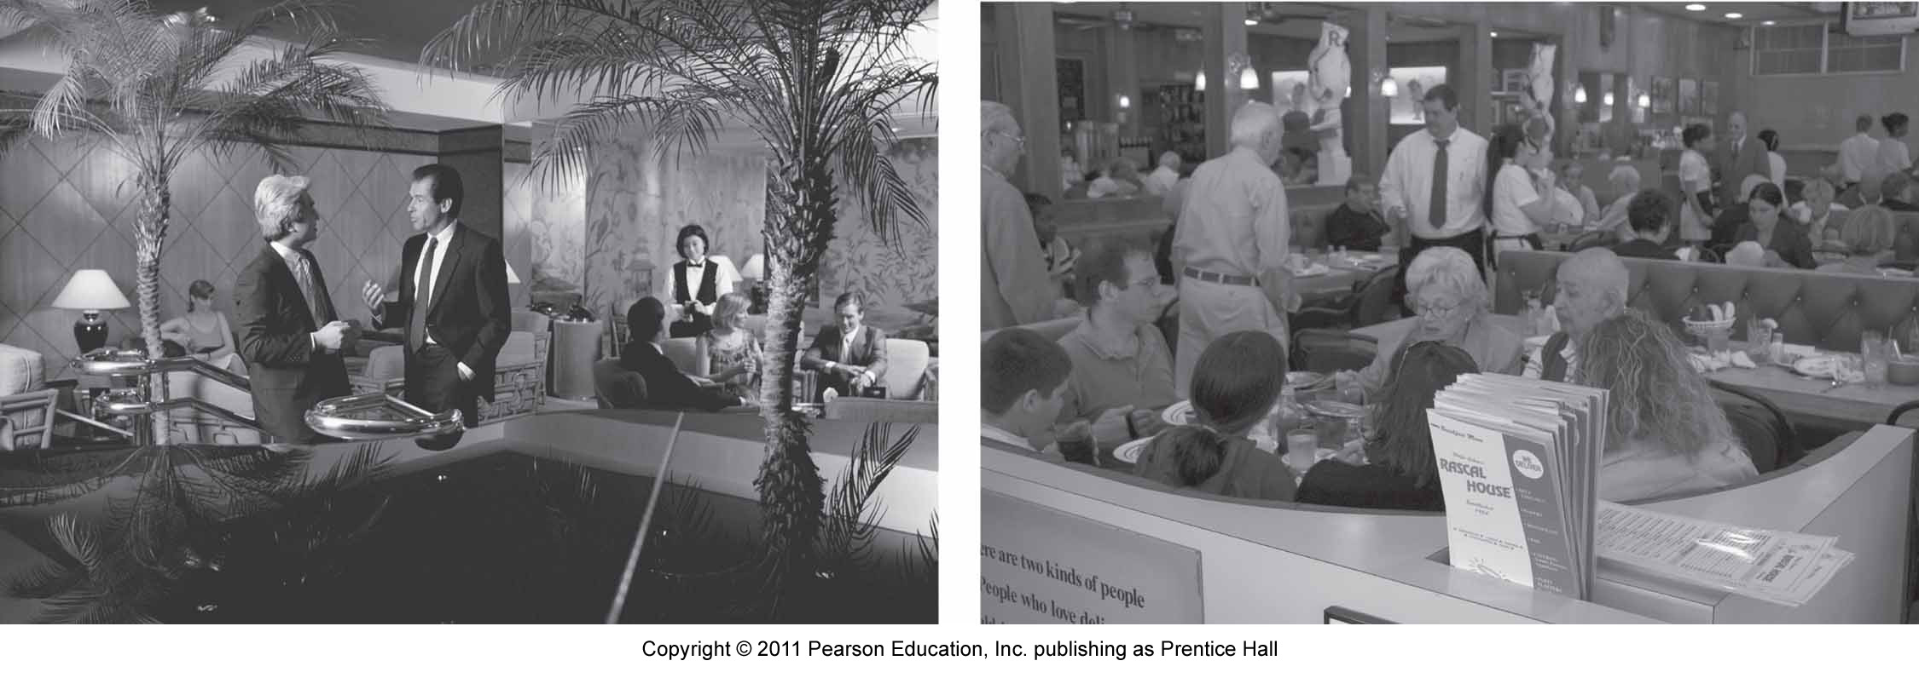
Selection of Environmental
Design Elements
Consumers perceive service environments holistically
  No dimension of design can be optimized in isolation, because everything depends on everything else
  Holistic characteristic of environments makes designing service environment an art

Slide 28
Tools to Guide Servicescape Design
Keen observation of customers’ behavior and responses
Feedback and ideas from frontline staff and customers
Photo audit – Mystery Shopper to take photographs of service experience
Field experiments can be used to manipulate specific dimensions in an environment and the effects observed
Blueprinting or service mapping – extended to include physical evidence in the environment

Slide 29
Summary
Service environment:
  Shapes customers’ experiences and behavior
  Facilitates service encounters and enhances productivity
Mehrabian-Russell stimulus-response model and Russell’s model of affect help us understand customer responses to service environments
Main dimensions of servicescape model:
  Ambient conditions – music, scent, color, etc.
  Spatial layout and functionality
  Signs, symbols, and artifacts

Slide 30
Summary
When putting it all together, firms should
  Design with a holistic view
  Design from a customer’s perspective
  Use tools to guide servicescape design

