Slide 1
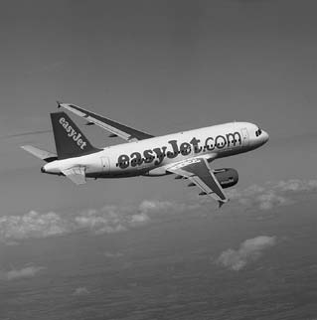
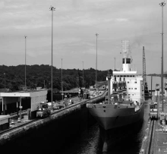
Services Marketing 7e, Global Edition
Chapter 7:
Promoting Services and Educating Customers

Slide 2
Overview of Chapter 7
Role of Marketing Communications
Challenges of Services Communications
Marketing Communications Planning
The Marketing Communications Mix
Role of Corporate Design
Integrating Marketing Communications

Slide 3
Define Promotion
Promotion: Activity that supports or encourages a cause, project, or aim.
Or
The publicizing of a product, organization, or project so as to increase sales or public awareness.

Slide 4
Role of Marketing Communications

Slide 5
Specific Roles of Marketing Communications
Position and differentiate service
Help customer evaluate offerings and highlight differences that matter
Promote contribution of personnel and backstage operations
Add value through communication content
Facilitate customer involvement in production
Stimulate (increase) or dampen (decrease) demand to match capacity (i.e. what is the need? How much is the need? Do we have the proper capacity for storing or full fill the demand

Slide 6
Help Customers to Evaluate Service Offerings
Customers may have difficulty distinguishing one firm from another
Provide tangible clues related to service performance
Some performance qualities lend themselves better to advertising than others
e.g., Airlines
Firm’s expertise is hidden in low-contact services(i.e internet banking, internet based services).
Need to show equipment, procedures, employee activities that take place backstage

Slide 7
Promote Contributions of Service Personnel(workers)
Frontline personnel are central to service delivery in high-contact services (i.e. 5 star hotel, good restaurant, Airlines)
Make the service more tangible and personalized
Show customers work performed behind the scenes to ensure good delivery
To enhance trust, highlight expertise and commitment of employees
Advertisements must be realistic
Messages help set customers’ expectations
Service personnel should be informed about the content of new advertising campaigns or brochures before launch

Slide 8
Facilitate Customer Involvement in Production
Customers are actively involved in service production; they need training to perform well
Show service delivery in action
Television and videos engage viewer
e.g., Dentists showing patients videos of surgical procedures before surgery
Streaming videos on web and podcasts are new channels to reach active customers

Slide 9
Marketing Communications Planning

Slide 10
Checklist: The “5 Ws” Model
Who is our target audience?
What do we need to communicate and achieve?
How should we communicate this?
Where should we communicate this?
When do communications need to take place?

Slide 11
Educational and Promotional Objectives in Service Settings
Create memorable images of specific companies and their brands
Build awareness and interest for unfamiliar service
Compare service favorably with competitors’ offerings
Build preference by communicating strengths and benefits
Reduce uncertainty or perceived risk by providing useful info and advice

Slide 12
Educational and Promotional Objectives(purposes) in Service Settings
Provide reassurance (e.g., promote service guarantees)
Encourage trial by offering promotional incentives
Familiarize customers with service processes before use
Teach customers how to use a service to best advantage
Recognize and reward valued customers and employees

Slide 13
The Marketing Communications Mix

Slide 14
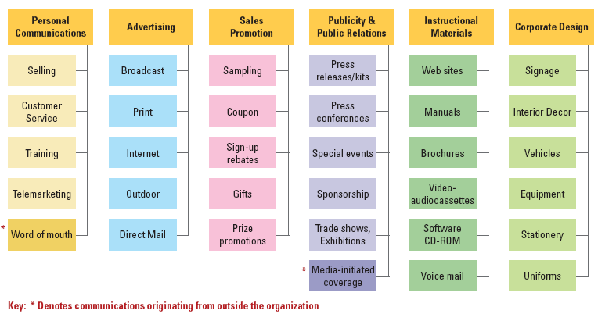
Marketing Communications Mix for Services
Notes:
signage

Slide 15
Traditional Marketing Channels
Channels (networks) | Aim (goal or purpose)
Advertising: The activity or profession of producing advertisements for commercial products or services | Build awareness, inform, convey message, and remind
Public relations: the professional maintenance of a favorable public image by a company or other organization. | Builds reputation and credibility to secure an image favorable to conduct business
Direct Marketing such as mail, e-mail& text messages | Send personalized messages to highly targeted micro-segments; use permission marketing where customers “raise their hands” and agree to learn more about a company and its products

Slide 16
Traditional Marketing Channels
Channel | Aim
Sales Promotion: Communication attached to an incentive that is specific to a period of time, price, or customer group | Generate attention and speed up introduction and acceptance of new services
Personal Selling: Face-to-face selling in which a seller attempts to encourage a buyer to make a purchase. | Educate customers and promote preferences for particular brand or product
Trade Shows A trade fair is an exhibition organized so that companies in a specific industry can showcase and demonstrate their latest products, service, study activities of competitors and examine recent market trends and opportunities | Stimulate extensive media coverage with many prospective buyers

Slide 17
Effective Advertising on Internet: Banner Advertising
Banner Advertising: Placing advertising banners and buttons on portals such as Yahoo and other firms’ websites to draw online traffic to own site
Easy for advertisers to measure how many visits to its own website are generated by click-through

Slide 18
Effective Advertising on Internet: Search Engine Advertising
Search Engine Advertising: search engines let advertisers know exactly what consumer wants through their keyword search
Advertising options:
Pay for targeted placement of ads to relevant keyword searches
Sponsor a short text message with a click-through link
Buy top rankings in the display of search results

Slide 19
Messages Transmitted through Service Delivery Channels
Service outlets
Self-service delivery points
Messages reach customers through the service delivery environment
Front-line employees
Delivers supplementary services
Cross-selling of additional services
ATM, vending machines and websites
Require clear signage and instructions on how to use the service
Customer training
Familiarize customers with service product and teach them how to use it to their best advantage

Slide 20
Messages Originating from Outside the Organization
Word of Mouth (WOM)
Recommendations from other customers viewed as more credible
Strategies to stimulate(encourage) positive WOM:
Creating exciting promotions that get people talking about firm’s great service
Offering promotions that encourage customers to encourage others
Developing recommendation incentive schemes
Referencing other purchasers and knowledgeable individuals
Presenting and publicizing testimonials(references)

Slide 21
Messages Originating from Outside the Organization
Blogs – A new type of online WOM
Twitter
Media Coverage
Compares, contrasts service offerings from competing organizations
Advice on “best buys”

Slide 22
Ethical Issues in Communication
Poor internal communications between operations and marketing personnel concerning level of service performance
Deliberately(intentionally) blown up promises to secure sales
Deceiving (lying, misleading) promotions
Unwanted interference by aggressive marketers into people’s personal lives

Slide 23
Role of Corporate Design

Slide 24
Strategies for Corporate Design
Many service firms employ a unified and distinctive(unique) visual appearance for all tangible elements
e.g., Logos, uniforms, physical facilities
Provide a recognizable theme linking all the firm’s operations use of physical evidence
e.g., FedEx, Saudi Arabian Airlines, any good hotel staff

Slide 25
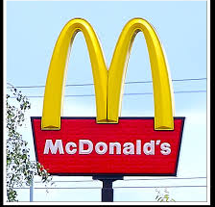
Strategies for Corporate Design
Use of trademarked symbol as primary logo, with name secondary
McDonald’s “Golden Arches”

Slide 26
Strategies for Corporate Design
International companies need to select designs carefully to avoid conveying a culturally inappropriate message
Easily recognizable corporate symbols important for international marketers in markets where:
Local language is not written in Roman Script
Significant portion of population is illiterate

Slide 27
Summary
Marketing communications adds value through its content
Overcome problems of intangibility – use metaphors to communicate value proposition
Communication planning involves knowing (5Ws)
Marketing communications originate from within the organization through production and marketing channels

Slide 28
Summary
Service delivery channels include
Service outlets
Front-line employees
Self-service delivery points
Marketing communications originating from outside organization include
Word of mouth
Blogs
Twitter
Media coverage
Corporate design strategies are part and parcel of communication mix

