Slide 1
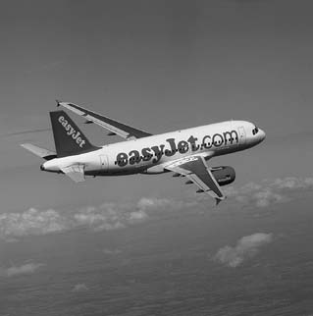
Chapter 7:
Promoting Services and Educating Customers

Slide 2
Overview of Chapter 7
Role of Marketing Communications
Challenges of Services Communications
Marketing Communications Planning
The Marketing Communications Mix
Role of Corporate Design
Integrating Marketing Communications

Slide 3
Role of Marketing Communications

Slide 4
Specific Roles of Marketing Communications
Position and differentiate service
Help customer evaluate offerings and highlight differences that matter
Promote contribution of personnel and backstage operations
Add value through communication content
Facilitate customer involvement in production
Stimulate or dampen demand to match capacity

Slide 5
Help Customers to Evaluate Service Offerings
Customers may have difficulty distinguishing one firm from another
Provide tangible clues related to service performance
Some performance attributes lend themselves better to advertising than others
e.g., Airlines
Firm’s expertise is hidden in low-contact services
Need to illustrate equipment, procedures, employee activities that take place backstage

Slide 6
Promote Contributions of Service Personnel
Frontline personnel are central to service delivery in high-contact services
Make the service more tangible and personalized
Show customers work performed behind the scenes to ensure good delivery
To enhance trust, highlight expertise and commitment of employees
Advertisements must be realistic
Messages help set customers’ expectations
Service personnel should be informed about the content of new advertising campaigns or brochures before launch

Slide 7
Facilitate Customer Involvement in Production
Customers are actively involved in service production; they need training to perform well
Show service delivery in action
Television and videos engage viewer
e.g., Dentists showing patients videos of surgical procedures before surgery
Streaming videos on web and podcasts are new channels to reach active customers

Slide 8
Stimulate or Dampen Demand to Match Capacity
Live service performances are time-specific and can’t be stored for resale at a later date
Advertising and sales promotions can change timing of customer use
Examples of demand management strategies:
Reducing usage during peak demand periods
Stimulating demand during off-peak period

Slide 9
Challenges of Services Communications

Slide 10
Overcoming Problems of Intangibility
Intangibility creates 4 problems:
Generality
- Items that comprise a class of objects, persons, or events
Abstractness
- No one-to-one correspondence with physical objects
Non-searchability
- Cannot be searched or inspected before purchase
Mental impalpability
- Customers find it hard to grasp benefits of complex, multi-dimensional new offerings

Slide 11
Overcoming Problems of Intangibility
To overcome intangibility
Use tangible cues in advertising
Use metaphors
Tangible metaphors help to communicate benefits of service offerings, e.g.,
Allstate – “You’re in good hands”
Prudential Insurance – uses Rock of Gibraltar as symbol of corporate strength
Metaphors communicate value propositions more dramatically and emphasize key points of difference

Slide 12
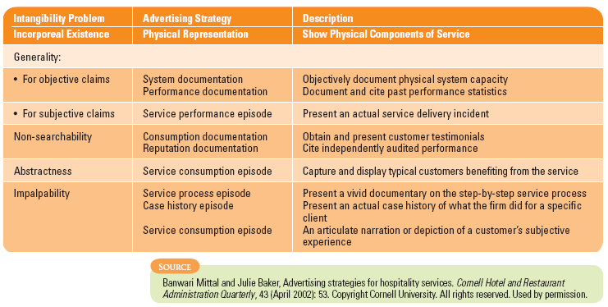
Advertising Strategies for Overcoming Intangibility

Slide 13
Marketing Communications Planning

Slide 14
Checklist: The “5 Ws” Model
Who is our target audience?
What do we need to communicate and achieve?
How should we communicate this?
Where should we communicate this?
When do communications need to take place?

Slide 15
Target Audience: 3 Broad Categories
Prospects
Employ traditional communication mix because prospects are not known in advance
Users
More cost effective channels utilized
Employees
Secondary audience for communication campaigns
Shape behavior
Part of internal marketing campaign using company-specific channels

Slide 16
Educational and Promotional Objectives in Service Settings
Create memorable images of specific companies and their brands
Build awareness and interest for unfamiliar service
Compare service favorably with competitors’ offerings
Build preference by communicating strengths and benefits
Reposition service relative to competition
Reduce uncertainty or perceived risk by providing useful info and advice

Slide 17
Educational and Promotional Objectives in Service Settings
Provide reassurance (e.g., promote service guarantees)
Encourage trial by offering promotional incentives
Familiarize customers with service processes before use
Teach customers how to use a service to best advantage
Stimulate demand in off-peak, discourage during peak
Recognize and reward valued customers and employees

Slide 18
Educational and Promotional Objectives in Service Settings

Slide 19
The Marketing Communications Mix

Slide 20
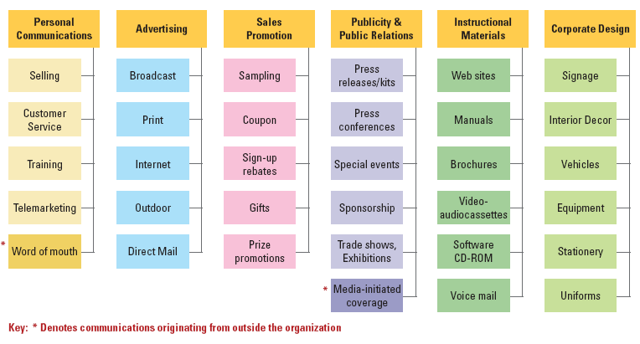
Marketing Communications Mix for Services

Slide 21
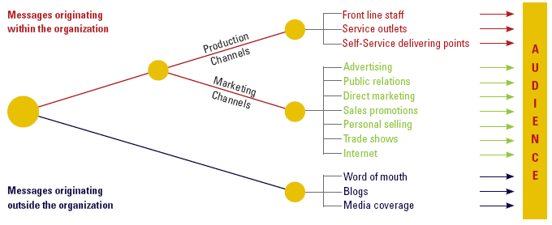
Sources of Messages Received by Target Audience
Source: Adapted from a diagram by Adrian Palmer, Principles of Services Marketing, London: McGraw-Hill,4th ed., 2005, p. 397

Slide 22
Traditional Marketing Channels
Channel | Aim | Challenges
Advertising: Done via media channels | Build awareness, inform, persuade, and remind | Needs to be unique as less than half of all ads generate a positive ROI
Public relations: Efforts to stimulate positive interest through third parties | Builds reputation and credibility to secure an image conducive to conduct business | Form relationships with its employees, customers, and the community
Direct Marketing such as mail, e-mail & text messages | Send personalized messages to highly targeted micro-segments; use permission marketing where customers “raise their hands” and agree to learn more about a company and its products | Advance in on-demand technologies (e.g., spam filters, cookie busters, pop-up blockers) empower consumers to decide how and when they prefer to be reached, and by whom

Slide 23
Traditional Marketing Channels
Channel | Aim | Challenges
Sales Promotion: Communication attached to an incentive that is specific to a period of time, price, or customer group | Generate attention and speed up introduction and acceptance of new services | Motivating customers to use a service sooner, in greater volume, or more frequently especially during periods when demand would be weak
Personal Selling: Common in b2b and infrequently purchased services | Educate customers and promote preferences for particular brand or product | Relationship marketing strategies based on account management programs incur high staffing costs; telemarketing is a lower cost alternative
Trade Shows | Stimulate extensive media coverage with many prospective buyers | Opportunity to learn about latest offerings from wide array of suppliers

Slide 24
Internet Marketing Offers Powerful Opportunities
Supplement traditional marketing channels at a reasonable cost
Part of an integrated, well-designed communications strategy
Can market through the company’s own website or through online advertising

Slide 25
Website Design Considerations
Used for a variety of communication tasks
Promoting consumer awareness and interest
Providing information and consultation
Facilitating 2-way communication
Stimulating product trial
Enabling customers to place orders
Design should address attributes that affect website “stickiness”
High in quality content
Ease of use
Quick to download
Frequency of update
Memorable Web address helps attract visitors to the site

Slide 26
Effective Advertising on Internet: Banner Advertising
Banner Advertising: Placing advertising banners and buttons on portals such as Yahoo and other firms’ websites to draw online traffic to own site
Easy for advertisers to measure how many visits to its own website are generated by click-throughs
Limitations
Obtaining many exposures does not necessarily lead to increase in awareness, preference, or sales
Fraudulent click-throughs designed to boost apparent effectiveness

Slide 27
Effective Advertising on Internet: Search Engine Advertising
Search Engine Advertising (Reverse broadcast network): search engines let advertisers know exactly what consumer wants through their keyword search
Target relevant messages directly to desired consumers
Advertising options:
Pay for targeted placement of ads to relevant keyword searches
Sponsor a short text message with a click-through link
Buy top rankings in the display of search results
E.g., Google – The New Online Marketing Powerhouse via Adsense and Adwords

Slide 28
Messages Transmitted through Service Delivery Channels

Slide 29
Messages Originating from Outside the Organization
Word of Mouth (WOM)
Recommendations from other customers viewed as more credible
Strategies to stimulate positive WOM:
Creating exciting promotions that get people talking about firm’s great service
Offering promotions that encourage customers to persuade others
Developing referral incentive schemes
Referencing other purchasers and knowledgeable individuals
Presenting and publicizing testimonials

Slide 30
Messages Originating from Outside the Organization
Blogs – A new type of online WOM
Twitter
Media Coverage
Compares, contrasts service offerings from competing organizations
Advice on “best buys”

Slide 31
Ethical Issues in Communication
Poor internal communications between operations and marketing personnel concerning level of service performance
Deliberately exaggerated promises to secure sales
Deceptive promotions
Unwanted intrusion by aggressive marketers into people’s personal lives

Slide 32
Role of Corporate Design

Slide 33
Strategies for Corporate Design
Many service firms employ a unified and distinctive visual appearance for all tangible elements
e.g., Logos, uniforms, physical facilities
Provide a recognizable theme linking all the firm’s operations use of physical evidence
e.g., BP’s bright green and yellow service stations
Use of trademarked symbol as primary logo, with name secondary
McDonald’s “Golden Arches”

Slide 34
Strategies for Corporate Design
International companies need to select designs carefully to avoid conveying a culturally inappropriate message
Easily recognizable corporate symbols important for international marketers in markets where:
Local language is not written in Roman Script
Significant portion of population is illiterate

Slide 35
FedEx: Use of Company Name In Corporate Design
Created “FedEx Family of companies” consisting of subbrands for different services; carried its positive FedEx Express image to other, often low cost services.
FedEx Express
FedEx Ground
FedEx Home Delivery
FedEx Freight
FedEx Custom Critical
FedEx Supply Chain Services
FedEx Kinko’s
Each subbrand has different color scheme for second word to create differentiation for subbrands, e.g.,
Express is red/orange
Ground is green

Slide 36
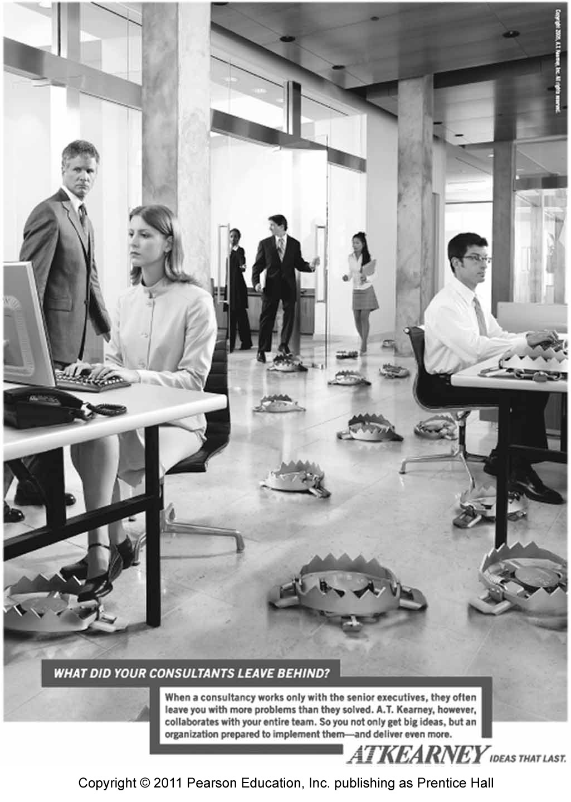
Developing An Integrated Marketing Communications Strategy
IMC ties together and reinforces all communications to deliver a strong brand identity
Communications in different media should form part of a single, overall message about the service firm

Slide 37
Summary
Marketing communications adds value through its content
Overcome problems of intangibility – use metaphors to communicate value proposition
Communication planning involves knowing (5Ws)
Marketing communications originate from within the organization through production and marketing channels

Slide 38
Summary
Service delivery channels include
Service outlets
Front-line employees
Self-service delivery points
Marketing communications originating from outside organization include
Word of mouth
Blogs
Twitter
Media coverage
Corporate design strategies are part and parcel of communication mix

