Slide 1
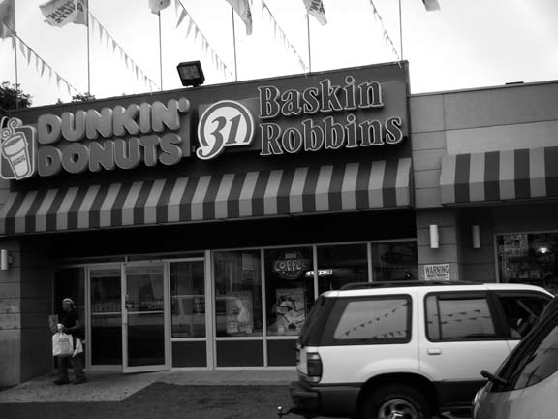
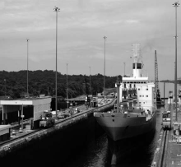
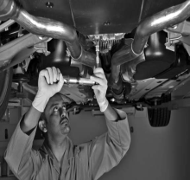
Chapter 5:
Distributing Services
Through Physical
And Electronic Channels

Slide 2
Overview Of Chapter 5
Distribution in a Services Context
Options for Service Delivery
Place and Time Decisions
Delivering Services in Cyberspace
The Role of Intermediaries
The Challenge of Distribution in Large Domestic Markets
Distributing Services Internationally

Slide 3
Distribution in a Services Context

Slide 4
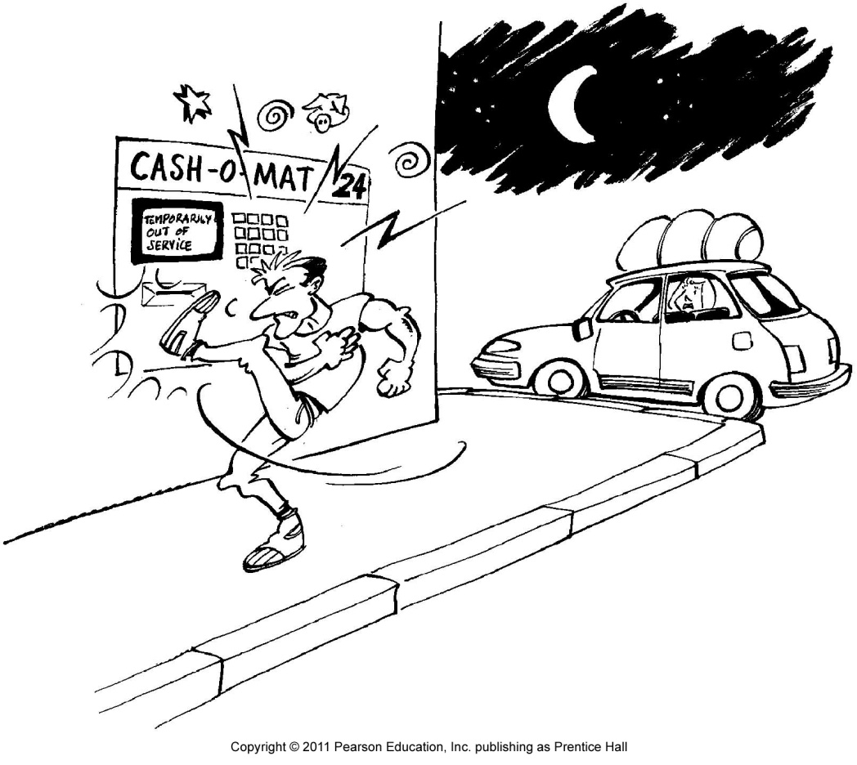
Distribution in a Services Context
In a services context, we often don’t move physical products
Experiences, performances, and solutions are not being physically shipped and stored
More and more informational transactions are conducted through electronic and not physical channels

Slide 5
Applying the Flow Model of Distribution to Services
The three interrelated elements of distribution are:
Information and promotion flow
To get customer interested in buying the service
Negotiation flow
To sell the right to use a service
Product flow
To develop a network of local sites

Slide 6
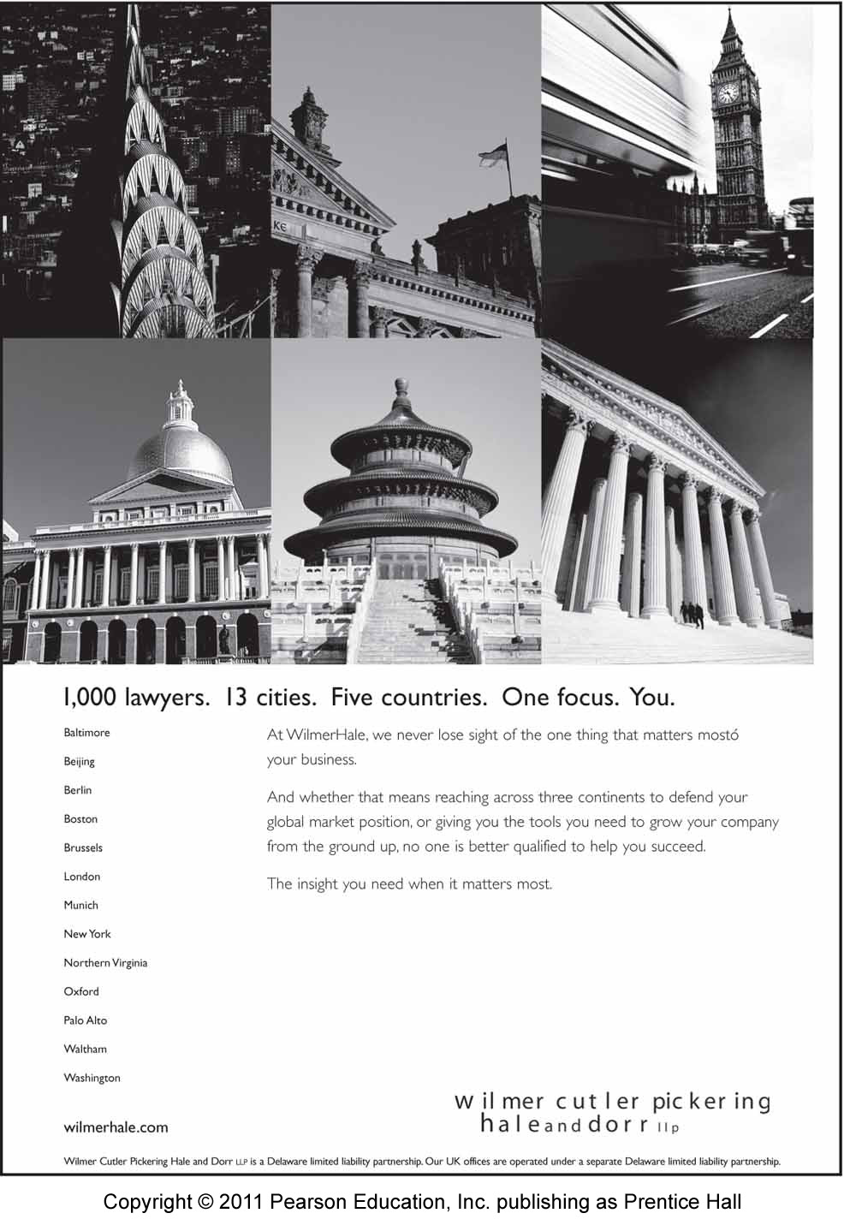
Distinguishing between Distribution of Supplementary and Core Services
Most core services require physical locations
Many supplementary services are informational; can be distributed widely and cost-effectively via other means
Telephone
Internet

Slide 7
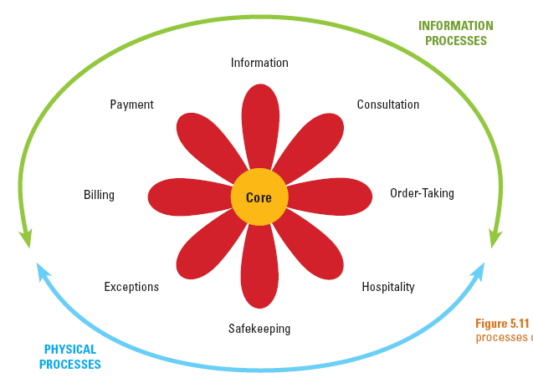
Information and Physical Processes of Augmented Service Products

Slide 8
Using Websites for Service Delivery
Information
Read brochure/FAQ; get schedules/
directions; check prices
Payment
Pay by bank card
Direct debit
Consultation
Conduct e-mail dialog
Use expert systems
Billing
Receive bill
Make auction bid
Check account status
Order-Taking
Make/confirm reservations
Submit applications
Order goods, check status
Core
Exceptions
Make special requests
Resolve problems
Hospitality
Record preferences
Safekeeping
Track package movements
Check repair status
CORE: Use Web to deliver information-based core services

Slide 9
Options for Service Delivery

Slide 10
Distribution Options for Serving Customers
Customers visit service site
Convenience of service factory locations and operational schedules important when customer has to be physically present
Service providers go to customers
Unavoidable when object of service is immovable
More expensive and time-consuming for service provider
Service transaction is conducted remotely
Achieved with help of logistics and telecommunications

Slide 11
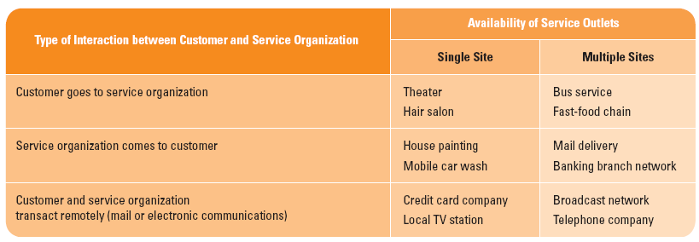
Six Options For Service Delivery

Slide 12
Channel Preferences Vary Among Customers
For complex and high-perceived risk services, people tend to rely on personal channels
Individuals with greater confidence and knowledge about a service/channel tend to use impersonal and self-service channels
Customers with social motives tend to use personal channels
Convenience is a key driver of channel choice

Slide 13
Place and Time Decisions

Slide 14
Place Decisions of Service Delivery
Cost, productivity, and access to labor are key determinants to locating a service facility
Location constraints
Operational requirement (e.g., airports)
Geographic factor (e.g., ski resorts)
Need for economies of scale (e.g., hospitals)

Slide 15
Place Decisions of Service Delivery
Ministores
Creating many small service factories to maximize geographic coverage
Separating front and back stages of operation
Purchasing space from another provider in complementary field
Locating in Multipurpose Facilities
Proximity to where customers live or work
Service Stations
Service Perspectives 5.2

Slide 16
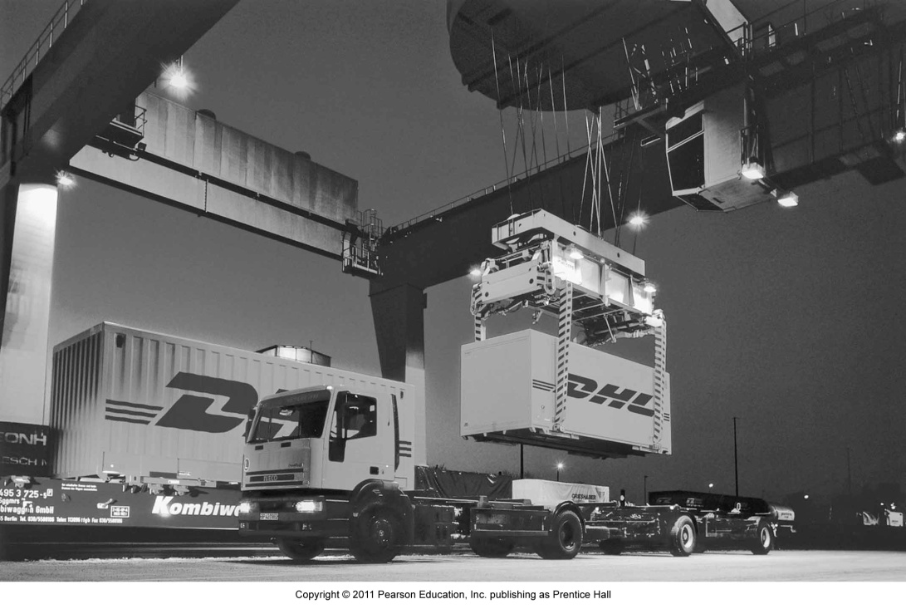
Time of Service Delivery
Traditionally, schedules were restricted
Service availability limited to daytime, 40-50 hours a week
Today
For flexible, responsive service operations: 24/7 service, 24 hours a day, 7 days a week, all around the world

Slide 17
Delivering Services in Cyberspace

Slide 18
Service Delivery Innovations Facilitated by Technology
Technological Innovations
Development of “smart” mobile telephones and PDAs, and presence of Wi-Fi
Voice-recognition technology
Websites
Smart cards
- Store detailed information about customer
- Act as electronic purse containing digital money
Electronic channels can be offered together with physical channels, or replace physical channels

Slide 19
E-Commerce: Move to Cyberspace
What are the factors that encourage you to use virtual stores?
Convenience
Ease of search
Broader selection
Potential for better prices
24-hour service with prompt delivery

Slide 20
E-Commerce: Move to Cyberspace
Recent developments: websites, customer management (CRM) systems, and mobile telephony
Integrating mobile devices into the service delivery infrastructure can be used as means to:
Access services
Alert customers to opportunities/problems
Update information in real time

Slide 21
Role of Intermediaries

Slide 22
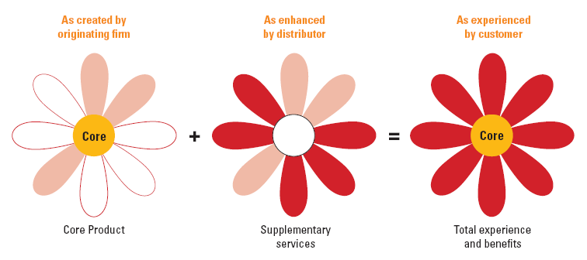
Splitting Responsibilities for Service Delivery
Challenges for original supplier
Act as guardian of overall process
Ensure that each element offered by intermediaries fits overall service concept

Slide 23
Franchising
Franchisor provides training, equipment, and support marketing activities.
Franchisees invest time and finance, and follow copy and media guidelines of franchisor.
Advantages:
Expand delivery of effective service concept without a high level of monetary investment
Franchisees are motivated to ensure good customer service and high-quality service operations

Slide 24
Franchising
Disadvantages of franchising
Loss of control over delivery system and how customers experience actual service
Effective quality control is difficult
Conflict between franchisees may arise especially as they gain experience
Alternative: license another supplier to act on the original supplier’s behalf to deliver core product
Trucking companies
Banks selling insurance products

Slide 25
Challenge of Distribution in Large Domestic Markets

Slide 26
The Challenge of Distribution in Large Domestic Markets
Distributing services (i.e., physical logistics) faces challenges due to:
Distances involved
Multiple time zones
Multiculturalism
Differences in laws and tax rates

Slide 27
Distributing Services Internationally

Slide 28
Factors Favoring Adoption of Transnational Strategies
Transnational strategy involves integration of strategy formulation and its implementation across all countries in which company elects to do business
Market Drivers
Common customer needs across countries
Corporate customers seek to standardize and simplify suppliers used in different countries – ad agencies, logistics suppliers, Big 4 accounting firms
Government Drivers
Favorable trade policies, compatible technical standards, common marketing regulations

Slide 29
Factors Favoring Adoption of Transnational Strategies
Competition Drivers
Competitors from overseas; interdependence of countries
Firms may be obliged to follow competitors into new markets to protect own positions elsewhere
Technology Drivers
Advances in information technology – miniaturization and mobility of equipment, digitization of voice
Cost Drivers
Economies of scale
Lower operating costs

Slide 30
How Service Processes Affect International Market Entry
People processing services require direct contact with customers
Export service concept
Acting alone or in partnership with local suppliers
e.g., chain restaurants, hotels, car rental firms
Import customers
Inviting customers from overseas to firm’s home country
e.g., hospitals catering to “medical tourism”
Transport customers to new locations
Passenger transportation (air, sea, rail, road)

Slide 31
How Service Processes Affect International Market Entry
Possession processing involves services to customer’s physical possessions
- Repair and maintenance, freight transport
Information-based services include mental processing services and information processing services
Export the service to a local service factory
- Hollywood film shown around the world
Import customers
Export the information via telecommunications and transform it locally
- Data can be downloaded via CDs or DVDs

Slide 32
Impact of Globalization Drivers on Various Service Categories
Globalization Drivers | People Processing | Possession Processing | Information Based
Competition | Simultaneity of production and consumption limits leverage of foreign competitive advantage, but management systems can be globalized. | Technology drives globalization of competitors with technical edge. | Highly vulnerable to global dominance by competitors with monopoly or competitive advantage in information.
Market | People differ economically and culturally, so needs for service and ability to pay may vary. | Level of economic development impacts demand for services to individually owned goods. | Demand for many services is derived to a significant degree from economic and educational levels.

Slide 33
Impact of Globalization Drivers on Various Service Categories
Globalization Drivers | People Processing | Possession Processing | Information Based
Technology | Use of IT for delivery of supplementary services may be a function of ownership and familiarity with technology. | Need for technology- based service delivery systems depends on possessions requiring service and the cost trade-offs in labor substitution | Ability to deliver core services through remote terminals may be a function of investment in computerization, etc.
Cost | Variable labor rates may impact pricing in labor-sensitive services. | Variable labor rates may favor low-cost locations. | Major cost elements can be centralized and minor cost elements localized.
Government | Social policies (e.g., health) vary widely and may affect labor cost, etc. | Policies may decrease/increase cost and encourage/discourage certain activities | Policies may impact demand and supply and distort pricing

Slide 34
Barriers to International Trade in Services
Passage of free-trade legislation is important facilitator of transnational operations
Notable developments: NAFTA, Latin American economic blocs, EU
Despite efforts of WTO and GATT, barriers still exist:
Restrictions on international airline operating rights
Heavy taxation
Legal restrictions
Lack of broadly agreed upon accounting standards
Cultural issues

Slide 35
Summary
Distribution relates to both core and supplementary services and embraces three interrelated elements
Information and promotion flow, negotiation flow, product flow
Channel options include:
Customers visit the service site
Service providers go to their customers
Service transaction is conducted remotely
Place and time decisions include where services should be delivered in bricks-and-mortar context, when it should be delivered

Slide 36
Summary
Delivery in cyberspace is facilitated by technology; e-commerce allows 24-hour delivery, saving time and effort
Intermediaries play roles in distributing services
Service processes (people processing services, possession processing services, and information-based services) affect international market entry via the drivers:
Market drivers
Competition drivers
Technology drivers
Cost drivers
Government drivers

