Slide 1




Chapter 4:
Developing
Service Products:
Core and Supplementary Elements

Slide 2
Overview of Chapter 4
Planning and Creating Services
The Flower of Service
Branding Service Products and Experiences
New Service Development

Slide 3
Planning and Creating
Service Products

Slide 4
Service Products
A service product comprises of all elements of service performance, both tangible and intangible, that create value for customers.
Service products consist of:
Core Product ➔ central component that supplies the principal, problem-solving benefits customers seek
Supplementary Services ➔ augments the core product, facilitating its use and enhancing its value and appeal
Delivery Processes ➔ used to deliver both the core product and each of the supplementary services

Slide 5
Designing a Service Concept
Service concept design must address the following issues:
  How the different service components are delivered to the customer
  The nature of the customer’s role in those processes
  How long delivery lasts
  The recommended level and style of service to be offered

Slide 6
Documenting Delivery Sequence
Over Time
Must address sequence in which customers will use each core and supplementary service
Determine approximate length of time required for each step
Information should reflect good understanding of customers, especially their:
  needs
  habits
  expectations

Slide 7
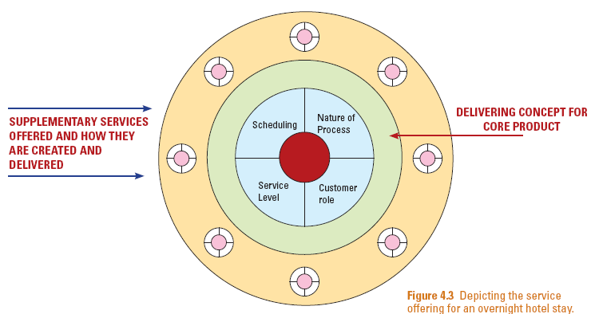
Integration of Core Product, Supplementary Elements, and Delivery Process

Slide 8
Temporal Dimension to Augmented Product
Reservation
internet
Parking
Get car
Check in
Check out
Internet
Internet
Use Room
USE GUESTROOM OVERNIGHT
Porter
Pay TV
Meal
Room service
Before Visit
Time Frame of an Overnight Hotel Stay
(real-time service use)

Slide 9
The Flower of Service

Slide 10
The Flower of Service
There are two types of supplementary services
  Facilitating: either needed for service delivery, or help in the use of the core product
  Enhancing: add extra value for the customer
In a well-managed service organization, the petals and core are fresh and well-formed
Market positioning strategy helps to determine which supplementary services should be included

Slide 11
The Flower of Service
Information
Payment
Consultation
Billing
Core
Order-Taking
Exceptions
Hospitality
Safekeeping
KEY:
Enhancing elements
Facilitating elements

Slide 12

Facilitating Services – Information
• Directions to service site
• Schedules/service hours
• Prices
• Reminders
• Warnings
• Conditions of sale/service
• Notification of changes
• Documentation
• Confirmation of reservations
• Summaries of account activities
• Receipts and tickets

Slide 13

Facilitating Services – Order-Taking
Applications
• Memberships in clubs/programs
• Subscription services
(e.g., utilities)
• Prerequisite based services (e.g., financial credit, college enrollment)
Order Entry
• On-site order fulfillment
• Mail/telephone/e-mail/web order
Reservations and Check-in
• Seats/tables/rooms
• Vehicles or equipment rental
• Professional appointments

Slide 14
Facilitating Services – Billing
• Periodic statements of account activity
• Invoices for individual transactions
• Verbal statements of amount due
• Self-billing (computed by customer)
• Machine display of amount due

Slide 15
Facilitating Services – Payment
Self-Service
• Insert card, cash or token into machine
• Electronic funds transfer
• Mail a check
• Enter credit card number online
Direct to Payee or Intermediary
• Cash handling or change giving
• Check handling
• Credit/charge/debit card handling
• Coupon redemption
Automatic Deduction from Financial Deposits
• Automated systems (e.g., machine- readable tickets that operate entry gate)
• Human systems (e.g., toll collectors)

Slide 16
Enhancing Services – Consultation
• Customized advice
• Personal counseling
• Tutoring/training in product use
• Management or technical consulting

Slide 17
Enhancing Services – Hospitality
Greeting
Food and beverages
Toilets and washrooms
Waiting facilities and amenities
• Lounges, waiting areas, seating
• Weather protection
• Magazines, entertainment, newspapers
Transport
Security

Slide 18
Enhancing Services – Safekeeping
Caring for Possessions Customer Bring
with Them
• Child care, pet care
• Parking for vehicles, valet parking
• Coat rooms
• Baggage handling
• Storage space
• Safe deposit boxes
• Security personnel

Slide 19
Enhancing Services – Safekeeping (cont)
Caring for Goods Purchased (or Rented) by Customers
• Packaging
• Pickup
• Transportation and delivery
• Installation
• Inspection and diagnosis
• Cleaning
• Refueling
• Preventive maintenance
• Repair and renovation

Slide 20
Enhancing Services – Exceptions
Special Requests in Advance of Service Delivery
• Children’s needs
• Dietary requirements
• Medical or disability needs
• Religious observances
Handling Special Communications
• Complaints
• Compliments
• Suggestions

Slide 21
Enhancing Services – Exceptions (cont)
Problem Solving
• Warranties and guarantees
• Resolving difficulties that arise from using
the product
• Resolving difficulties caused by accidents,
service failures
• Assisting customers who have suffered an accident or a medical emergency
Restitution
• Refunds and compensation
• Free repair of defective goods

Slide 22
Managerial Implications
Core products do not have to have supplementary elements
Nature of product helps determine supplementary services offered to enhance value
People-processing and high contact services have more supplementary services
Different levels of service can add extra supplementary services for each upgrade in service level
Low-cost, no-frills basis firms needs fewer supplementary elements

Slide 23
Branding Service
Products and Experiences

Slide 24
Service Products, Product Lines, and Brands
Service Product: A defined and consistent “bundle of output”
  Supported by supplementary services (assembly of elements that are built around the core product)
  Differentiated by bundle of output
Product Line: Most service organizations offer a line of products rather than just a single product.
There are three broad alternatives for product lines:
  Single brand to cover all products and services
  A separate, stand-alone brand for each offering
  Some combination of these two extremes

Slide 25
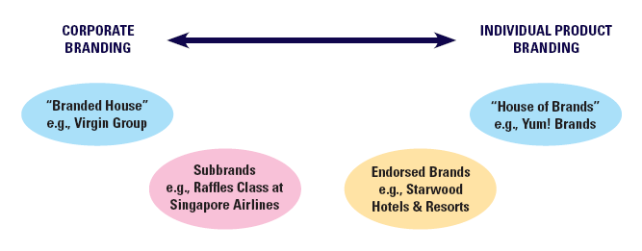
Spectrum of Branding Alternatives
Source: Derived from Aaker and Joachimsthaler

Slide 26
Example:
British Airways Subbrands
British Airways offers seven distinct air travel products
Intercontinental Offerings
Intra-European Offerings
First (Deluxe Service)
Club World (Business Class)
Club Europe (Business Class)
Shuttle
World Traveller Plus (Premier economy)
World Traveller (Economy)
Euro-Traveller (Economy)

Slide 27
Offering a Branded Experience
Branding can be employed at corporate and product levels
Corporate brand:
  Easily recognized,
  Holds meaning to customers,
  Stands for a particular way of doing business
Product brand:
  Helps firm communicate distinctive experiences and benefits associated with a specific service concept

Slide 28
Moving Towards a Branded Experience
Create brand promise
Shape truly differentiated customer experience
Give employees skills, tools, and supporting processes to deliver promise
Measure and monitor

Slide 29
Offering A Branded Experience
“The brand promise or value proposition is not a tag line, an icon, or a color or a graphic element, although all of these may contribute.
It is, instead, the heart and soul of the brand.”
Don Schultz

Slide 30
New Service Development

Slide 31
A Hierarchy of
New Service Categories
Supplementary Service Innovations: Additions of new or improved facilitating or enhancing elements
Service Improvements: Modest changes in the performance of current products
Style Changes: Visible changes in service design or scripts
Process-line Extensions: Alternative delivery procedures
Product Line Extensions: Addition to current product lines
Major Process Innovations: Using new processes to deliver existing products with added benefits
Major Service Innovations: New core products for previously undefined markets

Slide 32
Reengineering Service Processes
Service processes affect customers and also cost, speed, and productivity
Reengineering – analyzing and redesigning processes to achieve faster and better performance
Examination of processes can lead to creation of alternative delivery methods:
  Add or eliminate supplementary services
  Re-sequence delivery of service elements
  Offer self-service options

Slide 33
Physical Goods as a Source of New Service Ideas
Goods and services may become competitive substitutes if they offer the same key benefits
Provides an alternative to owning the physical good that can attain the desired outcome
Any new good may create need for after-sales services now and be a source of future revenue stream

Slide 34
Creating Services as Substitutes for Physical Good
Own a Physical Good
Rent Use of Physical Good
Perform Work Oneself
Drive Own Car
Use Own Computer
Rent a Car and Drive it
Rent Use of Computer
Hire Someone to Do Work
Hire a Chauffeur to Drive
Hire a Typist to Type
Hire a Taxi or Limousine
Send Work out to a
Secretarial Service

Slide 35
Achieving Success in Developing New Services
Services are not immune to high failure rates that plague new manufactured products
In developing new services:
  core product is often of secondary importance, many innovations are in supplementary services or service delivery
  ability to maintain quality of the total service offering is key
  accompanying marketing support activities are vital
  Market knowledge is of utmost importance

Slide 36
Success Factors in
New Service Development
Market synergy
  Good fit between new product and firm’s image
  Advantage in meeting customers’ needs
  Strong support from firm during and after launch
  Understands customer purchase decision behavior
Organizational factors
  Strong inter-functional cooperation and coordination
  Internal marketing to educate staff on new product and its importance

Slide 37

Success Factors in
New Service Development
Market research factors
  Scientific studies conducted early in development process
  Product concept well defined before undertaking field studies

Slide 38
Summary
Creating services involve:
  Designing the core product, supplementary services, and their delivery processes
Flower of service includes core product and two types of supplementary services: facilitating and enhancing
  Facilitating services include information, order taking, billing, and payment
  Enhancing services include consultation, hospitality, safekeeping, and exceptions

Slide 39
Summary
Spectrum of branding alternatives exists for services
  Branded house
  Subbrands
  Endorsed brands
  House of brands
To develop new services, we can
  Reengineer service processes
  Use physical goods as a source of new service ideas
  Use research to design new services
  Understand how to achieve success in new service development

