Slide 1
Statistical Techniques in Business & Economics
Douglas Lind,
William Marchal &
Samuel Wathen

Slide 2
What is Statistics
Chapter 1

Slide 3
GOALS
Understand why we study statistics.
Explain what is meant by descriptive statistics and inferential statistics.
Distinguish between a qualitative variable and a quantitative variable.
Describe how a discrete variable is different from a continuous variable.
Distinguish among the nominal, ordinal, interval, and ratio levels of measurement.

Slide 4
What is Meant by Statistics?
Statistics is the science of collecting, organizing, presenting, analyzing, and interpreting numerical data to assist in making more effective decisions.

Slide 5
Who Uses Statistics?
Statistical techniques are used extensively by marketing, accounting, quality control, consumers, professional sports people, hospital administrators, educators, politicians, physicians, etc...

Slide 6
Types of Statistics
1.Descriptive Statistics - methods of organizing, summarizing, and presenting data in an informative way.
EXAMPLE 1: A Gallup poll found that 49% of the people in a survey knew the name of the first book of the Bible. The statistic 49 describes the number out of every 100 persons who knew the answer.

Slide 7
Types of Statistics – Descriptive Statistics
EXAMPLE 2: According to Consumer Reports, General Electric washing machine owners reported 9 problems per 100 machines during 2001. The statistic 9 describes the number of problems out of every 100 machines.
2.Inferential Statistics: A decision, estimate, prediction, or generalization about a population, based on a sample.

Slide 8
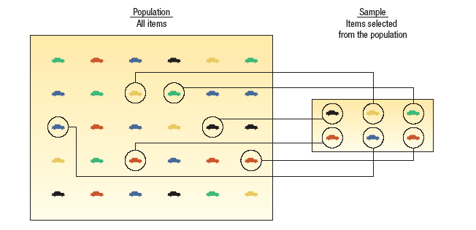
Population versus Sample
A population is a collection of all possible individuals, objects, or measurements of interest.
A sample is a portion, or part, of the population of interest

Slide 9
Types of Variables
A. Qualitative or Attribute variable - the characteristic being studied is nonnumeric.
EXAMPLES: Gender, religious affiliation, type of automobile owned, state of birth, eye color are examples.
B. Quantitative variable - information is reported numerically.
EXAMPLES: balance in your checking account, minutes remaining in class, or number of children in a family.

Slide 10
Quantitative Variables - Classifications
Quantitative variables can be classified as either discrete or continuous.
Discrete variables: can only assume certain values and there are usually “gaps” between values.
EXAMPLE: the number of bedrooms in a house, or the number of hammers sold at the local Home Depot (1,2,3,…,etc).
B. Continuous variable can assume any value within a specified range.
EXAMPLE: The pressure in a tire, the weight of a pork chop, or the height of students in a class.

Slide 11
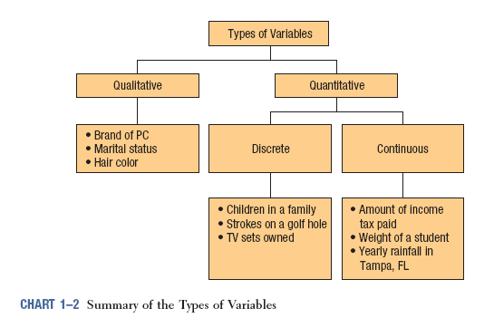
Summary of Types of Variables

Slide 12
Four Levels of Measurement
Nominal level - data that is classified into categories and cannot be arranged in any particular order.
EXAMPLES: eye color, gender, religious affiliation.
Ordinal level – involves data arranged in some order, but the differences between data values cannot be determined or are meaningless.
EXAMPLE: During a taste test of 4 soft drinks, Mellow Yellow was ranked number 1, Sprite number 2, Seven-up number 3, and Orange Crush number 4.
Interval level - similar to the ordinal level, with the additional property that meaningful amounts of differences between data values can be determined. There is no natural zero point.
EXAMPLE: Temperature on the Fahrenheit scale.
Ratio level - the interval level with an inherent zero starting point. Differences and ratios are meaningful for this level of measurement.
EXAMPLES: Monthly income of surgeons, or distance traveled by manufacturer’s representatives per month.

Slide 13
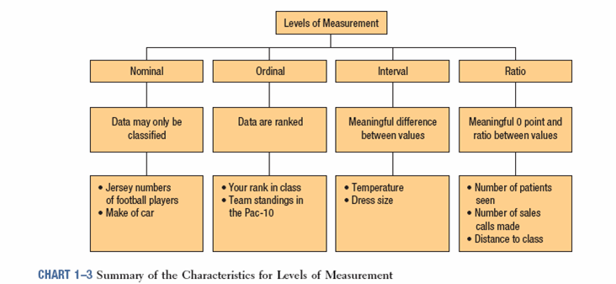
Summary of the Characteristics for Levels of Measurement

Slide 14
End of Chapter 1

