Slide 1
مقدمة في الإحصاء الحيوي مع تطبيقات برنامج الحزم الإحصائية SPSS
د. أسامة عبدالحليم سمرقندي
المشرف على إدارة الإحصاء والمعلومات
جامعة الملك سعود

Slide 2
Introduction to Biostatistics with SPSS Application
Osama A Samarkandi, PhD

Slide 3
Session II

Slide 4
* Welcome Back *

Slide 5
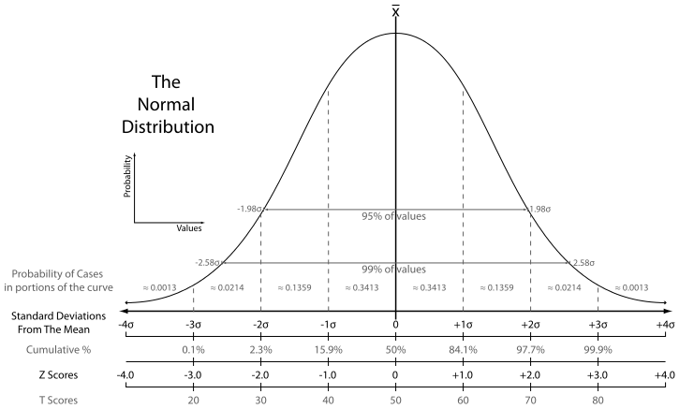
Normal Distribution Curve

Slide 6
Normal Distribution Curve
zσ | Percentage within CI | Percentage outside CI | Fraction outside CI
1σ | 68.2689492% | 31.7310508% | 1 / 3.1514872
2σ | 95.4499736% | 4.5500264% | 1 / 21.977895
3σ | 99.7300204% | 0.2699796% | 1 / 370.398
4σ | 99.993666% | 0.006334% | 1 / 15,787
5σ | 99.9999426697% | 0.0000573303% | 1 / 1,744,278
6σ | 99.9999998027% | 0.0000001973% | 1 / 506,797,346
7σ | 99.9999999997440% | 0.000000000256% | 1 / 390,682,215,445

Slide 7
Measures of Variability or Scatter
Range (R): The difference between the lowest and highest numbers in the data set
Variance (S²): defined as a number indicating how spread out the data is.
$$S2 =\frac{Σ{(Xi−\overline{X})}^{2}}{n−1}$$
Standard Deviation (SD) ($σ$): defined as a number representing how far from the mean (average) each score is.
$$σ = \sqrt{\frac{Σ {(Xi−\overline{X})}^{2}}{n−1}}=\sqrt{S^{2}}$$

Slide 8
Example
Calculate the Measures of Variability (S2, σ) for length of stay (in hours) of older patients in the hospital; (61, 70, 112, 74, 104, 97, 85, 132, 125, 70).

Slide 9
Solution
 | X | X-$\overline{X}$ | (X-$\overline{X}$)² | X²
1 | 61 | 61-93=-32 | 1,024 | 3,721
2 | 70 | 70-93=-23 | 529 | 4,900
3 | 112 | 112-93=19 | 361 | 12,544
4 | 74 | 74-93=-19 | 361 | 5,476
5 | 104 | 104-93=11 | 121 | 10,816
6 | 97 | 97-93=4 | 16 | 9,409
7 | 85 | 85-93=-8 | 64 | 7,225
8 | 132 | 132-93=39 | 1,521 | 17,424
9 | 125 | 125-93=32 | 1,024 | 15,625
10 | 70 | 70-93=-23 | 529 | 4,900
Total: | 930 | 0 | 5,550 | 92,040
$\overline{X}$= ΣX/n
=930/10=93
$$S2 =\frac{Σ{(Xi−\overline{X})}^{2}}{n−1}$$
= 5,550/9
=616.67 Hours²
$$σ = \sqrt{\frac{Σ {(Xi−\overline{X})}^{2}}{n−1}}=\sqrt{S^{2}}$$
= $\sqrt{616.67}$
= 24.8 Hours

Slide 11
* Break *

