Slide 1
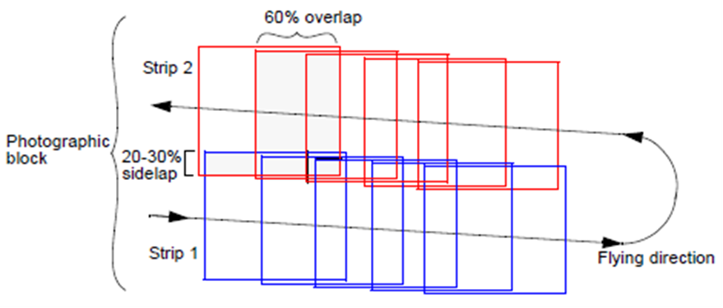
Flight Planning

Slide 2
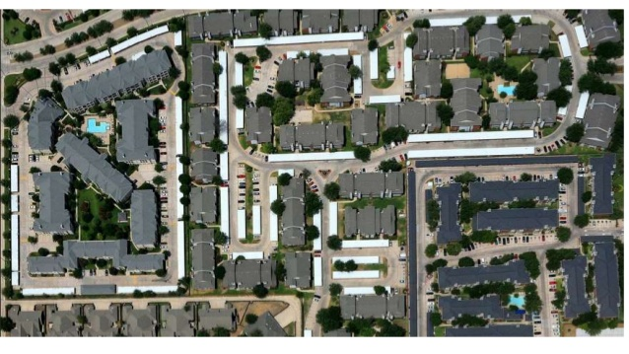
To prepare photography for photogrammetric operations a flight planning is necessary

Slide 3
Flight Planning
Factors to be discussed in flight planning:
Selection of photo scale:
* Flight direction - Flying Height and Camera focal length
* Overlap for stereo viewing and complete coverage
Forward Overlap 50-80%
Side Overlap 15-30%
* Number of strips and total number of photos needed to cover an area (BLOCK)

Slide 4
Flight Planning
Standard photo dimensions is the squared format
23x23 cm
Commonly used camera focal length is 150mm
(100mm, 210mm and 300mm are also available)
For a plotting instrument of accuracy factor (C-F) of 2000 and CI = 1m; It is recommended to fly at an altitude
H = CI x CF = 1m x 2000=2000m or less
Flying height and photo scale will decide required camera focal length, f = H x photo scale

Slide 5
Flight Planning Flying Height – Camera – Photo Scale
Photo scale = f/H
A photo of scale 1/10000 can allow ground accuracy of 0.05m if plotter accuracy is 2µm
For this scale flying height should be within 1.5km if a camera of focal length 150mm is available

Slide 6
Flight Planning – Flying Height
Example:
A camera of focal length 150mm is available, what is the maximum flying height if the scale should not be smaller than 1:8000, CI=1.0m and plotter C-Factor is 1500?
From scale and focal length, H < 0.15x8000 < 1200m
From CI and CF; H < 1.00x1500 < 1500m
Flying height should be less or equal to 1200m

Slide 7
Flight Planning - Image Motion
This is caused by movement of camera in craft during exposure, affected by camera opening time, craft speed and photo scale
Flight Direction

Slide 8
Flight Planning
Flight speed, V should also be selected to reduce image motion (IM) on the photo.
With slow‐flying aircraft, fast film, and fast shutter speeds (t), IM is frequently not a problem.
For a photography flown close to the ground (large scale photo), IM calculation should be made prior to the photo mission so that adjustments for V or t can be made if necessary.
We can calculate image movement (IM) in mm using the equation:
IM = (V) (t) (f / H); V in m/sec; t, shutter speed in sec, H, flying height in m, f, focal length in mm

Slide 9
Flight Speed and Image Motion
Example:
Compute the maximum craft speed to produce an aerial photo of scale 1:10000, using a shutter of speed 1/1000 sec, if image motion is not to exceed 0.005mm
Solution:
IM = V t (f/H) = 0.005 = V x (1/1000) x (1/10000)
V = (0.005/1000) x 1000 x 10000 = 50 m/sec = 180 km/hr
If flight speed is is 300km/hr, what shutter speed is needed to allow image motion of 0.010mm (photo scale is 1/10000)?
t= IM (H/f) / V = 0.010 x 10000 / (300x1000x1000/3600) = 1/833 sec;
Use shutter speed 1/1000 sec

Slide 10
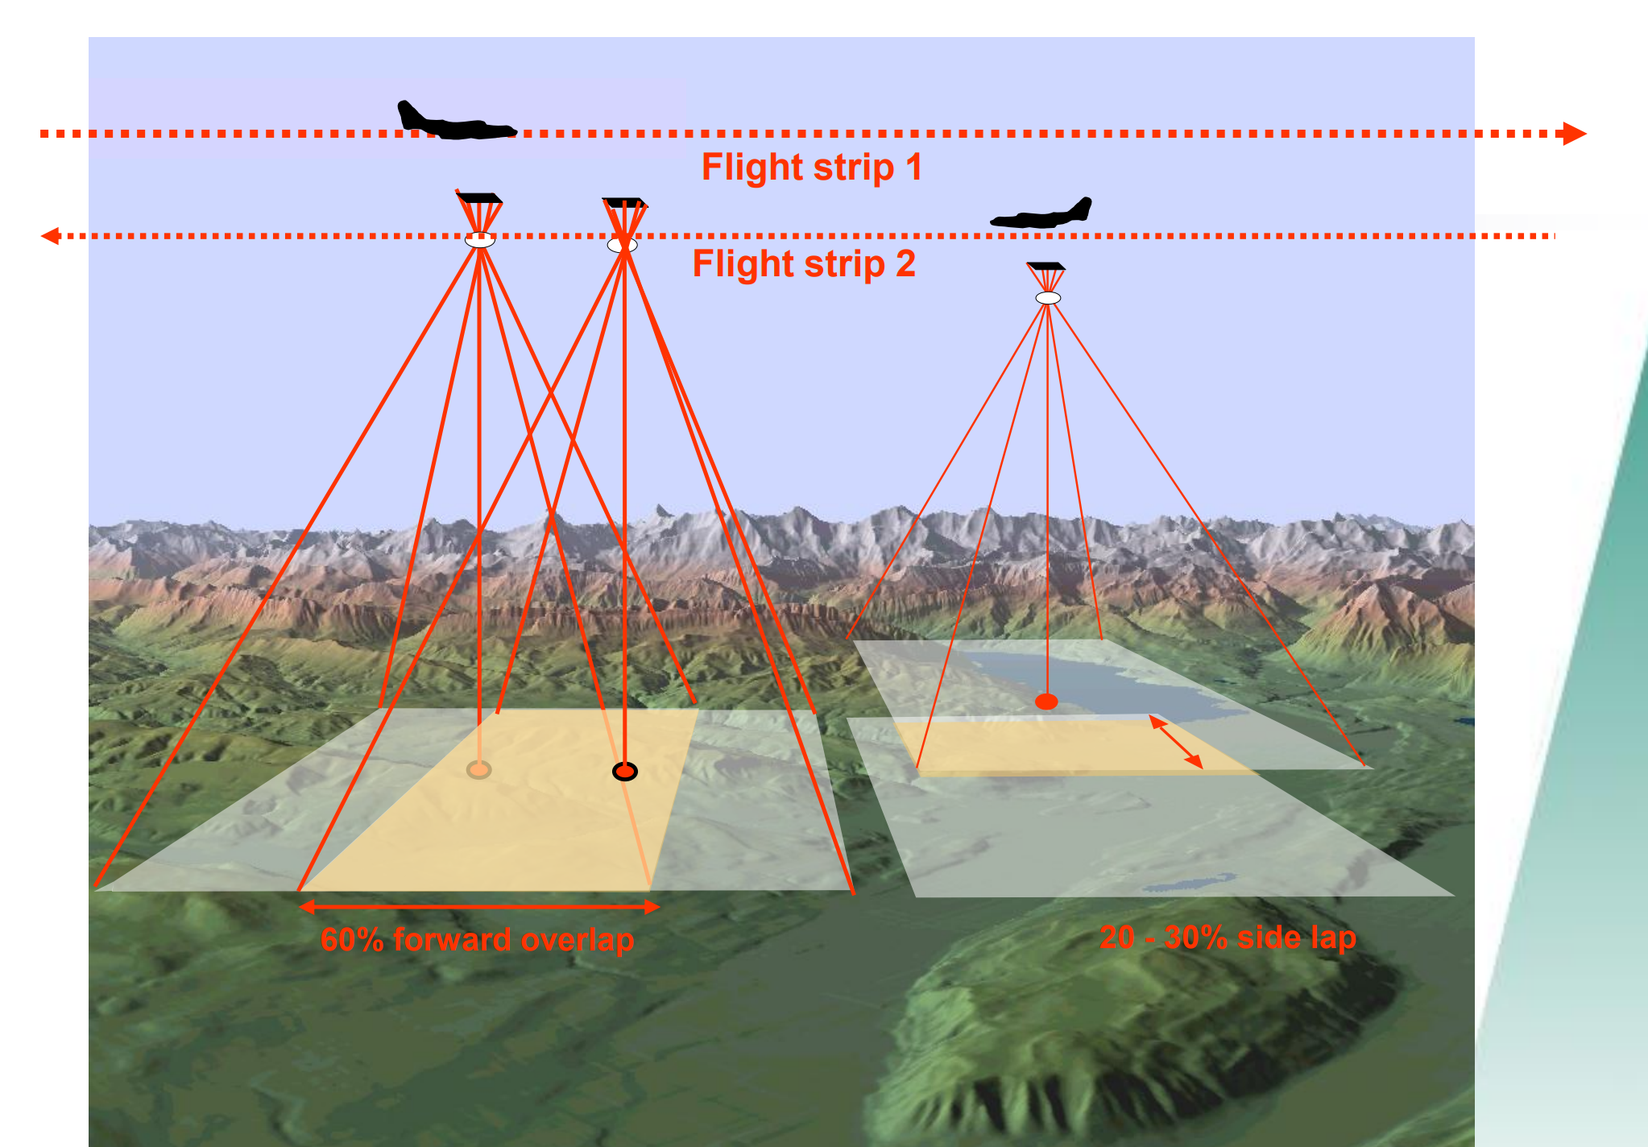
Overlap

Slide 11
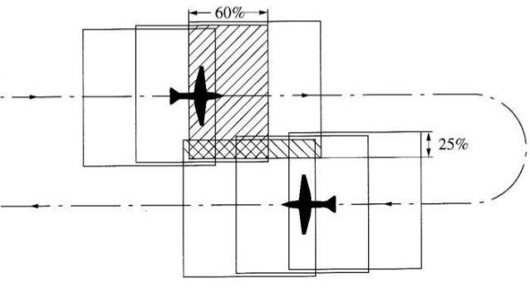
Flight run
Overlap
In the flight direction, called Forward overlap (FL), should not be less than 60%. Mainly needed for stereo viewing

Slide 12
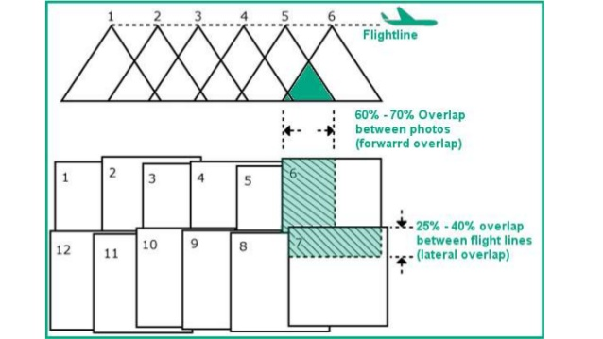

Slide 13
FL

Slide 14
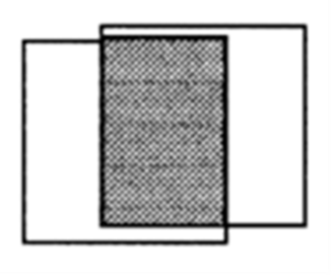
Forward Overlap (FL)
Forward lap (between consecutive photos in a strip) is usually chosen to be more than 50% (usually 60-70%).
If forward lap is 60%, stereo model area (effective model area) will be =
(40%L) * L = 0.4 * 2300 * 2300 =2.116 sq.km.
(Assuming photo format 23cmx23cm and photo scale
1/10000)
Distance between consecutive exposure stations
is the air base, B = 0.4 * L =0.4 * 2300 = 920m
B/H (Base to Height Ratio) is preferred to be large enough for better stereo viewing and height determination.

Slide 15
Forward Overlap Distance between consecutive exposure stations is Base line, B. If format dimension in flight direction is L and FL is 60% then B = 40% of L = 0.4xL. If format is 23x23cm and scale is 1:2000, L=460m and B=184m. Exposures on one line form a strip of photos.

Slide 16
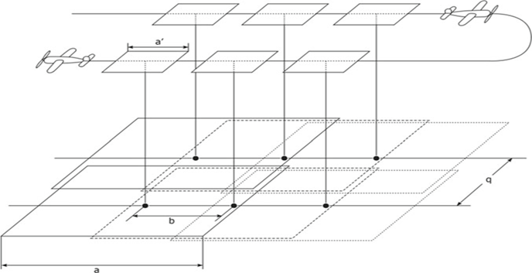
Number of Photos in a Strip
Number of photos per strip =
length of area to be photographed (Q) / distance between consecutive photos (B) + 1:
If area to be covered by aerial photos = Q * W =60km * 20km, flight direction better be chosen along longer area dimension (60km). Q=60km; W=20km
Number of photos per strip = (Q/B) + 1 = (60/0.92) +1
= 65.2 +1, Take 66 + 1 = 67 photos
To assure stereo coverage
add two photos on each
Side of the strip, hence
67 + 4 = 71 photos
Per strip

Slide 17
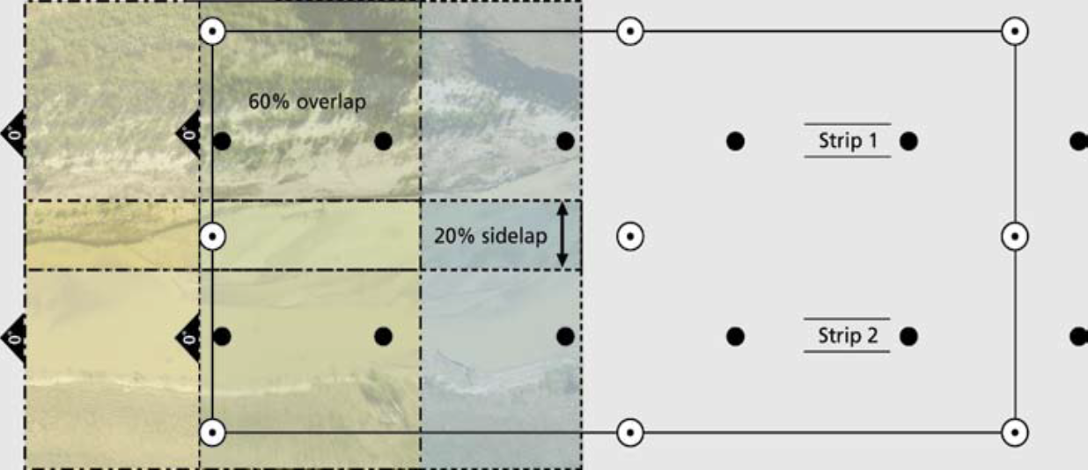
Side Overlap (SL)
Between each consecutive strips there should be overlap of not less than 15%, usually 30%, called side overlap (SL); distance between consecutive flight lines (G) will be 70% of photo ground coverage (L)

Slide 18
Side Overlap
Overlap between consecutive strips (side lap) assures complete coverage along width of the area, assumed 25% in this case:

Slide 19
Number of Strips
Side lap is usually taken more than 20% of width of photo coverage
Distance between consecutive flight lines, G = 80% of coverage width = 0.8 * 2300 = 1840m; 2300m is the photo ground coverage
If Area width is 20km, Align first and last flight lines 0.3*2300m (one third of the photo lateral ground coverage) outside the north and south boundary lines to ensure lateral coverage outside the project area.
Hence, effective area width, W’=20km + 2x0.3x2.3= 21.38km. Number of strips to cover the area = W’/G + 1= (21.38/1.84) +1
= 11.6 +1 = 13 strips

Slide 20
Total Number of Photos
The total Number of photos to cover the whole area 60kmx20km =
Number of photos per strip x number of strips
Total number of photos required = number of photos per strip x number of strips= 71*13=923 photos.
Length of film for one photo = 23cm/scale= 23cm = 0.23m
Length of film required=923*0.23= 212.3m
A flight plan should be drawn to scale showing positions of exposure stations and flight lines to be used by craft crew

Slide 21
Conclusions on Flight Planning Requirements
Determine photogrammetric specifications in terms of flight height, the number of photographs per strip, the number of strips or (flight lines), approximate locations for exposure stations, and equipment to be used.
Specifications should also be developed for ground control and compilation methodology.
Verify that the weather conditions are suitable for flying.
Flying under conditions of low visibility or potential strong turbulence should be avoided.
Bad weather conditions could not only produce unacceptable photographic results, but also risk the flying crew.

Slide 22
Example
Determine data required to produce photography of scale 1:8000 to produce contour maps of CI=1m, Using Stereo plotter of C-Factor 1800; maximum image motion not more than 0.010mm, to cover an area of dimensions 80km x 30km. Forward and Side laps to be 70% and 20%, respectively, shutter sped (exposure time) 1/1500 sec
Solution:
From C-F and CI; H less than CI x CF, 1.0 x 1800 = 1800m
For scale 1:8000, focal length, f = [1800 / 8000] x 1000 mm = 225mm
Photo ground coverage length= 23x8000/100 =1840m
Forward Lap = 70%; Air Base, B = 30% of 1840 = 552m
No of photos per strip = (80000/552) +1 = 144.9; take 145 photos
For certainty of long coverage add to photos to each side :
Number of photos per strip =145 + 4 =149 photos

Slide 23
Example Solution
Distance between flight lines = 80% of ground coverage (1840m) = 0.8x1840 = 1472m
No of flight lines (strips) = (W’/1472) + 1
W’ = W + 2x1.84x0.3= 21.104km
No of strips = (21104/1472) + 1 = 14.3 + 1; take 15 + 1 = 16 strips
Total No. of photos =149x16 = 2384 photos
Film length = 2384x0.23 =548.32m
Air craft flight speed = IM / (t x f/H) = IM x (H/f) / t
= [0.01 x 8000x1000/ (1/1500)] m/sec = 120m/sec
= 120 x 3600 / 1000 = 432 km/hr
=

