Slide 1
Photogrammetry
SE 321
Stereo plotters and Orientation
Prof. Ismat M. Elhassan
Office Tel: 4677040
e-mail: ismat@ksu.edu.sa
mobile: 0509426590
Notes:
Prepared by Dr. Ahmad H. Alashaikh

Slide 2
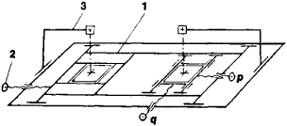
Stereo comparator
For measuring photo coordinates and parallax (x, y, dx, dy) on images of overlapping photos (left and right photos).
It has two carriages to carry photos, binocular for viewing and hand-wheels for moving floating marks.

Slide 3
Stereoscopic Plotting Instruments
Stereoscopic plotting instruments are instruments
designed to provide rigorously accurate solutions for
object point positions from their corresponding
image positions on overlapping pairs of photos.
• They can produce accurate X, Y, and Z object space
coordinates when properly oriented and calibrated.
• The primary uses of stereo-plotters are compiling
topographic maps and generating digital files of
topographic information.

Slide 4
Types of Stereo-plotters
* Analogue Plotters:
Direct Optical projection instruments: create a
true three-dimensional stereo-model by
projecting transparency images through
projector lenses forming directly observed rays.
Mechanical or optical‐mechanical instruments
can create 3D model through mechanical
means (space rods)
• Analytical plotters: most of the work done by
Computer (inner and analytical relative and absolute orientation)

Slide 5
Principles of Stereo-plotters
One of the main tasks of all stereo-plotters is to
establish the projective relationship between each model point and its corresponding image points on the stereo-pair of photographs to allow observing a model of the photographed ground.
• In the analog plotters (optical, mechanical and opto-mechanical) this relationship is realized by analog means, either optically, or mechanically or optical‐mechanically.
• In the analytical plotters, the projective
relations are implemented analytically using computer

Slide 6
Components of stereo plotters
All stereo plotters should have the following system components, being formed in different designs:
- Projection System: Two projection plates for left and right photos with lenses and lighting systems
- Orientation system to view the photos stereoscopically
- Viewing system to observe the model
- Measuring or plotting system for output of survey data

Slide 7
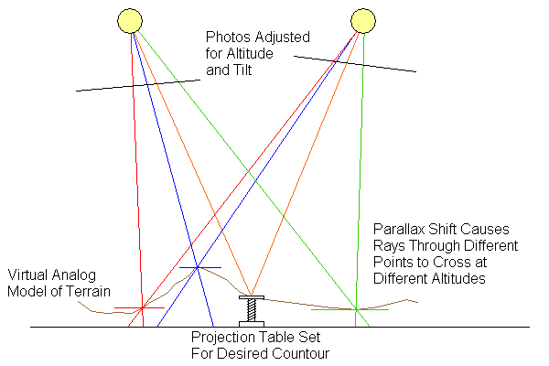
Direct Optical Projection

Slide 8
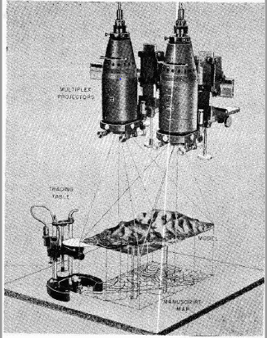
Direct Optical Projector
Multiplex plotter is a typical example
Projectors
Projected rays
Tracing Table stereo
plotting table model

Slide 9
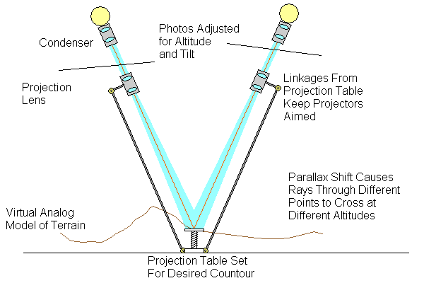
Optical-Mechanical Projection

Slide 10
Parts of Direct Optical Stereo-plotters
1. Main frame
2. Reference table
3. Tracing table
4. Platen
5. Guide rods
6. Projectors
7. Illumination lamps
8. Diapositives
9. Leveling screws
10. Projector bar
11. Tracing pencil

Slide 11
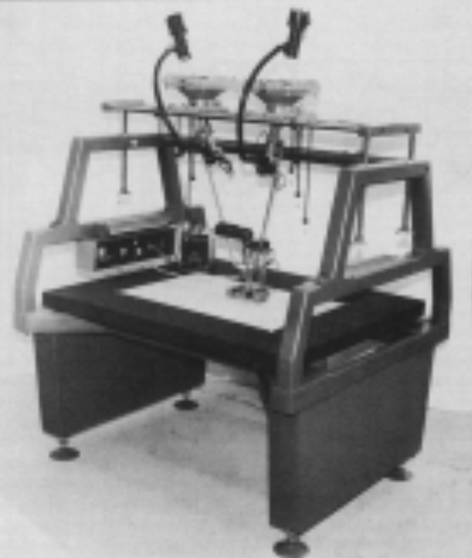
Kelsh Direct Optical Projection Plotter an exaample

Slide 12
Mechanical Projection Plotters
Space rods are used to simulate direct optical
projection of light rays
• Advantages of MP instrument over direct optical
Plotters:
– More versatile
– Higher accuracy
– Better overall stability
– Need not be operated in dark room

Slide 13
Parts of Mechanical Projection Plotters
Example: Wild B8

Slide 14
Mechanical Projection Plotters
Diapositives are placed in carriers and illuminated from above
• Space rods are free to rotate about gimbal joints: O’ and O” and can slide up and down through joints
• Model air base defined by O’O” model base
• Joints are fixed in position except their spacing can be changed (base length)

Slide 15
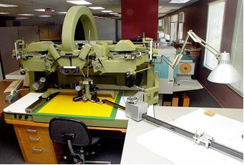
Mechanical Projection Plotter
Wild B8-S

Slide 16
Analytical Plotters
Development became possible with advances in computers,
digital encoders and servo-systems
Exact Mathematical Models define the Stereo-model
Precisely measure x and y photo coordinates on both photos of a stereo-pair (2-3 microns)
* Can be used for preparing maps, photo mosaics and digital models from unlimited focal length and tilted photos

Slide 17
Analytical Plotters
The analytical stereo-plotter became a popular machine of choice photogrammetry since the late 1960s to 1970s.
Computers allowed orientation and precise calculations that ensure additional accurate output instead of approximations.
Analytical stereo-plotters edged out their analog predecessors and became the primary method of acquiring elevation data from stereo photographs.
Analytical stereo-plotters use a mathematical projection based on the co-linearity (two vectors pointing in the same direction) equation model, course SE 422.

Slide 18
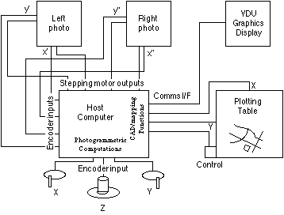
Components of Analytical Plotter
All analytical plotters have the following common components:

Slide 19
Analytical Plotters Models
Zeiss P‐3
Wild BC-1
Analytical approaches have demonstrated efficiency in term of costs, accuracy and time.

Slide 20
Analytical versus Analogue Plotters
Analytical Plotters have the following advantages over analogue plotters:
- Optical and mechanical errors from light rays and mechanical space rods are not introduced, with image measuring accuracy up to 2 micrometers
- They can correct any combination of systematic errors (lens distortion, shrinkage, refraction, earth curvature)
- Redundant observations and least squares can be used.
Any form of photography can be accomodated: tilted, oblique, terrestrial, very long focal length, etc.

Slide 21
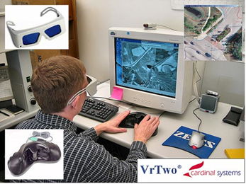
Digital Photogrammetric
Workstation
Digital photogrammetric workstations are now replacing previous stereo plotters.
Digital (softcopy) photos are used. The viewing system of digital stereo plotters may be either: anaglyph, polarization or shuttering in combination with appropriate glasses.

Slide 22
Digital Plotters
• Digital stereo plotters have become more and more common because they have the distinct advantage that there are no mechanical or moving parts, except for the scanner.
• A further advantage is that image processing techniques can be used to enhance or otherwise manipulate the digital images either prior to or after photogrammetric analysis.

Slide 23
Orientation of Photo Pairs
The objective of orientation is to transform
centrally projected images into a three-dimensional
model, which we can use to plot an orthogonal map.
• Steps of Orientation are:
– Interior orientation
– Relative orientation
– Absolute orientation

Slide 24
Interior Orientation
Objective is: to recreate the geometry of the projected rays or to duplicate exactly the geometry of the original photos.
It is composed of Three steps:
1. Centering diapositives on the projectors
2. Setting the proper principal distance in the plotter
3. Compensation for image distortions (camera inner orientation)

Slide 25
Elements of Interior orientation
Elements of Interior Orientation are:
1. The camera focal length, f
2. Location of the principal point with respect to
the fiducial marks, (xo, yo)
3. All distortion parameters
A. Correction for film shrinkage and expansion
B. Correction for lens distortion
dr = ko r + k1 r3 + k2 r5 + k3 r7 rc = r – dr
where r is the radial distance from the principal point
ko, k1, k2, k3 are coefficient of the polynomial

Slide 26
Relative Orientation
Definition and function:
Relative orientation can be defined as the placing of two overlapping bundles of rays in their correct relative position so that all corresponding pairs of rays intersect, thus forming a model surface.
The bundles are generated by the central projection of the photographs and are supposed to have the correct shape through accurate interior orientations. Once the model surface has been formed it has to be scaled and levelled, but that is part of the absolute orientation to be discussed later.

Slide 27
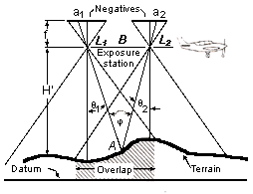
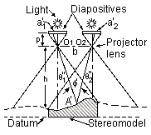
Relative Orientation
Aerial Photography to Stereo model

Slide 28
Relative Orientation Elements
Projectors must have rotational and translational movement capabilities
– 6 possible movements for each projector
• ω (omega) – x rotation also called roll
• ϕ (phi) – y rotation also called pitch
• κ (kappa) – z rotation also called yaw
• bx translation
• by translation
• bz translation
These are called relative orientation elements (ROE).

Slide 29
Base setting
Once the relative orientation is completed, the right- hand projector may be shifted parallel to itself along O'O" without upsetting the intersection of rays.
That is to say, bx may be given an arbitrary value, and need not be considered in the relative orientation.
This, to a certain extent may also be deduced from the fact that relative orientation is the elimination of y-parallaxes, upon which a correction to bx cannot have any effect

Slide 30
Standard Points of Relative Orientation
Because there are five independent degrees of freedom for relative orientation, five points are necessary and sufficient for the elimination of y-parallax.
These points may be chosen anywhere in the model, provided no more than two are on the same line parallel to the base, otherwise the solution becomes indeterminate.
The fact that the five points may be chosen at random with one restriction only means that the relative orientation of irregular models (eg with part of the area consisting of water or featureless terrain) is possible.

Slide 31
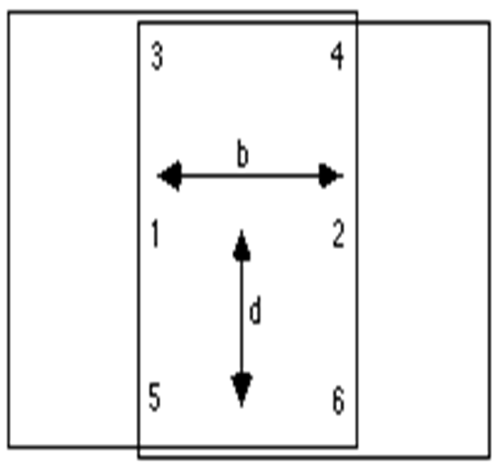
Standard Points of RO
Five points known as Standard Relative Orientation Points are used when removing y-parallax, denoted 1 to 6 and distributed as follows:

Slide 32
Standard Model Relative Orientation
Points

Slide 33
Effect of projectors movements on image points

Slide 34
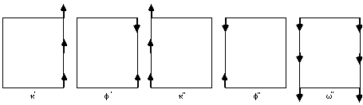
Effects of Movements of Orientation Elements on Stereo model

Slide 35
Principle of RO movement to clear y-parallax
The selection of which orientation elements to use in order to eliminate y-parallax is based on:
•For a given point, clear the y-parallax by that orientation element which causes a maximum y-displacement at the point
•At any subsequent point, use the orientation element which will not introduce y-parallax at a previously cleared point.
* Two Methods of y parallax removal will be considered:

Slide 36
Methods of Relative Orientation
These two methods can be used manually, numerically or analytically and digitally:
Method (1): by orienting the position and attitude of one photograph with respect to the other (the latter being fixed in space): Dependent Relative Orientation.
Method (2): by orienting the attitude of both projectors with respect to the same reference system (Independent Relative Orientation)
• The following diagrams show each of the two methods

Slide 37
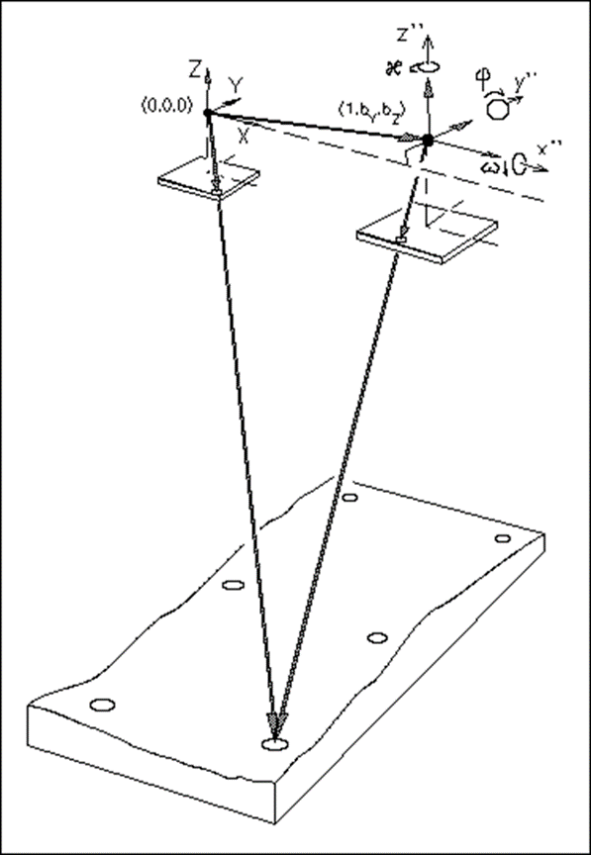
Dependent Method of RO
ROE of only one projector will be used:
For example: fixing left
Projector and using elements
of the right projector
Five elements to be
used in Method (1) are:
b_{yR}, b_{zR}, ɷ", ɸ", k"

Slide 38
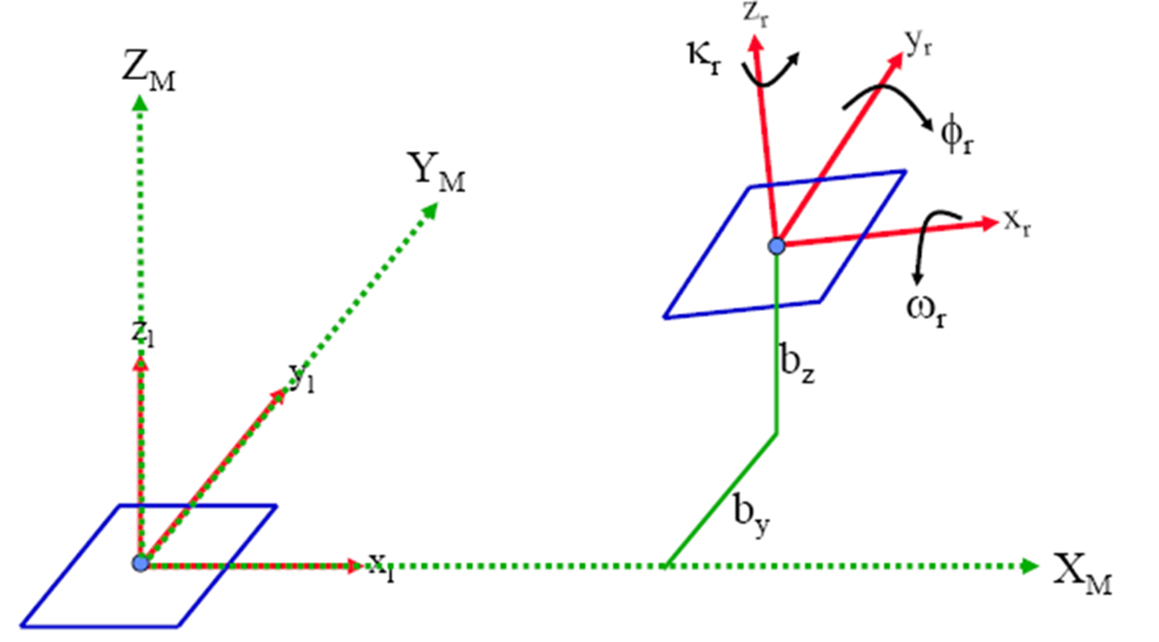
Dependent Relative Orientation
ROE of one projector: rotations and translations are used, other projector is fixed:

Slide 39
Dependent Relative Orientation
Steps to be followed for manual (empirical) orientation
Moving Right projector only (keeping left one fixed):
1. Clear py at point 2 with by”‐translation
2. Clear py at point 1 with κ” rotation
3. Clear py at point 4 with bz”‐translation
4. Clear py at point 3 with ϕ” rotation
5. Observe py at point 6 and overcorrect by
introducing 150% correction to the measured
parallax with ω”
6. Repeat steps 1‐5 until no py exists at point 6
7. Check for py at point 5.

Slide 40
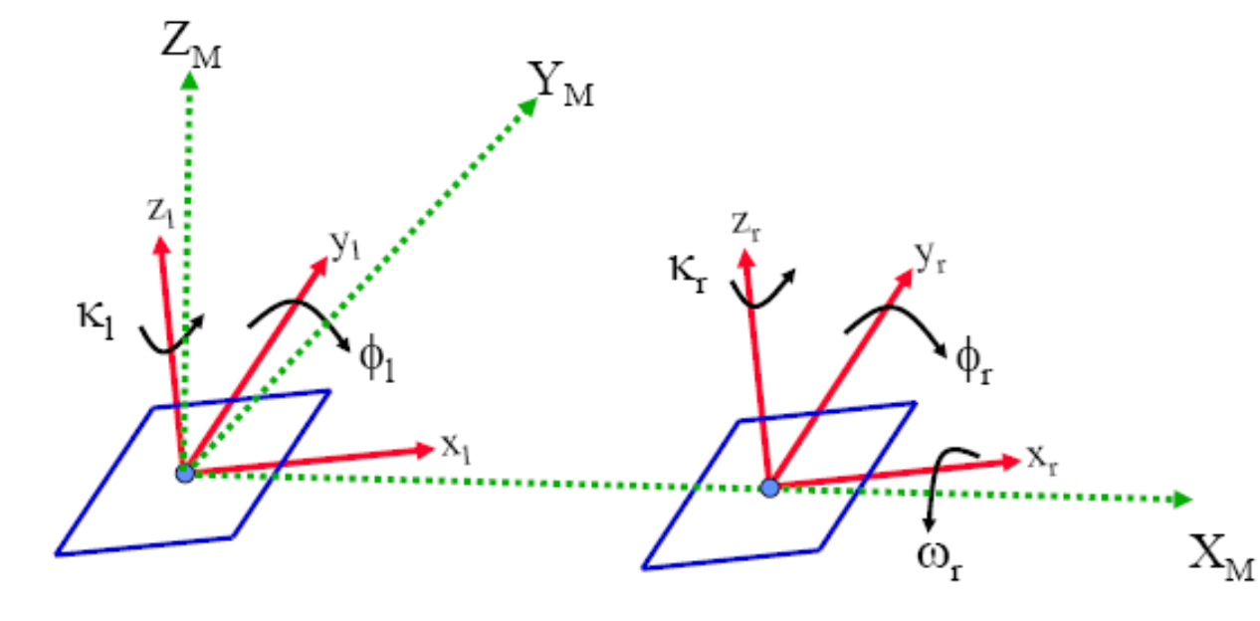
Independent Relative Orientation
Here rotation elements of both projectors are used:

Slide 41
Independent Relative Orientation
Empirical Orientation
Use rotations of both projectors:
1. Clear py at point 1 with κ”
2. Clear py at point 2 with κ’
3. Clear py at point 3 with ϕ”
4. Clear py at point 4 with ϕ’
5. Observe py at point 5 and overcorrect by introducing 150% correction to the measured parallax with ω”
6. Repeat steps 1‐5 until no py exists at point 5
7. Check for py at point 6

Slide 42
Condition for Balanced Model Parallax
After inner orientation existing y-parallax should be such that:
2Py1+ Py4 + Py6 = 2Py2 + Py3 + Py5
Example:
The y-parallax in (µm) at the six points (satisfying balanced model condition) was recorded as:
This will allow complete relative orientation using steps of either method 1 or 2.
point | 1 | 2 | 3 | 4 | 5 | 6
Py | +2 | +3 | +4 | -1 | -2 | +5

Slide 43

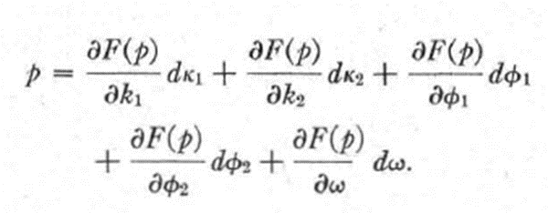
Numerical RO
Relation between ROE and y parallax:
For independent method:

Slide 44
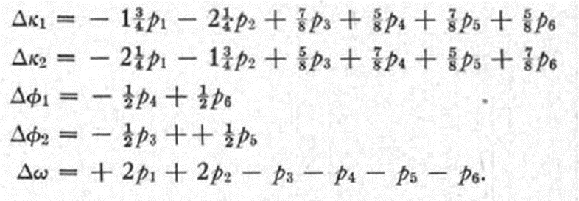
Numerical RO
Applying differentiation for independent method, resulting relation is:
Read y parallax for standard points 1 to 6 and substitute in these equations to determine ROE movements to carry out RO.

Slide 45
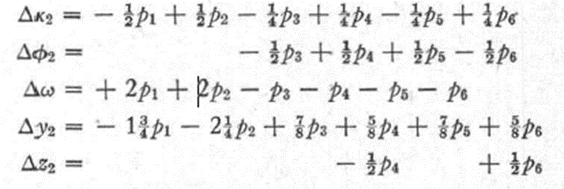
Numerical RO
For dependent method resulting relation is:
Direct reading of y parallax using by movement and substituting values of the six points in the above equations give required ROE movements for RO.

Slide 46
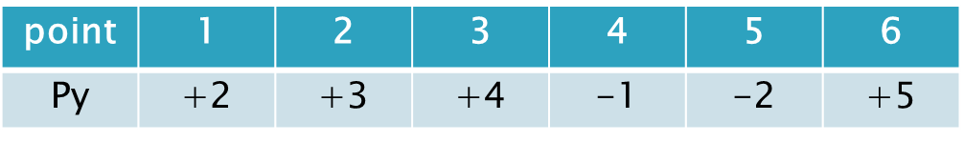
Example
Assume that y parallax (in µm) was read at each point of the 6 standard model points and recorded as in Table.
Compute required movements of ROE for dependent and independent RO method. parallax is given in (µm)
Solution:
Substitute the data in the given relation to calculate Rotations in radians and translations in the same units as of parallax (µm).. continue in the lecture.

Slide 47
Analytical Relative Orientation
Five Equations can be formulated based on collinearity or coplanarity principal to solve for required ROE movements, depending on which method is selected dependent or independent, for RO.
This will be a subject of the course SE 422.

Slide 48
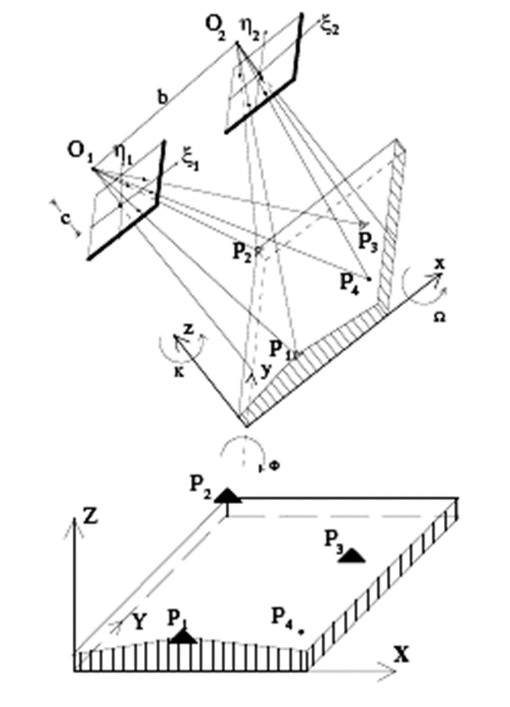
Absolute Orientation (AO)
The model formed after
RO is arbitrary in scale
and direction.
It should be scaled
horizontally
and vertically,
oriented in plan
direction and shifted.
This process needs
Ground Control points

Slide 49
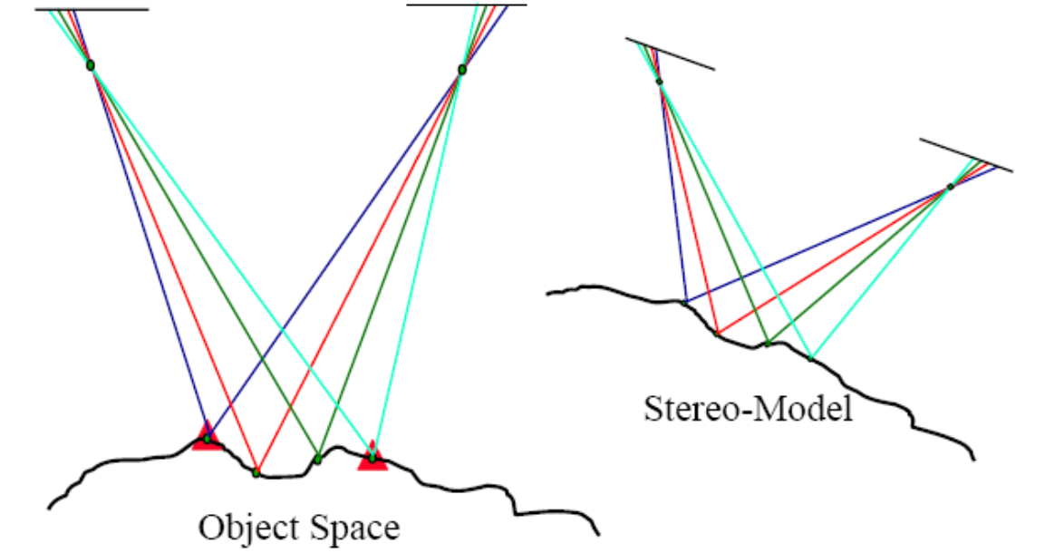
AO
The process is to scale and move observed stereo model to fit with ground

Slide 50
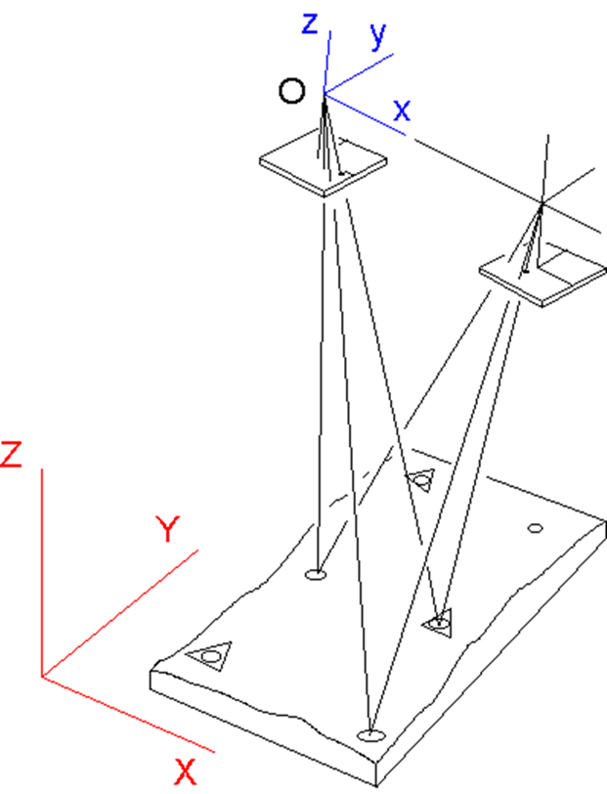
Absolute Orientation (AO)
Minimum of 2 plan control and 3 height control points are needed. For empirical AO these are first plotted on a map sheet
to scale.
Distribution:
Height control are
to be in 3 corners;
2 plan should be
far from each other
Better at opposite
Corners.

Slide 51
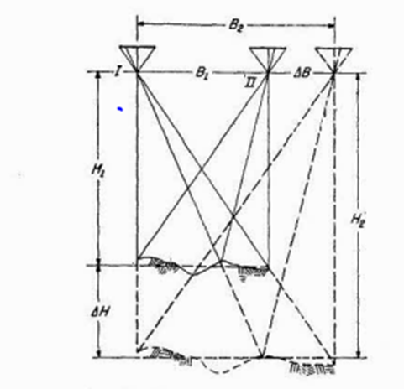
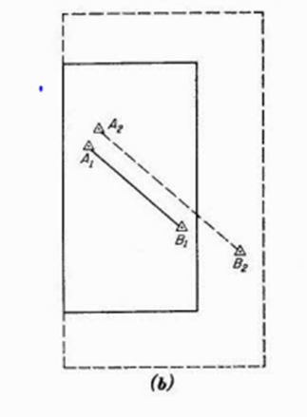
Analogue AO (Plan Scaling)
Scale change: Raising or separating projectors will change model scale in planimetry to fit ground control points already plotted to scale on plotting sheet

Slide 52
Plan Scale (base setting)
Once the relative orientation is completed, the right- hand projector may be shifted parallel to itself along O'O" without upsetting the intersection of rays.
That is to say, bx may be given an arbitrary value, and need not be considered in the relative orientation.
This, to a certain extent may also be deduced from the fact that relative orientation is the elimination of y-parallaxes, upon which a correction to bx cannot have any effect

Slide 53
Analogue AO Plan Scaling
If the distance between the given control points A and B, being plotted on the map is D1
Distance between two points A1-B1 as plotted from stereo model = D2
To fit model to ground in plan use scale
= D1 / D2
Move center of one projector relative to the other along x-axis (which will not affect y-parallax) until the required scale is reached: distance on model fit with that on the control points sheet.

Slide 54
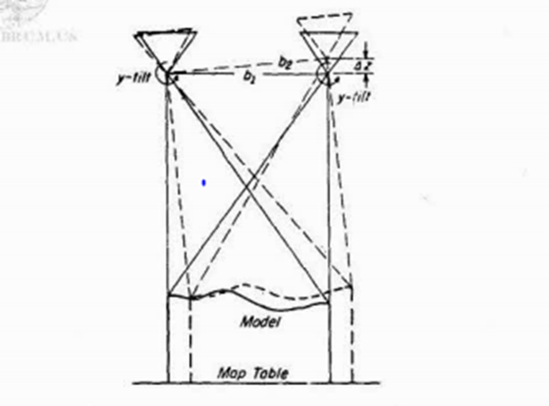
Analogue AO Levelling
Leveling is accomplished by rotating the projection plates about the x (ɷ-rotation) and y (ɸ-rotation)

Slide 55
Absolute Orientation
Difference in Level between points A1 and C1 from stereo model and given levels of control points A2 and C2 = dh_{AC} and distance between A and C along y direction = D_{AC};
Rotate model about y-axis an angle ɸ given from:
tan ɸ = dh_{AC} / D_{AC}
ɸ will result in radians, it should be converted to degrees to be introduced in the plotter.
Similar rotation is required to be done about x-axis, to determine required rotation, ɷ

Slide 56
Analytical Absolute Orientation
Absolute orientation is achieved by a 3D conformal coordinates transformation (7 parameter)
– Three rotations, to orient axes of model system to be in the same as directions of ground system
– One scale factor, so that model distance fits with corresponding ground distance.
– Three shifts (translations), to shift origin of model system to ground system
Details will be illustrated in course SE 422.

Slide 57
Output Data
After absolute orientation the plotter is ready to be used for giving required output.
A plotting sheet with ground control points should be prepared.
Details and contour lines can be traced to produce topographic map, digitize 3-D coordinates to produce DEM.

Slide 58
Photogrammetric Ground Control
Aerial survey data must be referenced to ground control points in order to maximize the absolute accuracy achievable for the aerial data.
This is achieved by survey crews establishing photo ground control within the project area.
Targets are placed over ground control so that the location of the point is easily identified on the imagery.
Ground control requirements for aerial mapping will be predicted upon flying height, terrain, equipment, accuracy requirements and technology used.

Slide 59
Photo Control Targets
The target design shall be symmetrical and centered on the aerial control point.
There are three designs commonly applied for aerial surveys. These include four-legged “X” targets, three-legged “Y” targets), and two-legged “L” targets, see next slide.
More than one type can be used for a project if there is a need to distinguish between different types of control.
The length and width of the target legs will depend on the specifications of the flight mission.

Slide 60
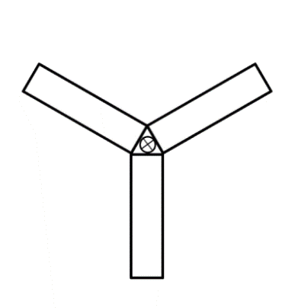
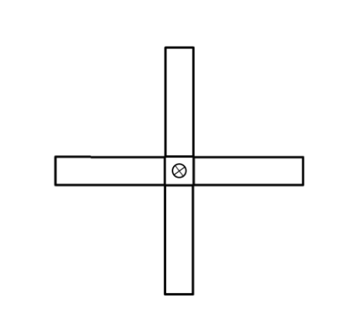
Photo Control Target Shapes
“X” Type Target
“Y” Type Target
“L” Type Target

