Slide 1
Stat 223 Introduction to the Theory of Statistics

Slide 2
(1.1)Sampling Distribution

Slide 3
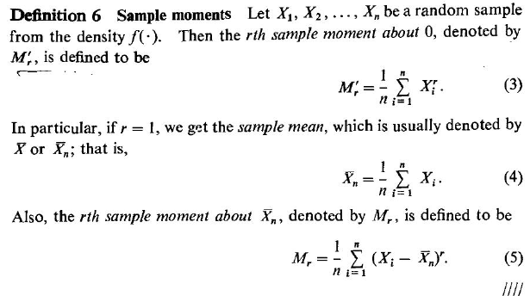

Slide 6
(1.2)Sample Mean (1.2.1) Law of Large Numbers

Slide 7
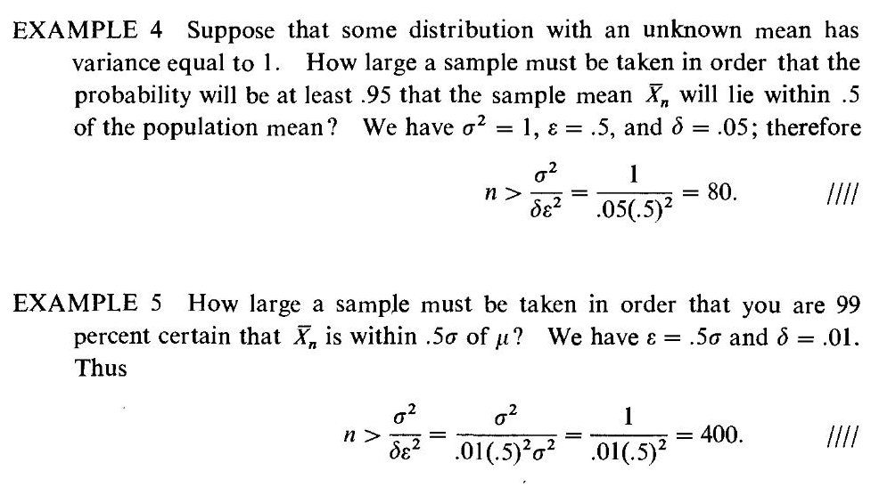

Slide 8
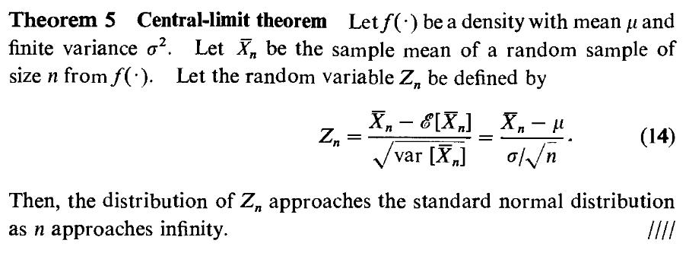
(1.2.2) Central-Limit Theorem

