Slide 1
Saliva
It is a watery secretion in the mouth produced
by the salivary glands that aids in the digestion
of food.
It serves as an aid to swallowing and digestion
by moistening and softening food.

Slide 2
1- parotid glands : which produces a serous; a watery secretion,
2-submaxillary (submandibular) glands: which produces a mixed serous and mucous secretion.
3-sublingual glands; which secretes a saliva that is predominantly mucous in character.

Slide 3
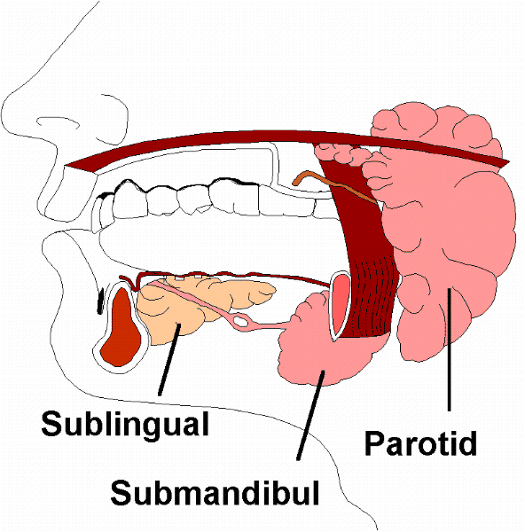
Salivary Gland
An exocrine gland in the mouth that secrete saliva.
under normal physiological conditions.
Humans have three major pairs of salivary glands
that differ in the type of secretion produced:
1- parotid glands.
2-submaxillary (submandibular) glands
3-sublingual glands

Slide 4
Salivary gland
Salivary glands are made up of secretory acini and ducts.
The basic secretory units of salivary glands are clusters of cells called an acini .
There are two types of secretions - serous and mucous.
The acini can either be serous, mucous, or a mixture of serous and mucous.

Slide 5
Acini cells

Slide 6
A serous acinus secretes proteins in an isotonic watery fluid.
A mucous acinus secretes mucin-lubricants
In mixed serous – mucous acinus, the serous acinus forms a serous demilune around mucous acinus

Slide 10
The formation of saliva takes place in two stages:
First stage, the secretory acini produces an isotonic primary saliva with ionic composition is similar to that of plasma.
Second stage, the primary saliva is modified as it passes through the duct system by selective reabsorption of Na+ and Cl- (but not water) and some secretion of K+ and HCO3⁻ .

Slide 11
Acini cells

Slide 12
The final saliva is secreted into the mouth. Thus, it becomes hypotonic with salt concentration below that of primary saliva.
Small ducts within salivary glands lead into larger ducts, eventually forming a single large duct that empties into the oral cavity.

Slide 15
properties
Volume : there is production between 0.75 – 1.5 liter of
saliva per day.
Appearance: a clear colorless fluid.
pH = 6 – 7.4
Specific gravity 1.002 -1.012 .
In healthy, non-medicated persons, the unstimulated
whole saliva flow rates 0.3 – 0.5 ml/min.
and the stimulated whole saliva flow rates
1.0 – 1.5 ml/min.

Slide 16
Stimulation of saliva secretion
Secretion of saliva is under control of the nervous
system.
Potent stimuli for increased salivation include the
presence of food or irritating substances in the mouth.
(taste, mastication)
The composition of saliva is affected by the salivation
rate , during maximal salivation , the rate of formation of
the primary secretion increases, which makes it flow
through the ducts rapidly.

Slide 17
Salivary Composition
Normally saliva is composed of more than 99% water and less than 1% of solutes (such as electrolytes, enzymes, mucus, antibacterial compounds)

Slide 18
Organic Components of Saliva
such as:
Amylase
Lysozymes
Histatins
Secretory IgA
peroxidases
Lipase
Kallikrein
proline-rich protein
mucins
Statherin

Slide 19
There are three major enzymes found in saliva.
α-amylase :starts the digestion of starch before the food is even swallowed. It has a pH optima of 7.4.
lingual lipase. Lingual lipase has a pH optimum ~4.0 so it is not activated until entering the acidic environment of the stomach.
Antimicrobial enzymes that kill bacteria.
Lysozyme
Salivary lactoperoxidase
Lactoferrin
Immunoglobulin A
Proline-rich proteins (function in enamel formation, Ca²⁺-binding, microbe killing and lubrication)

Slide 20
Mucins:
Mucins (glycoproteins) are essential components in human saliva. They lubricate the oral mucosa and give saliva its viscosity characteristic.
Lactoferrin:
It is an iron binding protein ( it can deprive microorganisms from iron acting as playing an antimicrobial role).

Slide 21
Statherins:
It is a salivary protein that prevents precipitation or
crystallization of supersaturated calcium phosphate
in ductal saliva and oral fluid.
Histatins:
A group of small histidine-rich proteins that have an
a antimicrobial and antifungal effect.

Slide 22
Salivary gland stones (salivary calculi):
are deposits of minerals (calcified structure) that may
form inside a salivary gland or duct. It can block the
flow of saliva into the mouth.
This may cause pain and swelling of the gland.
Salivary stones are formed when chemicals in the saliva
accumulate in the duct or gland.
80% of stones originate in the submandibular glands.
They mostly contain calcium

Slide 23
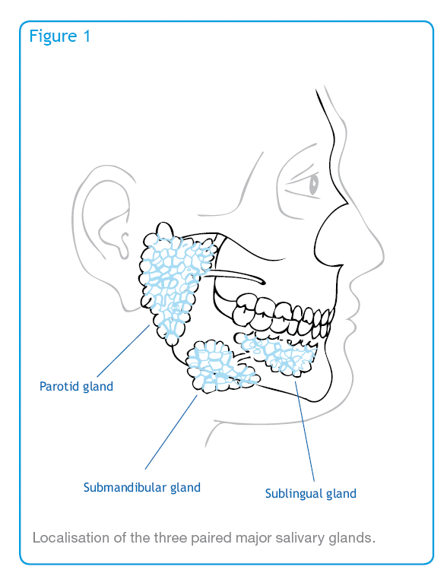

Slide 24
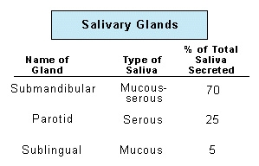

Slide 25
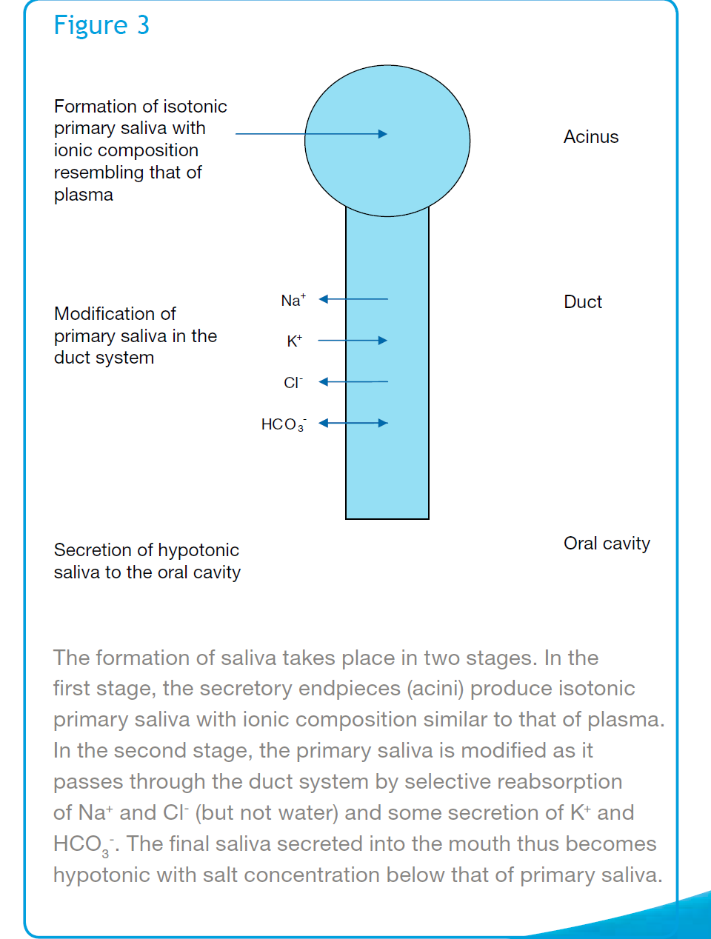

Slide 26
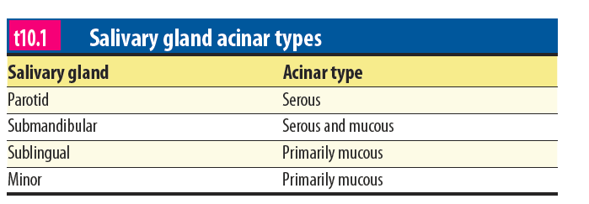

Slide 27
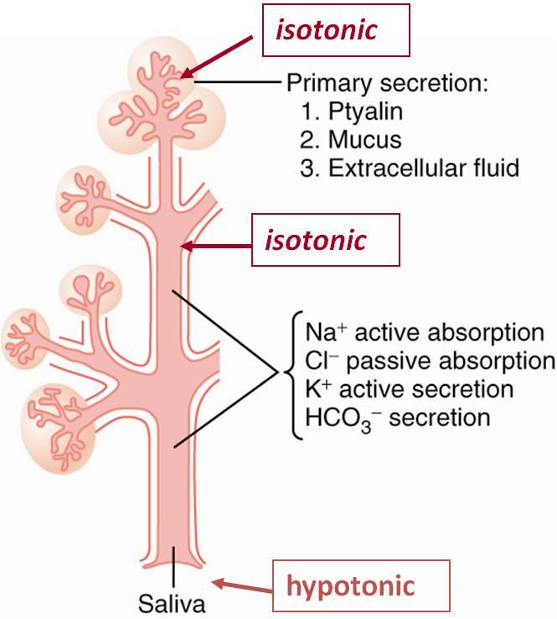

Slide 28
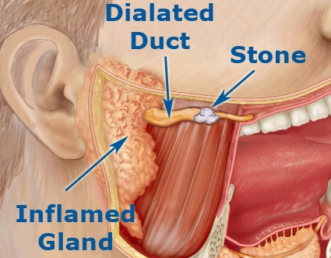

Slide 29
https://www.youtube.com/watch?v=AEBoOZQ_r30
https://www.youtube.com/watch?v=BST5-J4xCNE
https://www.youtube.com/watch?v=3j6fJxgb1fM

