Slide 1
Advanced Solid State Physics
Syllabus of the Phys 672
Electron-electron interactions,
Electron-phonon interactions,
Dielectric and Optical Properties
Magnetism in solids: Magnetic Properties, Diamagnetism and Para magnetism, Magnetic Resonance,
Superconductivity and Ginzburg-Landau equations.

Slide 2
Books
Introduction to solid state physics:
by Charles Kittle
2.
by

Slide 3
Review of Free Electron Model
1. Classical Theory
Drude Model
2. Quantum theory

Slide 4
Drude model
History
Hundred years ago (around 1900) there was no understanding of physics of solids.
There was no explanation of Photo electric effect.
Rutherford has not determined the size of the nucleus.
Bohr had not given the shell (discrete energy level ) picture of atom.
Formulation of quantum mechanics was decade behind.
Thomson had discovered the electrons in 1897

Slide 5
Drude model continue
Drude in 1900 formulate a model to explain the two of the most striking properties of the metallic state: namely conduction of electricity and heat.
Physical model: In metallic state most loosely bound electrons some how become mobiles.
These electrons behaves like classical particles generally we call it electron gas.
Energy of the electron is determined by the temperature of metal.
The electrons don’t interact with each other rather with the much larger atomic cores.

Slide 6
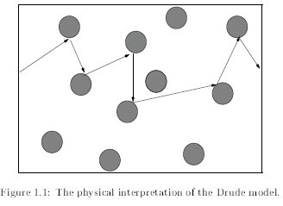
Drude model continue
Geometrical consideration imply mean free path between collision of λ ∼1/(πR²n)
Where R is core radius and n # of atoms per unit volume
Estimate the number of electrons per unit volume.

Slide 7
continue
n =( N_{A}Z_{c} ρ_{m})/A
= (6:02 x 10²³atoms/mol x1e/atomx1x10⁶g/m³)/ 29g/mol
= 2 x 10²⁸ e/m3
where N_{A} is Avogadro's number, ρ_{m} is the density of the metal, A is the atomic
number of the element and the numbers are for Na (sodium).
He assumed that after collision a conduction electron has random direction and speed and does not depend on velocity before.

Slide 8
continue
By analogy with ideal gas, Maxwell Boltzman distribution was applied for electrons.
Thermal velocity of electron is order of 10⁵ m/s.
But average velocity is zero.
If the electron is subjected to external force, then the electrons accelerate.
However in Drude model the collision of electrons with atomic cores prevents to accelerate indefinitely rather results in establishment of drift velocity in the direction of the force.

Slide 9
A statistical equation for describing the "mean drift velocity" in the direction of the field may be written:
where τ is the "mean free time" or "relaxation time" (the "mean free path" λ is given by t times the "mean thermal velocity", v_{therm}. When the field is zero, this equation, obviously, describes the decay of any gross charge carrier motion in any particular direction.

Slide 10
This equation has the simple solution:
where
is the mobility. Finally, if we have n charge carriers per unit volume, the net flux of charge carriers per unit time is given by

Slide 11
continue
and the current density by
Where
is electrical conductivity.
If we have both negative and positive charge carriers then

Slide 12
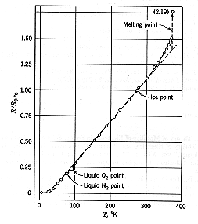
continue
For metals the number carriers is fixed and the essentially linear temperature dependence of metallic conductivity is attributed to the temperature dependence of the mobility.
Electrical conductivity of sodium metal
There are a couple of implications of this. For a metal like Na with a resistivity, ρ_{Na} = 1/σ= 50 nΩ-m the relaxation time is about 10⁻¹⁴ s.

Slide 13
QUANTUM MECHANICAL TREATMENT OF ELECTRON GAS
We find the ground state properties of N electrons confined in Volume V.
Ground state of N independent electrons can be found by finding the energy levels of single electron in the volume V and filling the N electrons according to Pauli exclusion principle.
A single electron will satisfy the time independent Schrödinger equation

Slide 14
continue
Confinement of electrons is represented by boundary condition of
The choose of boundary condition
Whenever one is dealing with problems that are not explicitly concerned with the effects of metallic surface, then choice of boundary condition is on one’s disposal and can be determined with mathematical convenience. If metal is sufficiently large , we expect that bulk properties will be unaffected by the detailed configuration of surface.
Our choice will be cube of length L=V^{1/3}

Slide 15
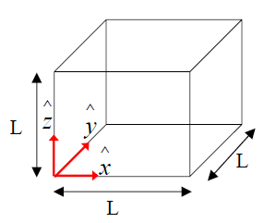
Boundary condition
The boundary condition
Every where outside the box
In particular at boundaries.

Slide 16
Boundary condition
Taking wave function 0 at boundary gives standing wave solution inside the box. Which is unsatisfactory.
Transport of charge and energy of electrons are more conveniently discussed in terms of running wave.
This can be achieved by assuming the periodic boundary condition.

Slide 17
continue
The analytical form
Ψ(x,y,z+L)=ψ(x,y,z)
ψ(x,y+L,z)=ψ(x,y,z)
ψ(x+L,y,z)=ψ(x,y,z)
This boundary condition is known as Born-von Karman boundary condition.
The solution of Schrodinger eqn is
ψ(r)= Ae^{ik.r} = (1/V) e^{ik.r}
where E = ħ²k²/2m

Slide 18
continue
Energy
$E={[ℏk]}^{2}$/2m

Slide 19
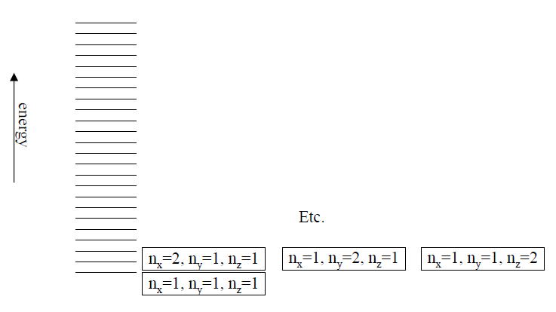
Energy Spectrum for many electrons

Slide 20
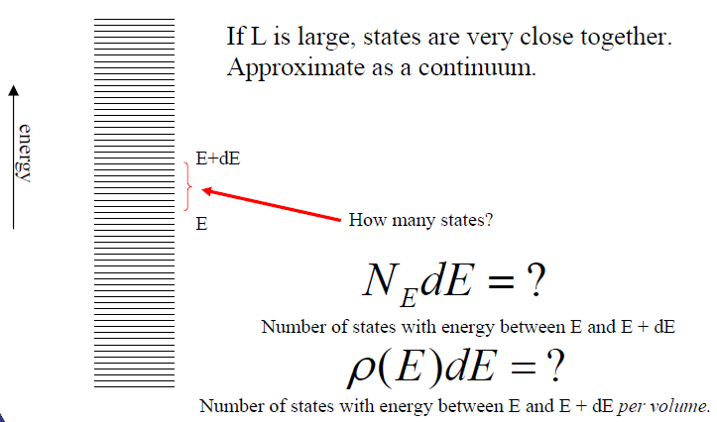
Density of states

Slide 21
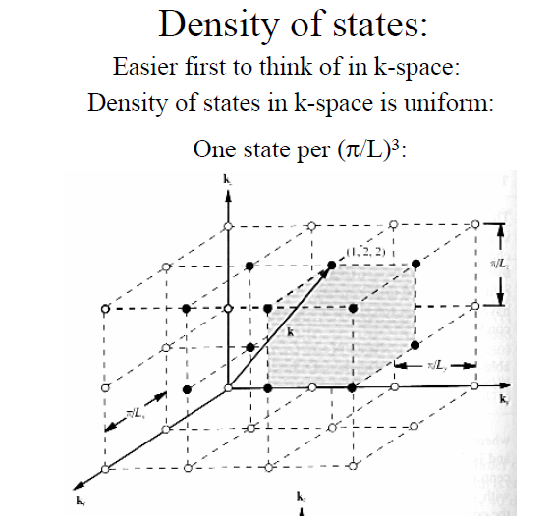
K -Space

Slide 22
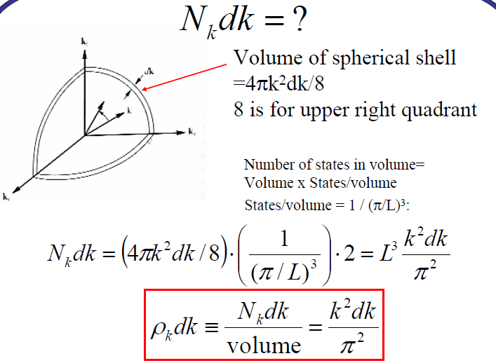
continue

Slide 23
continue
In terms of energy
Solve it at home

Slide 24
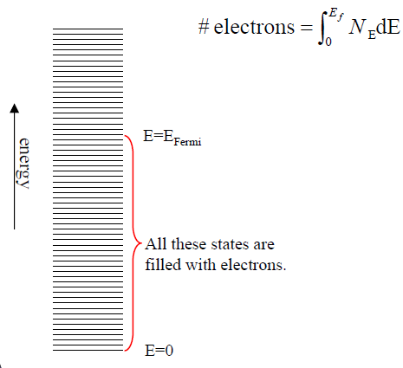
Fermi energy
How to calculate

Slide 25
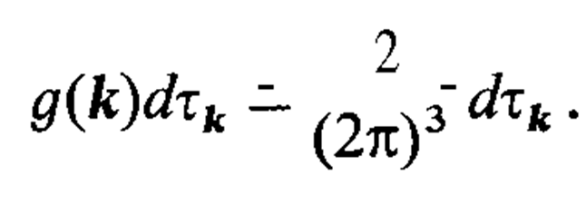
Ground state of N non interacting electrons gas
We define the density of states g(k)

Slide 26
The number of states in a given energy range (E,dE) is equal to the volume enclosed between the spherical shells E +dE = constant and E = constant, multiplied by the density of states in k-space.
From this we obtain the density of states on the energy scale

Slide 27
We now consider an electron gas with N electrons. The state of lowest energy
(ground state) will then correspond to the N/2 points in k-space having the
lowest energy, each being occupied by two electrons (Fig. 2.1). In k-space these
points fill a sphere of radius (Fermi sphere). is defined by the condition

Slide 28
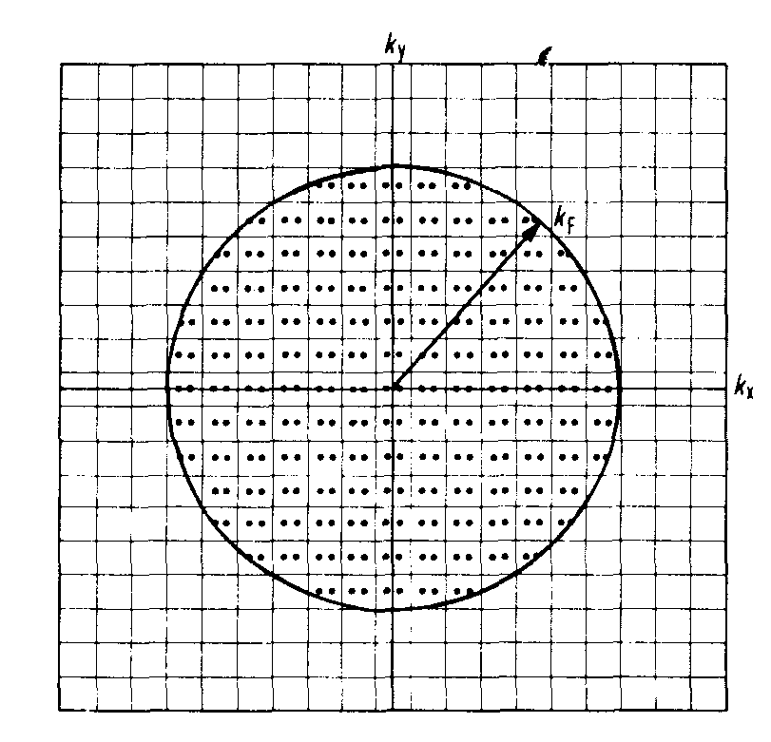
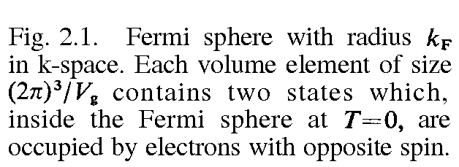

Slide 29
Here n= N/V_{g} is the electron concentration.
We then have the following expression for the Fermi radius K_{F} and for the energy of electrons at the surface

Slide 30
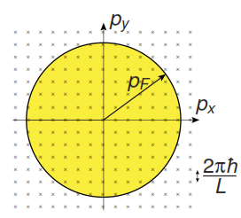
Excited states
The excited states of the system consist of states where one or more fermions is excited to higher energy states. The average occupations of the states at a given temperature T is given by the Fermi-Dirac distribution

Slide 31
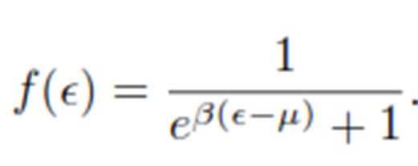
Fermi Dirac distribution

Slide 32
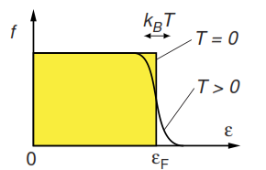
Fermi Dirac distribution

Slide 33
Excited state

Slide 34
Excited state

Slide 35
Excited State

Slide 36
Excited state

Slide 37
Excited State

Slide 38
Average Energy and Specific heat
Calculate ground state energy

Slide 39
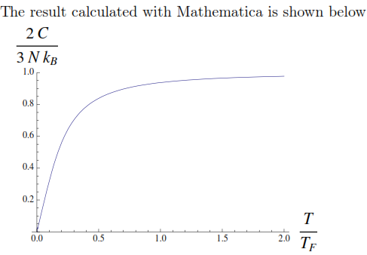
Specific heat

