Slide 1
Fundamentals of crystal Structure
LATTICE : An infinite array of points in space, in which each point has identical surroundings.
By "identical surroundings” we mean that the lattice of points, when viewed in a particular direction from one lattice point, would have exactly the same appearance when viewed in the same direction from any other lattice point.
The lattice points are just mathematical construction.

Slide 2
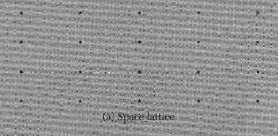
Fundamentals of crystal Structure
LATTICE : An infinite array of points in space, in which each point has identical surroundings to all others.

Slide 3
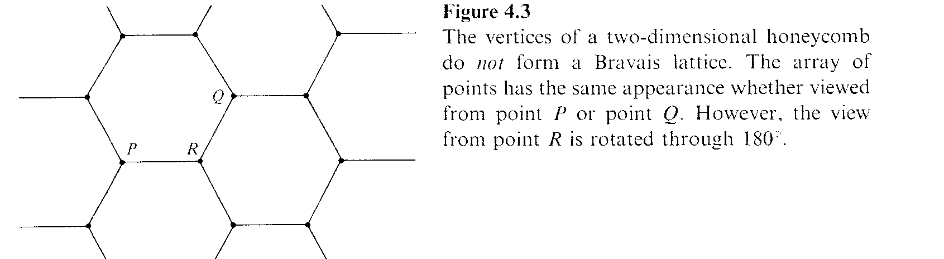
Bravais Lattice
An infinite array of discrete points with an arrangement and orientation that appears exactly the same, from any of the points the array is viewed from.
Honeycomb: NOT Bravais

Slide 4
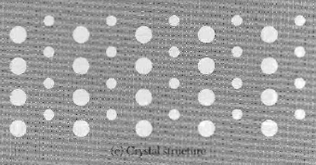

Fundamentals of crystal Structure
CRYSTAL STRUCTURE: The periodic arrangement of atoms in the crystal. It can be described by associating with each lattice point a group of atoms called the BASIS.
Every basis in a given crystal is identical to every other in composition, arrangement, and orientation

Slide 5
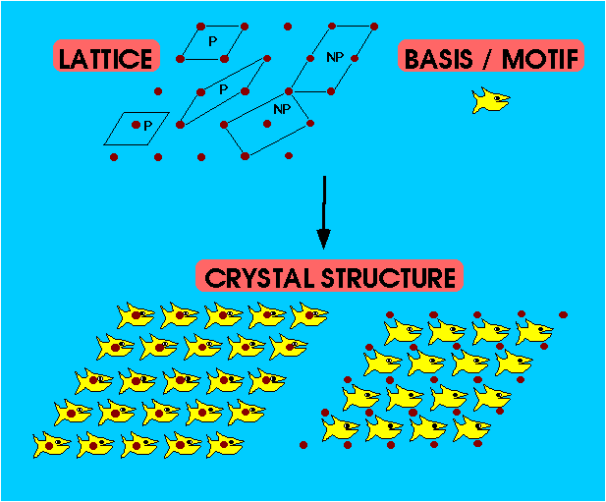

Slide 6
Lattice point and Basis
Don't mix up atoms with lattice points
Lattice points are infinitesimal points in space
Atoms are physical objects
Lattice Points do not necessarily lie at the centre of atoms

Slide 7
Basis
The number of atoms in the basis may be one, or it may be more than one.
The position of the center of an atom j of the basis relative to the associated lattice point is

Slide 8
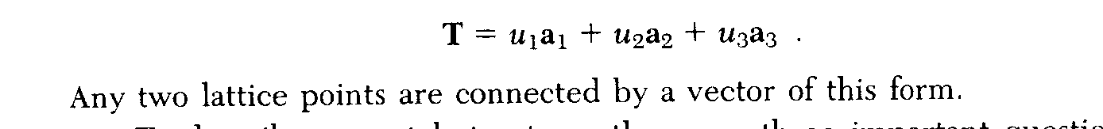
Translation Vector T
A three dimensional Bravais lattice consists of all points with position vectors R that can be written as a linear combination of primitive vectors. The expansion coefficients must be integers.

Slide 9
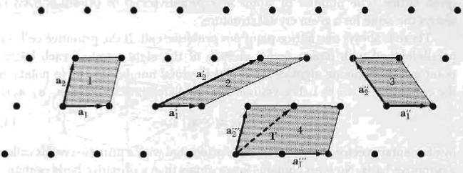
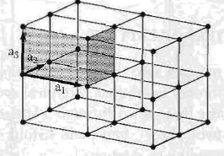
Primitive translation vectors a_{i}
Lattice points of a space lattice in two dimension. All pairs of vectors a₁ and a₂ are translation vectors of the lattice. But a₁”’ and a₂”’ are not primitive translation vector.
The parallelogram 1, 2 and 3 are equal in area. These pairs may be taken as primitive lattice translation vectors. Some time this called lattice constant. some time .

Slide 10
Unit cell
UNIT CELL = The smallest component of the crystal, which when stacked together with pure translational repetition reproduces the whole crystal
Primitive (P) unit cells contain only a single lattice point
These vectors a₁, a₂, a₃ define the cell and are called the crystallographic axes of the cell.
They may also be described in terms of their lengths (a₁, a₂, a₃ ) and the angles between them (α, β γ).
These lengths and angles are the lattice constants or lattice parameters of the unit cell.

Slide 11
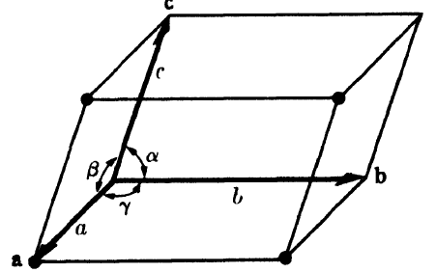
Primitive lattice vectors in 3-D
Primitive cell “of space lattice in three dimension”

Slide 12
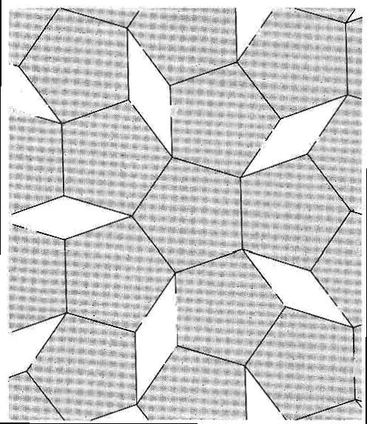
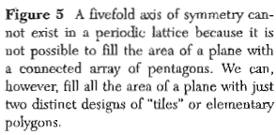
Pentagon can not be unit cell

Slide 13
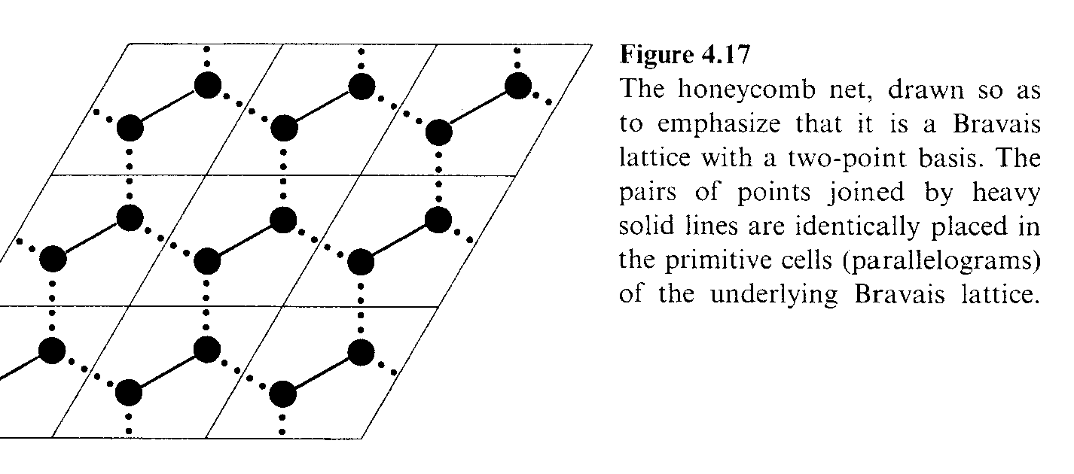
Honeycomb net: Bravais lattice with two point basis

Slide 14
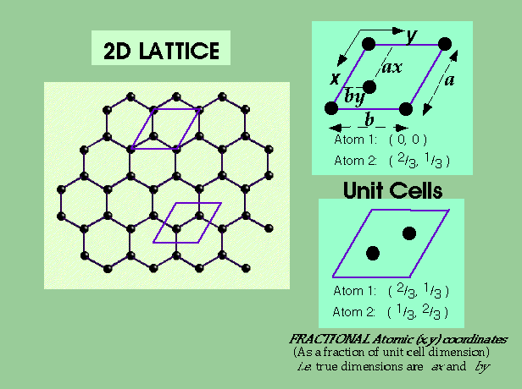
2D LATTICES
the fused hexagonal pattern of a single layer of GRAPHITE

Slide 15
Counting Lattice points and Atoms in Unit Cell
Unit cell is Primitive (1 lattice point) but contains TWO atoms in the Basis
Atoms at the corner of the 2D unit cell contribute only ¹/₄ to unit cell count
Atoms at the edge of the 2D unit cell contribute only ¹/₂ to unit cell count
Atoms within the 2D unit cell contribute 1 (i.e. uniquely) to that unit cell

Slide 16
Types of Lattice
Two dimensional
An oblique lattice has arbitrary a₁ and a₂ and is invariant only under rotation of π and 2 π about any lattice point.
If we put restriction on a₁ and a₂
There are five distinct type of Bravais lattice (point lattice) in two dimensions. One oblique and four special types

Slide 17
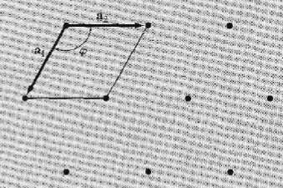
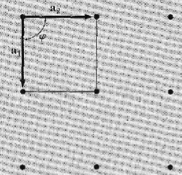


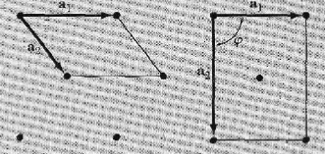
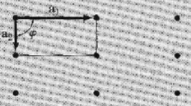


Four special lattice in two dimension

Slide 18
Types of Lattice
Three dimensional
The general unit cell in three dimension is triclinic.
We can produce six special unit cells in three dimension putting restricting on a, b, and c

Slide 19
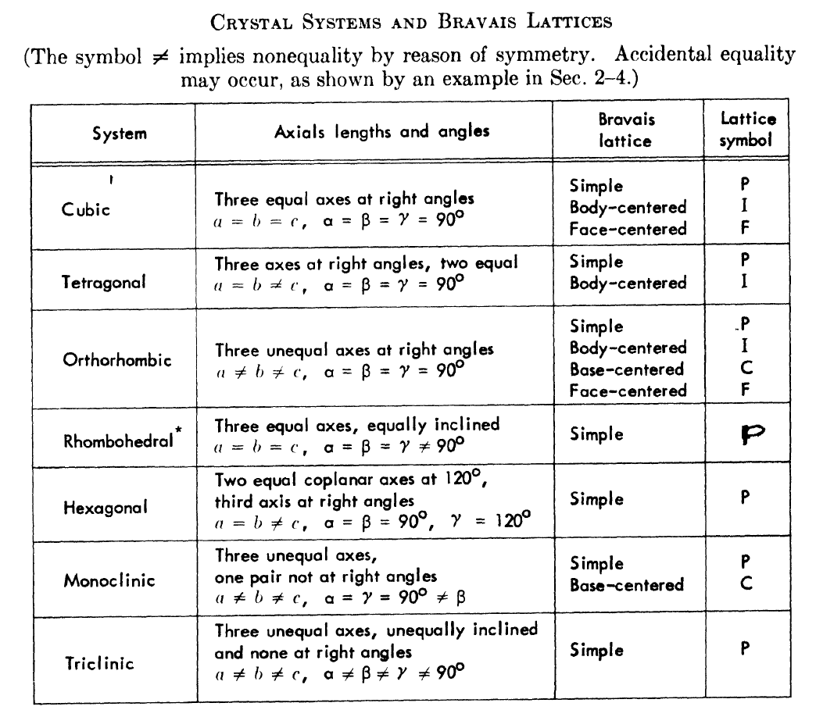

Slide 20
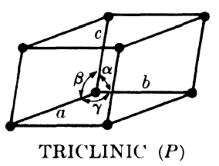
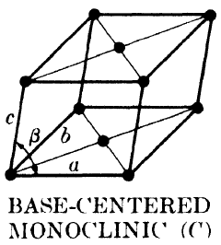
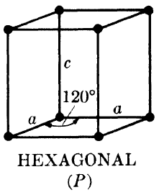
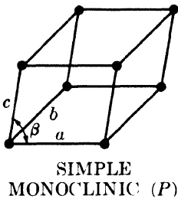

Slide 21
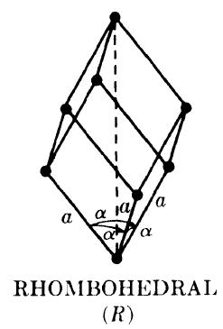
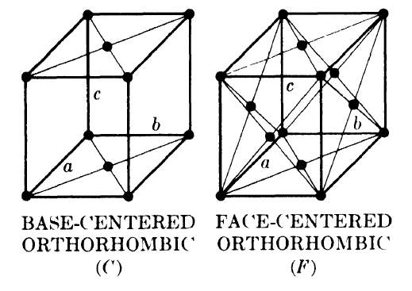
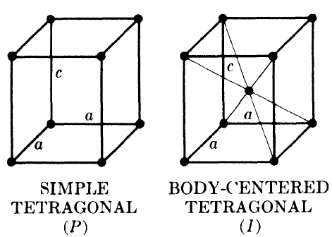
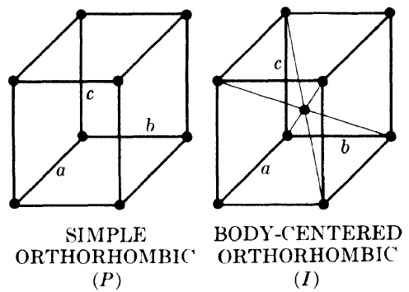

Slide 22
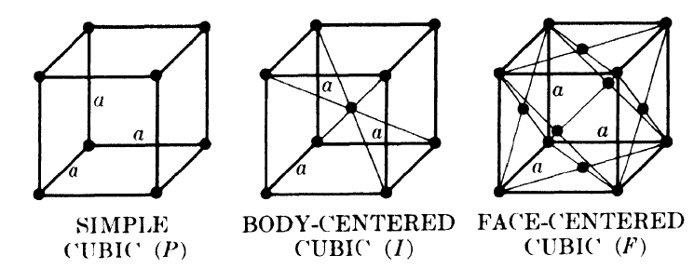

Slide 23
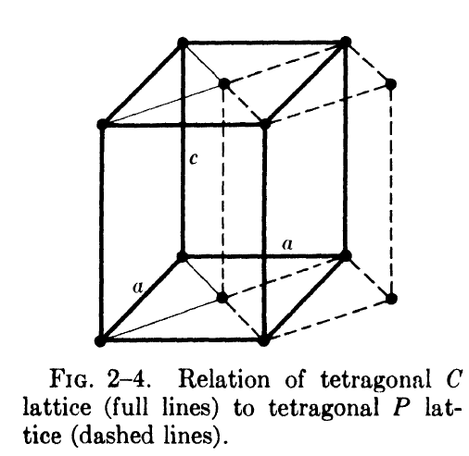

Slide 24

Counting Lattice points and Atoms in Unit Cell
where Ni = number of interior points, N_{f} = number of points on faces, and N_{c} = number of points on corners.
The symbols F and I refer to face-centered and body-centered cells, respectively.
While A, B, and C refer to base-centered cells, centered on one pair of opposite faces A, B, or C. (The A face is the face defined by the b and c axes, etc.)
The symbol R is used especially for the Rhombohedral system.

Slide 25
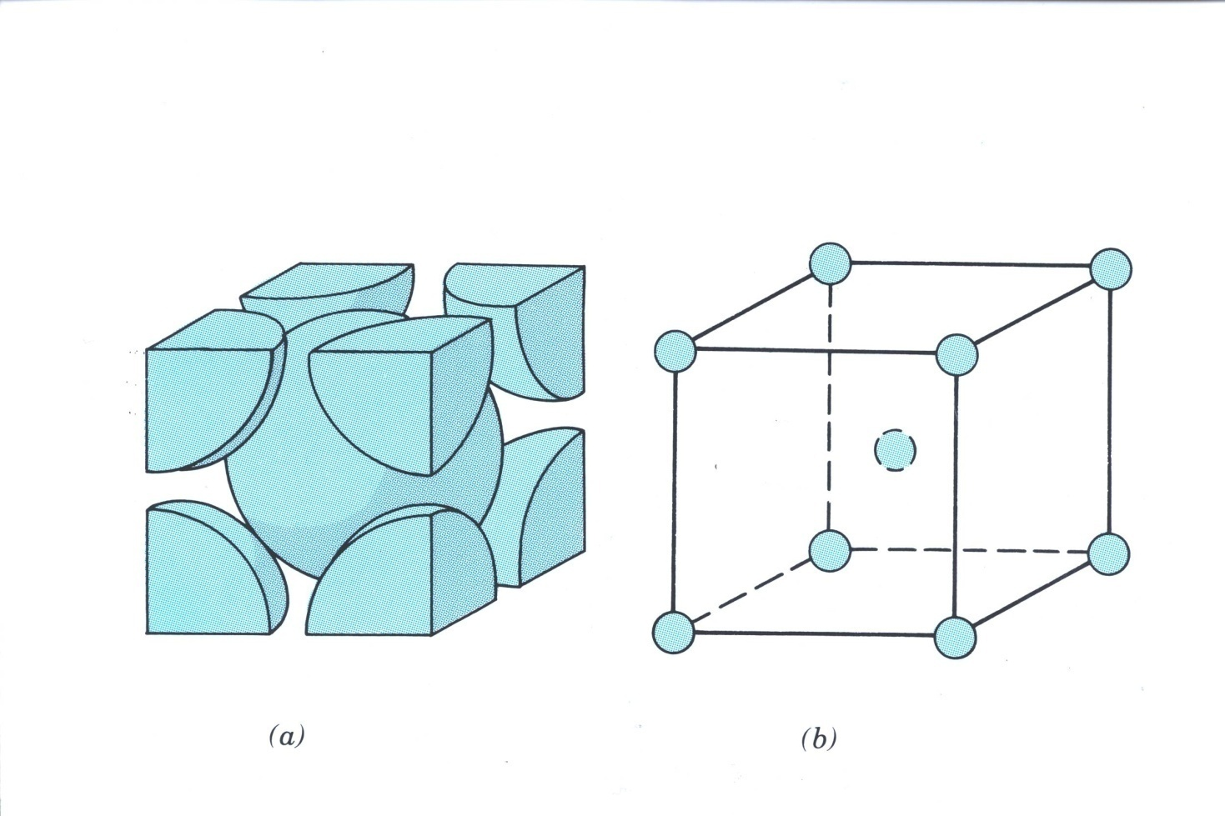
BCC Lattice

Slide 26
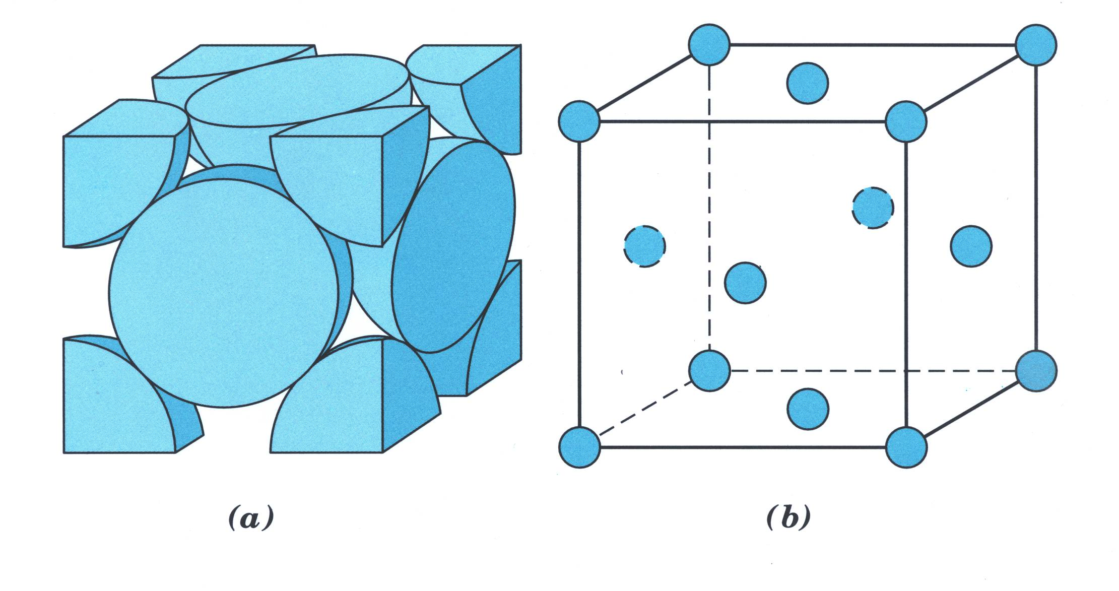
FCC lattice

Slide 27
Symmetry
Both Bravais lattices and the real crystals which are built up on them exhibit various kinds of symmetry.
A body or structure is said to be symmetrical when its component parts are arranged in such balance, so to speak, that certain operations can be performed on the body which will bring it into coincidence with itself. These are termed symmetry operations or elements.

Slide 28
Symmetry
There are in all four macroscopic symmetry operations or elements:
  1. reflection,
  2. rotation,
  3. Inversion,
  4. Rotation-inversion.
A body has n-fold rotational symmetry about an axis if a rotation of 360 /n brings it into self-coincidence .
A typical symmetry operation is that of rotation about an axis that passes through a lattice point. Allowed rotations of : 2 π, 2π/2, 2π/3,2π/4, 2π/6
(Note: lattices do not have rotation axes for 2π/5, 2π/7 …)

Slide 29
Five fold axis of symmetry cannot exist

Slide 30
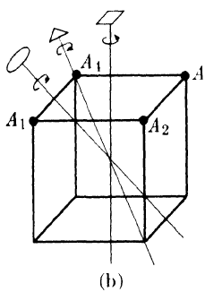

Symmetry
Thus a cube has a 4-fold rotation axis normal to each face,
3-fold axis along each body diagonal,
2-fold axes joining the centers of opposite edges.

Slide 31
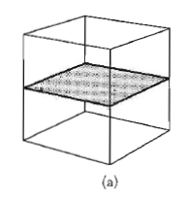
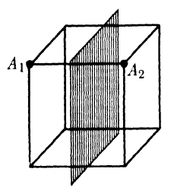
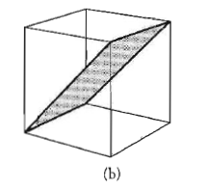
Reflection Symmetry

Slide 32
Reflection Symmetry

Slide 33
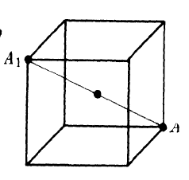
Inversion Symmetry
A body has an inversion center if corresponding points of the body are located at equal distances from the center on a line drawn through the center.
A body having an inversion center will come into coincidence with itself if every point in the body is inverted, or "reflected," in the inversion center.
A cube has such a center at the intersection of its body diagonals

Slide 34
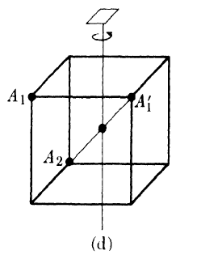
Rotation-Inversion Symmetry
If it has an n-fold rotation-inversion axis,
it can be brought into coincidence with itself by a rotation of 360/n about the axis followed by inversion in a center lying on the axis.
Figure (d) illustrates the operation of a 4-fold rotation-inversion axis on a cube.
Rotation inversion axis : 4-fold axis - A₁ becomes A₁’ Inversion center- A₁’ becomes A₂

Slide 35
Symmetry elements
The possession of a certain minimum set of symmetry elements is a fundamental property of each crystal system, and one system is distinguished from another just as much by its symmetry elements as by the values of its axial lengths and angles.
In fact, these are interdependent.
The minimum number of symmetry elements possessed by each crystal system is listed.
Some crystals may possess more than the minimum symmetry elements required by the system to which they belong, but none may have less.)

Slide 36
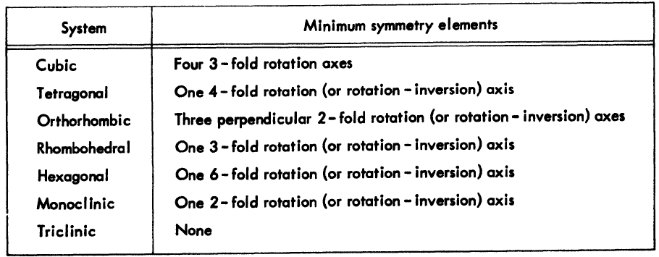
Symmetry elements

Slide 37
Symmetry elements contd.
Symmetry operations apply not only to the unit considered merely as geometric shapes, but also to the point lattices associated with them.
The latter condition rules out the possibility that the cubic system, for example, could include a base-centered point lattice, since such an array of points would not have the minimum set of symmetry elements required by the cubic system, namely four 3-fold rotation axes.

Slide 38
Symmetry elements contd.
Such a lattice would be classified in the tetragonal system, which has no 3-fold axes and in which accidental equality of the a and c axes is allowed.
However, this lattice is simple, not base centered, tetragonal.
Crystals in the rhombohedral (trigonal) system can be referred to either a rhombohedral or a hexagonal lattice.

Slide 39
Primitive and non-primitive cells
In any point lattice a unit cell may be chosen in an infinite number of ways and may contain one or more lattice points per cell.
It is important to note that unit cells do not "exist“ as such in a lattice: they are a mental construct and can accordingly be chosen at our convenience. The conventional cells shown in Fig. earlier are chosen simply for convenience and to conform to the symmetry elements of the lattice.

Slide 40
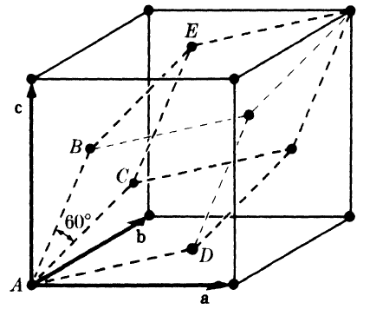
Primitive and non-primitive cell contd.
Any of the fourteen Bravais lattices may be referred to a primitive unit cell.
For example, the face-centered cubic lattice shown in Fig. may be referred to the primitive cell indicated by dashed lines.
The latter cell is rhombohedral, its axial angle a is 60, and each of its axes is 1/√2 times the length of the axes of the cubic cell.

Slide 41
Primitive and non primitive unit cell
Each cubic cell has four lattice points associated with it, each rhombohedral cell has one, and the former has, correspondingly, four times the volume of the latter.
Nevertheless, it is usually more convenient to use the cubic cell rather than the rhombo-hedral one because the former immediately suggests the cubic symmetry which the lattice actually possesses.

Slide 42
Primitive and non primitive cell
If nonprimitive lattice cells are used, the vector from the origin to any point in the lattice will now have components which are nonintegral multiples of the unit-cell vectors a, b, c.
The position of any lattice point in a cell may be given in terms of its coordinates] if the vector from the origin of the unit cell to the given point has components xa, yb, zc, where x, y, and z are fractions, then the coordinates of the point are x y z.

Slide 43



Primitive and non primitive cell
Thus, point A in Fig. taken as the origin, has coordinates 000 while points
B, C, and D, when referred to cubic axes, have coordinates
Point E has coordinates and is equivalent to point D), being separated from it by the vector c.

Slide 44
Contd.
Note that the coordinates of a body-centered point, for example, are always no matter whether the unit cell is cubic, tetragonal, or orthorhombic, and whatever its size.

Slide 45
Direction in the lattices
The direction of any line in a lattice may be described by first drawing a line through the origin parallel to the given line and then giving the coordinates of any point on the line through the origin.
Let the line pass through the origin of the unit cell and any point having coordinates (u v w) , where these numbers are not necessarily integral. (This line will also pass through the points 2u 2v 2w, 3u 3v 3w, etc.)
Then [uvw], written in square brackets, are the indices of the direction of the line.

Slide 46
Lattice direction contd.
They are also the indices of any line parallel to the given line, since the lattice is infinite and the origin may be taken at any point.
Whatever the values of u, v, w, they are always converted to a set of smallest integers by multiplication or division throughout: thus, , [ [112], and [224] all represent the same direction, but [112] is the preferred form.

Slide 47
Lattice direction contd.
Negative indices are written with a bar over the number, e.g. . Direction indices are illustrated in Fig. 2-8.

Slide 48
Direction related by symmetry are called directions of a form, and a set of these are represented by the indices of one of them enclosed in angular brackets.
For example, the four body diagonals of a cube
may be represented by

Slide 49
Planes in the lattices
The orientation of planes in a lattice represented symbolically, according to a system popularized by the English crystallographer Miller.
In the general case, the given plane will be tilted with respect to the crystallographic axes.
we might describe the orientation of the plane by giving the actual distances, measured from the origin, at which it intercepts the three axes.

Slide 50
Miller indices
The Miller indices, which are defined as the reciprocals of the fractional intercepts which the plane makes with the crystallographic axes.
For example, if the Miller indices of a plane are (hkl), then the plane makes fractional intercepts of 1/h, 1/k, 1/l with the axes.
If the axial lengths are a, b, c, the plane makes actual intercepts of a/h, b/k, c/l, as shown in Fig.

Slide 51

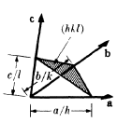
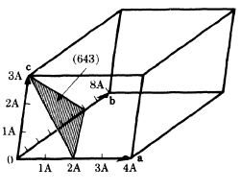
Miller indices of Plane
Miller indices are always cleared of fractions, as shown above.

Slide 52
Miller Indices contd.
If a plane cuts a negative axis, the corresponding index is negative and is written with a bar over it.
Planes whose indices are the negatives of one another are parallel and lie on opposite sides of the origin, such that

Slide 53
Miller Indices
The same plane may belong to two different sets.
The Miller indices of one set being multiples of those of the other; thus the same plane belongs to the (210) set and the (420) set, and, in fact, the planes of the (210) set form every second plane in the (420) set.
In the cubic system, it is convenient to remember that a direction [hkl] is always perpendicular to a plane (hkl) of the same indices.
But this is not generally true in other systems.

Slide 54
Miller Indices contd.

Slide 55
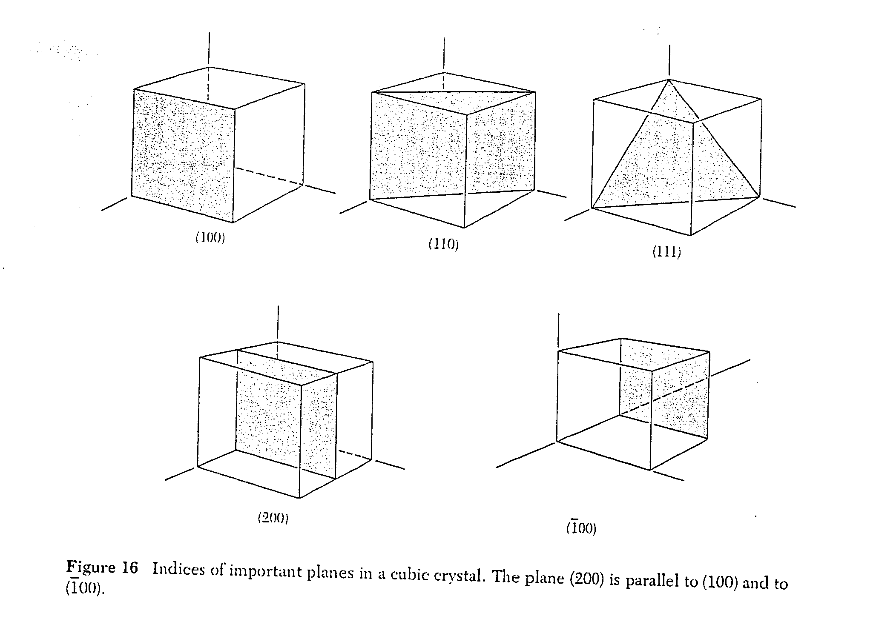
Indices of Planes: Cubic Crystal

Slide 56
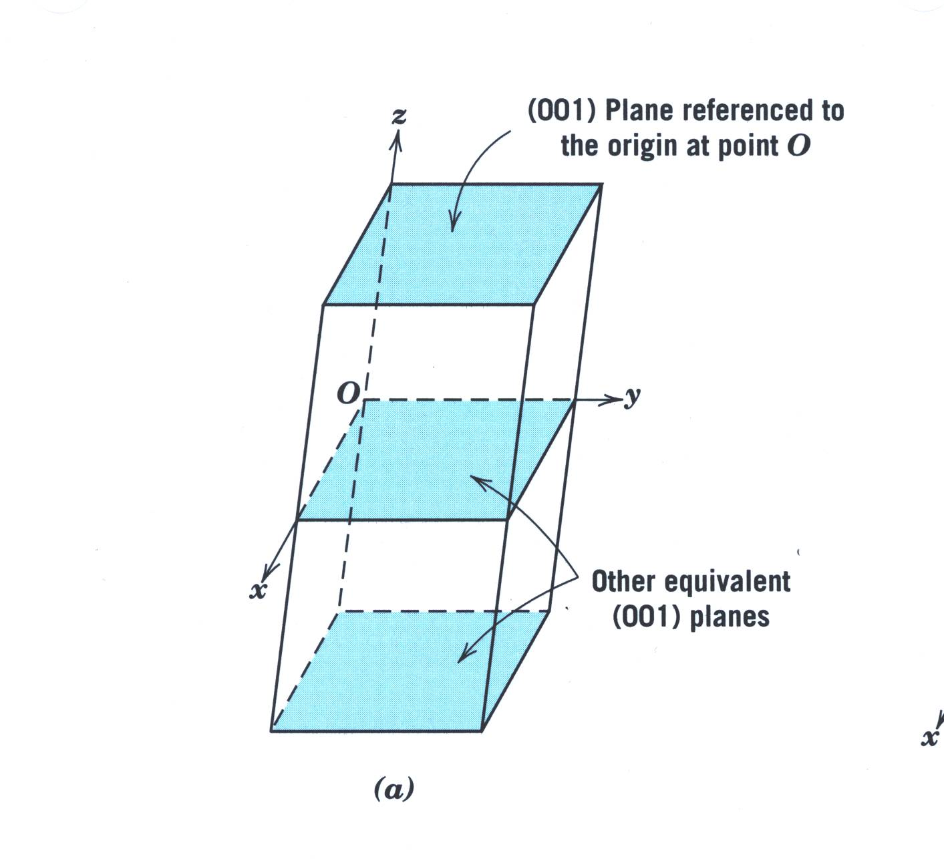
001 Plane

Slide 57
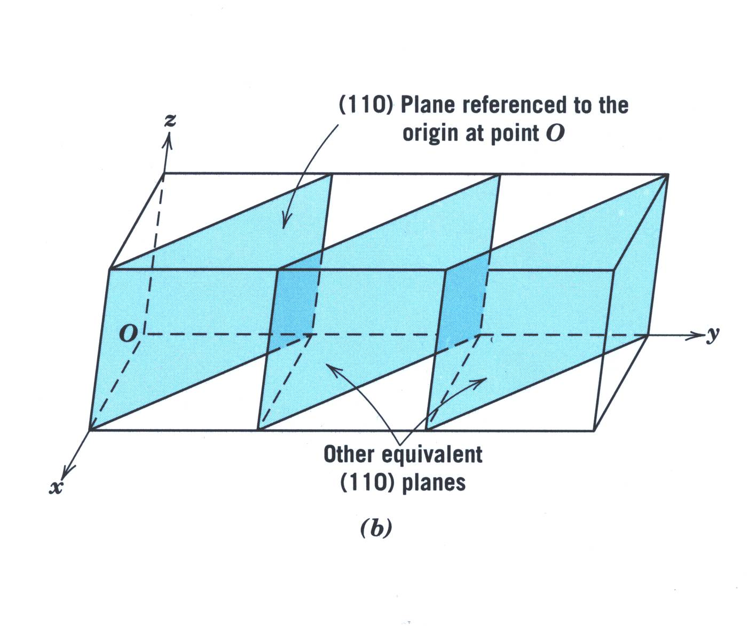
110 Planes

Slide 58
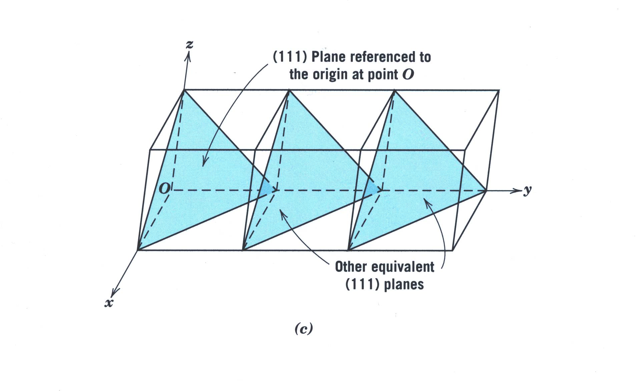
111 Planes

Slide 59
Planes of a form
In any crystal system there are sets of equivalent lattice planes related by symmetry. These are called planes of a form, and the indices of any one plane, enclosed in braces {}, stand for the whole set.
In general, planes of a form have the same spacing but different Miller indices.
For example, the faces of a cube,
Are planes of the form

Slide 60
Plane of the form in Tetragonal
In the tetragonal system, however, only the planes (100), (010), (TOO), and (OTO) belong to the form {100};
The other two planes, (001) and (OOT), belong to the different form {001} ; the first four planes mentioned are related by a 4-fold axis and the last two by a 2-fold axis.*

Slide 61
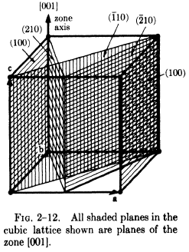
Planes of a zone
Planes of a zone are planes which are all parallel to one line, called the zone axis, and the zone, i.e., the set of planes, is specified by giving the indices of the zone axis.
Such planes may have quite different indices and spacings, the only requirement being their parallelism to a line. Figure 2-12 shows some examples.
If the axis of a zone has indices [uvw], then any plane belongs to that zone whose indices (hkl) satisfy the relation hu + kv + Iw = 0.

Slide 62
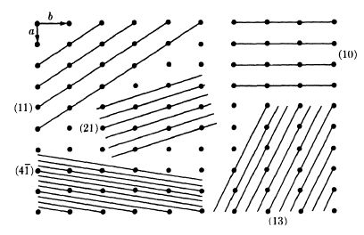
Inter planar spacing

Slide 63
Inter planar spacing
The various sets of planes in a lattice have various values of inter planar spacing.
The planes of large spacing have low indices and pass through a high density of lattice points, whereas the reverse is true of planes of small spacing.
The inter planar spacing d_{hkl} measured at right angles to the planes, is a function both of the plane indices (hkl) and the lattice constants (a, b,c and α, β, γ).
The exact relation depends on the crystal system involved and for the cubic system takes on the relatively simple form

Slide 64



Slide 65
Marks distribution
Exam
Mid sem - 30
End sem - 40
Home assignment – 20
Term paper- 10

Slide 66
The End

