Slide 1
RAD 222 practical
Introduction to the course
Alia Bafaqeeh
abafaqeeh@ksu.edu.sa

Slide 2
RAD 222 practical
The Upper Limbs- Part 1:
Fingers, hand &wrist
Alia Bafaqeeh
abafaqeeh@ksu.edu.sa

Slide 3
RAD 222 practical
The Upper Limbs- Part 2: forearm, elbow & humerus
Alia Bafaqeeh
abafaqeeh@ksu.edu.sa

Slide 4
RAD 222 practical
The shoulder joint
Alia Bafaqeeh
abafaqeeh@ksu.edu.sa

Slide 5
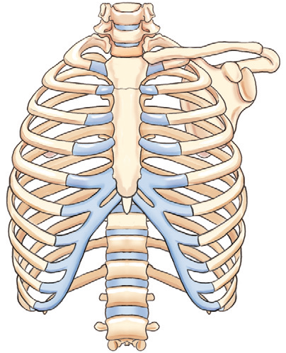
RAD 222 practical
Bony thorax:
Ribs, Sternum & SCJs
Reem A. Althekair
ralthekair@ksu.edu.sa

Slide 6
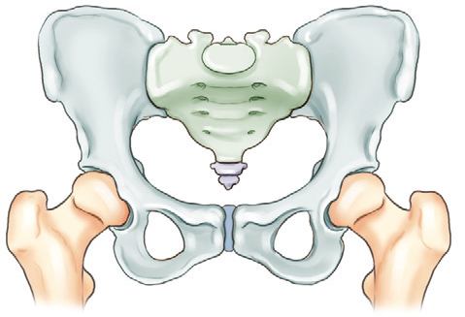
RAD 222 practical
Pelvis, hips and SIJs
Reem A. Althekair
ralthekair@ksu.edu.sa

Slide 7
RAD 222 practical
Femur, knee, patella & leg
Reem A. Althekair
ralthekair@ksu.edu.sa

Slide 8
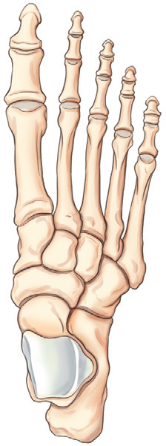
RAD 222 practical
Foot, toes, calcaneus & ankle
Reem A. Althekair
ralthekair@ksu.edu.sa

