Slide 1
Quiz2

Slide 3
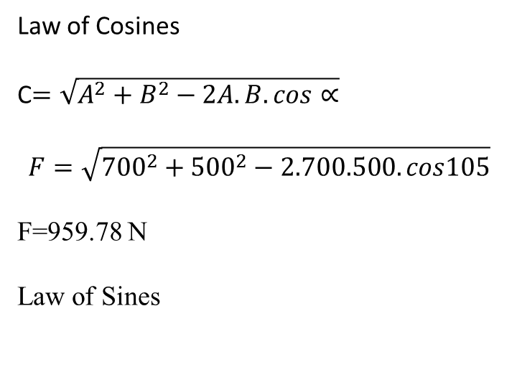
Law of Cosines
C$=\sqrt{A^{2}+B^{2}−2A.B.cos∝}$
$$F=\sqrt{{700}^{2}+{500}^{2}−2.700.500.cos105}$$
F=959.78 N
Law of Sines
700
F
R=500

