Slide 1
Laboratory Quality Control

Slide 2
introduction
Laboratory testing can be performed on many types of fluids from the body other than blood.
Some body fluid analyses include:
Urinalysis
Semen Analysis
Sweat Chloride
Fetal Fibronectin (fFN)
Amniotic Fluid Analysis
CSF Analysis
Synovial Fluid Analysis
Pleural Fluid Analysis
Pericardial Fluid Analysis
Peritoneal Fluid Analysis
Samples are usually obtained through collection of the fluid in a container (e.g., urine, semen) or by inserting a needle into the body cavity and aspirating with a syringe a portion of the fluid (e.g., CSF, pericardial fluid).
Once a sample is obtained, a variety of tests may be performed, including chemistry tests, microscopic examinations, genetic tests, and infectious disease tests
_

Slide 3
Quality Control
QC is the measurements that must be included during each assay run to verify that the test is working properly.
Quality Assurance
QA is defined as the overall program that ensures that the final results reported by the laboratory are correct.
The aim of quality control is simply to ensure that the results generated by the test are correct.
Quality control gives the laboratory a confidence that test results are accurate and reliable before patient results are reported.

Slide 4
Purpose
The goal of QC is to detect errors and correct them before patients’ results are reported

Slide 5
Variables that affect the quality of results
Operator performance
The condition of the specimens
The controls used in the test runs
Reagents
Equipment
Working environment
The interpretation of the results

Slide 6
Quality control and assurance failure includes:
Control of pre-analytical variables:
Patient preparation, Patient identification, and specimen processing and handling
Control of analytical variables:
Choice of analytical method, analytical specificity, and analytical precision

Slide 7
Pre- analytical variables
Envolves the time from when the test is ordered by the physician until the sample is ready for analysis.
Pre-analytic variables can be:
1. Physiological factors
2. Specimen collection and handling.

Slide 8
Physiological factors:
The effects of age, gender, time, conditions such as menstruation and pregnancy, and lifestyle are some of the physiological variables that affect laboratory results.
Age:
(e.g., increase in alkaline phosphate level due to bone growth)
gender:
( e.g., women has lower iron than men )
Time:
Time of test can affect the level of some circulating analysts
- A classic example is Cortisol
(Peaks 4–6 a.m.; lowest 8 p.m. to 12 a.m.);
50% lower at 8 p.m. than at 8 a.m.

Slide 9
Menstruation:
(e.g., FSH, LH levels depend on stages of cycle)
Diet:
(e.g. Glucose and triglycerides level are increased after eating)

Slide 10
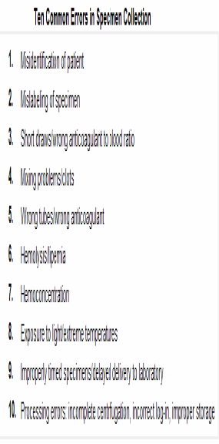
Specimen collection

Slide 11
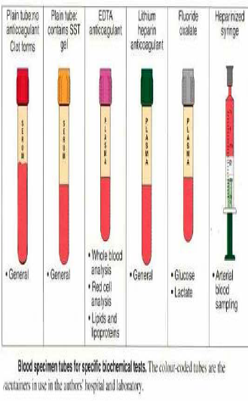

Slide 12
An error in any part of the cycle can produce a poor laboratory result.
i.e. A damaged or altered sample , improper collection or transportation of a sample.

Slide 13
Two major types of errors may occur in a laboratory:
1) Random errors:
that arise due to inadequate control on pre-analytical variables
(Random errors can be minimized by training, supervision )
2) Systematic errors:
that occur due to inadequate control on analytical variables
e.g., impure calibration material.

Slide 14
Random errors
Examples of random errors include errors in pipeting and changes in incubation time. Random errors can be minimized by training, supervision and by strictly following the standard operating procedures.

Slide 15
Random Errors

Slide 16
Systematic errors
Systematic errors produce errors that are consistently in the same direction.
Systematic errors may be induced by factors such as variations in incubation temperature, blockage of plate washer, change in the reagent batch or modifications in testing method

Slide 17
Systematic errors

Slide 18
Negative consequences of laboratory error
Unnecessary treatment; treatment complications
Failure to provide the proper treatment
Delay in correct diagnosis
Additional and unnecessary diagnostic testing.
These consequences result in increased cost in time, personnel effort, and often in poor patient outcomes.

