Slide 1
Proteins
https://www.youtube.com/watch?v=izwgt1C8Kus
https://www.youtube.com/watch?v=qBRFIMcxZNM
https://www.youtube.com/watch?v=NWJ8LKxxS4k

Slide 2
Proteins
Proteins are made up of large numbers of amino acids
linked into chains by peptide bonds joining the amino
group of one amino acid to the carboxyl of the next.
The number of amino acids present varies from about
a hundred to several thousands in different proteins.
Some proteins are composed of only one polypeptide
chain while others are composed of two or more
polypeptide chains (multisubunit proteins) held together
by non-covalent bonds.

Slide 3
- The individual polypeptide chains in a multisubunit protein
may be identical or different.
If at least two are identical, the protein is said to be
oligomeric and the identical units are referred to as
protomers.
- Each protein has a unique amino acid sequence and a well-
defined three-dimensional structure known as the
conformation.
Notes:
3

Slide 4
Classification of proteins:
A) proteins can be classified
on the basis of the chemical
composition.
B) proteins can be classified
on the basis of shape.
C) proteins can be
classified on the basis
of their biological
function.

Slide 5
A) proteins can be classified on the basis of the chemical
composition:
a) Simple proteins b) conjugated proteins
a) Simple proteins:
are those proteins which upon hydrolysis give only amino acids.
Example:
ribonuclease A, chymotrypsin.

Slide 6
b) Conjugated proteins:
are proteins which yield upon hydrolysis organic or
inorganic components in addition to the amino acids.
- The non-protein part is called the prosthetic group.
Conjugated proteins are classified on the basis of the
chemical nature of their prosthetic groups:
i) nucleoproteins
ii) glycoproteins
iii) lipoproteins
iv) hemoproteins
v) metalloproteins
vi) phosphoproteins

Slide 7
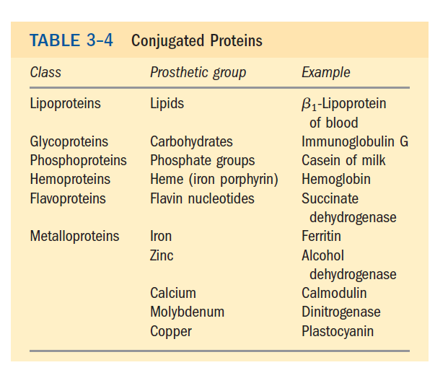

Slide 8
B) proteins can be classified on the basis of shape:
a) Globular proteins b) Fibrous proteins
a) Globular proteins:
- They are generally soluble in water.
- The polypeptide chains are tightly folded into a globular shape.
Example:
enzymes, hemoglobin, myoglobin

Slide 9
b) Fibrous proteins:
- They are insoluble in water
- Their polypeptide chains are arranged in long strands
(elongated in the form of fibers).
Example:
Collagen, keratin

Slide 10
C) proteins can be classified on the basis of their
biological function:
i) enzymes
ii) Transport proteins
[e.g., hemoglobin iii) Nutrient and
lipoprotein] storage proteins
[e.g., casein
ferritin] iv) contractile or
mobile proteins
(e.g., actin, myosin)
v) structural
proteins
( e.g., α-keratin vi) defense proteins [e.g., immunoglobulins(antibodies) collagen)
fibrinogen and thrombin]
vii) Regulatory proteins
(protein hormones)

Slide 11
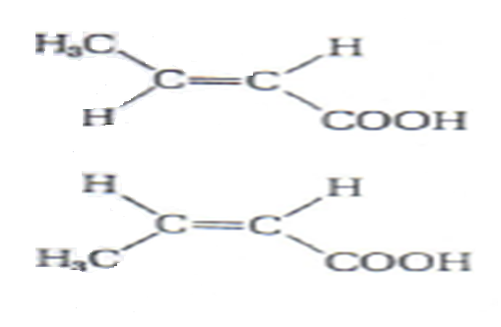
Configuration and conformation
Configuration:
It is the arrangement in space of substituent groups in steroisomers; such structures can not be interconverted without breaking one or more covalent bond.

Slide 12
Conformation:
refers to the spatial arrangement of substituent groups that are free to assume many different positions, without breaking bonds, because of rotation about single bonds in the molecule.

Slide 13
Structure of proteins
The amount and type of amino acids found in a protein and the sequence in which they are arranged in the polypeptide chains
is a unique characteristic of each protein.
- The amino acid sequence of a number of proteins has been determined and it is established that the sequence of amino acids is the force that determines the protein conformation, which in turn is responsible for the biological function of protein.

Slide 14

Protein structure:
Protein structure can be considered at four levels:
1) Primary structure
2) Secondary structure
3) Tertiary structure
4) Quaternary structure
Note:
[-All proteins have their own specific primary structure [amino acids sequence],
determined by their genes
- All intracellular globular proteins have a tertiary structure.
- proteins made of more than one subunit [polypeptide] have quaternary
structure].

Slide 15
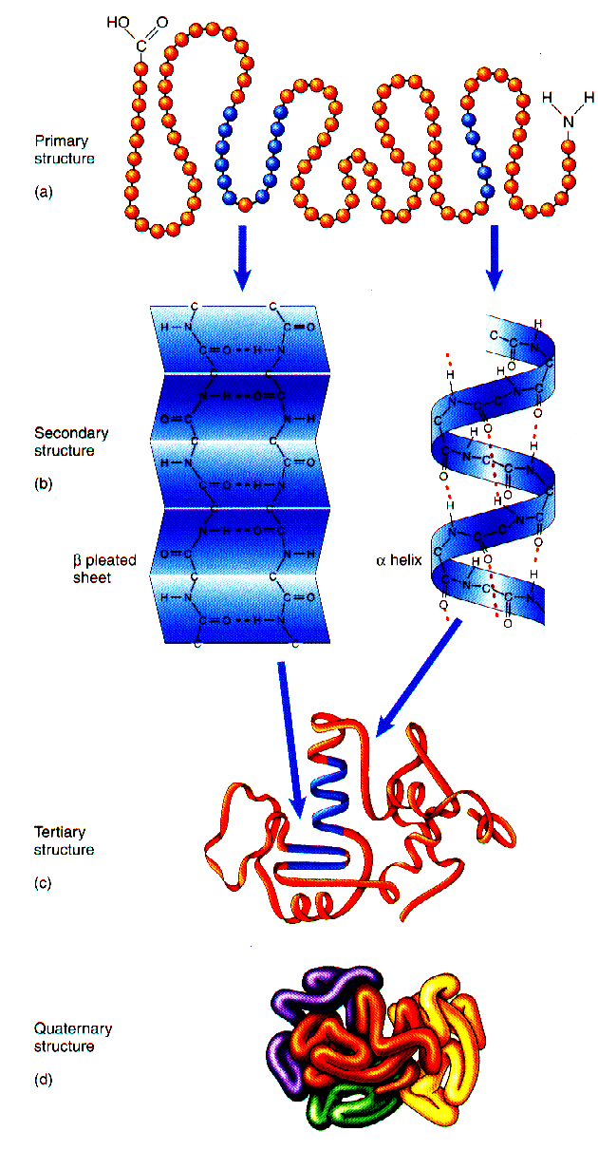
-Primary structure
- Secondary structure
- Tertairy structure
- Quarternary structure
Notes:
15

Slide 16
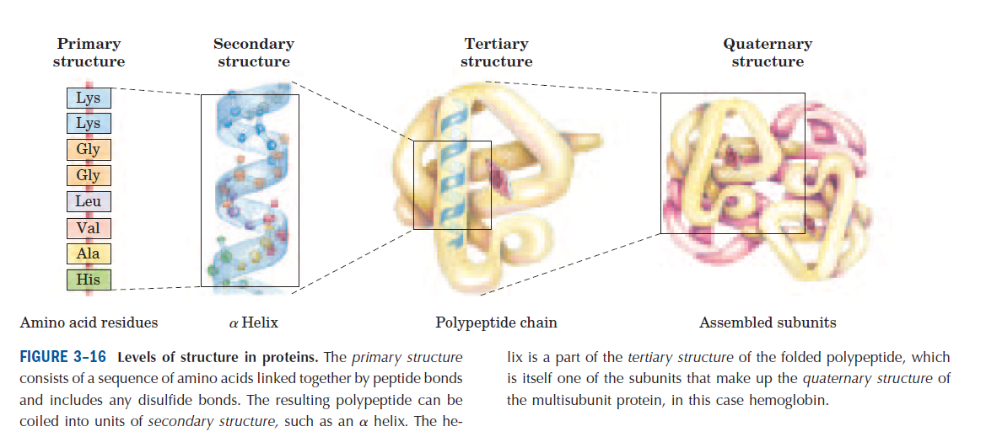

Slide 17
1) Primary structure:
It is the sequence of amino acids in a protein.
- Different proteins differ from each other in their primary structure but every protein has a free carboxyl end terminal and a free amino end terminal.
- The bonds responsible for the primary structure are:
O
the covalent bonds The peptide bonds (C – N)
H
The disulfide bonds (S – S)

Slide 18
- The disulfide bonds (if present) between two cysteine
residues of the same polypeptide chain or between different
polypeptide chains.
The primary structure is therefore very stable due to
these bonds.
- Peptide bonds are not broken by normal handling nor that
conditions that denature proteins such as heating.
- Prolonged exposure to strong acid or base at elevated
temperature is required to hydrolyze these bonds (peptide
bond), non-enzymatically.
- Treatment with strong reducing agents disrupts the disulfide
bridges and effects the biological properties of the proteins.

Slide 19
Characteristics of the peptide bond:
a) The peptide bond is rigid and planar:
- The peptide bond has a partial double bond character – that
is, it is shorter than a single bond [i.e peptide bond is
intermediate in bond length (0.132 nm ) between a single
bond (0.147 nm) and a double bond (0.123 nm)] and is,
therefore, rigid and planar.
This prevents free rotation around the bond between the carbonyl carbon and the nitrogen of the peptide bond.
-The rigid peptide bonds limit the number of conformations by polypeptide chains.
[ However, the bond between α-carbon and the α-amino or
α-carboxyl groups can be freely rotated].

Slide 20
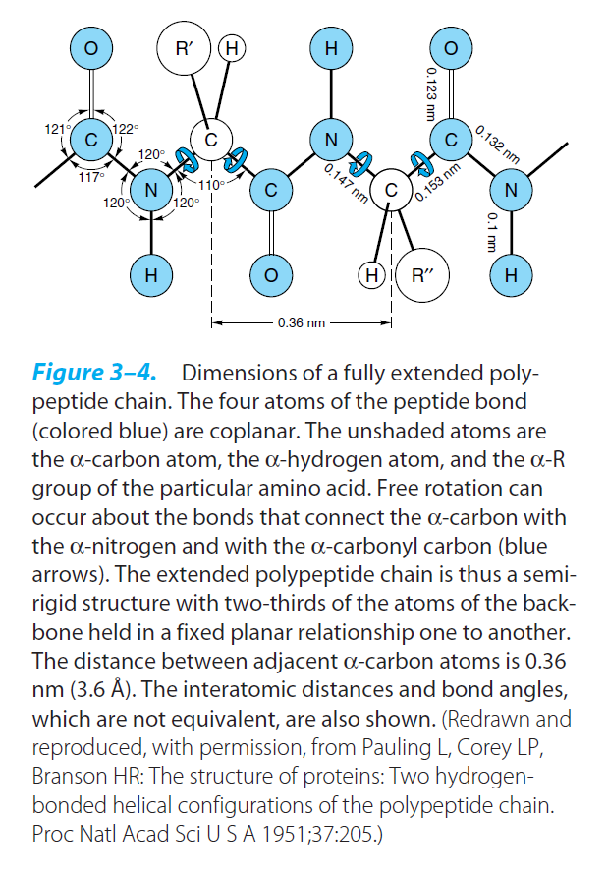
Notes:
20

Slide 21
b) Trans configuration:
The peptide bond is generally a trans bond (instead of cis), because of steric interference of the R-groups when in the cis position.
c) Uncharged but polar:
( The - C = O and –NH groups of the peptide bond are polar
and are involved in hydrogen bonds).

Slide 22
2) Secondary structure
It is the spatial arrangement of amino acid residues that are near one another in the linear sequence of the polypeptide chain.
The secondary structure are of three types:
a) The α-helix
b) β-pleated sheets
c) Collagen helix

Slide 23
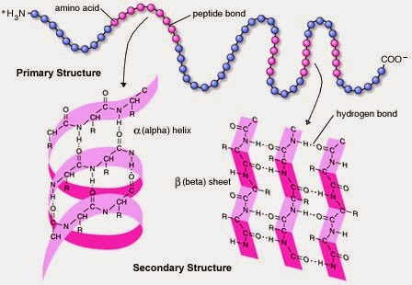
The bonds responsible for stability of secondary structure:
The secondary structure is stabilized by a hydrogen bonds
between peptide bond groups (i.e. between NH group of one
amino acid residue and the carbonyl oxygen (C=O) of other
amino acid).

Slide 24
a) α-helix:
- It is a spiral structure, consisting of tightly packed, coiled polypeptide core backbone and the R-groups of amino acid
residues protrude outward from the helical backbone.
- -Each helical turn includes 3.6 amino acid residues
- In all proteins, the helical twist of the α-helix is right-handed.
The bonds responsible for stability of α-helix :
It is stabilized by a hydrogen bonds between peptide bond
groups.

Slide 25
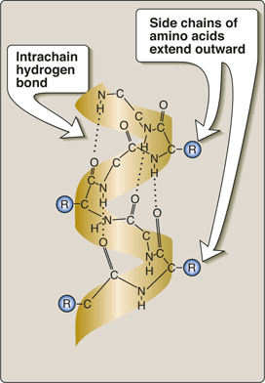
Secondary Structure of Proteins

Slide 26
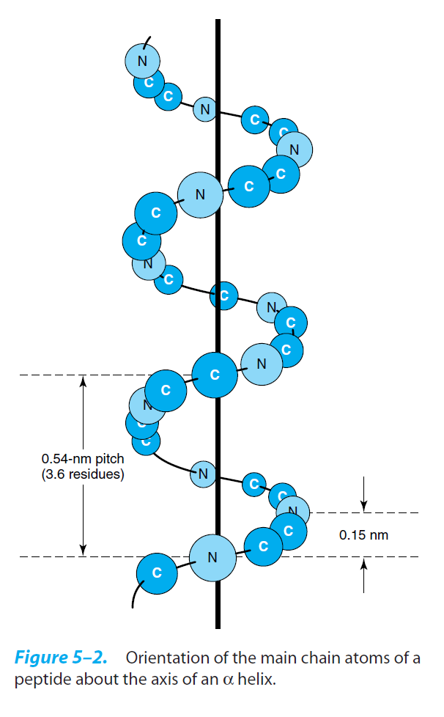

Slide 27
- An α-helix permits the formation of intrachain hydrogen
bonds between successive coils of the helix, parallel to the
long axis of the helix.
-The hydrogen bond formed between the hydrogen atom
attached to the electronegative nitrogen atom of each peptide
linkage and the electronegative carbonyl oxygen atom of the
fourth amino acid on the amino terminal side of it in the
helix.
- Every polypeptide bond of the chain participates in such
hydrogen bonding.
- Each successive turn of the α-helix is held to the adjacent
turns by three to four hydrogen bonds, conferring significant
stability in the overall structure.

Slide 28
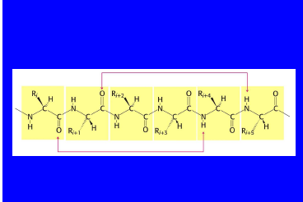

Slide 29
- Hydrogen bonds are individually weak but collectively serve
to stabilize the helix.
Example:
● α-keratin:
- it is a fibrous protein whose structure is entirely
α-helix
- it is rich in cysteine residues.
- major component of tissues such as hair and
skin.
● hemoglobin:
- it is a globular protein.
- 80% of hemoglobin structure is α-helix.

Slide 30
Factors that affect the stability of α-helix:
a) Electrostatic repulsion (or attraction) between amino acid
residues with charged R-groups.
[ e.g., if there is a large numbers of charged amino acids (for example, glutamate, aspartate, histidine, lysine, or arginine) they disrupt the helix by forming ionic bonds, or by electrostatically repelling each other].
b) The bulkiness of adjacent R-groups.
[e.g., tryptophan, or amino acids, such as valine or isoleucine, that branch at the β-carbon (the first carbon in the R-group, next to the
α-carbon) can interfere with formation of the α-helix if they are present in large numbers and close to each others].

Slide 31
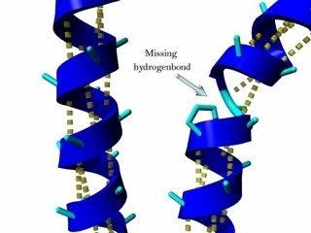
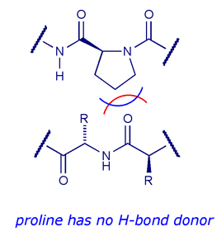
c) The interaction between amino acid side chains spaced three
(or four) residues apart.
[e.g two aromatic amino acids are resulting in hydrophobic interaction].
d) The occurance of proline residues:
In proline, the nitrogen atom is part of a rigid ring and the rotation
around N-α C bond is not possible .
In addition , the nitrogen atom of a proline residue in peptide linkage
has no substitutent hydrogen to form hydrogen bond with other residues
So it inserts a kink in the chain that disrupts the smooth, helical
structure.

Slide 32
b) β-pleated sheet:
In the β-conformation, the backbone of the polypeptide chain is extended into a zigzag rather than a helical structure.
The zigzag polypeptide chains can be arranged side by side to form a structure resembling a series of pleats, such
a structure is called a β-pleated sheet.
The R-groups of adjacent amino acids protrude from the
zigzag structure in opposite directions, creating the
alternating pattern.
Hydrogen bonds form between adjacent segments of
polypeptide chain
β- pleated sheet are composed of two or more β-strands.

Slide 34
The adjacent polypeptide chains in a β-sheet can be either
Parallel OR antiparallel
(having the same amino to (having the opposite
carboxyl orientations) amino to carboxyl
orientations)
When two or more β-sheets are layered close together within a protein, the R-groups of the amino acid residues on the touching surfaces must be relatively small.

Slide 35
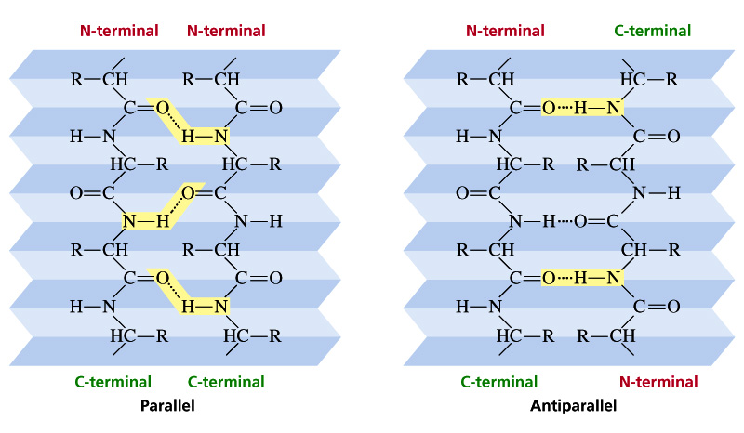
H-bond : Pleated sheet structure

Slide 36
The bonds responsible for stability of β-pleated sheet :
It is stabilized by a hydrogen bonds between peptide bond
groups.
Example:
β-keratins (such as silk fibroin):
- consist almost entirely stacks of
antiparallel β-sheets.
- rich in amino acids having relatively
small R-groups, particularly glycine
and alanine.
- the β-keratin such as fibroin, have
no S – S cross linkages.

Slide 37
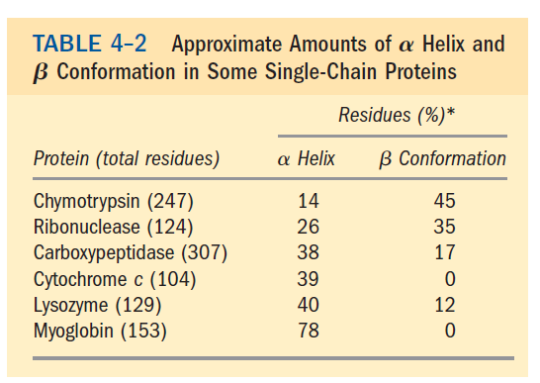

Slide 38
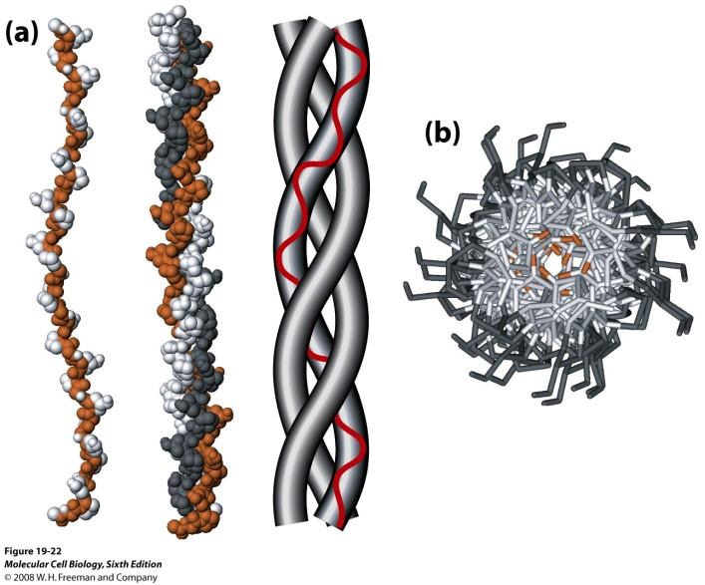
c) Collagen helix:
Collagen is found in connective tissue such as tendons, cartilage, the organic matrix of bone and the cornea of the eye.
● Collagen molecules (tropocollagen – basic unit) consist of
three polypeptide, called α-chains (each α-chain is twisted
into a left handed helix of 3 residue per turn) which wrap
around each other in a triple helix (right handed) forming
a rope-like structure.
.

Slide 39
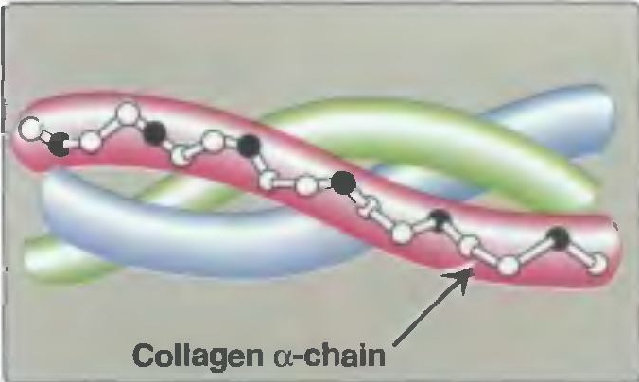

is built of recurring subunit structure, triple stranded tropocollagen (triple helix) molecules, having distinctive heads

Slide 40
These arranged head to tail in many parallel bundles, but the
heads are staggered.
- Between the end of one triple helix and the beginning of the
next is a gap that may provide a site for deposition of
hydroxyapatite crystals in bone formation.
The polypeptide chains of tropocollagen are covalently cross linked by dehydrolysinonorleucine residues formed by
an enzymatic reaction between two lysine residues of
adjacent tropocollagen subunits.
The three polypeptide chains are held together by hydrogen
bonds between chains.

Slide 41
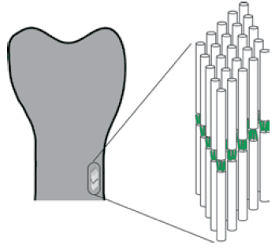

Slide 42
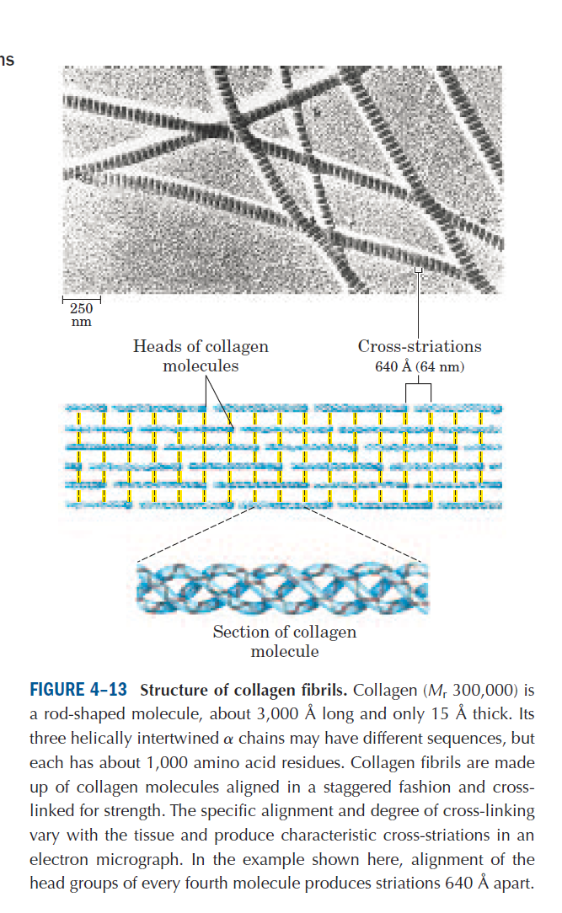

Slide 44
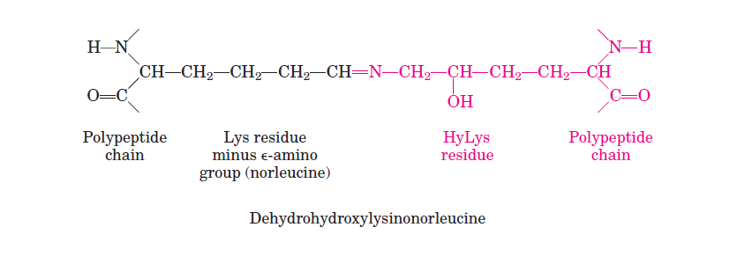

Slide 45
● The amino acid sequence in collagen is generally a repeating
tripeptide unit ( Gly – X – Y )
where X is frequently proline
Y is often hydroxyproline or hydroxylysine
Thus, most of the molecule can be regarded as
a polytripeptide.
- Glycine constitute every third residue in the triple helical
portion of each α-chain.

Slide 46
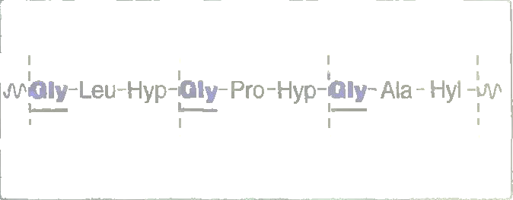
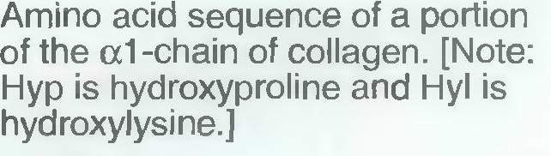

Slide 47
- Collagen contains hydroxyproline and hydroxylysine, which
are not present in most other proteins.
Although collagen of different species differ in amino acid sequence, most contain about 35% glycine and 11% alanine,
resembling the β-keratin in this respect.
- Collagen is distinctive in containing about 12% proline and
9% hydroxyproline, are amino acids rarely found in proteins
other than collagen.

Slide 48
3) Tertiary structure:
Refer to the spatial arrangement of amino acid residues that are far apart in the linear sequence (i.e in the primary structure), so the polypeptide chain is folded into three dimension.
-Tertiary structure is three-dimensional conformation of
a polymer in its native folded state.
The unique three-dimensional structure of each polypeptide
is determined by its amino acids sequence.
Interaction of the amino acid side chains guide the folding of the polypeptide chain to form a compact structure.

Slide 49
Hydrophobic side chains are buried in the interior whereas
hydrophilic groups are generally found on the surface of the
molecule.
Bonds that stabilize tertiary structure:
a) Hydrophobic interaction
b) Hydrogen bonds Non-covalent bonds
c) Ionic interaction between R-groups
(i.e between groups in the
side chains). [weak bonds]

Slide 50
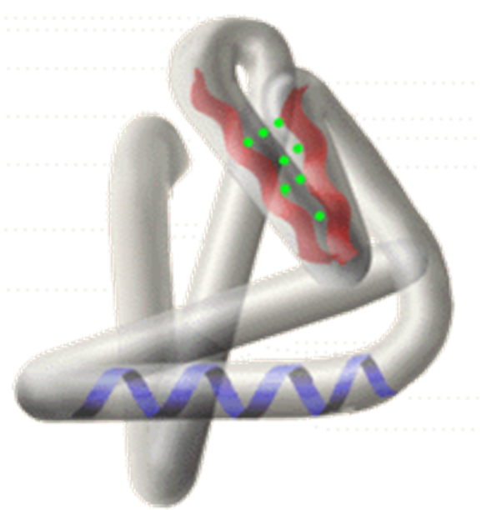

Slide 51
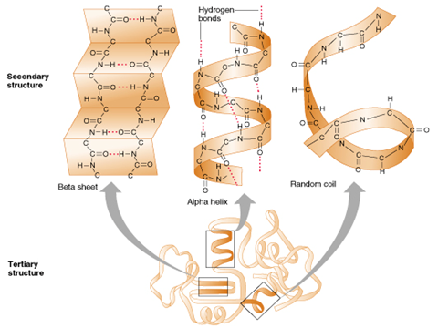

Slide 52
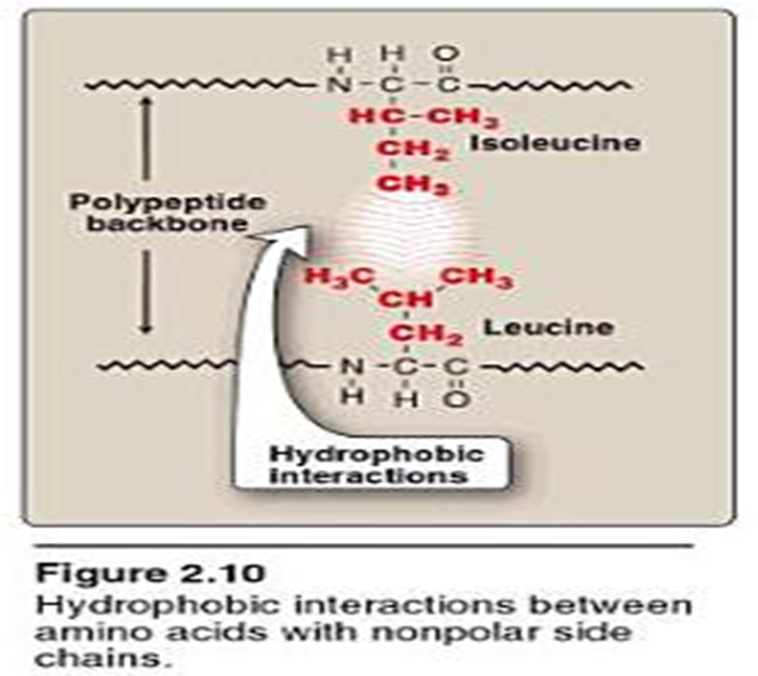
a) Hydrophobic interactions:
it is the association between non-polar groups (hydrophobic
groups) in the side chains of amino acids.

Slide 53
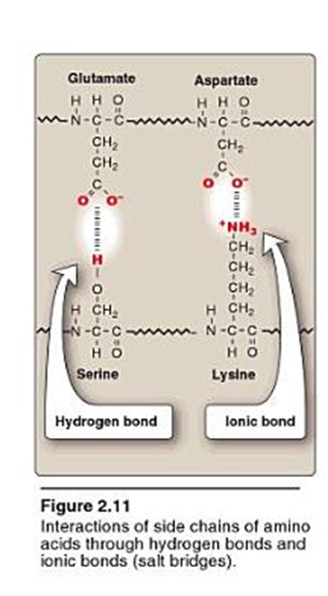
b) Hydrogen bonds:
A hydrogen bond is a type of attractive interaction between
an electronegative atom (such as oxygen or nitrogen) and
a hydrogen atom bonded covalently to another electronegative
atom.

Slide 54
c) Ionic interaction (electrostatic interaction):
Interaction between opposite charged groups of the side chains of amino acids.

Slide 55
Example:
Myoglobin:
-It is small globular protein (hemoprotein), present in heart
and skeletal muscle.
- It functions both as a reservoir for oxygen and as an oxygen
carrier that increases the rate of transport of oxygen within
the muscle cell.
- Myoglobin consists of a single polypeptide chain of 153 amino acid residues of known sequence and a single heme group.

Slide 56
- Myoglobin is a compact molecule with approximately 80%
of its polypeptide chain folded into eight stretches of
α-helix. These α-helical regions, labeled A to H.
- The backbone of the myoglobin molecule is made up of 8
relatively straight segments of α-helix interrupted by bends.
- The longest α-helix has 23 amino acid residues and the
shortest only seven; all are right handed.
more than 70% of the amino acids in the myoglobin
molecule are in these α-helical regions.
- The eight α-helical regions, labeled A to H, are terminated
either by the presence of proline, whose five-membered ring
can not be accomedated in α-helix, or by β-bends and loops
stabilize by hydrogen bonds and ionic bonds.

Slide 57
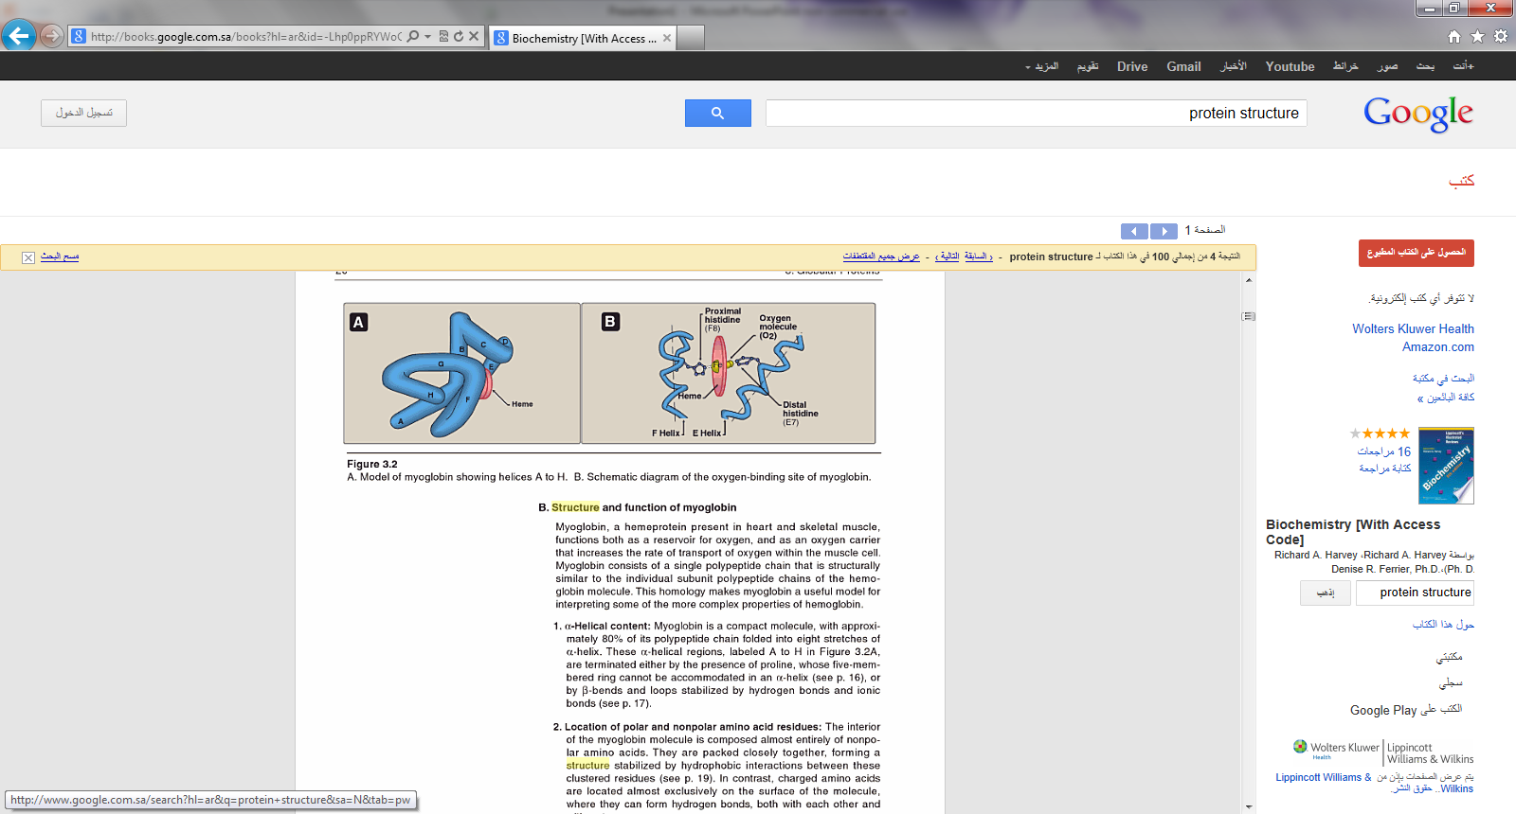

Slide 58
Location of polar and non-polar amino acid residues:
-The interior of the myoglobin molecule is composed almost
entirely of non-polar amino acids.
- They are packed closely together, forming a structure
stabilized by hydrophobic interactions among these clustered
residues.
- In contrast, charged amino acids are located almost
exclusively on the surface, where they can form hydrogen
bonds with water.

Slide 59
Heme group:
Heme is prosthetic group that tightly bound to hemoprotein.
- It is ferroprotoporphyrin.
heme protoporphyrin
iron (Fe⁺²)
protoprphyrin:
It is tetrapyrol ring linked by four methene bridge
(= CH- groups) in an alternating double bond ring system.
- It contains methyl, vinyl and propionic acid groups on the
pyrrole rings.
● If the iron in protoporphyrin is Fe⁺² ferroprotoporphyrin
or heme
●If the iron in protoporphyrin is Fe⁺³ ferriprotoporphyrin
or hemin

Slide 60
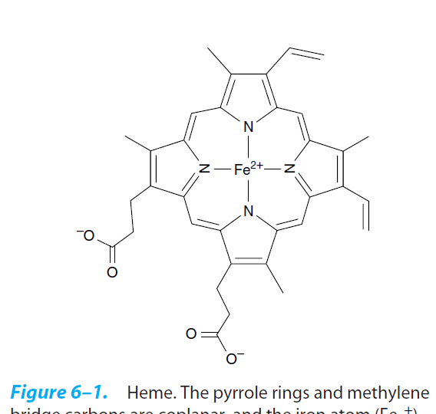
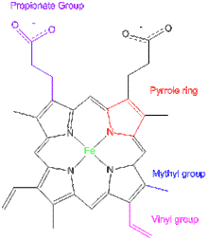
Heme structure

Slide 61
- The heme group of myoglobin sits in a pocket.
- The non-polar vinyl groups of the heme are buried in the
hydrophobic interior of the pocket, and the hydrophilic
propionate project out of the pocket toward the surface.
-Iron bind to the 4 nitrogen in the center.
Binding of heme group:
- The heme group of myoglobin sits in a crevice in the
molecule, lined with non-polar amino acids.
- Notable exception are two histidine residues:
One, termed the proximal histidine (F8), binds directly to the
iron of heme.
The second, or distal histidine (E7) does not directly interact with
the heme group but helps stabilize the binding of oxygen to the
ferrous iron.

Slide 62
- Oxygen binding site is between iron and His E7(distal His).
Myoglobin structure is stabilized by:
Non-covalent bonds.

Slide 63
4) Quaternary structure:
Proteins that are composed of more than one polypeptide
chain (subunits) show a fourth level of protein structure
which is the quaternary structure.
Quaternary structure is the three-dimensional structure of
a multisubunit protein, particularly the manner in which the subunits fit together.
- Subunits may either function independently of each other or may work cooperatively, as in hemoglobin.

Slide 64
-The interaction between subunits are stabilized by the same forces that stabilize tertiary structure (non-covalent bonds).
Bonds that stabilize quaternary structure:
a) Hydrophobic bonds.
b) Hydrogen bonds. Non-covalent bonds
c) Ionic bonds (electrostatic bonds). between R-groups
(i.e between groups in
the side chains).
[weak bonds]

Slide 65
Example:
Hemoglobin:
Hemoglobin is simple oligomeric protein.
-It is found in red blood cells (RBC), where its main function is to transport oxygen from the lungs to the capillaries of the tissues.
- Hemoglobin is hemoprotein, composed of four polypeptide chains and four heme groups.
- The protein portion (globin), consist of four polypeptide chains (two α-chains and two β-chains; α₂β₂) held together by non-covalent interactions.
-The α and β chains contain several segments of α-helix separated by bends, with a tertiary structure very similar to that of the single polypeptide of myoglobin.

Slide 66
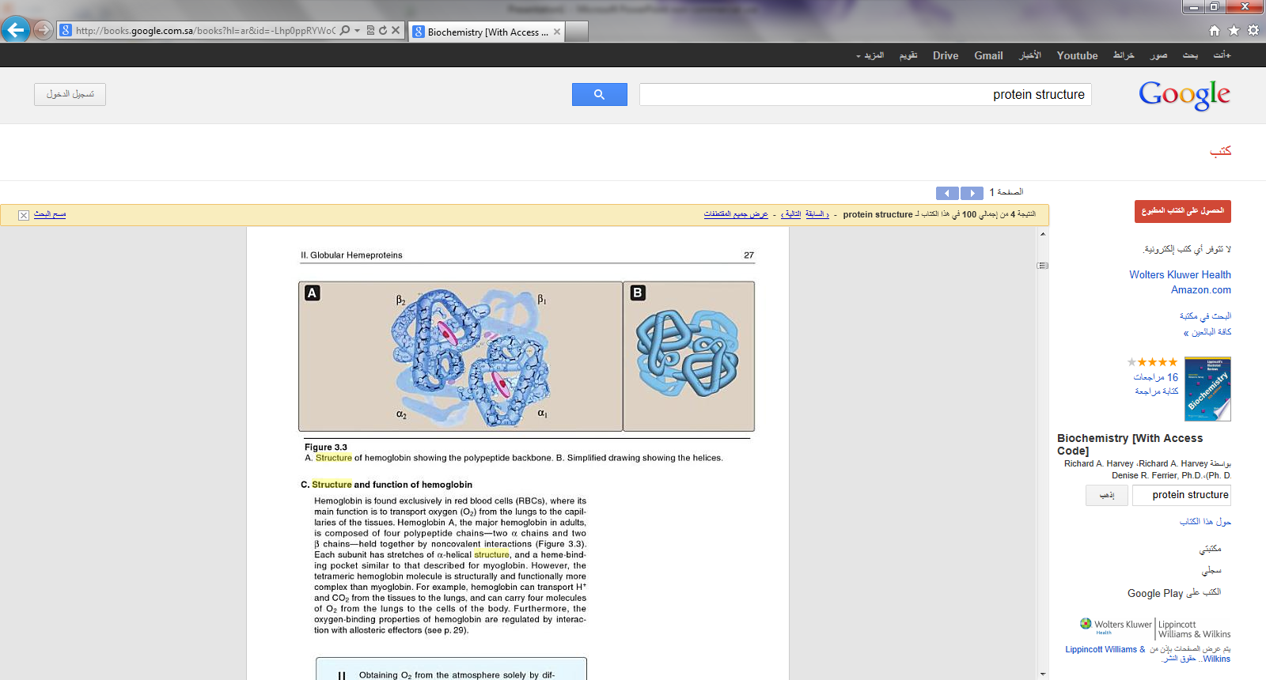

Slide 67
Each subunit has stretches of α-helical structure and a heme-
binding pocket similar to that described for myoglobin.
- One heme is bound to each polypeptide chain of hemoglobin.
- Each heme is partially buried in a pocket lined with
hydrophobic amino acid side chains.
It is bound to its polypeptide chain through a coordination
bond of the iron atom to the R-group of His residue.
Quaternary structure of hemoglobin:
The hemoglobin tetramer composed of two identical dimers:
a) (αβ) dimer 1
b) (αβ) dimer 2
- The two polypeptide chains within each dimer are held
tightly together, primarily by hydrophobic interactions.
Notes:
67

Slide 68
- Interchain hydrophobic interaction form association between
α and β subunits in the dimers.
- Ionic and hydrogen bonds also occur between the members
of the dimer.
- The two dimers are held together primarily by polar bonds.
- The weaker interactions between these mobile dimers result
in the two dimers occupying different relative positions in
deoxyhemoglobin compared to oxyhemoglobin.
i) T form:
- The deoxy form of hemoglobin is called the “T” or taut
(tense) form .

Slide 69
- In the T form, the two αβ dimers interact through a network
or ionic bonds and hydrogen bonds that constrain the
movement of the polypeptide chains.
- The T form is the low oxygen-affinity form of hemoglobin.
ii) R form :
- The binding of oxygen to hemoglobin causes rupture of some
of the ionic bonds and hydrogen bonds between the αβ
dimers. this leads to a structure called the “R” or relaxed
form, in which the polypeptide chains have more freedom of
movement.
- The R form is the high oxygen affinity form of hemoglobin.

Slide 70
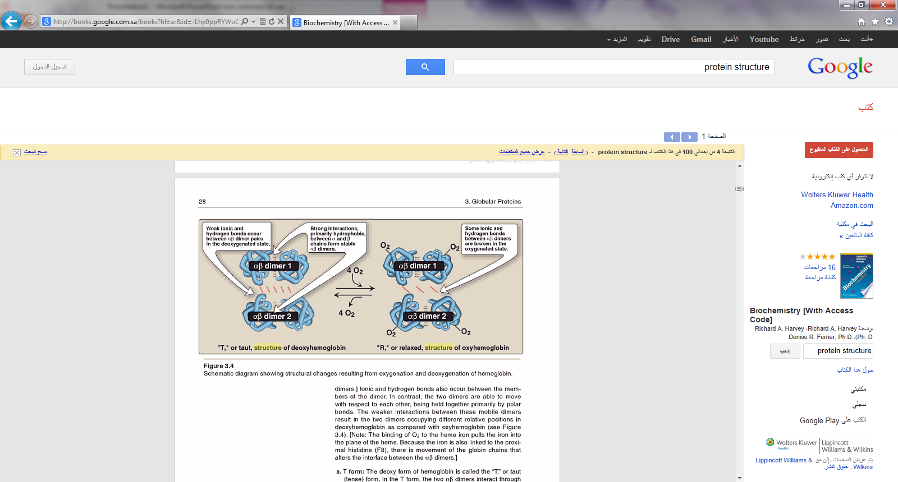

Slide 71
Binding of oxygen to hemoglobin:
- Myoglobin can bind only one molecule of oxygen because it
contains only one heme group.
- In contrast, hemoglobin can bind one oxygen molecule (O₂)
at each of its four heme groups.
- The degree of saturation (Y) of these oxygen-binding sites on
all myoglobin or hemoglobin molecules can vary between
zero (all sites are empty) and 100% (all sites are full).
Oxygen dissociation curve:
- A plot of Y is measured at different partial pressures of
oxygen (pO₂) is called the oxygen dissociation curve.

Slide 72
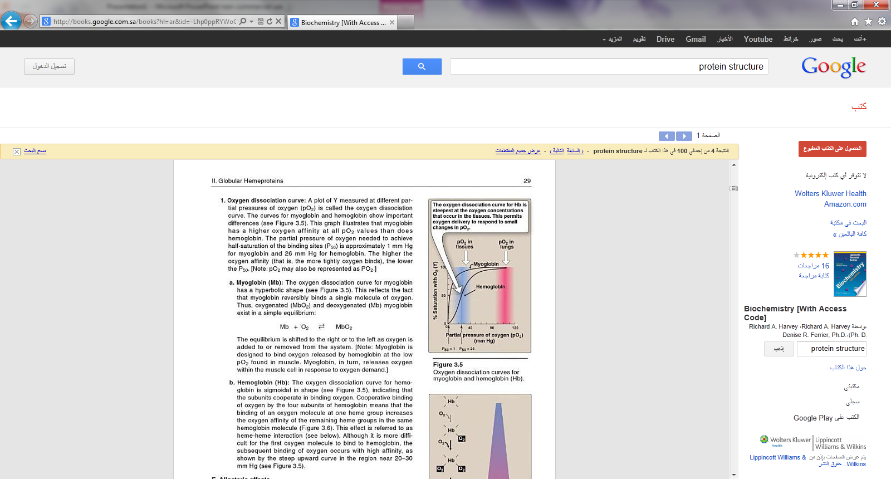

Slide 73
- This graph illustrates that myoglobin has a higher oxygen
affinity than does hemoglobin.
-The partial pressure of oxygen needed to achieve half-
saturation of the binding sites (P₅₀) is approximately 1mm Hg
for myoglobin and 26 mm Hg for hemoglobin.
[Note: The higher oxygen affinity (that is, the more tightly
oxygen binds), the lower the P₅₀ ].
a)myoglobin:
-The oxygen dissociation curve for myoglobin has
a hyperbolic shape. This reflects the fact that myoglobin
reversibly binds a single molecule of oxygen.

Slide 74
b) Hemoglobin:
-The oxygen dissociation curve for hemoglobin is sigmoidal in shape, indicating that the subunits cooperate in binding
oxygen.
- Cooperative binding of oxygen by the four subunits of
hemoglobin means that the binding of an oxygen molecule at
one heme group increases the oxygen affinity of the
remaining heme groups in the same hemoglobin molecule.
-This effect is referred to heme – heme interaction

Slide 75
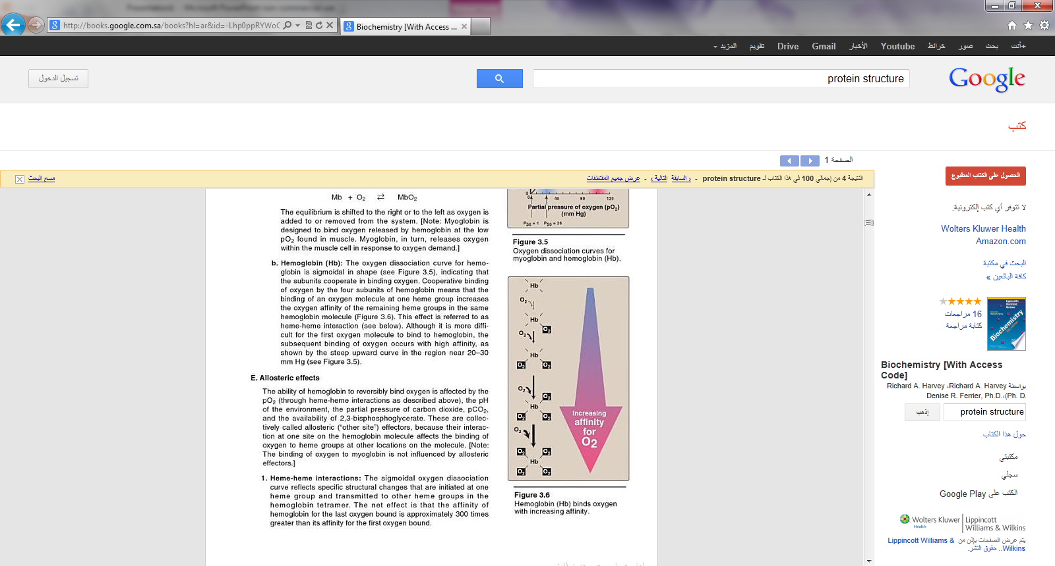

Slide 76
Denaturation of proteins:
- Protein denaturation results in unfolding and disorganization
of the protein΄s structure, which are not accompanied by
hydrolysis of peptide bonds.
Denaturing agents include:
● heat
● organic solvents
● mechanical mixing
● strong acids or bases
● detergents
● ions of heavy metals such as lead and mercury.
- Most proteins, once denatured, remain permanently disordered

Slide 77
Steps in the determination of amino acid sequence
1) If the protein contains more than one polypeptide chain, the
individual chains are first separated and purified.
2) All the disulfide groups are reduced and the resulting sulfhydryl
groups alkylated.
3) A sample of each polypeptide chain is subjected to total hydrolysis,
and its amino acid composition is determined.
4) On another sample of the polypeptide chain, the N-terminal and
C-terminal residues are identified.
5) The intact polypeptide chain is cleaved into a series of smaller
peptides by enzymatic or chemical hydrolysis.
6) The peptide fragments resulting from step 5 are separated and their
amino acid composition and sequence are determined.

Slide 78
7) Another sample of the original polypeptide chain is partially
hydrolyzed by a second procedure to fragment the chain at points
other than those cleaved by the first partial hydrolysis. The peptide
fragments are separated and their amino acid composition and
sequence determined.
8) By comparing the amino acid sequence of the two sets of peptide
fragments, particularly where the fragments from the first partial
hydrolysis overlap the cleavage points in the second, the peptide
fragments can be placed in the proper order to yield the complete
amino acid sequence.
9) The positions of the disulfide bonds and the amide groups in the
original polypeptide chain are determined.

Slide 79
1) Cleavage of disulfide bonds and separation of
polypeptide chains:
-Before analyzing the amino acid sequence of a protein, we must determine whether the protein contains more than one polypeptide chain.
- If the polypeptide chains have no covalent cross-linkages, they can be separated by treating the protein with acid , base
or high concentration of salt or denaturing agent.
- If the polypeptide chains are covalently cross linked by one or more disulfide bonds between half residues of cystine, these cross-linkages must be cleaved by appropriate chemical reaction.

Slide 80
The commonest procedure:
a) is to reduce the disulfide bond to sulfhydryl groups with
an excess of mercaptoethanol.
b) An alkylating agent like iodoacetate is then used to alkylate
the sulfhydryl group of the cysteine residues to yield their
S-carboxy-methyl derivatives.
-When the polypeptide chain is subsequently hydrolyzed, these residues appear as S-carboxymethyl cysteine, which is easily identified by the chromatographic procedure used for amino acid analysis.
- Alkylation of cysteine residues is desirable because the sulfhydryl group of cysteine is relatively unstable and tends to undergo oxidation.

Slide 81
H₂N
R₁ - C - H
C = O
HN
SH - CH₂ – CH
C = O HI
HN
R₂ - C – H
COOH
Tripeptide containing
cysteine
+
ICH₂COOH
Iodoacetate
H₂N
R₁ - C - H
C = O
HN
COOH- CH₂ - S - CH₂ – CH
C = O
HN
R₂ - C – H
COOH
S-carboxymethyl derivative of
cysteine-containing peptide

Slide 82
2) Complete hydrolysis of polypeptide chains and
determination of amino acid composition:
-Once the polypeptide chain to be examined has obtained with
no remaining disulfide cross-links or free sulfhydryl groups,
it is completely hydrolyzed and its amino acid composition
determined.
-Peptide bond are readily hydrolyzed by heating with either
acid or base.
a) Hydrolysis:
i) Acid hydrolysis:
Heating polypeptide with excess 6 N HCl at 100-120ͦ C
for 10-24 hr , usually in an evacuated, sealed tube, is the
usual procedure for complete hydrolysis.

Slide 83
ii) Alkaline hydrolysis:
Polypeptide can hydrolyzed by boiling with strong NaOH
solution.
b) The amino acid composition of hydrolyzate of polypeptide
and protein is determined by automated ion exchange
chromatography in an amino acid analyzer.
6MHCl Chromatography
Polypeptide Free amino acids amino acid
composition

Slide 84
3) Identification of the N-terminal residue of a peptide:
By different methods:
a) Sanger developed the reagent 1 fluoro 2,4 dinitrobenzen
(FDNB):
Free α-amino group of peptide reacts with
2,4 dinitrofluorobenzen to form yellow 2,4 dinitrophenyl
derivative.
When peptide subjected to hydrolysis with 6 N HCl , all the peptide bonds are hydrolyzed, but the bond between the
2,4 dinitrophenyl group and the α-amino group of the
N-terminal amino acid is relatively stable to acid hydrolysis.

Slide 85
Consequently, the hydrolyzate of such a dinitrophenyl
peptide contains all the amino acid residues of the peptide
chain as free amino acids except the N-terminal one, which
appears as the yellow 2,4 dinitrophenyl derivative.
The labelled residue can easily be separated from unsubstituted amino acids and identified by chromatographic comparison with known dinitrophenyl derivatives of the different amino acids.
b) By reagent 1-dimethylaminonaphthalene-5-sulfonyl
chloride (abbreviated dansyl chloride).

Slide 86
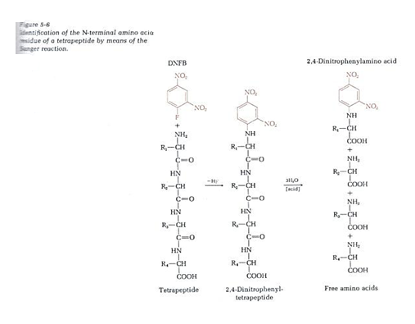

Slide 87
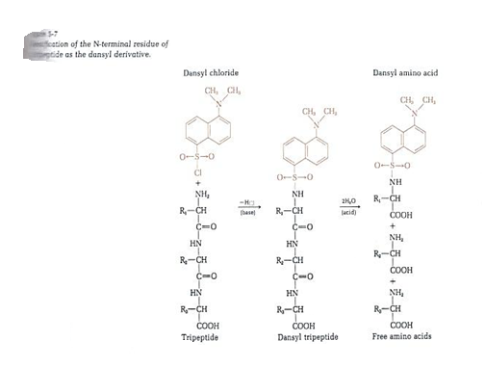

Slide 88
c) Edman procedure:
-The Edman degradation procedure labels and remove only the
amino terminal residue from a peptide, leaving all other
peptide bonds intact.
-The peptide is reacted with phenylisothiocyanate, and the
amino terminal residue is ultimately removed as
a phenylthiohydantoin derivatives.
-After removal and identification of the amino terminal
residue, the new amino terminal residue so exposed can be
labelled, removed, and identified by repeating the same series
of reactions.
- This procedure is repeated until the entire sequence is
determined.

Slide 89
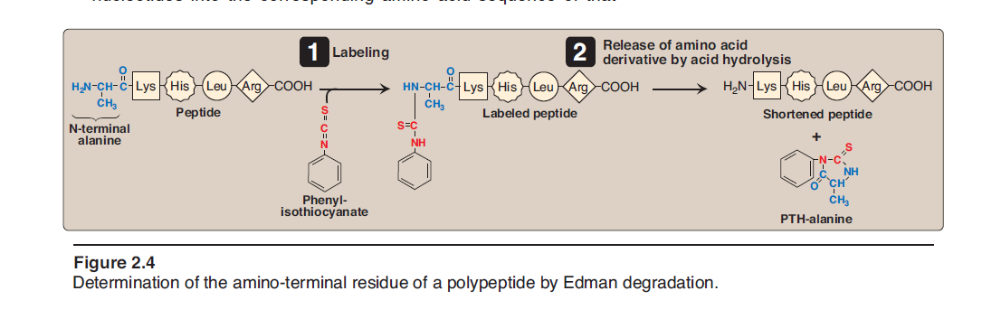

Slide 90
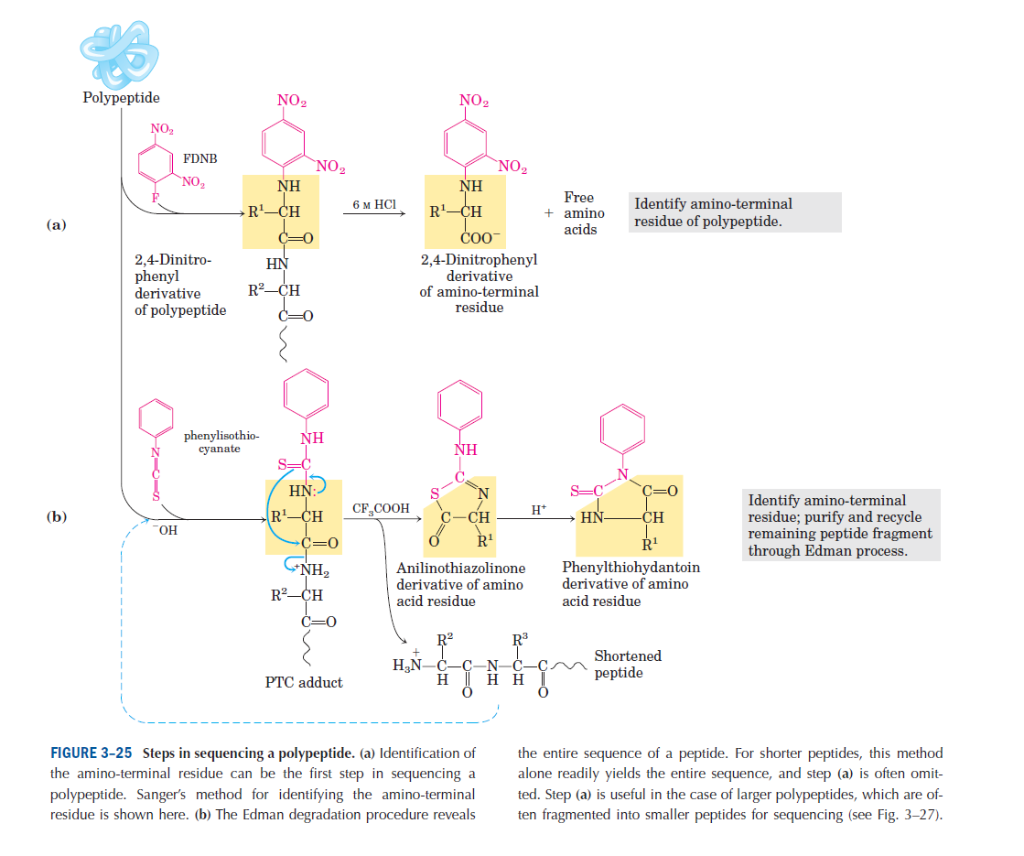

Slide 91
4) Identification of the C-terminal residue of peptides:
a) Lithium borohydride:
The C-terminal amino acid of peptides can be reduced with
lithium borohydride to the corresponding α-amino alcohol.
If the peptide chain is then completely hydrolyzed, the
hydrolyzate will contain one molecule of an α-amino
alcohol corresponding to the original C-terminal amino
acid.(this can be easily identified by chromatographic
method).
b) Carboxypeptidase:
The C-terminal amino acid of a peptide can be selectively
removed by action of the enzyme carboxypeptidase which
specifically attacks C-terminal peptide bonds.

Slide 92
5) Partial hydrolysis of polypeptide chains into small
fragments:
It is fragmentation of the chain to yield a set of short peptides which can be separated and identified.
This is accomplished by:
a) Enzymatic cleavage:
Trypsin:
It catalyzes the hydrolysis of peptide bonds in which the carbonyl group is contributed by either lysine or an arginine residue.

Slide 93
Chymotrypsin:
It cleaves peptide bonds on the carbonyl side of phenylalanine, tryptophan, tyrosine.
Pepsin:
It cleaves peptide bonds from the N of phenylalanine, tryptophan, tyrosine.
Ala – Val – Phe – Ser - Asp
b) Chemical cleavage:
Treatment with cyanogen bromide is used for cleaving
polypeptide.
- It split polypeptide chain on the carbonyl side of methionine
residues leads to the products of a limited number of
peptide fragments.

Slide 94
6) Ordering peptide fragments:
By using at least two different ways.
Example:
Determination of amino acid sequence from overlapping peptide:
Fragments from Tyr – Lys
trypsin cleavage Glu – Met – Leu – Gly – Arg
Ala – Gly
Fragments from cyanogen Tyr – Lys – Glu – Met
bromide cleavage Leu – Gly – Arg – Ala – Gly
Sequence deduced Tyr – Lys – Glu – Met – Leu – Gly – Arg – Ala - Gly

Slide 95
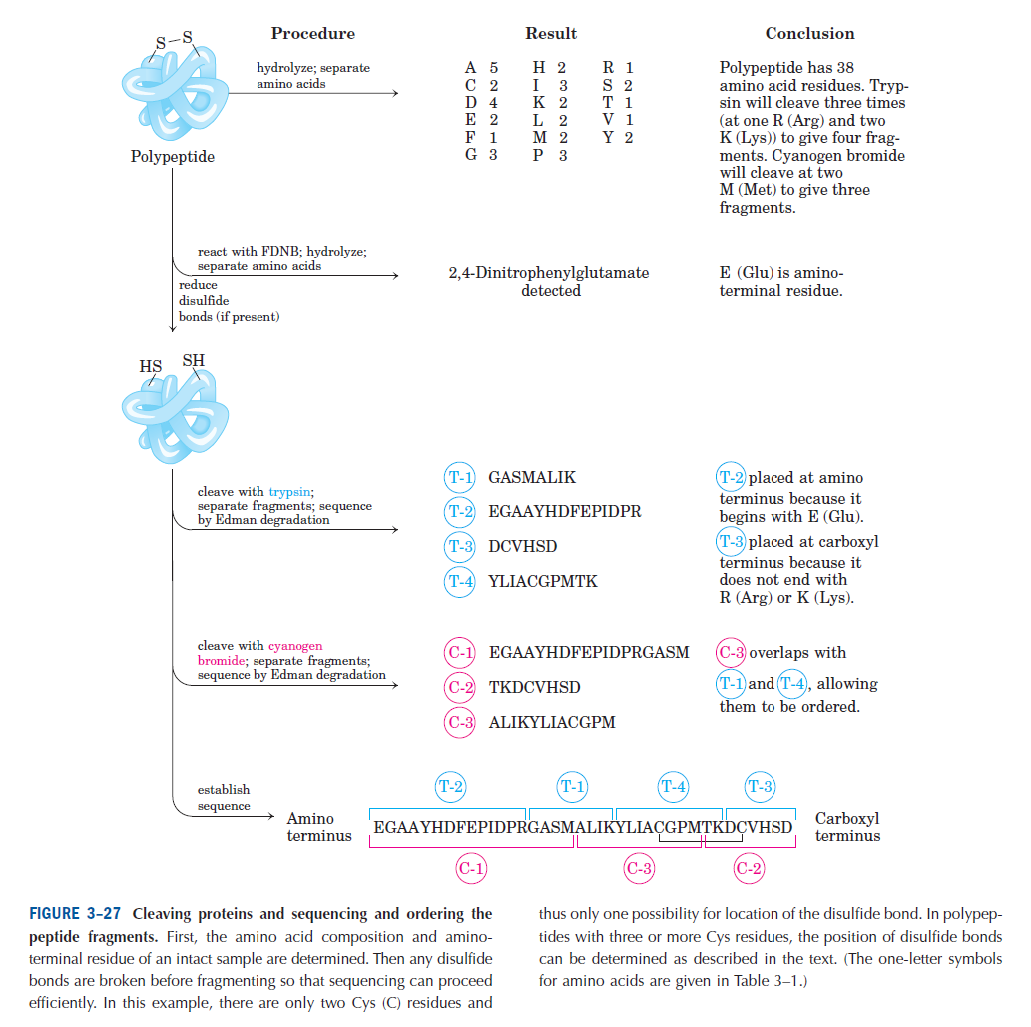

Slide 96
Problem 1:
Partial hydrolysis of a protein yielded a number of polypeptides. One of them was purified.
Deduce the sequence of amino acids in this polypeptide from the following information:
a) Complete acid hydrolysis yielded
ala + arg + ser + ser + lys + phe + met + trp + pro
b) Treatment with fluorodinitrobenzen (FDNB, sanger
reagent) followed by complete acid hydrolysis yielded
dinitrophenylalanine (DNP-ala).
c) Niether carboxypeptidase A nor carboxypeptidase B
released a C-terminal amino acid.

Slide 97
d) Treatment with cyanogen bromide (CNBr) yielded two
peptides:
- One contained ser + trp + pro
- The other contained all the remaining amino acids
(including the second ser)
e) Treatment with chymotrypsin yielded three peptides:
- One contained only ser + pro
- Another contained only met + trp
- The third contained phe + lys + ser + arg + ala
f) Treatment with trypsin yielded three peptides:
- One contained only ala + arg
- Another contained only lys +ser
- The third contained phe + trp + met + ser + pro

Slide 98
a) 9 amino acids
FDNB
b) Polypeptide Dinitrophenylalanine
(DNP-ala)
N-terminal residue is alanine
c) Carboxypeptidase A:
will cleave all C-terminal amino acid except Arginine, lysine,
proline
Carboxypeptidase B:
will cleave only C-terminal arginine or lysine
The C-terminal amino acid is proline

Slide 99
CNBr-
d) Polypeptide ser + trp + pro
ala + arg + ser + lys + phe + met
CNBr-
H₂N – Ala –(Arg + Ser +Lys + Phe) – Met – (Ser + Trp) – Pro – COOH
chymotrypsin
e) Polypeptide ser + pro
met + trp
phe + lys + ser + arg + ala
H₂N – Ala –(Arg + Ser + Lys)– Phe – Met – Trp – ser – Pro – COOH

Slide 100
Trypsin
f) Polypeptide ala + arg
lys +ser
phe + trp + met + ser + pro
H₂N – Ala –Arg – Ser – Lys – Phe – Met – Trp – ser – Pro – COOH
The sequence is:
H₂N – Ala –Arg – Ser – Lys – Phe – Met – Trp – ser – Pro – COOH

Slide 101
Problem 2:
Reaction of a tetrapeptide with 2,4 dinitrofluorobenzen,
followed by hydrolysis in 6 N HCl , yielded the 2,4
dinitrophenyl derivative of valine and three other amino acids.
- Hydrolysis of another sample of the tetrapeptide with trypsin
give two fragments: one was reduced with LiBH4 and then
hydrolyzed. In the hydrolyzate, the amino alcohol
corresponding to glycine was detected, together with an
amino acid forming a yellow reaction product with
ninhydrin.
Give a possible amino acid sequence for the tetrapeptide.

Slide 102
FDNB
●Tetrapeptide 2,4 dinitrophenyl derivative of valine
and three other amino acids
N-terminal residue is valine
H₂N – Val - - - - COOH

Slide 103
Trypsin
●Tetrapeptide one was reduced with LiBH4 and then hydrolyzed.
[In the hydrolyzate, the amino alcohol corresponding
to glycine was detected, together with an amino
acid forming a yellow reaction product with ninhydrin]
The other fragment
H₂N – Val – Arg – Pro – Gly – COOH
Lys
The sequence:
H₂N – Val – Arg – Pro – Gly – COOH
OR
H₂N – Val – Lys – Pro – Gly – COOH

