Slide 1
Protein purification protocol
BCH 530
Dr. Samina Hyder Haq

Slide 2
objective of this course
To give practical training in various Biochemistry techniques
Explain how to organise experimental protocol.
Learn about Protein isolation strategies.
Learn about sequential purification of enzyme and evaluation of their results in the form of a table.
To know about the basic enzyme kinetics .
Learn about writing a Scientific report.

Slide 3
Purification protocol for Protein
Prerequisite information about the protein.
Protein are diverse in composition structure behaviour, you should know about their origin. As your purification strategy depends on it.
Where is this enzyme or protein present in the cell?(intracellular, extracellular, membranous).
How you can purify this protein in as few steps as possible without the loss of activity.(assayable enzyme activity). Keeping in consideration of temperature and time.

Slide 4
General protocol for protein purification
Taking the intact Tissue.
Homogenisation
Getting rid of debris and insoluble stuff
Precipitation of protein with the salt( salt –in)
Getting rid of salt by dialysis(salting out)
Further purification by column and ion exchange chromatography ,
Each above step is followed by enzyme Assay activity(in case you lost your enzyme )
Finding out the exact molecular weight by Column chromatography and by SDS-Gel-electrophoresis

Slide 5
1st Step Homogenisation
Disrupt the Tissue or cells with the help of Homogeniser.(mechanical way).
To get a homogeneous solution after getting rid of cell debris, tissues and insoluble stuff either by filtering through muslin cloth or filter paper. This is your Crude extract containing the protein or enzyme of your interest plus a mixture of other proteins.
Find out the amount of total protein(By Protein assay) as well as amount of your enzyme( by enzyme assay) in this Crude extract

Slide 6
Protein Assay
Two methods
Lowry method as being the most accurate and sensitive method down to 0.01mg/mL and widely used .
Based on the biuret reaction in which the peptide bonds of the proteins react with copper under alkaline conditions to produce CU+,which reacts with the Follins reagent resulting in strong blue colour which depends partly on aromatic a.acid such as tyrosine and tryptophane.

Slide 7
Protein assay by Bradford Assay
This technique is simpler , faster and more accurate than lowry’s method.
The bradford assay relies on the binding of the dye coomasive Blue G-250 to protein.The quantity of protein can be estimated by determining the amount of dye in the blue ionic form. This is achieed by measuring the absorbance at 595nm.The dye appears to bind readly to arginyl and lysyl residues of proteins.

Slide 8
Preparing the standard curve for the protein
Absorbance
X
Concentration of Protein mg/mL

Slide 9
Measuring enzyme activity (enzyme Assay)
Depends upon the enzyme and substrate activity.
Many different protocol but we are going to use spectrophotometric method.
We measure the rate of reaction which is directly proportional to the amount of product formed.
You should know how to calculate enzyme units and concentration of enzyme using Lambert-Beer’s Law which states that the absorbance of the light absorbing material is proportional to its concentration in solution.

Slide 10
Enzyme assay for Acid phosphatase
We will measure the relative amount of product formed by comparing the intensity of the yellow color in each tube following the reaction.

Slide 11
Enzyme assay for alpha amylase
Alpha Amylase's official name is 1,4-a-D-Glucan glucanohydrolase; EC 3.2.1.1
It breaks the starch to maltose
Assay method is that of Bernfield (1951) wherein the reducing groups released from starch are measured by the reduction of 3,5-dinitrosalicylic acid. One unit releases from soluble starch one micromole of reducing groups (calculated as maltose) per minute at 25°C and pH 6.9 under the specified conditions

Slide 12
Monitoring the progress of purification Protocol
Total protein mg/mL
Quantity of protein present in the fraction
Total activity (units of activity)
Use a portion of sample to determine activity.
Multiply activity by total volume to determine total activity.

Slide 13
Specific activity (units of activity/mg)
S.A = Total activity of E
Total protein
% yield: measure of activity retained after each step in procedure.
Percentage yield =
Total activity at particular step
Total activity of initial extract
Purification level increases at each step of purification. = S.A at particular step
S.A of initial crude extract

Slide 14
The purification table We fill out this important table at each stage
Steps | Total protein | Total E activity | Specific Activity | Yield % | Purification level
1. Crude Extract
2. Ammonium sulphate ppt
3. After Dialysis
4. Coulumn chromatography
5. Ion exchange chromatography

Slide 15
Ammonium sulphate(NH4)2SO4 precipitation
Has a wide range of application
Very effective to ppt out water soluble proteins.
These ions have stabilizing effect on protein
You can do sequential ppt of your desired protein depending upon its molecular weight.
Proteins are readly stored as ammonium sulphate ppt.

Slide 16
Ammonium sulphate ppt ( a strategy)
Proteins are soluble in aqueous media because they have hydrophilic amino acid side-chains facing outwards that can interact with water. These are provided by the basic amino acids (arginine, histidine, arginine and lysine), the acidic amino acids (aspartate and glutamate) and the neutral hydrophilic amino acids (asparagine, glutamine, serine, threonine, tyrosine and cysteine).
Any compound that interferes with these interactions between amino acid side-chains and water, by reducing the available water, will reduce the solubility of the protein. As interactions with water become less marked, so protein-protein interactions become more important, and the protein will aggregate and come out of solution. Provided that the temperature is maintained low enough (around 4C), the protein is not irreversibly denatured, but the precipitate can be redissolved in buffer.

Slide 17
Salting in
Most native soluble proteins like globular proteins are soluble at 25% ammonium sulphate but ppt out at 100%
Try to choose the saturation where the desired protein is soluble but others ppt out
Can salt out the unwanted proteins for example at 25% saturation and than increase the salt concentration to ppt out the desired proteins.

Slide 18
Salting in
Salting IN
At low concentrations, added salt usually increases the solubility of charged macromolecules because the salt screens out charge-charge interactions.
So low [salt] prevents aggregation and therefore precipitation or “crashing.”

Slide 19
Salting in
At high concentrations added salt lowers the solubility of macromolecules because it competes for the solvent (H₂O) needed to solvate the macromolecules.
So high [salt] removes the solvation sphere from the protein molecules and they come out of solution

Slide 20
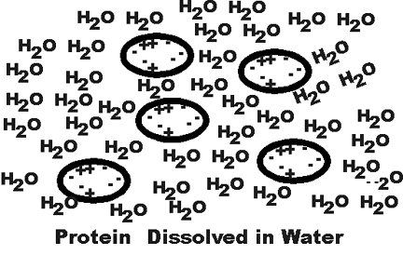
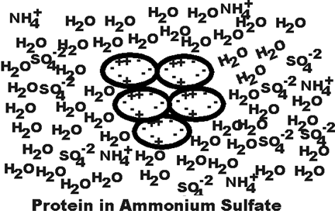
Ammonium sulphate precipitation

Slide 21
Salt OUT
Dialysis is commonly used for removing the salt from the proteins. As ammonium sulphate presence in the protein can interfere in many ways.

Slide 22
Dialysis
Passage of solutes through a semi-permeable membrane.
Pores in the dialysis membrane are of a certain size.
Protein stays in; water, salts, protein fragments, and other molecules smaller than the pore size pass through it.

Slide 23
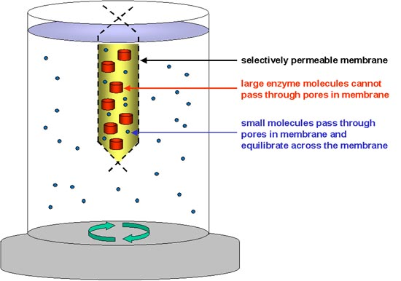
Dialysis will increase the volume of the enzyme solution, because of the initial osmotic effect of the ammonium sulphate; (this is why it is important to leave an air gap at the top of the membrane tube, to prevent it bursting).

Slide 24
Overview of the Protein purification protocol
Crude extract
Protein assay
Enzyme assay
Sequential (0-30% or 30-80%)Ammonium sulphate precipitation
Protein assay
Enzyme assay
Dialysis
Protein assay
Enzyme Assay

Slide 25
You Must!!!
Not through away any sample unless you are sure you don't need it
Label everything clearly.
Keep the enzyme solution and buffers on ice.
Be efficient don't waste time between two steps. Always plan before .
Record all the readings and protocol steps on a proper note book instead of using scrape paper and losing it.
Be organised and methodical.
Keep your workplace clean and tidy , avoid using someone else workplace and be confused.

