Slide 1
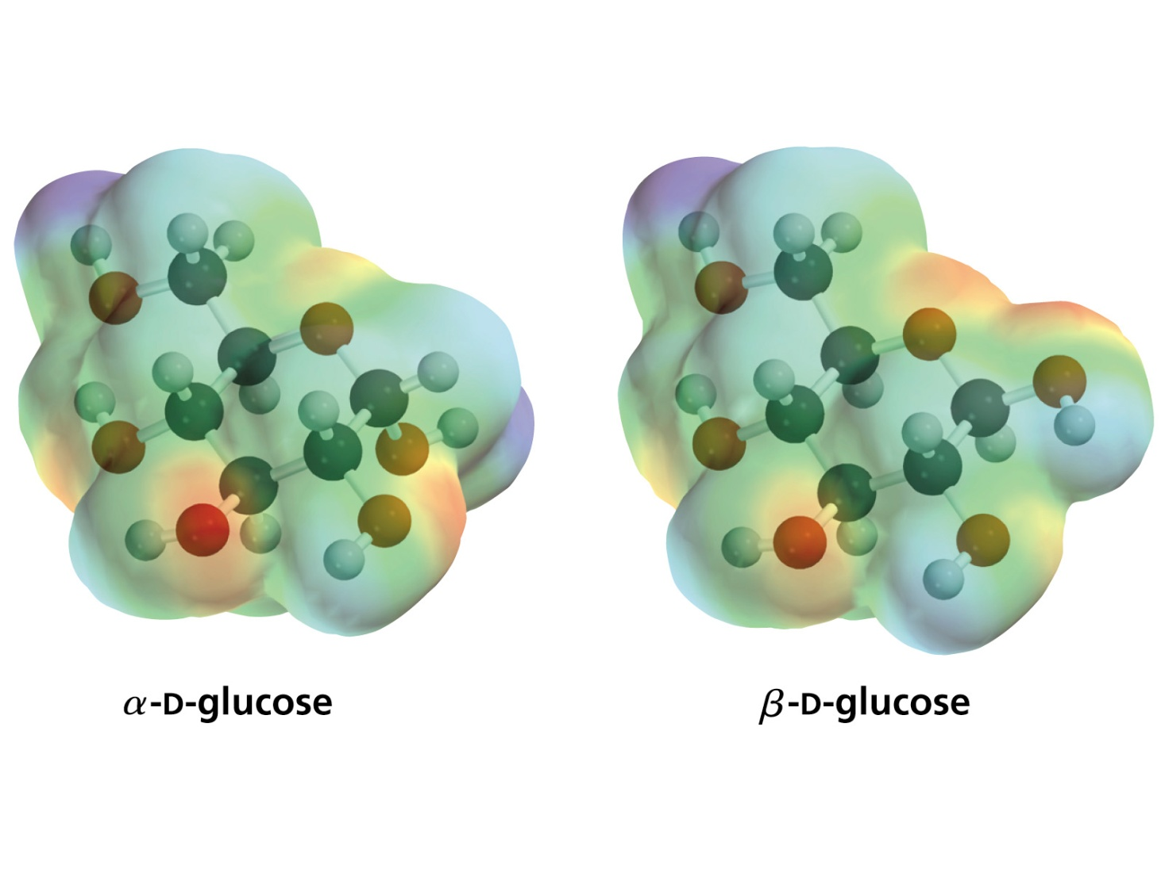
Carbohydrates

Slide 2
Carbohydrates have the following basic composition:
the formula of carbohydrates C_{n}(H₂O)_{n} can be expressed as hydrates of carbon
Monosaccharides - simple sugars with multiple OH groups. Based on number of carbons (3, 4, 5, 6), a monosaccharide is a triose, tetrose, pentose or hexose.
Disaccharides - 2 monosaccharides covalently linked.
Oligosaccharides - a few monosaccharides ( three to ten monosaccharides)covalently linked.
Polysaccharides - polymers consisting of chains of monosaccharide (ten or more monosaccharides) or disaccharide units.

Slide 3
According to nature of carbonyl group:
Carbohydrates are described as aldoses if they have aldehydic group at C-1 and described as ketoses if they have ketonic group on C-2
According to the number of carbon atoms in a given aldose or ketose:
If a sugar is made of three atoms it is described as triose and if it has four atoms it is tetrose.
The full name of a sugar must has a prefix indicating the nature of the carbonyl group, a Latin word indicating the number of carbons present and a suffix –ose.

Slide 4
According to the configuration of the hydroxyl group attached to the last chiral carbon atom in a given aldose or ketose drawn as fischer projection
When there is more than one chiral centre in a carbohydrate, look at the chiral carbon farthest from the carbonyl group in Fischer projection and assign its configuration as D or L as described
Aldoses (e.g., glucose) have an aldehyde group at C-1
Ketoses (e.g., fructose) have a keto group, usually at C-2.

Slide 5
Hemiacetal & hemiketal formation
An aldehyde can react with an alcohol to form a hemiacetal.
A ketone can react with an alcohol to form a hemiketal.

Slide 6
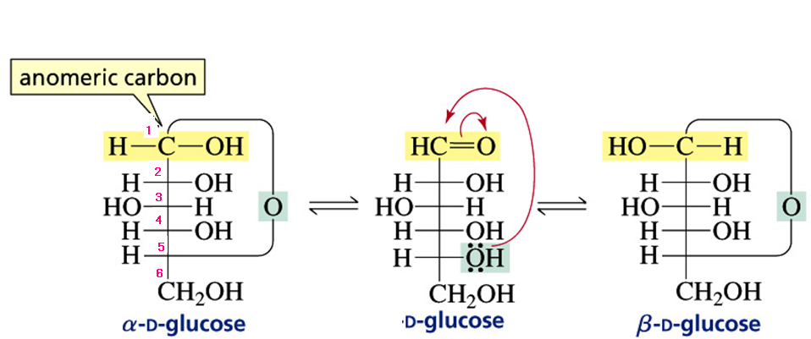
CONVENTIONS For WRITING CYCLIC MONOSACCHRIDE STRUCTURES
React the OH group at the last chiral carbon (C-5 ) in the Fischer projection withthe carbonyl group CHO i.e. in aldolses. This hydroxyl will become hemiacetal (anomeric carbon C-1 has the OH at the right in the form α form and at the left in the β form for the D-monosaccharides (i.e. in D-glucose).

Slide 7
Cyclic Structure of Monosaccharides
Hemiketal Formation
React the OH group at the last chiral carbon (C-5 ) in the Fischer projection with the carbonyl group (ketonic group in ketoses
This hydroxyl will become hemiketal (anomeric carbon C-2 has the OH at the right in the form α form and at the left in the β form for the D-monosaccharides (i.e. in D-Fructose).

Slide 8
Oxidation of monosaccharides
Aldoses can be oxidized easily but the product of oxidation depends on the oxidizing agent used.
Although ordinary ketones resist oxidation, ketoses can be oxidised specially in the basic medium due to they will isomerize to aldoses thus being oxidized easily.
Oxidation by Tollen’s reagent
Tollen’s reagent can be used to differentiate between simple aldehydes and
ketones where simple aldehydes give +ve result (sliver mirror due to reduction
of Ag⁺¹ ions in the reagent by the aldehyde to Ag⁰) while ketones give –ve result.
However this reagent can not be used to differentiate between aldoses and ketoses since both of them give +ve result this due to ketoses isomerize to aldoses by this reagent which is basic in nature.
Sugars which give +ve results with Tollen’s called reducing sugars.

Slide 9
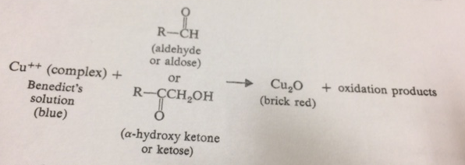
Reducing sugar is suger that give positive tests with T Tollen’s or Fehling’s or Benedict’s solution.

