Slide 1
Studio 6. Human Factors Engineering
Class Teacher: Dr. Raja Rizwan Hussain
Course: GE105
Introduction to Engineering Design College of Engineering
King Saud University
year 2019

Slide 2
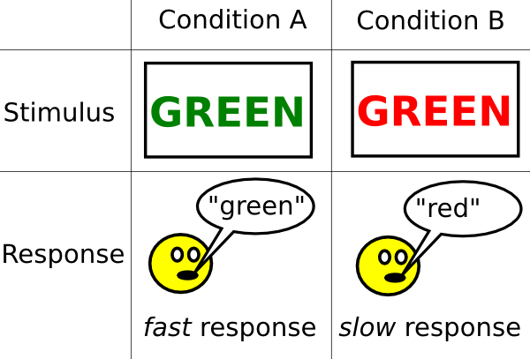
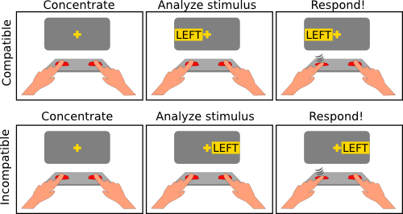
Fun Human Factors Exercises:
Stroop Test (test for color compatibility):
The Simon Task: (stimulus-response compatibility)
Q: why are there tests important?*
Notes:
* Compatibility is an essential psychological-HFE part of any successful design (see the lecture slides that are relevant to psychological HFE)
More fun psychological tests are available here: http://www.psytoolkit.org/lessons/

Slide 3
Educational Videos:
“Ergonomics and Design”
https://youtu.be/LAKlmdMHpdE
(00:00 – 16:31)
“Human Factors in Aviation”
https://youtu.be/4VIYlxTowq8
https://youtu.be/c5fGOP5Jo1o
Entertaining/Practical Examples:
https://youtu.be/1KEse_x1Sko
https://youtu.be/syFev-ojRnQ

Slide 4
Assignment
Watch a number of documentary movies on Human Factors
Make sure to take notes
Open discussion
Identify human factors applicable to your final design project

