Slide 1
Project Time Management
(Project Scheduling)
Chapter#6 part#1

Slide 2
Objectives
Understand the process of project decomposition into activities
 Understand the level of details required for activities
 Understand the process of sequencing activities
 Understand estimation efforts and techniques
 Time management: methods, techniques and tools

Slide 3
Time Management
(main steps):
1. Define activities and sequences
2. Estimate activity resources
3. Estimate activity durations
4. Develop project schedule

Slide 4
Step 1.1 Defining Activities
Depending on the technique used to create the WBS (refer to chapter 5), typically the work packages are built by decomposing parent activities down into smaller and smaller units of work.
Each activity is decomposed into smaller and smaller units until the deliverable can be:
  1) assigned to one person who is held responsible for the completion of the task,
  2) a time and cost estimate can be accurately generated
  3) schedule created
  4) metrics tracked

Slide 5
Step 1.1 Defining Activities
Activity charesterastics
Status and/or completion is measurable and can be reported easily at any time
Start and end events are clearly defined and easily communicated
Each activity has a single deliverable
Time and cost is easily estimated
Activity duration is within acceptable limits no longer than 10 work days. This is not a hard unbreakable rule but a suggested guideline that no activity be defined with an effort longer than two weeks.
Work assignments are independent, you shouldn’t need to interrupt the work in the middle of an activity due to another activity not working as planned
Reminders:
   The 100% rule is in affect; all of the work packages defined must add up to 100% of the total scope of the project
   Not all of the work packages will be defined at the same level of detail

Slide 6
Step 1.2. Activity Sequencing
involves identifying and documenting the logical and sometimes physical relationships among schedule activities
  Mandatory dependencies: inherent in the nature of the work; write software and then test
  Discretionary dependencies: defined by the project team offer the most flexibility;
  External dependencies: based on work being performed by an entity outside of the organization
You must determine correct dependencies to create a realistic schedule

Slide 7
Schedules
Regardless of which scheduling method is chosen, they all strive to graphically demonstrate the sequential relationships between activities
The two techniques of activity sequencing are the precedence diagram method and the activity on arrow diagramming method

Slide 8
Arrow Diagramming Method (ADM)
Also called activity-on-arrow (AOA) project network diagram
Activities are represented by lines with arrows
Nodes or circles are the starting and ending points of activities
Key Drawback: Can only show finish-to-start dependencies

Slide 9
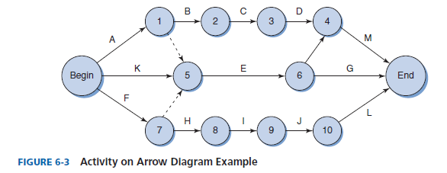
Sample Activity-on-Arrow (AOA) Network Diagram
Lines with arrows represent tasks
Circles with words or numbers represent the begin or end of a task

Slide 10
Example
Develop the network for a project with following activities and immediate predecessors:
Activity Immediate
predecessors
A -
B -
C B
D A, C
E C
F C
G D,E,F
Try to do for the first five (A,B,C,D,E) activities

Slide 11
Network of first five activities
A
D
1
3
4
E
B
C
5
2
We need to introduce a dummy activity

Slide 12
Network of Seven Activities
1
A
3
D
G
6
5
dummy
E
B
C
4
F
2
Note how the network correctly identifies D, E, and F as the immediate predecessors for activity G.
Dummy activities is used to identify precedence relationships correctly and to eliminate possible confusion of two or more activities having the same starting and ending nodes
Dummy activities have no resources (time, labor, machinery, etc) – purpose is to PRESERVE LOGIC of the network

Slide 13
Precedence Diagramming Method (PDM)
uses boxes to represent activities (nodes) and lines with arrows to represent the dependencies see example next slide
The task names are for this example shortened to just letters. The lines with arrows are not labeled
Notice that some of the activities (C, F, G, and H) have more than one predecessor; some only have a successor (Begin) and some only have a predecessor (End)

Slide 14
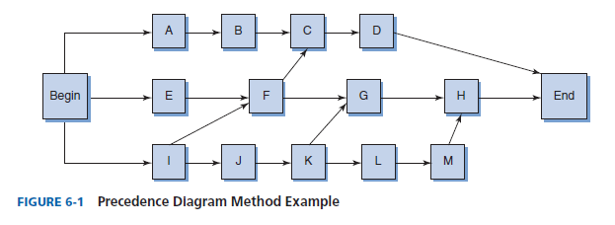
Sample PD

Slide 15
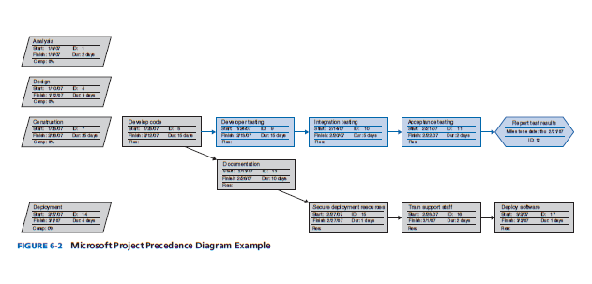
Microsoft Project Sample PD

Slide 16
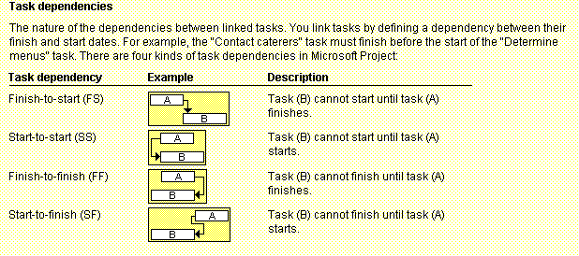
Task Dependency Types

Slide 17
Step 2 : Estimate Activity Resources
Before estimating activity durations, you must have a good idea of the quantity and type or level of resources that will be assigned to each activity.
Consider important issues in estimating resources:
  How difficult/complex will it be to complete specific activities on this project?
  What is the organization’s history in doing similar activities?
  Are the required resources available? Internal or External?
  Very important to match the right person with the right task!

Slide 18
Step 2 :Estimate Activity Resources
Process Activities:
  Activity resource requirements
  Resource calendars
  Assigned resources
Notes:
Remind students that as happens with many of the processes discussed in this course, activity resource estimating, activity duration estimating, and cost estimating generally occurs at the same time on many projects

Slide 19
Techniques for Resource Estimating
Expert judgment
Analogous
Alternatives analysis
Notes:
EXPERT JUDGMENT An estimator uses expert judgment to gain insight into the resource
requirements for each individual work package. No estimator will have all the knowledge
needed to assess an entire project. The estimator will need to consult IT SMEs—network
engineers, database designers, software developers, and user SMEs—accountants, engineers,
marketing people, and so on. The estimator seeks to determine what expertise is
needed and what level of knowledge is required to complete the deliverable of the work
package. (Do we need a senior network engineer with 10 years of experience? Or is this a
task that a junior network engineer with 2 years of experience can handle?)
THE ANALOGOUS APPROACH If the WBS was created using the analogous approach—that
is, building the WBS using a similar project first and then editing to fit the uniqueness of
the current project—the required resources have already been determined. Adjustments
will be needed based on the lessons learned from the previous project and the uniqueness
of the current project. For example, say that in the previous analogous project, a junior systems
analyst with just one year of experience was assigned to develop the specifications
for a small key piece of the application. The junior analyst who was struggling to complete
the work didn’t want to look bad in front of his boss, so he worked very long hours and
weekends to complete the assignment but didn’t report the extra effort. The task ended up
getting done, but the quality was not up to expectations. The junior analyst then confessed
his difficulties to his boss. If this information is not recorded and communicated, the same
mistake will be made again.
ALTERNATIVES ANALYSIS Each work package will have alternative ways in which the
work can be accomplished. Some examples include different skill levels of resources, internal
versus external resources, technology selected, and time constraints. Some of these
alternatives are voluntary choices, and others are required. For example, say that a new
software package selected is written in Java, and no one on the current staff has Java experience.
Or say that the added functionality needed for a student registration system must
be done while the students are on break, so time is critical

Slide 20
Step 3: Activity Duration Estimating
Duration vs Effort
  Duration = the effort (actual amount of time worked on an activity) + elapsed time
Estimates and Project Progress:
  Developing an estimate for a large technology project is a complex task requiring a significant amount of effort.
  Remember that estimates are done at various stages of the project “Progressive Elaboration”
Notes:
This is where you need to explain to the students the difference between duration and actual effort. Most IT workers multi-task working on more than one project so it may take only 8 hours to complete an activity but will take 40 hours of duration to find time to get the 8 hours of work accomplished.

Slide 21
Problems with Estimates:
Many people doing estimates have little experience doing them. Try to provide training and mentoring
People have a bias toward underestimation. Review estimates and ask important questions to make sure estimates are not biased
Management wants a number for a bid or just to look good to superiors, not a real estimate. Project managers must negotiate with project sponsors to create realistic estimates

Slide 22
Activity Duration Estimating Methods
To arrive at an estimate of time, you first determine which estimate of SW project size is needed.
 Many different techniques have been used:
  Task Sizing-Based Methods:
    LOC (lines of Code)-based;
    FP (Function Points)-based;
  Analogous Estimating
  Packaged: Top-down or Bottom-Up Estimating
  Three-point Estimating
  Simulation Estimating (Monte Carlo Method)
  COCOMO Model
After the effort has been sized using one of these methods, time estimates can be applied

Slide 23
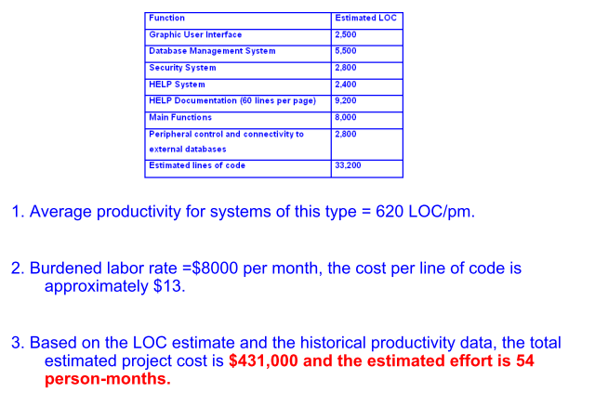
LOC (lines of Code)-based approach
Has been one of the most used methods
 Based on historical results

Slide 24
LOC (lines of Code)-Example
Example:
  - Assume estimated lines of code of a system is: 33,200 LOC
  - Average productivity for system of this type is: 620 LOC/person-month
  - There are 6 developers
  - Labor rate is: $ 800 per person-month
Calculate the total effort and cost required to complete the above project.
Way1
  => Total Effort = Total LOC/Productivity = 33200/620=53.54 ≈ 54 person-months
  => 6 developers ➔Effort = Total Effort/6 = 54/6 = 9 months
  => Total Cost = Total Effort * Labor Rate = 54 * 800 ≈ $43,200
Way2
  => Cost per LOC = Labor Rate /Productivity=800/620=$1.29 ≈ $1.3
  => Total Cost = Total LOC * Cost per LOC = 33,200* 1.3=$43160 ≈ $43,200

Slide 25
Function Points
used to estimate time and dollars based on the generated system requirements specification
A function point measures the size of a business function that the new system needs to have such as an input screen or a report
Function Point analysis can be done at any point in the project but are not considered accurate until late in the planning phase
Uses pf FP:
  # of pages of documentation per FP
  Levels of effort per FP (person months)
  Level of expertise per FP (expert, novice)
  Cost per FP
New derivative called “Feature Points” or “Object Points”

Slide 26
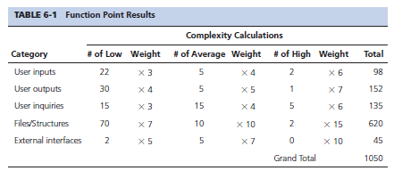
Example

Slide 27
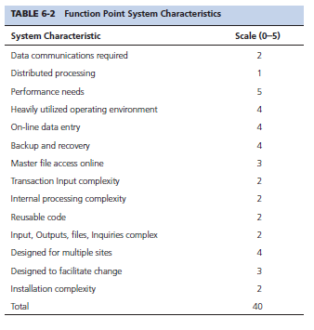
Next Step: compute the value adjustment factor based on the following table
0 = no effect
1 = incidental
2 = moderate
3 = average
4 = significant
5 = essential

Slide 28
Function Points
Next: calculate the total adjusted function points: Unadjusted total x (0.65 + 0.01 x VAF) or
    1050 x (0.65 + 0.01 x 40) = 1102.50
Results
  Effort = (1.49 hrs effort per f/point) (1102.50) = 1,642.7 hrs
  Documentation (.25 pages per f/point) (1102.50) = 275.63 pages
  Bugs (.025 bugs per f/point) (1102.50) = 27.5 bugs
  User Instructed Rework (.04 per f/point) (1102.50) = 44.1
  Dollars ($105.10 per f/point) (1102.50) = $115,872.75

Slide 29
System Analogy
bases a current work package time estimate on the actual time of a work package from a similar project already completed
  Usually done in a “Top-down” approach
  Have 3 or 4 experts review requirements
  Make sure you have the experience and that the two systems are very similar
  Can use time, or LOC, or Function Points

Slide 30
Three Point
Use a weighted average approach or beta probability distribution approach to capture three point estimates for each work package
  Optimistic, Normal, Pessimistic
Equations for expected value (E), and the standard deviation (SD) are:
  E = (a + 4b + c)/6; SD = (c-a)/6
  a = the optimistic estimate
  b = normal estimate
  c = pessimistic estimate

Slide 31
Three Point
Adds the element of risk into its calculations
SME’s determine three types of estimates:
  Most Likely
  Optimistic
  Pessimistic
Next the SME uses the weighted average formula

Slide 32
Three Point Example
  Weighted average =
  8 workdays + 4 X 10 workdays + 24 workdays = 12 days 6
  where:
  optimistic time= 8 days
  most likely time = 10 days
  pessimistic time = 24 days
  Therefore, you’d use 12 days on the schedule instead of 10 when using this technique.

Slide 33
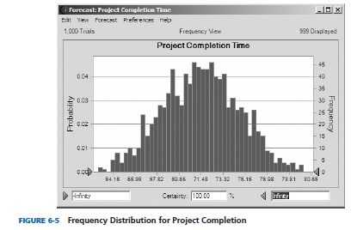
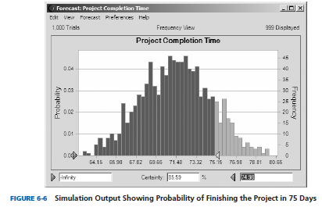
Simulation
  a technique that randomly generates specific end values for a variable with a specific probability distribution

Slide 34
COCOMO
Consists of three project types described as:
  Organic – small project teams, little innovation, constraints and deadlines are few, stable development environments, known familiar technology, few changes expected
  Semidetached – medium sized project teams, some innovation, few constraints, tighter deadlines, and more changes expected, still a fairly stable development environment
  Embedded – largest of the three in all categories, large project teams, constant innovation, many constraints, very tight deadlines, and many changes expected, complex development environment

Slide 35
Effort Sizing
Organic:
  Effort = 2.4 x KLOC^{1.05} where KLOC = 1000 lines of code
  Duration = 2.5 x Effort^{0.38}
Semidetached
  Effort = 3.0 x KLOC^{1.12}
  Duration = 2.5 x Effort^{0.35}
Embedded
  Effort = 3.6 x KLOC^{1.2}
  Duration = 2.5 x Effort^{0.32}

Slide 36
Step 4 :Develop project schedule
Determines the planned start and completion dates for each activity listed on the WBS. The deliverable from this process is the project schedule.
 Uses results of the other time management processes (activity definition, sequencing) to determine the start and end date of the project.
 Tools used for schedule development:
  Critical Path Method (CPM)
  Program Evaluation Review Technique (PERT)
  Critical Chain Method (CCM)
  Resource Leveling
  Gantt chart

Slide 37
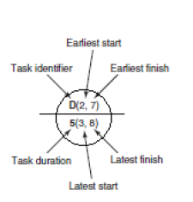
Basics of Project Scheduling
Activities (tasks, steps) – they are characterized by Identifier, ES, EF, LS, LF, ST, and TT
  ES – Earliest Start time (the earliest time when a given activity or step could start)
   EF – Earliest Finish (the earliest time when a given activity or step could be completed
   LS – Latest Start time (the latest time when a given activity or step could start)
   LF – Latest Finish (the latest time when a given activity or step could be completed
   ST - slack time. It refers to the amount of time an activity (a step, a task) can be delayed without affecting the start time of any successor tasks
   TT – time (duration) of a task

Slide 38
Critical Path Method
The critical path represents the shortest time in which a project can be completed. In other words, any activity on the critical path that is delayed in completion will result in delaying the entire project.

Slide 39
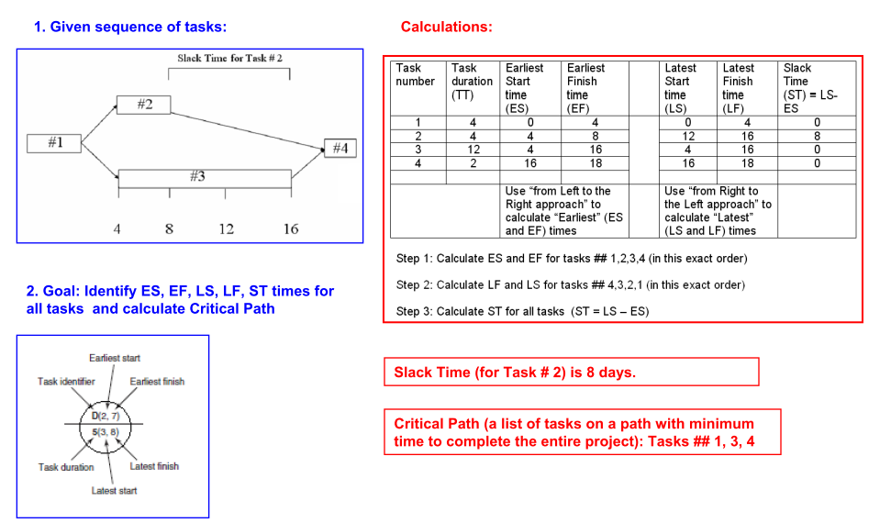
Example 1
Critical Path

Slide 40
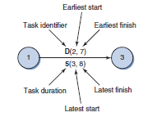
Example 2
Critical Path

Slide 41
Example 2
Critical Path
  Path 1 = A, D, G, K, L = 22 days (Those activities with zero slack are on the critical path)
  Path 2 = A, E, H, K, L = 19
  Path 3 = A, E, I, L = 15
  Path 4 = B, H, K, L = 20
  Path 5 = B, I, L = 16
  Path 6 = C, F, J, L = 19
Path A,D,G,K,L is the critical path duration is longest
Slack : The difference between the earliest time an activity can
begin and the latest time an activity can begin without
changing the completion date of the project

Slide 42
Critical Path analysis
If one of more activities on the critical path takes longer than planned, the whole project schedule will slip unless corrective action is taken
Misconceptions:
  The critical path is not the one with all the critical activities; it only accounts for time
  The critical path can change as the project progresses!!!!!!!!!

Slide 43
PERT
The Program Evaluation and Review Technique (PERT)Uses a weighted average approach or beta probability distribution to capture the three point estimates discussed in previous lecture (optimistic, most likely, and pessimistic) for activity duration
The PERT weighted averages for each activity are added to the network diagram to show the start dates and finish dates for each and the final project end date

Slide 44
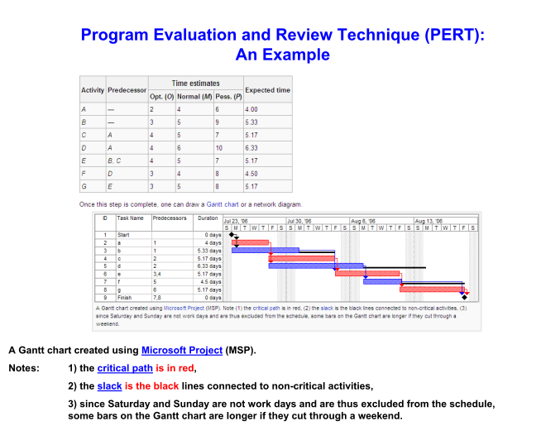

Slide 45
Gantt Charts
Gantt charts provide a standard format for displaying project schedule information by listing project activities and their corresponding start and finish dates in a calendar format
Symbols include:
  Black diamonds: milestones
  Thick black bars: summary tasks
  Lighter horizontal bars: durations of tasks
  Arrows: dependencies between tasks

Slide 46
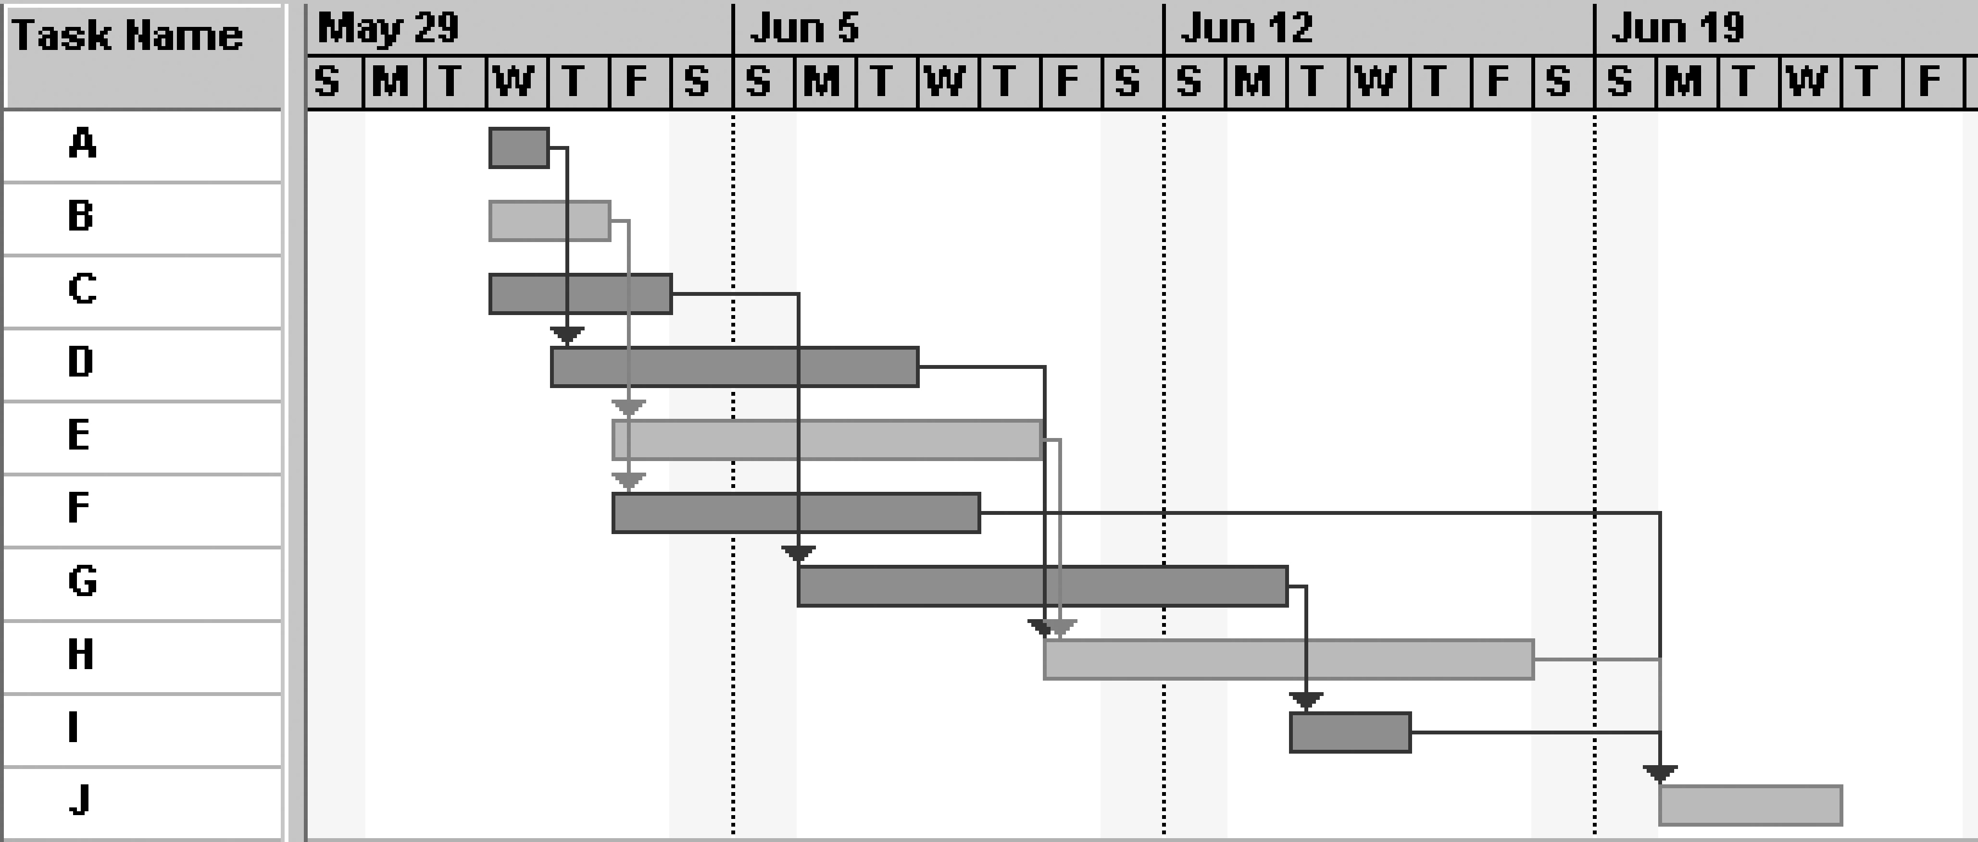
Gantt Chart for Project X
Note: Darker bars would be red in Project 2007 to represent critical tasks.

Slide 47
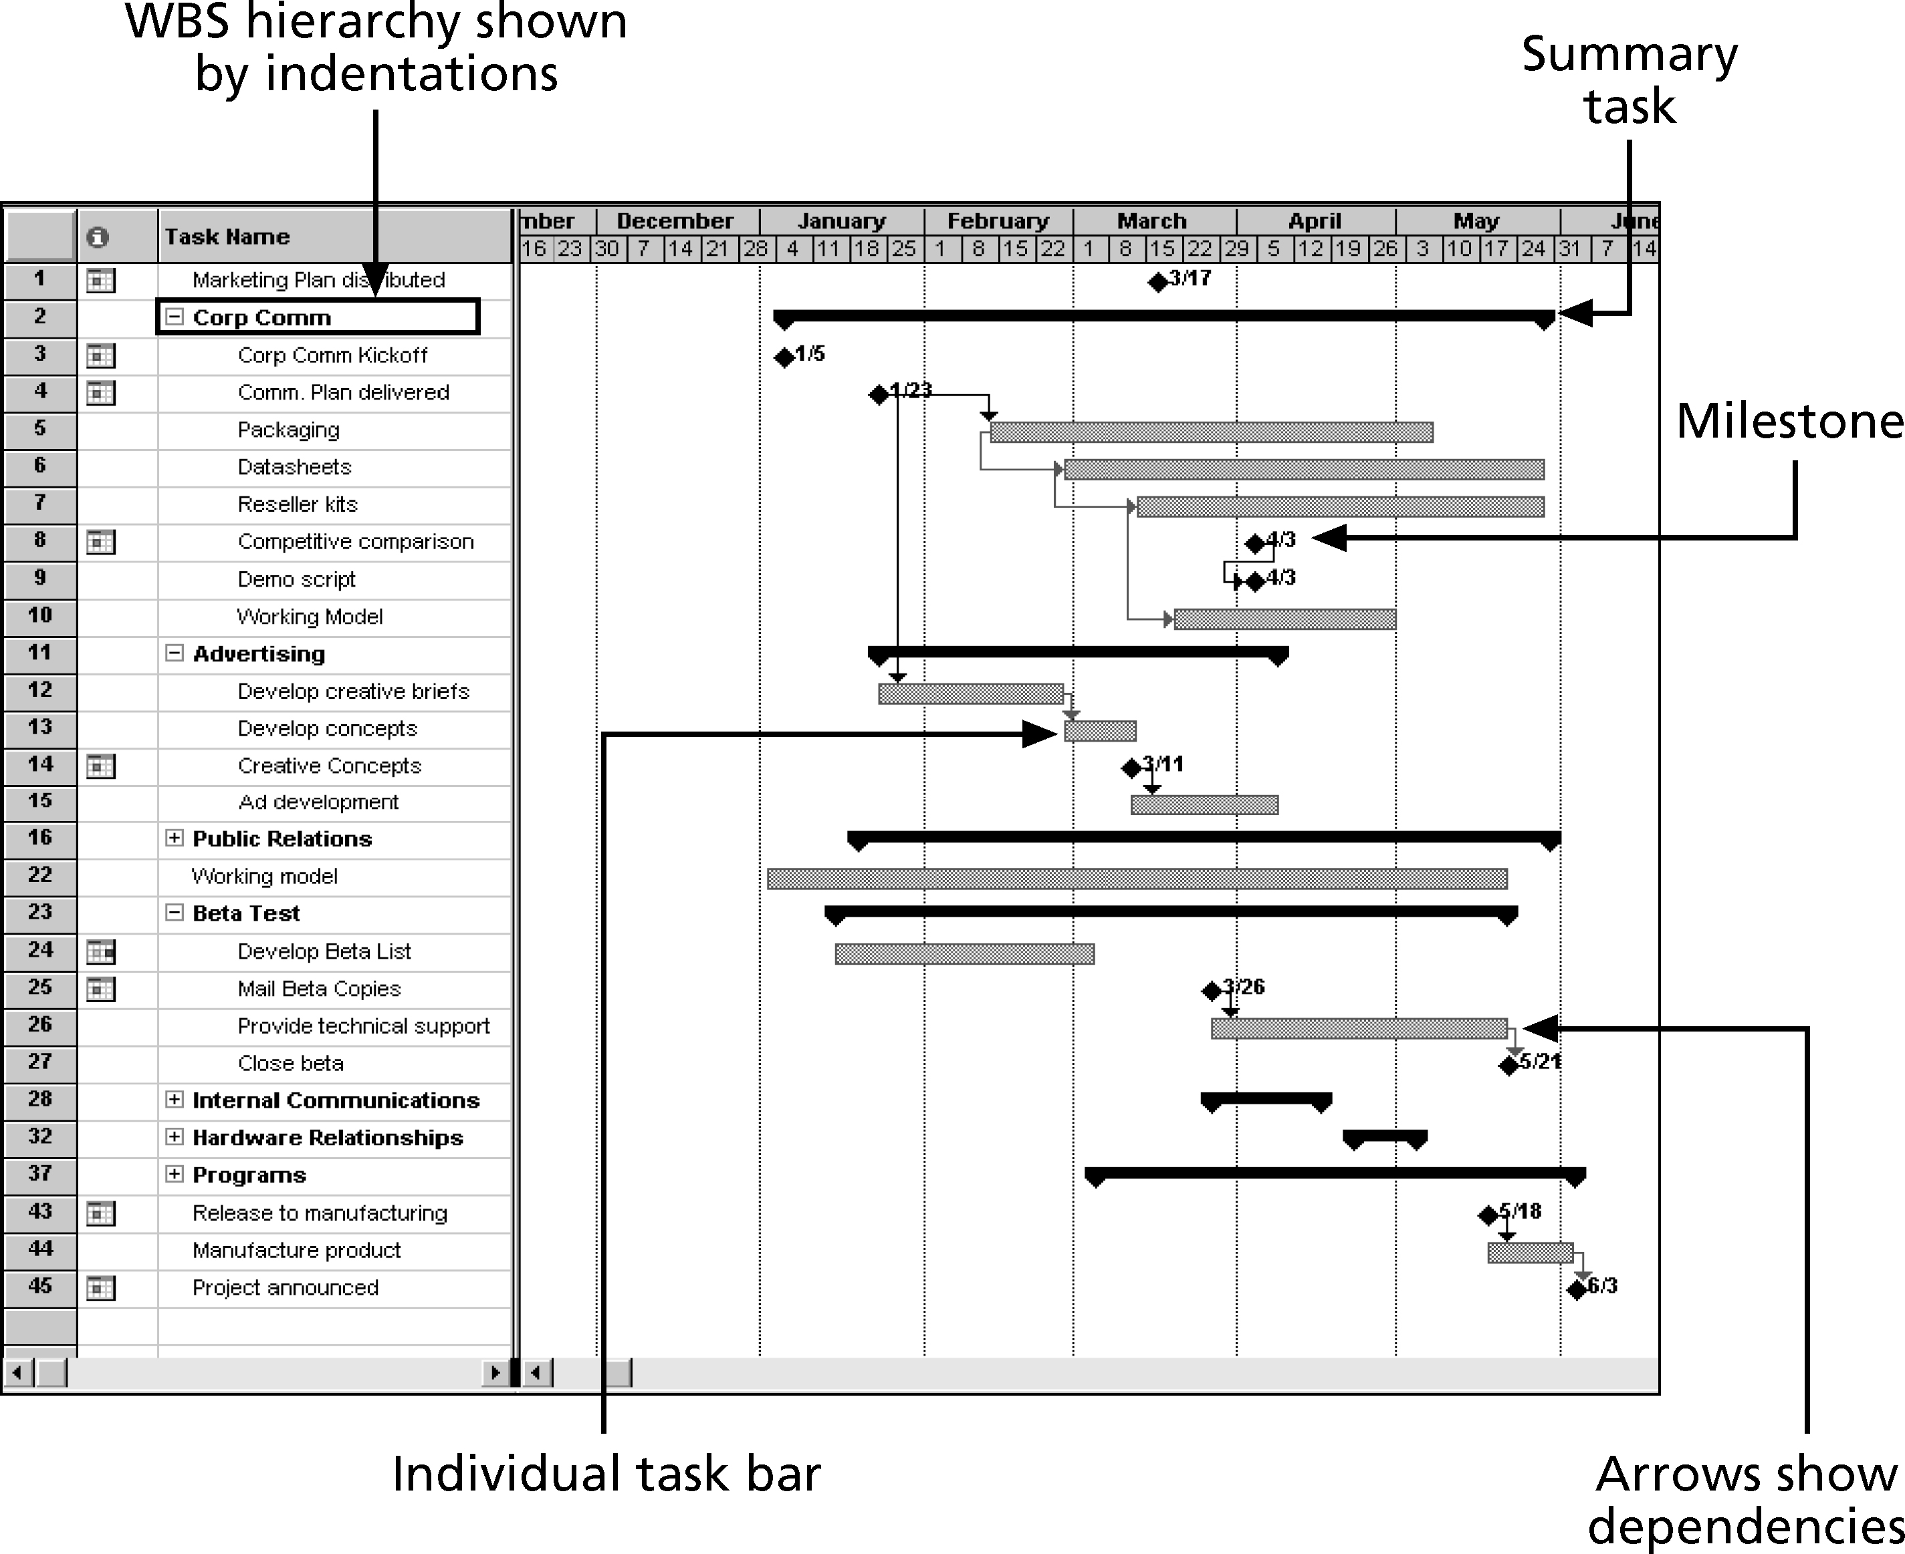
Gantt Chart for Software Launch Project

Slide 48
Adding Milestones to Gantt Charts
A milestone is a significant event that normally has no duration
It often takes several activities and a lot of work to complete a milestone
They’re useful tools for setting schedule goals and monitoring progress
Many people like to focus on meeting milestones, especially for large projects
Milestones emphasize important events or accomplishments on projects
Normally create milestone by entering tasks with a zero duration, or you can mark any task as a milestone
Notes:
Examples include obtaining customer sign-off on key documents or completion of specific products

Slide 49
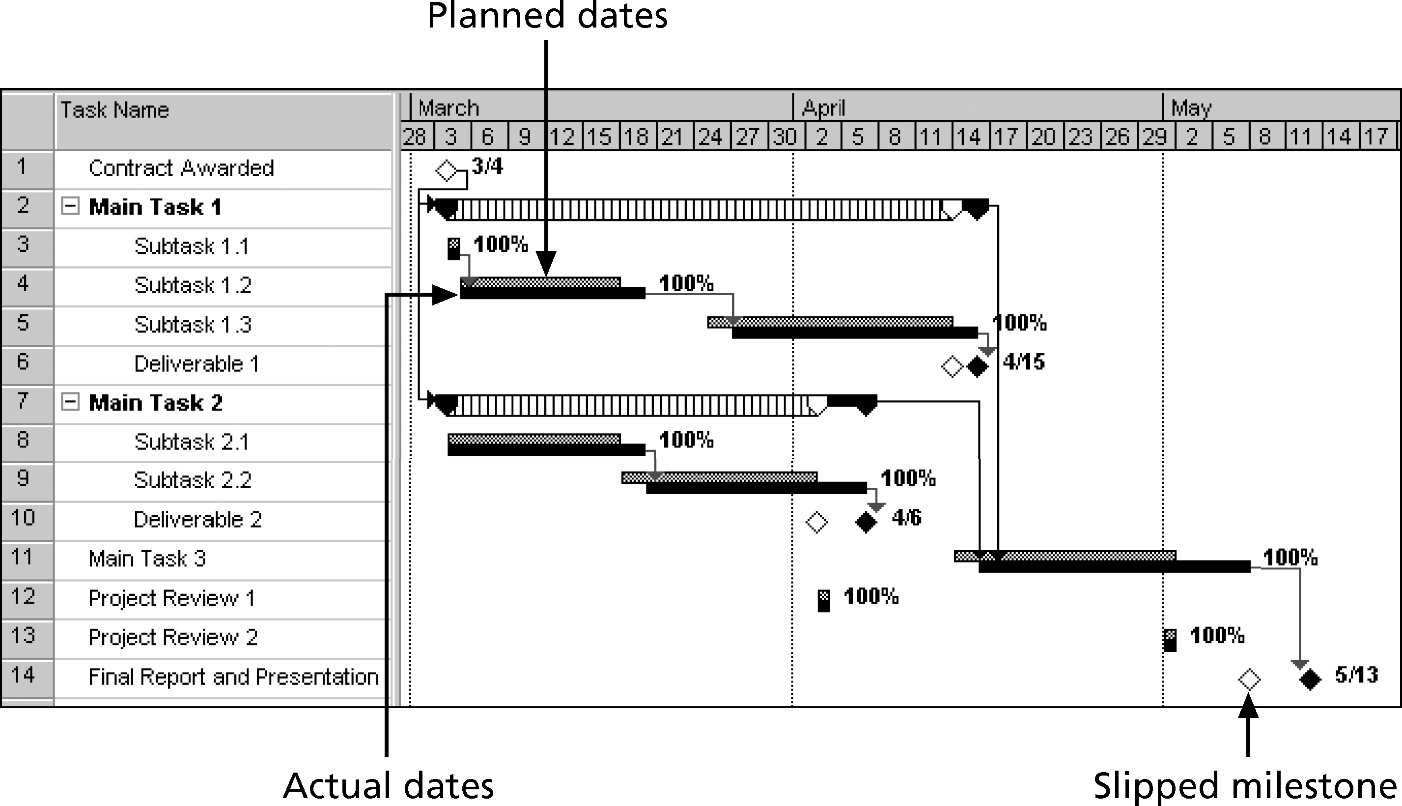
Sample Tracking Gantt Chart
Notes:
Used to compare actual dates to baseline (planned) dates
Gray bar shows the planned duration of the task
Black bar shows the actual duration of the task
striped bar shows the planned line of the summary task
White diamond represents a slipped milestone (milestone activity that was actually completed later than originally planned)
Percentage shows the percentage of work completed for each task

Slide 50
Summary
The activity definition process is used to decompose the initial WBS into assignable units of work that can be estimated and monitored.
Two techniques that can help project managers with sequential activities are the precedence diagram method and the activity on arrow diagramming method.
Many techniques can be used in activities duration estimating, including the lines of code, function points, analogous, simulation, and COCOMO methods.
The critical chain method gives project managers a process that tracks critical activities and scarce resources.

