Slide 2
KINGDOOM OF SAUDI ARABIA
King SaudUniversity
College of Sciences - Department Botany & Microbiology
Plant Physiology
BIO 323
Dr. Abdulrahman Al-hashimi

Slide 3
Lecture 4
Mineral Nutrition
1- Essential elements
2- Nutrient deficiency
3- Soil, Root and Microbes

Slide 4
Introduction
Plants are capable of making all necessary organic compounds from inorganic compounds and elements in the environment (autotrophic).
MINERAL NUTRIENTS ARE ELEMENTS acquired primarily in the form of inorganic ions from the soil.
“Mineral”: An inorganic element (acquired mostly in the form of inorganic ions from the soil).
“Nutrient”: A substance needed to survive or necessary for the synthesis of organic compounds.

Slide 5
Introduction
They enter the biosphere predominantly through the root systems of plants.
After being absorbed by the roots, the mineral elements are translocated to the various parts of the plant, where they are utilized in numerous biological functions.
The study of how plants obtain, distribute, metabolize, and utilize mineral nutrients is called Mineral nutrition.
Hydrogen, carbon, and oxygen are not considered mineral nutrients because they are obtained primarily from water (H2O) or carbon dioxide (CO₂).

Slide 6
1- Essential elements
Essentiality of mineral nutrients
Essential: Universal for all plants
Absence prevents completion of life cycle
Absence leads to deficiency
Required for some aspect of mineral nutrition
Beneficial: Often limited to a few species
Stimulates growth and development
May be required in some species

Slide 7
1- Essential elements
An essential element is defined as one whose absence prevents a plant from completing its life cycle.
If plants are given these essential elements, as well as energy from sunlight, they can synthesize all the compounds they need for normal growth.
Essential mineral elements are usually classified as macronutrients or micronutrients, according to their relative concentration in plant tissue.
Many elements often are present in concentrations greater than the plant’s minimum requirements.

Slide 8
1- Essential elements
Adequate tissue levels of elements that may be required by plants
The values for the nonmineral elements (H, C, O) and the macronutrients are percentages. The values for micronutrients are expressed in parts per million (ppm).

Slide 9
1- Essential elements
Adequate tissue levels of elements that may be required by plants
The values for the nonmineral elements (H, C, O) and the macronutrients are percentages. The values for micronutrients are expressed in parts per million (ppm).

Slide 10
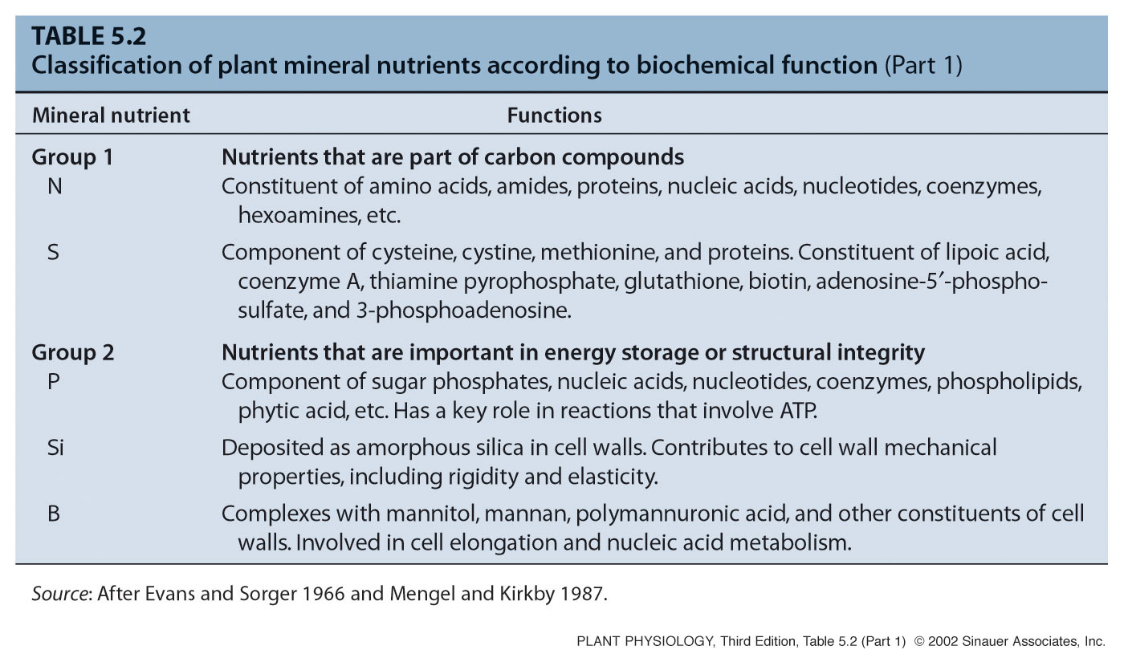
Classification of plant mineral nutrients
according to biochemical function

Slide 11
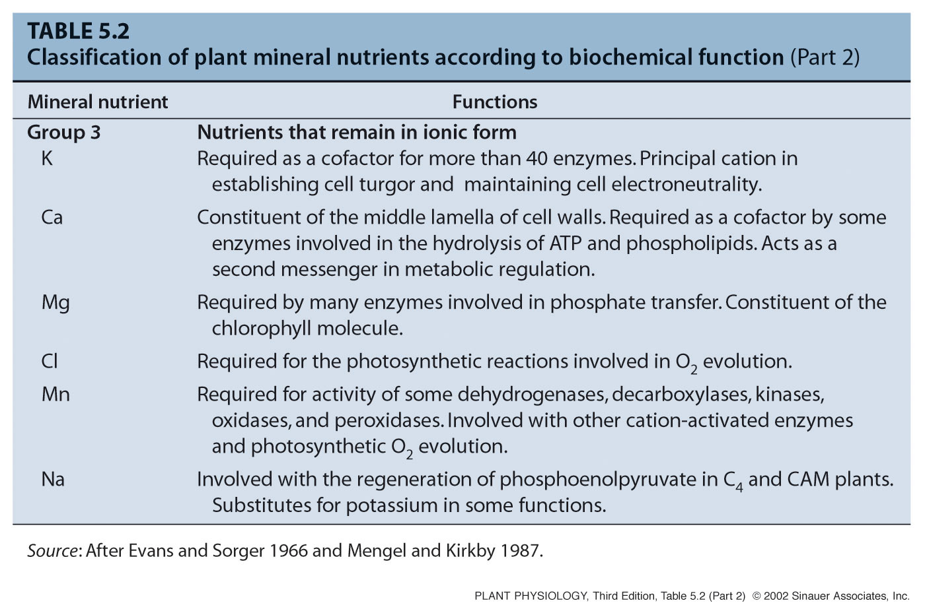
Classification of plant mineral nutrients
according to biochemical function

Slide 12
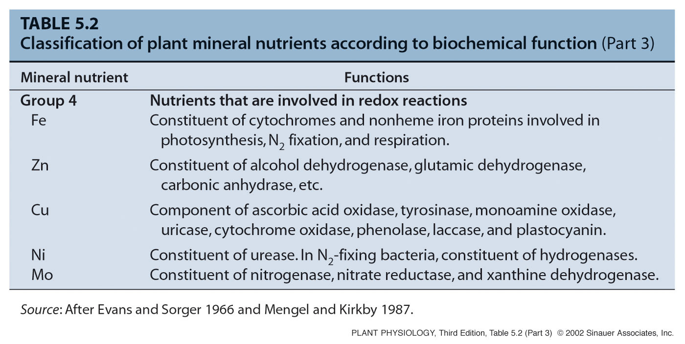
Classification of plant mineral nutrients
according to biochemical function

Slide 13
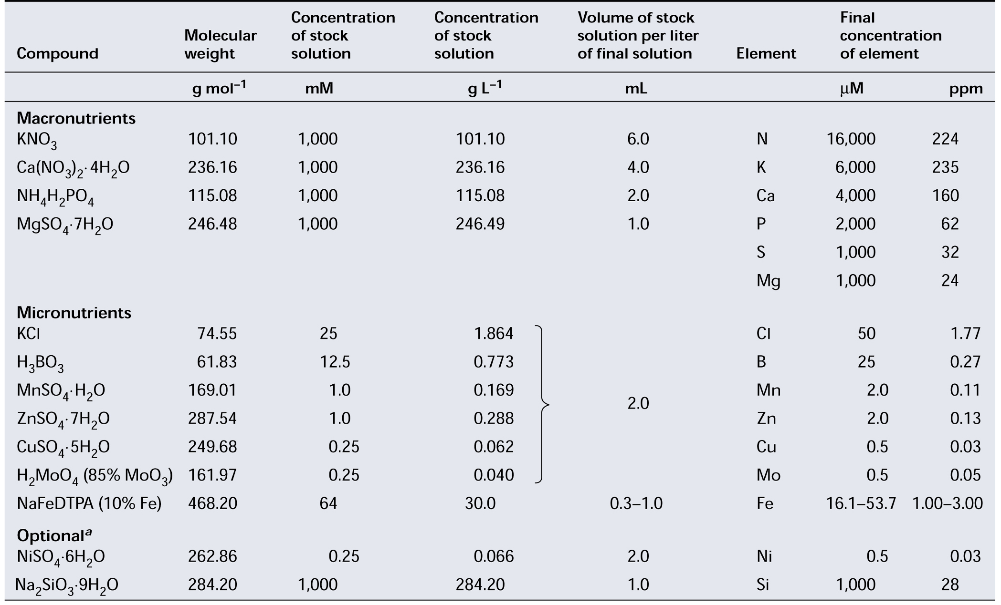
Composition of a modified Hoagland
nutrient solution for growing plants

Slide 14
Techniques used to study plant nutrition
Hydroponic and aeroponic systems for growing plants in nutrient solutions in which composition and pH can be automatically controlled.
Hydroponic system, the roots are immersed in the nutrient
solution, and air is bubbled through the solution.

Slide 15
Techniques used to study plant nutrition
Hydroponic and aeroponic systems for growing plants in nutrient solutions in which composition and pH can be automatically controlled.
An alternative hydroponic system, often used in commercial production. The nutrient solution is pumped as a thin film down a shallow trough surrounding the plant roots.

Slide 16
Techniques used to study plant nutrition
Hydroponic and aeroponic systems for growing plants in nutrient solutions in which composition and pH can be automatically controlled.
Aeroponic system, the roots are suspended over the nutrient solution, which is whipped into a mist by a motor-driven rotor.

Slide 17
2- Nutrient deficiency
Mineral Deficiencies Disrupt Plant Metabolism and Function
Mineral nutrient deficiencies occur when the concentration of a nutrient decreases below the typical range.
Both chronic and acute deficiencies of several elements may occur simultaneously.
Deficiencies or excessive amounts of one element may induce deficiencies or excessive accumulations of another.
Nutrient deficiency symptoms in a plant are the expression of metabolic disorders resulting from the insufficient supply of an essential element.

Slide 18
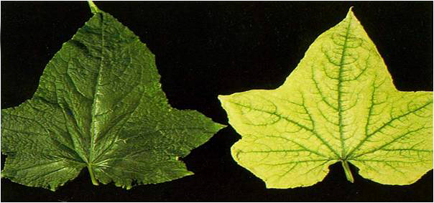
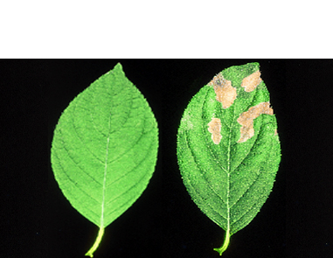
2- Nutrient deficiency
Deficiencies of specific nutrients lead to specific visual, often characteristic, symptoms reflective of the role of that nutrient in plant metabolism.
These symptoms can be used as diagnostic for the deficiency.
Some virus-induced plant diseases may produce symptoms similar to those of nutrient deficiencies.
Chlorosis, Nitrogen deficiency
Necrosis, Potassium deficiency

Slide 19
2- Nutrient deficiency
When relating acute deficiency symptoms to a particular essential element, such element can be recycled (redistributed) from old to young leaves.
Nitrogen, Phosphorus, and Potassium, can readily move from leaf to leaf (mobile). Boron, Iron, and Calcium, are relatively immobile in most plant species.
Mobile, symptoms tend to appear first in old leaves.
Immobile, symptoms tend to appear first in young leaves.

Slide 20
2- Nutrient deficiency
Remobilization of nutrients from old to young leaves
Older leaves on celery turning yellow while
the growing points in the center remain green

Slide 21
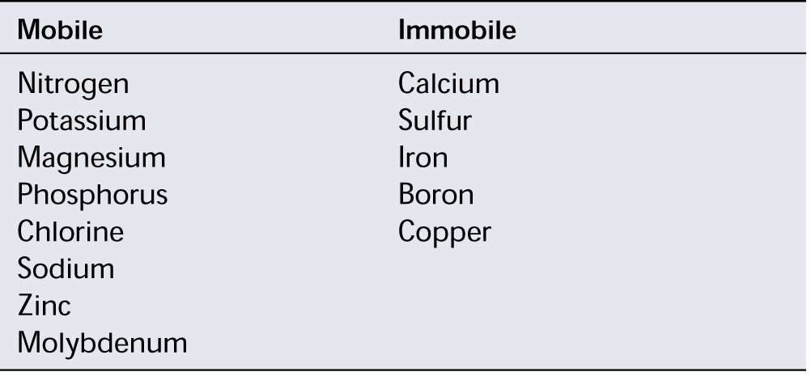
2- Nutrient deficiency
Mineral elements classified on the basis of their mobility within a plant and their tendency to retranslocate during deficiencies
Elements are listed in the order of their abundance in the plant

Slide 22
2- Nutrient deficiency
The relationship between plant growth (or yield)
and the mineral concentration of plant tissue
The transition between the deficiency and adequate zones
of the curve reveals the critical concentration of the nutrient

Slide 23
Treating nutritional deficiencies
Addition of Chemical Fertilizers: contain inorganic salts of the macronutrients; nitrogen, phosphorus, and potassium.
Straight fertilizers: contain one mineral nutrient.
Compound or mixed fertilizers: contain two or more.
Foliar application: (uptake through plant leaves).
Iron
Copper
Manganese

Slide 24
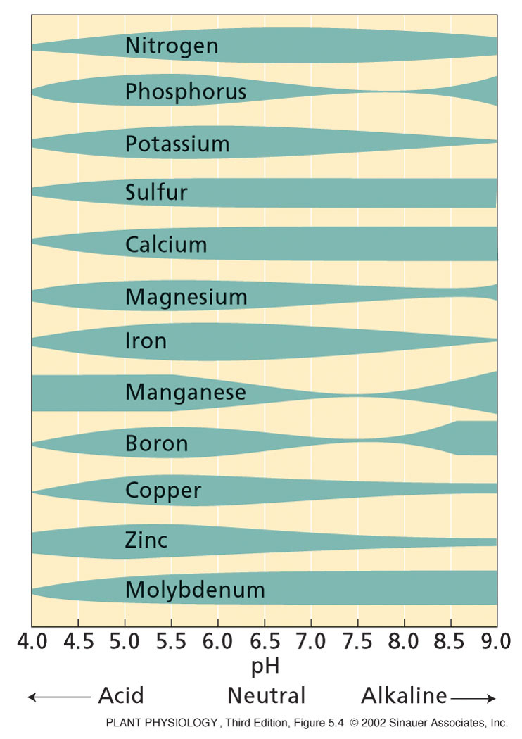
Treating nutritional deficiencies
The soil pH affects the growth of plant roots and soil microbes.
Acidic conditions weathers rock and releases potassium, magnesium, calcium, and manganese.
The decomposition of organic material lowers soil pH.
Chemicals may also be applied to the soil to modify soil pH.

Slide 25
Treating nutritional deficiencies
Addition of Organic Fertilizers: originate from residues of plant or animal life or from natural rock deposits.
- Before crop plants can acquire the nutrient elements from these residues, the organic compounds must be broken down, usually by the action of soil microorganisms through a process called Mineralization.
- The Mineralization depends on:
1- Temperature, water and oxygen availability.
2- Type and number of microorganisms present in the soil.

Slide 26
3- Soil, Root and Microbes
The soil is a complex physical, chemical, and biological substrate.
It is a heterogeneous material containing solid, liquid, and gaseous phases. All of these phases interact with mineral elements.
The inorganic particles of the solid phase provide a reservoir of potassium, calcium, magnesium, and iron.
Also associated with this solid phase are organic compounds containing nitrogen, phosphorus, and sulfur.

Slide 27
3- Soil, Root and Microbes
The liquid phase of the soil constitutes the soil solution, which contains dissolved mineral ions and serves as the medium for ion movement to the root surface.
Gases such as oxygen, carbon dioxide, and nitrogen are dissolved in the soil solution.
In roots gases are exchanged predominantly through the air gaps between soil particles.
Soil constitutes a diverse ecosystem in which plant roots and microorganisms compete strongly for mineral nutrients.
Roots and microorganisms can form alliances for their mutual benefit (symbioses, singular symbiosis).

Slide 28
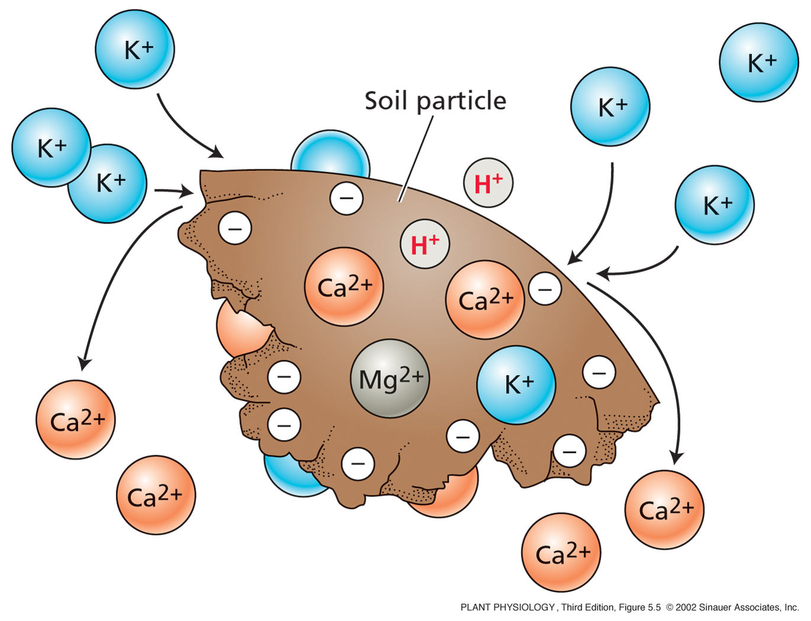
The soil affects nutrient absorption
Negatively charged soil particles affect the absorption of mineral nutrients.
Cation exchange occurs on the surface of the soil particle.
Cations (+ve charged ions) bind to soil as it is (–ve charded).
If potassium binds to the soil,
it can displace calcium from the soil particle and make it available for uptake by the root

Slide 29
Soil pH affects soil microbes and root growth
Root growth favored in slightly acidic soils (pH, 5.5 - 6.5).
Fungi generally predominate in acidic soils.
Bacteria become more prevalent in alkaline soils.
Soil pH also determines the availability of soil nutrients.
Acidity promotes the weathering of rocks that releases K⁺, Mg²⁺, Ca²⁺, and Mn²⁺, and increases the solubility of carbonates, sulfates, and phosphates.
Increasing solubility of nutrients facilitates their availability.
The decomposition of organic matter and the amount of rainfall are major factors that lower the soil pH.

Slide 30
Excess minerals in the soil limits plant growth
When excess minerals are present in the soil, the soil is said to be saline, and plant growth may be restricted.
Sodium chloride and sodium sulfate are the most common salts in saline soils.
Excess minerals causes the accumulation of heavy metals (zinc, copper, cobalt, nickel, mercury, lead, cadmium, silver, and chromium) in the soil, which can cause severe toxicity in plants as well as humans.

Slide 31
Excess minerals in the soil limits plant growth
Excess minerals in soils can be a major problem in arid and semiarid regions because rainfall is insufficient to leach the mineral ions from the soil layers near the surface.
Irrigated agriculture fosters soil salinization if insufficient water is applied to leach the salt below the rooting zone.
To prevent toxic buildup of mineral ions in the cytosol, many plants may sequester them in the cell vacuole.

Slide 32
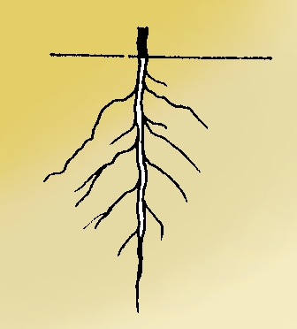
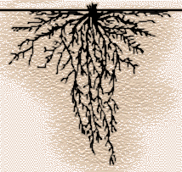
Plant roots
Root systems differ in form but are based on common structures
Tap Root Fibrous Root
Dicots Monocots

Slide 33
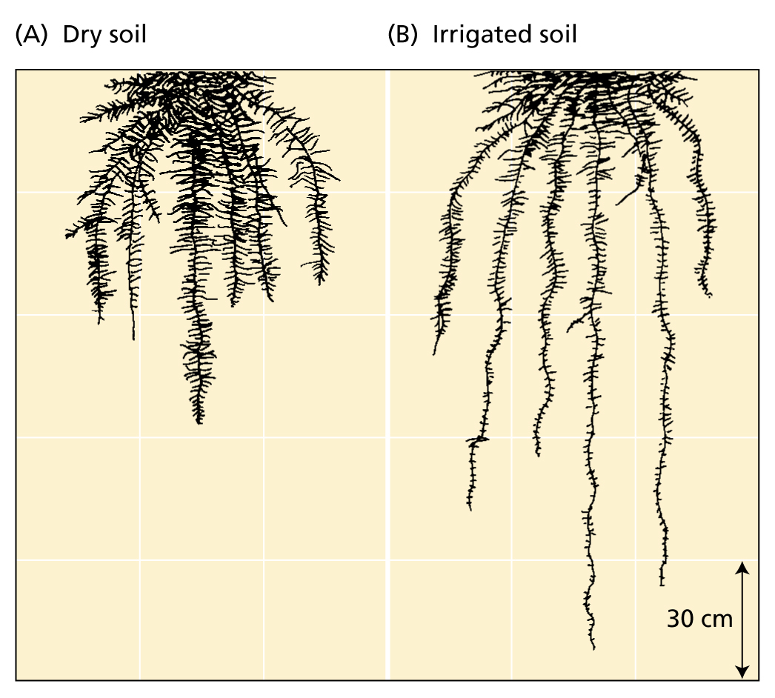
Plant roots
Plants develop extensive root systems
to obtain both water and mineral nutrients from the soil
The rhizosphere is the narrow region of the soil around the root.
If the rhizosphere is poor in nutrients or too dry, root growth is slow.
If the rhizosphere conditions is improved, root growth increases.
If fertilization and irrigation provide abundant nutrients and water, root growth may not keep pace with
shoot growth.
Fibrous root systems of wheat

Slide 34
Plant roots
Meristematic zone
Cells divide both in direction of root base to form cells that will become the functional root and in the direction of the root apex to form the root cap
Elongation zone
Cells elongate rapidly, undergo final round of divisions to form the endodermis. Some cells thicken to form casparian strip.
Maturation zone
Fully formed root with xylem and phloem – root hairs first appear here.
The apical region of the root

Slide 35
Plant roots
Different areas of the root absorb different mineral Ions
Calcium
Apical region
Iron
Apical region (barley)
Or entire root (corn)
Potassium, nitrate, ammonium, and phosphate
All locations of root surface
In corn, elongation zone has max K accumulation and nitrate absorption
In corn and rice, root apex absorbs ammonium faster than the elongation zone does
In several species, root hairs are the most active phosphate absorbers

Slide 36
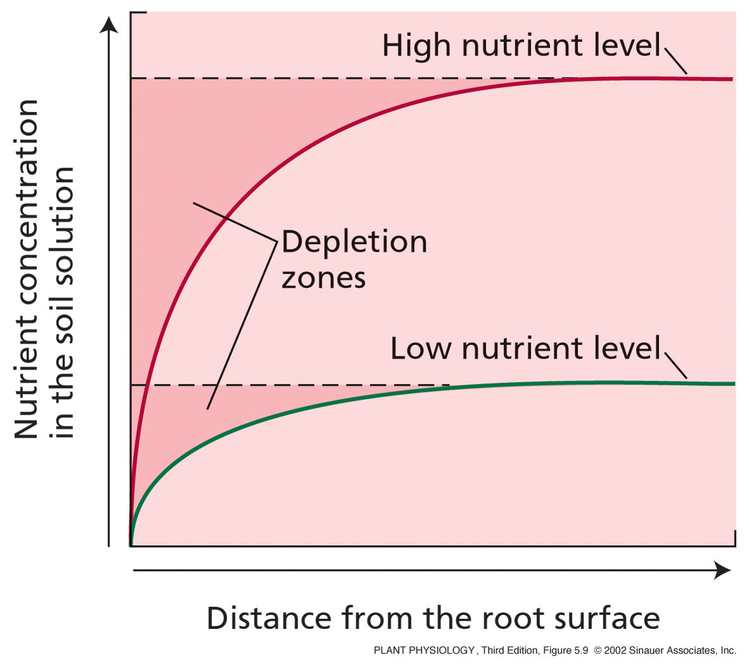
Plant roots
Formation of a nutrient depletion zone in the region of the soil near the plant root.
Forms when rate of nutrient uptake exceeds rate of replacement in soil by diffusion in the water column.
Root associations with Mycorrhizal fungi help the plant overcome this problem.

Slide 37
Mycorrhizal Fungi
Mycorrhizal fungi facilitate nutrient uptake by roots
Ectotrophic Mycorrhizal fungi
Form a thick sheath around root. Some mycelium penetrates the cortex cells of the root.
Root cortex cells are not penetrated, surrounded by a zone of hyphae called Hartig net.
The capacity of the root system to absorb nutrients improved by this association – the fungal hyphae are finer than root hairs and can reach beyond nutrient-depleted zones in the soil near the root.

Slide 38
Mycorrhizal Fungi
Vesicular arbuscular mycorrhizal fungi
Hyphae grow in dense arrangement , both within the root itself and extending out from the root into the soil.
After entering root, either by root hair or through epidermis hyphae move through regions between cells and penetrate individual cortex cells.
Within cells form oval structures – vesicles – and branched structures – arbuscules (site of nutrient transfer)
P, Cu, & Zn absorption improved by hyphae reaching beyond the nutrient-depleted zones in the soil near the root

Slide 39
Mycorrhizal Fungi
Nutrients move from mycorrhizal fungi to the root cells
Ectotrophic Mycorrhizal
Occurs by simple diffusion from the hyphae in the hartig net to the root cells.
Vesicular arbuscular mycorrhizal fungi
Occurs by simple diffusion from arbuscules to the root cells.
The nutrients may be released directly into the host cell.

Slide 40
Any
QUESTIONS ?

