Slide 1
Physical Biochemistry
333 BCH-Introduction

Slide 2
Mark Distribution
Mark Distribution
other
Quiz
15
Reports
15
Final 40
Med
20
Performance
5
Homework
5
Exams dates
Med:
20/5/1437
29/2/2016
Final:
11/7/1437
18/4/2016

Slide 3
Report
Introduction
Objective
Material and Method
Results
Discussion

Slide 4
Objective of this Lab
Physical biochemistry?? What does it mean?
Physical biochemistry is a branch of Biochemistry that deals with the theory, techniques and methodology used to study the Physical chemistry of Biomolecules.
In this course you will deal with important techniques in biochemistry that is important in Separating, Purification and detection of molecules in the samples based on the physical properties of the molecules

Slide 5
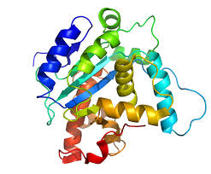
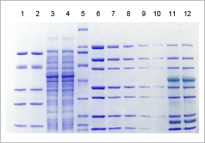
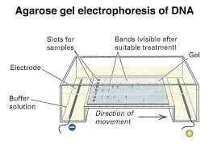
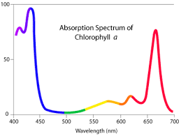
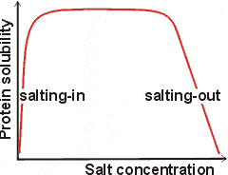
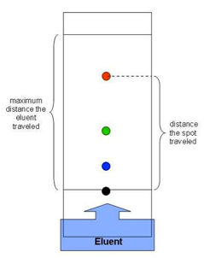
Course outline
Salting in and Salting out
Absorption spectrum
Protein estimation
Paper and thin layer Chromatography
Gel Filtration Chromatography
Ion exchange chromatography
SDS-PAGE
Agarose Electrophoresis

Slide 6
Important must be understood in this lab:
Spectrophotometer
Berlamber law
Standard curve
Chromatography
Centrifuge
Draw curves
Calculation

Slide 7
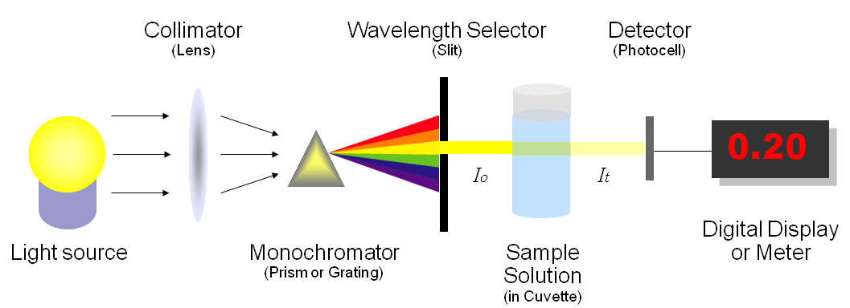
Spectrophotometer
Is an instrument that measures the amount the intensity of light absorbed after it passes through sample solution.
Using the spectrophotometer, we can measure absorbance, and this information can be used to determine the concentration of the absorbing molecule.
A more concentrated solution will absorb more light and transmits less.

Slide 8
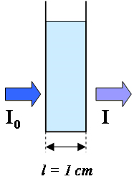
Berlamber law
Lower concentration
Lower absorption
higher concentration
higher absorption
A α c
Shorter pathlength
Lower absorption
longer pathlength
higher absorption
A α L
A = εlc Beer-lambert law
A= is the absorbance.
ε = extinction(absorption) coefficient.
l = length of the light path through the solution.
c = concentration of the absorbing substance.

Slide 9
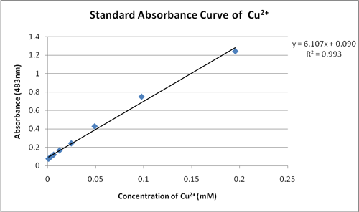
Standard Curve
Concentration of unknown sample

Slide 10
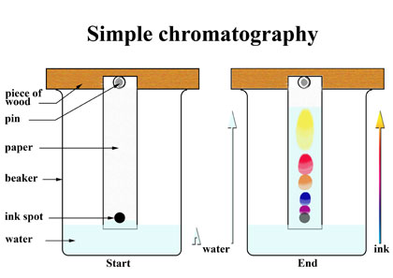
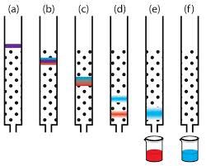
Chromatography
Chromatography, technique for separating the components, or solutes, of a mixture on the basis of the relative amounts of each solute

Slide 11
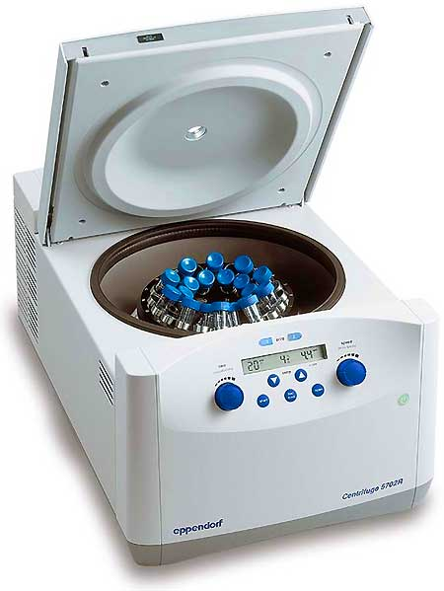
Centrifuge
a machine with a rapidly rotating container that applies centrifugal force to its contents, typically to separate fluids of different densities

Slide 12
Hope you all the best

