Slide 1
Pharmaceutical Quality Control & current Good Manufacturing Practice
PHT 436
Lecture 7

Slide 2
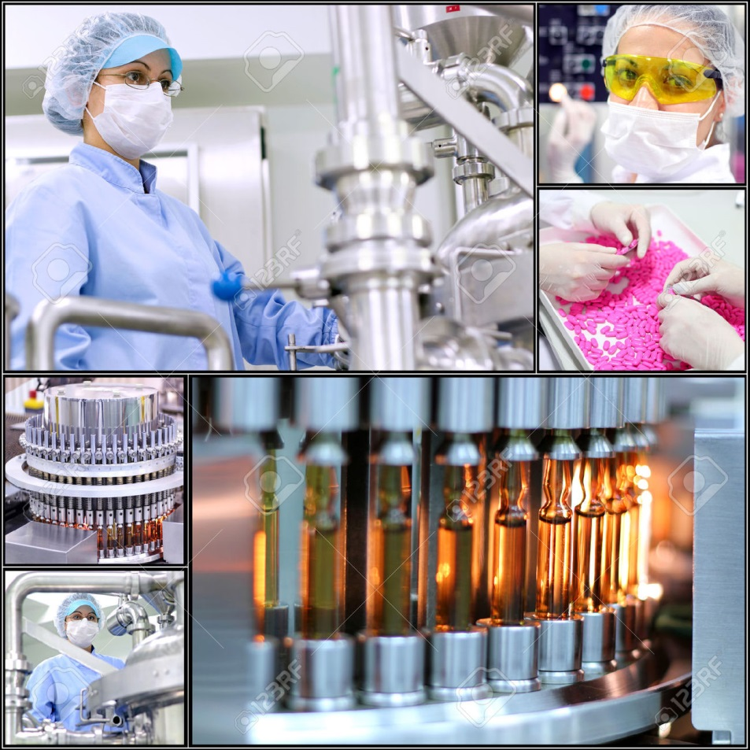
Good Manufacturing Practices Regulations
Subpart D : Equipment

Slide 3
Subpart D : Equipment
Sec. 211.63. Equipment design, size, and location
Sec.211.65. Equipment Construction
Sec. 211.67. Equipment Cleaning and Maintenance
Sec. 211.68. Automatic, mechanical, and electronic equipment.
Sec. 211. 72. Filters.

Slide 4
Sec. 211.63. Equipment design, size, and location
Equipment used in the manufacture, processing, packing, or holding of a drug product shall be of appropriate design, adequate size, and suitably located to facilitate operations for its intended use and for its cleaning and maintenance.

Slide 5
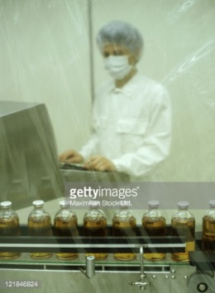
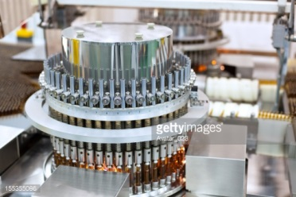
Discussion
Production equipment must be appropriately designed for the job that it will carry out.
For example, using the liquid filling equipment to fill larger or smaller volumes than specified could lead to inaccurate volumes being dispensed.

Slide 6
The size of batch to be processed in a particular piece of equipment should be well within its capacity.
Allowance should be provided for heat expansion, entrapped air, turbulence and other factors that affect the required volume or other characteristics of the equipment.

Slide 7
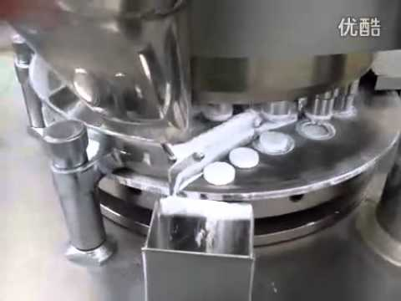
Equipment should be operated in such a way that any quality problems are spotted as quickly as possible.
For example, compression machines are a common source of problems, particularly at start up and shut down. As the speed changes, the weight of the tablet changes accordingly and out of specification tablets may be produced.

Slide 8
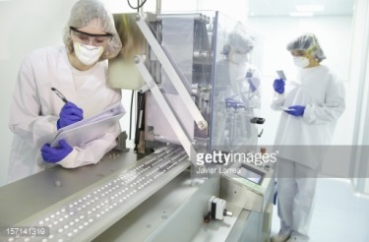
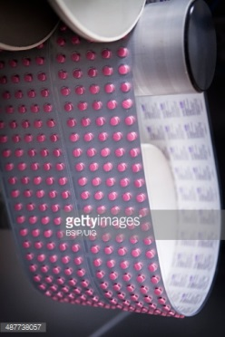
Equipment should be located to provide the best possible materials flow to secure efficiency and to prevent mix-up and contamination of product.
Such problems are particularly found in packaging machines and in tablet compression machines, respectively.

Slide 9
All equipment should be appropriately identified, usually with a unique number, to allow reference in maintenance programs and in batch records.

Slide 10
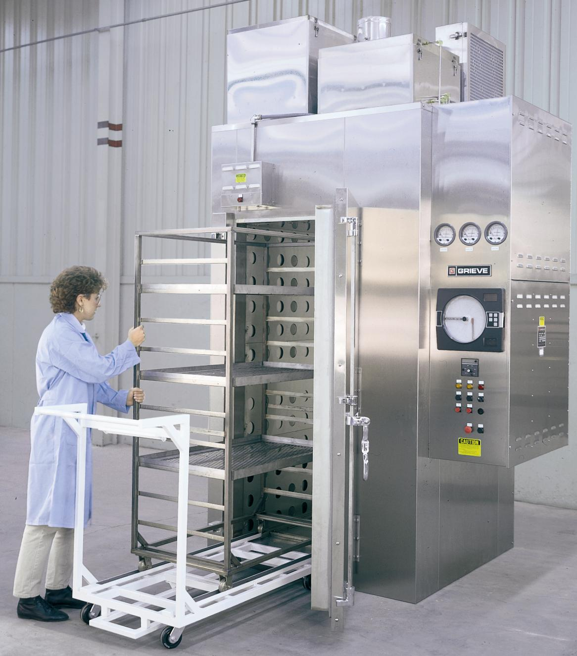
Availability of process controls:
E.g. automatic weight adjustment on tablet presses.
E.g. temperature recorders on ovens.
Although initially more expensive they could prove to be very economic overall by providing more consistent product quality and better records.

Slide 11
New equipment should not be used for commercial production until it has been qualified and the process in which it is to be used has been validated
this applies equally to laboratory and other test equipment.
Equipment must be not disseminate dust to prevent:
the potential for contaminating other products,
or making it necessary for operators to wear additional protective clothing,
and facilitates to be cleaned more frequently.

Slide 12
The possible impact of noise and energy use and dissipation should be considered.
The equipment may be designed for easy cleaning, particularly if it is will be used for more than one product.
The equipment should be made easy to inspect and possibly to take apart.

Slide 13
Balances and measuring equipment of an appropriate range and precision should be:
available for production and control operations.
calibrated and checked at defined intervals by appropriate methods.
Adequate records of such tests should be maintained.

Slide 14
Sec. 211.65. Equipment Construction
Equipment shall be constructed so that surfaces that contact components, in-process materials, or drug products shall not be reactive, additive, or absorptive so as to alter the safety, identity, strength, quality, or purity of the drug product beyond the official or other established requirements.

Slide 15
Compatibility of the materials of construction of the equipment means that the product neither absorbs anything from the equipment nor reacts with it.
The materials of construction of the equipment must be appropriate, particularly in the parts that come into contact with the product.
High quality stainless steel and glass are materials of choice.
However Stainless steel is not totally inert and care should be exercised in choosing the grade- note that distilled water is very corrosive and requires 316 grade, which should be passivated, usually with 15-38% nitric acid.

Slide 16
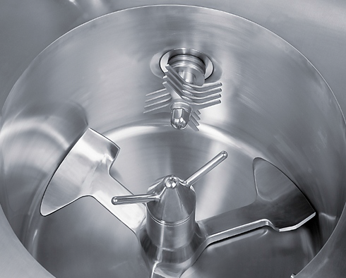
The materials of construction should also be good enough to resist the effect of the machine operation.
If the machine uses a scraper blade, for example, this should not cause damage to the surfaces being scraped nor should the blade be damaged.

Slide 17
Potential interactions will include:
Introduction of unacceptable extractives from the equipment into the product.
Alteration of the physical or chemical properties of the product.
Introduction of particulates from abrasion of surfaces.

Slide 18
Sec. 211.65. Equipment Construction
b) Any substances required for operation, such lubricants or coolants, shall not come into contact with components, drug product containers, closures, in-process materials, or drug products so as to alter the safety, identity, strength, quality, or purity of the drug product beyond the official or other established requirements.

Slide 19
Discussion
This requirement affects the design, construction and placement of manufacturing equipment.
Motors, drive belts, gears, and other potential sources of lubricant contamination should be located away from vessel or package openings that could result in product contamination.
For equipment such as mixers and tablet and encapsulating machines, lubrication needs to be controlled and monitored.
Buildup of lubricant and powdered product should be regularly removed and lubricants should be of food grade.

Slide 20
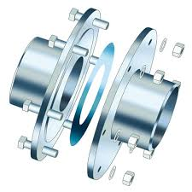
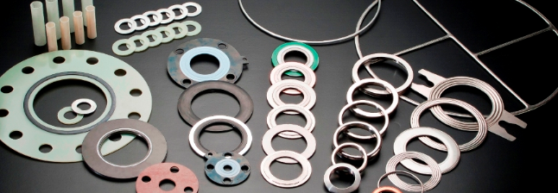
Gaskets and other connecting surfaces should be monitored to ensure they don’t break down, thereby allowing environmental contamination or gasket particles into the product.
A frequent source of black specks in tablets is excessive lubrication of punches and dies on tablet compression machines or insufficient lubrication.
Grey contamination of creams or ointments can come from bearings or plastics scraper blades that are incorrectly adjusted.

Slide 21
Sec. 211.67. Equipment Cleaning and Maintenance
a) Equipment and utensils shall be cleaned, maintained and sanitized at appropriate intervals to prevent malfunctions or contamination that would alter the safety, identity, strength, quality, or purity of the drug product beyond the official or other established requirements.

Slide 22
b) Written procedures shall be established and followed for cleaning and maintenance of equipment, including utensils, used in the manufacture, processing, packing, or holding of a drug product.
These procedures shall include the following:
1-Assignment of responsibility for cleaning and maintaining equipment.
2-Maintenance and cleaning schedules, including, appropriate, sanitizing schedules.

Slide 23
A description in sufficient detail of the methods, equipment, and materials used in cleaning and maintenance operations and the methods of disassembling and reassembling equipment as necessary to assure proper cleaning and maintenance.
Removal or obliteration of previous batch identification.
Protection of clean equipment from contamination prior to use.
Inspection of equipment for cleanliness immediately before use.
c) Records shall be kept of maintenance, cleaning, sanitizing and inspection.

Slide 24
Inadequate cleaning or maintenance may cause equipment to malfunction or break down and that this could have an adverse effect on the process or product.
For example, if a process required stirring for 30 minutes at 60 C˚ and the stirrer broke down, it is likely that the exposure to heat could exceed 30 minutes by the time the stirrer was repaired or replaced.
Ease of maintenance should be one of the criteria considered when selecting equipment.
Part of the purchasing specification should be for maintenance requirements, spare parts lists and any special tools needed.

Slide 25
It is important that the maintenance instructions are written in the local language so that they can be read by the mechanics.
The equipment must be correctly labeled at all times. This will show whether it is clean or dirty and whether dry or wet.
If equipment becomes defective for any reason, this must be clear from the status label, even if the equipment cannot be removed from the area. This will ensure that faulty equipment will not be used even by mistake.
Where equipment is part of an in-line process and it is defective, then its connection to other machines in the line should be broken.

Slide 26
The methods used for cleaning and sanitation should be supported by appropriate validation. This will confirm that the procedures do effectively remove the previous materials or reduce them to acceptable levels.
The importance of cleaning was further emphasized by the publication of the FDA Guide of Inspection of Validation of Cleaning Procedures.

Slide 27
Sampling methods to evaluate the degree of cleanliness regarding equipment
Swab testing of measured area of surface.
Swab Then the swab extracted with an appropriate solvent of extractive quantified.
Extrapolation of the amount of residue obtained from the swab to the total surface area of the equipment
It provides a measure of the total residue which is potentially capable of being transferred to the next product.
An advantage of this method is that areas that are hard to clean may be swabbed provided they are accessible.
One disadvantage is that some areas may not be accessible.

Slide 28
2) Solvent rinse:
After cleaning, the entire equipment surfaces are flushed or rinsed with a solvent in which the materials being evaluated are soluble.
By calculating the amount of solvent likely to be left in the equipment, which may later evaporate, it is possible to calculate residue level.
Advantage: it can be used for difficult-to-reach equipment parts such as valves and pipe-work.
It is important to demonstrate that residual materials are not adsorbed onto surfaces thereby giving a low value.

Slide 29
3) Placebo flush:
For solid dosage processing it may be possible to flush the equipment system with placebo or excipient material such as lactose.
Testing of the placebo for residues of the previous product will provide the required data.
4) Evaluation of next product:
In theory this is possibly the most meaningful way to evaluate carryover.
However, the analytical methodology to detect traces of product A in product B is complex, especially if every combination of A and B needs to be evaluated and validated.
The carryover may not be homogeneous.
5) Visual examination:
Should always be performed.

Slide 30
Once equipment has been cleaned it is necessary that it remains clean until use.
This may require some degree of protection or covering
plus an inspection immediately prior to use.
Batch records should include a note of this inspection which is both a check of the status labeling, confirming that equipment has been cleaned and visual check that it looks clean.
To eliminate the need for these confirmatory checks it has been suggested that cleaning and sanitation should be delayed until immediately prior to the next production run.
This is unacceptable since it could be more difficult to remove caked-on material than fresh material, also microbial growth in the presence of organic material is likely to be accelerated.

Slide 31
Where microbial cleanliness is important damp equipment should not be left for any significant length of time before use, it may need to be dried or rinsed prior to use.
Where appropriate clean-in-place techniques may be applied; these have the advantage of not requiring the time consuming stages of disassembly and reassembly.
The method has especial applicability to pipelines and can be adapted to sterilize in place.
Where dedusting procedures are utilized, these should involve vacuum rather than pressure; the latter simply spreads contamination.

Slide 32
The main emphasis for maintenance programs is:
to minimize the potential for breakdowns
to optimize production cycle times.
Poor maintenance can also result in:
equipment not functioning as intended, with consequent impact on processing and quality.
Also can enhance the potential for lubricant leakage, wear on bearings and other equipment components, which could disgorge metal into the product and difficult-to-remove buildup of residues, which could later dislodge.

Slide 33
Sec. 211.68. Automatic, mechanical, and electronic equipment
Automatic, mechanical, or electronic equipment or other types of equipment, including computers, or related systems that will perform a function satisfactorily, may be used in the manufacture, processing, packing, and holding of a drug product.
If such equipment is so used, it shall be routinely calibrated, inspected, or checked according to a written program designed to assure proper performance.
Written records of those calibration checks and inspections shall be maintained.

Slide 34
(b) Appropriate controls shall be exercised over computer or related systems to assure that changes in master production and control records or other records are instituted only by authorized personnel.
Input to and output from the computer or related system of formulas or other records or data shall be checked for accuracy.
The degree and frequency of input/output verification shall be based on the complexity and reliability of the computer or related system.

Slide 35
A backup file of data entered into the computer or related system shall be maintained.
except where certain data, such as calculations performed in connection with laboratory analysis, are eliminated by computerization or other automated processes.
In such instances a written record of the program shall be maintained along with appropriate validation data.
Hard copy or alternative systems, such as duplicates, tapes, or microfilm, designed to assure that backup data are exact and complete and that it is secure from alteration, inadvertent erasures, or loss shall be maintained.

Slide 36
(c) Such automated equipment used for performance of operations addressed by:
211.101(c) or (d), 211.103, 211.182, or 211.188(b)(11)
can satisfy the requirements included in those sections relating to the performance of an operation by one person and checking by another person if such equipment is used in conformity with this section, and one person checks that the equipment properly performed the operation.

Slide 37
Sec. 211. 72 Filters
Filters for liquid filtration used in the manufacture, processing, or packing of injectable drug products intended for human use shall not release fibers into such products.
If use of a fiber releasing filter is necessary, an additional non-fiber releasing filter of 0.22 micron maximum mean porosity shall subsequently be used to reduce the content of particles in the injectable drug product.
The use of an asbestos-containing filter is prohibited.

Slide 38
The midterm exam will be from lecture 1 to lecture 6. Tuesday 14/5/1437 10:00 – 10:50 am

