Slide 1
Pharmaceutical Quality Control & current Good Manufacturing Practice
PHT 436
Lecture 6

Slide 2
Good Manufacturing Practices Regulations
Subpart C: Building and Facilities
Continue

Slide 3
Sec. 211.50 Sewage and refuse
Sewage, trash, and other refuse in and from the building and immediate premises shall be disposed of in a safe and sanitary manner.

Slide 4
A pharmaceutical plant may consider disposal in several different ways:
Product disposal.
Printed packaging disposal.
General trash and sewage.

Slide 5
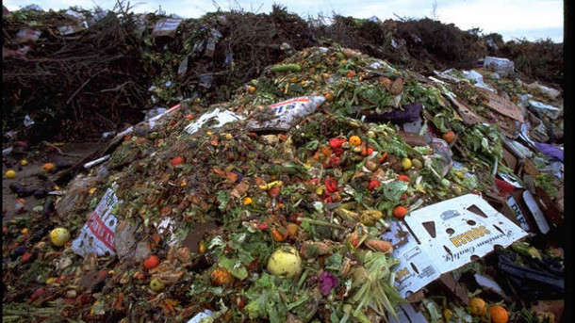
1. Product disposal:
Any product requiring disposal should initially be separated from its packaging if appropriate.
For example, any product to be disposed of in an approved landfill site should not be left in impermeable glass, plastic or other containers which would significantly delay destruction.
Tipping of product to bulk or crushing would be viable pretreatment.

Slide 6
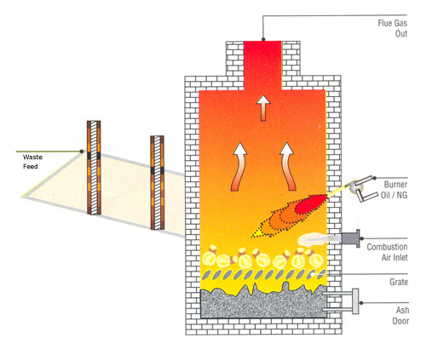
There are risks associated with the destruction of products-potential for the product to get diverted during the disposal sequence and contamination of groundwater.
Disposal procedures should involve agents with a proven record of dealing with such sensitive materials or the use of company personnel to accompany the material from plant to disposal.
Ideally, incineration procedures have preference over landfill.
Where incineration is used, product in plastic or other flammable packaging may not need to be returned to bulk.

Slide 7
2. Printed packaging disposal:
The disposal of printed packaging components including labels, inserts and cartons poses no health risk.
However, ineffective disposal, such as into public landfill, can give rise to public concern that product may be associated with the packaging. Such materials should preferably be incinerated.

Slide 8
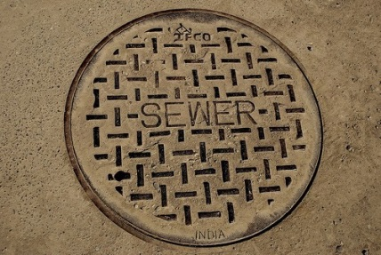
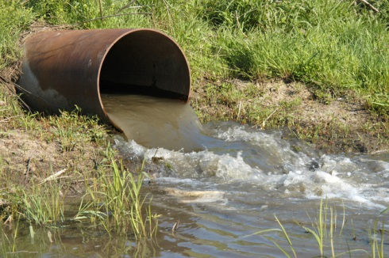
3- General trash and sewage:
Normal local services will usually be adequate for trash and sewage.
However, internal procedures should be sufficiently rigorous and monitored, to ensure that product and packaging waste does not get intermixed.
Containers used within the plant to accumulate waste materials should be clearly marked to denote their designated use.

Slide 9
Sec. 211.46 Ventilation, air filtration, air heating and cooling
Adequate ventilation shall be provided.
Equipment for adequate control over air pressure, micro-organisms, dust, humidity, and temperature shall be provided when appropriate for the manufacture, processing, packing, or holding of a drug product.
Air filtration systems, including prefilters and particulate matter air filters, shall be used when appropriate on air supplies to production areas. If air is recirculated to production areas, measures shall be taken to control recirculation of dust from production. In areas where air contamination occurs during production, there shall be adequate exhaust systems or other systems adequate to control contaminants.
Air-handling systems for the manufacture, processing, and packing of penicillin shall be completely separate from those for other drug products for human use

Slide 10
Air handling systems should consider the following factors:
Placement of air inlet and outlet ports: These should sited to minimize the entry of airborne particulates or odors from the surrounding areas. Outlets should not be sited near inlets.
Where recirculation of air is acceptable,
Adequate precautions must be taken to ensure that particulates from a processing area are removed.
This will require an alarm system or an automatic cutoff in the event that a filter develops a hole.
Dust extraction system should be provided, where appropriate, to further minimize this potential problem.
The degree of filtration and the air volume should be matched to the operations involved.

Slide 11
Temperature and humidity conditions should provide personnel comfort- which will enhance employee performance.
Where differential pressures are required between adjacent areas, suitable monitoring equipment must be provided.
E.g. solids manufacturing areas are usually maintained at a negative pressure in relation to adjacent rooms and corridors in order to minimize the possibility of dust migration to these other areas. Air usually enters room near the ceiling and leaves from the opposite side near the floor.
Handling of penicillin products must have separate air handling systems

Slide 12
Sec. 211.48 Plumbing
Potable water shall be supplied under continuous positive pressure in a plumbing system free of defects that could contribute contamination to any drug product.
Potable water shall meet the standards prescribed in the Environmental Protection Agency's Primary Drinking Water Regulations set forth in 40 CFR part 141.
Water not meeting such standards shall not be permitted in the potable water system.
Drains shall be of adequate size and, where connected directly to a sewer, shall be provided with an air break or other mechanical device to prevent back-siphonage

Slide 13
Potable water
can lose quality in transmission through the public piping system and, of course, through the manufacturer’s system. The manufacturer will test potable water periodically.
Where it is necessary to provide on-site potable water storage, an automatic chlorination system should be installed, usually at 2-3 ppm.
Drains
particularly those in production areas, can be a potential source of microbial hazard therefore there must be an air break between drain and sewer to prevent back-siphonage.
Drains should also be regularly disinfected.

Slide 14
Sec. 211.52 Washing and toilet facilities
Adequate washing facilities shall be provided, including hot and cold water, soap or detergent, air driers or single-service towels, and clean toilet facilities easily accessible to working areas.

Slide 15
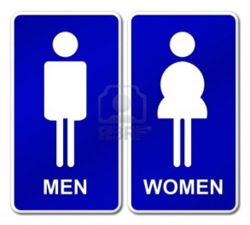
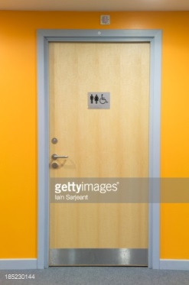
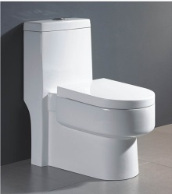
Toilet rooms are required to be separate for each sex.
except where individual locked toilet rooms are available.
Define the minimum number of water closets based on the number of users.
Conveniently located to all areas.
Hot shower facilities are provided.
Disinfectant soaps are utilized.
Adequate ash and waste receptacles are provided.

Slide 16
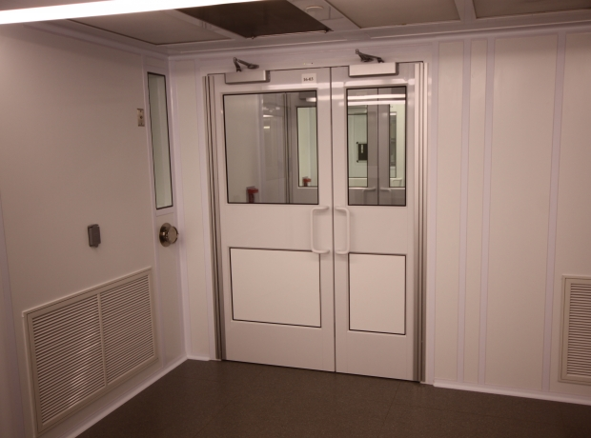
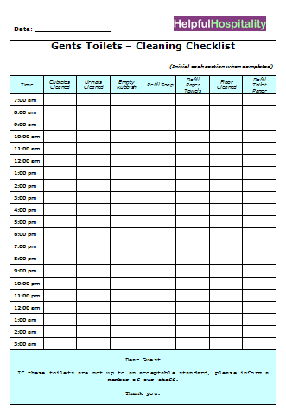
Periodic cleaning of the area during each shift with logging of times and conditions is mandatory.
Complete cleaning with cleansing and disinfectant agents daily.
Follow-up inspection by supervisory personnel is logged.
Areas separated from all aseptic spaces by an air lock.

Slide 17
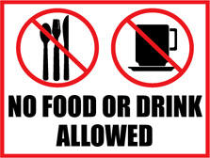
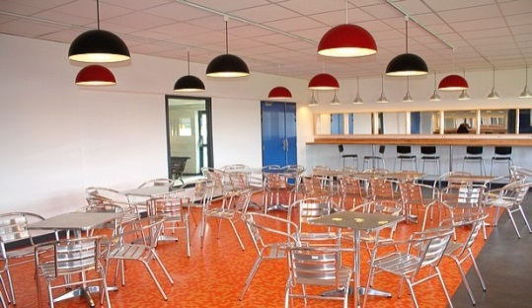
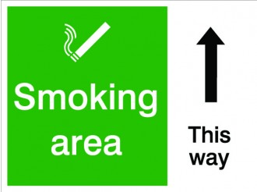
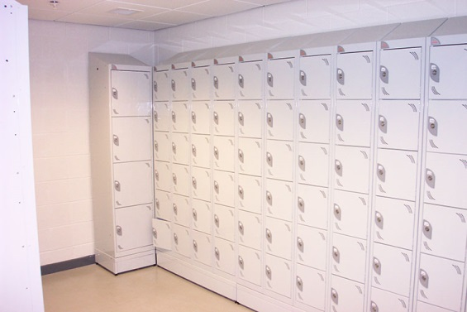
Eating facilities
For production and materials processing areas drinking, eating, smoking, tobacco chewing, and expectoration are prohibited.
Eating and drinking are permitted only in separate eating facilities well segregated from all production areas. E.g. Cafeterias serving hot meals are ideal.
Smoking is permitted only where an adequate disposal device is provided and apart from production areas.
Foods and beverages for meals and breaks may be stored only in lockers and then removed to a separate eating area.

Slide 18
Prominent signs indicating these rules are posted at entrances to production areas.
Enforcement procedures against violators are taken by management.

Slide 19
Sec. 211.56 Sanitation
Any building used in the manufacture, processing, packing, or holding of a drug product shall be maintained in a clean and sanitary condition, Any such building shall be free of infestation by rodents, birds, insects, and other vermin (other than laboratory animals). Trash and organic waste matter shall be held and disposed of in a timely and sanitary manner.
There shall be written procedures assigning responsibility for sanitation and describing in sufficient detail the cleaning schedules, methods, equipment, and materials to be used in cleaning the buildings and facilities; such written procedures shall be followed.

Slide 20
c. There shall be written procedures for use of suitable rodenticides, insecticides, fungicides, fumigating agents, and cleaning and sanitizing agents.
Such written procedures shall be designed to prevent the contamination of equipment, components, drug product containers, closures, packaging, labelling materials, or drug products and shall be followed.
Rodenticides, insecticides, and fungicides shall not be used unless registered and used in accordance with the Federal Insecticide, Fungicide, and Rodenticide Act (7 U.S.C. 135).
d. Sanitation procedures shall apply to work performed by contractors or temporary employees as well as work performed by full-time employees during the ordinary course of operations

Slide 21
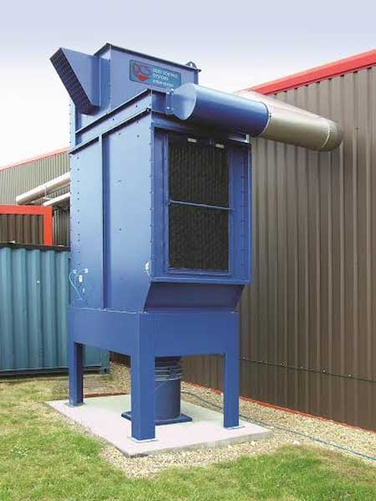
Cleaning and sanitation programs should be adjusted to meet the specific needs of each facility.
In addition to cleaning of floors, walls and ceilings, there should be attention to dust extraction and air input systems.
Duct work, especially for dust extraction systems, can come a potential explosion hazard if dust is allowed to accumulate.
Cleaning procedures should be written in sufficient detail with respect to materials, equipment, process and frequency that they are unambiguous.

Slide 22
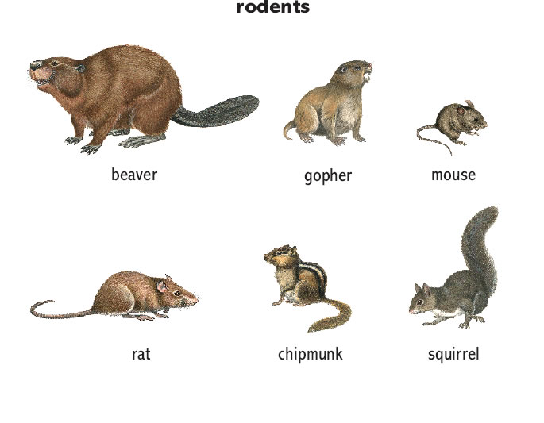
The total elimination of rodents, birds and insects is virtually impossible and the regulations do refer to freedom from infestation.
The use of rodenticides, fungicides, fumigating agents, and other techniques should be combined with good hygienic practices.
Spilled materials, such as sugar, that might attract creatures should immediately be eliminated.
Holes in buildings that could provide additional means of access should be blocked.

Slide 23
Where traps and other lethal techniques are used, there should be frequent examination and removal of corpses, which could in time become a source of further contamination.
If these traps consistently yield results, attempts should be made to identify and eliminate the source of the problem.
Frequently rodenticide and other treatments are contracted out .
As with any contracted service, the company must assure that the procedures used are viable, achieve the desired results, and that they are followed.

Slide 24
Sec. 211.58 Maintenance
Any building used in the manufacture, processing, packing, or holding of a drug product shall be maintained in a good state of repair.

Slide 25
Deterioration of buildings not only presents a poor image of the facility, it can also impact on product quality.
Cracks and holes in walls, floors, or ceilings can:
provide access for insects, rodents, birds, dirt or microorganisms. Holes in the roof or near the tops of buildings provide ready access to birds, which may then be encouraged to nest within the building.
They can also hinder cleaning and sanitation, thereby increasing the potential for cross contamination or microbial multiplication.
also become a safety hazard of people or even dislodge materials from trucks.

Slide 26
The ingress of water from roof leaks can cause significant damage to materials and equipment, give rise to electrical failures and fires and result in damage to the basic structure of the building.
Damage to insulation of pipes and duct work will detract from the basic purpose of such insulation It may result in:
freezing
leakage of pipes
shedding of insulation material into product and equipment.

Slide 27
Light fittings need regular cleaning to remove any accumulated dust, which can act both as a potential source of contamination and reduce light intensity.
Where the proper correction of building deficiencies requires shut-down of the area, it may be necessary to resort to temporary repair until adequate time can be made to enact a permanent repair.
Building inspection and maintenance programs should be defined in writing and a record kept confirming compliance and referencing any repairs performed.
Services can impact directly on processing and product quality and they must undergo routine maintenance.
Essential services will include water, steam, vacuum, compressed air and other gases, electricity, dust extraction, product/material pipelines, drainage and sprinkler system.

