Slide 1
Pharmaceutical Quality Control & current Good Manufacturing Practice
PHT 436
Lecture 5

Slide 2
Good Manufacturing Practices Regulations
Subpart C: Building and Facilities
211.22. Design and construction features
Continue

Slide 3
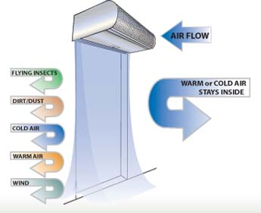
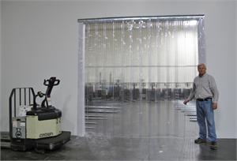
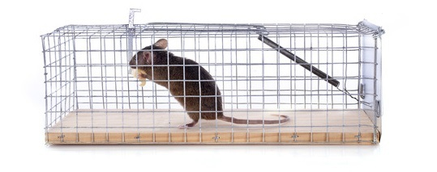
Receiving areas
It is where materials are unloaded from the delivery transportation.
It is an access point for air born contamination such as dust, insects, birds and even engine fumes from the delivery vehicles.
These access points should be protected by:
Flexible curtains.
Air curtains.
Insect and rodent traps.

Slide 4
Rejections of materials could be due to:
Inadequate definition/agreement of specification.
Different test methodologies used by the supplier and the customer.
Nonvalidated analytical methods.
Nonvalidated production procedures at the supplier resulting in variable quantity.
Use of untrained analysts.
Expected data variability around a specification limit.
The cause of any rejection does need to be thoroughly investigated and appropriate corrective action taken and documented.

Slide 5
Individual pieces of line equipment may be broken down
During packaging operations, individual pieces of line equipment may be broken down.
it may be economically viable to continue the operation and to accumulate part-package product until the effective unit is repaired.
Where possible, accumulation tables should be an integral part of a packaging line.
Thereby enabling short down-times on equipment to be handled without the need to remove part-packaged product from the line.

Slide 6
E.g. When the labeling unit breaks down, special care must be taken to ensure that unlabeled containers:
do not get onto another line,
Do not intermixed with a different batch of the same products.
Protracted breakdown of labeling equipment may result in
amounts of unlabeled product in excess of the capacity of accumulation tables.
Also some processes are designed to produce filled unlabeled product. This includes sterile products such ampoules and vials which are labeled outside of the sterile suite. In such situation great care must be taken to prevent mix-ups.
When labeling is to be performed later, security can be enhanced by holding the unlabeled product in sealed or locked containers.

Slide 7
The requirement of separate areas for control and laboratory operations does not preclude the use of in-process testing within the manufacturing and packaging areas.
The environmental conditions in these areas must be suitable for the proper operation of the equipment and performing of the testing.

Slide 8
211.22. Design and construction features
10- Aseptic processing, which includes as appropriate:
Floors, walls and ceilings of smooth, hard surfaces that are easily cleanable.
Temperature and humidity controls.
An air supply filtered through high-efficiency particulate air filters under positive pressure, regardless of whether flow is laminar or non-laminar.
A system for monitoring environmental conditions.
A system for cleaning and disinfecting the room and equipment to produce aseptic conditions.
A system for maintaining any equipment used to control the aseptic conditions.

Slide 9
Aseptic processing
Recognizing the importance of aseptic processing in the production of injections, the FDA issued a “ Guideline on Sterile Drug Products Produced by Aseptic Processing” 1987.
With respect to facilities, the guide provides guidance only on:
air quality,
air flow,
and pressure differentials.
There is no information on surface finishes.

Slide 10
Floors, walls and ceilings in sterile areas are subject to intensive and frequent cleaning and sanitization; they must be composed of :
smooth, hard surfaces with minimum of joints.
They should be resistant to abrasion,
not shed particles,
be free from holes, and cracks,
be sufficiently flexible to accommodate building strains,
and be impervious to water, cleaning and sanitization solutions.

Slide 11
Regular examinations should be performed to identify and repair any cracks in the surfaces or around service fittings and windows.
Critical rooms such as those for filling of final containers should preferably have windows to allow supervision without the necessity for access.
All service fittings should be flush with surrounding surfaces for ease of cleaning and sanitization.

Slide 12
Temperature and humidity need to be controlled primarily for the comfort of operations.
Conditions in the order of 20 ˚C and 45% relative humidity have been found to be suitable.
The most critical factor in aseptic processing is the microbial and nonviable particulate condition of the air.
The air is provided by way of High-Efficiency Particulate Air filters (HEPA).

Slide 13
The quality of the air is adjusted to meet the varying needs of the different processing areas.
Eg. At the points where sterilized containers and closures are exposed and filling and sealing operations occur, air is supplied with less than 100 particles of 0.5 micron or larger and with not more than one colony-forming organism per 100 cubic feet.
Airflows of about 90 ft/min are recommended.
These sensitive areas should have a positive pressure differential to adjoining areas of at least of 0.05 inch of water.

Slide 14
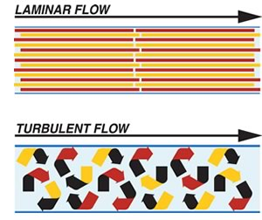
Within aseptic processing rooms it is usual to additionally incorporate laminar flow services over and around these most sensitive areas.
These laminar flow facilities should direct the filtered air in such a way that particulate matter from equipment or personnel is directed away from the sensitive points.

Slide 15
Air quality necessitates appropriate systems and procedures for monitoring. This will include evaluation of:
pressure differentials between rooms,
particulate levels (viable and nonviable)
and also temperature and humidity.

Slide 16
Cleaning and disinfection of aseptic facilities and equipment are of importance in the critical areas. Procedures must be validated with respect to both removal of previous product and to demonstrate effective disinfection.
Residual amounts of any cleaning or disinfectant agents should be at an acceptably low level.
In order to minimize the possibility of microbial resistance, the disinfectant should be changed periodically.
After cleaning and disinfecting, rooms and equipment must be maintained in such a manner.

Slide 17
211.22. Design and construction features
d) Operations relating to the manufacture, processing and packing of penicillin shall be performed in facilities separate from those used for other drug products for human use.

Slide 18
Operations relating to penicillin
The FDA holds that there is a possibility of a trace amounts of penicillin being released even under well-controlled conditions.
Separate equipment for use only for products containing penicillin is required. The isolation of penicillin production operations from operations for non-penicillin products is required.
Separation can be achieved even within a single building by effectively isolating the penicillin operation from other operations.
Separation by the geographical distance or the construction of a separate building is not required, but may be the preferred economic alternative.

Slide 19
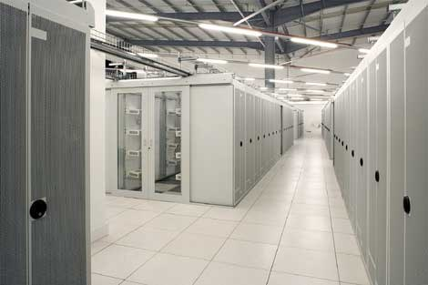
Sec. 211.44 Lighting.
Adequate lighting shall be provided in all areas.

Slide 20
Normally, a range of 30-50 foot – candles ensures worker comfort and ability to perform efficiently and effectively.
however 100 foot-candles may be needed in some areas,
as well as special lighting for some operations, such as inspection of filled vials.
It is necessary that the light levels be measured periodically and the results recorded.
The specifications should call either for replacement of light sources when some level above the established minimum has been reached or, alternatively, routine replacements of light sources on some schedule to ensure that light levels do no drop below the established minimum.

