Slide 1
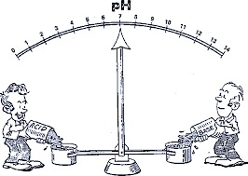
The effect of pH on the rate of an enzyme catalyzed reaction
322 BCH
Exp (6)

Slide 2
In this experiment, we will continue to study acid phosphatase kinetics.
Acid phosphatase kinetics
Time
Enzyme concentration
pH
Substrate concentration
Inhibitor
Temperature

Slide 3
Objectives
To establish the relationship between pH and the rate of an enzyme catalyzed reaction.
To determine the optimum pH for such a reaction.

Slide 4
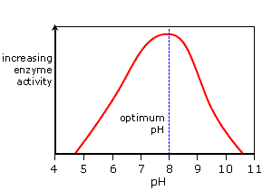
The effect of pH on enzyme activity
The rate of enzymatic reaction depends on pH of the medium.
Each enzyme have the a pH where the enzyme is most active – which is known as the optimum pH.
For most enzymes, the optimum pH lies in the range from pH 5 to pH 9.
The optimum pH for an enzyme depends on where it normally works.
Extremely high or low pH values generally result in complete loss of activity for most enzymes.

Slide 5
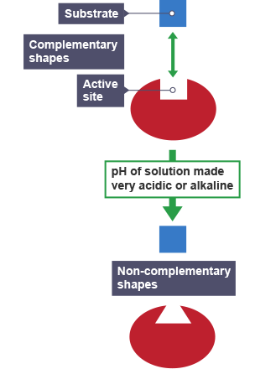
The effect of pH on enzyme activity
Changes in pH alter an enzyme’s shape. This is because changes in pH can make and break intra- and intermolecular bonds, changing the shape of the enzyme and, therefore, its effectiveness.
pH can have an effect of the state of ionization of the ionization states of the amino acid residues involved in the catalytic activity of the enzyme(active site)

Slide 6
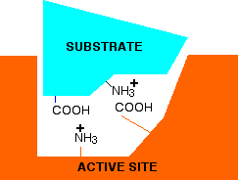
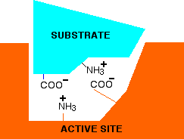
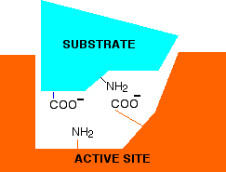
Changing pH will affect amino acid charges in active sites
Low pH
Neutral pH
High pH

Slide 7
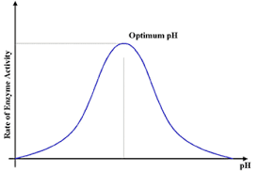
The shape of pH activity curve
For the majority of enzymes, the relationship between the rate of an enzymatic reaction and pH takes form of a bell-shape.

Slide 8
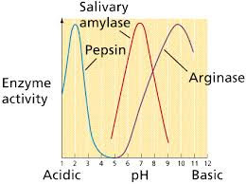
The shape of pH activity curve
The shape of pH activity curve is determined by the following factors:
Enzyme denaturation at extremely high or low pH:
With some exceptions, pepsin’s optimum pH is extremely acidic.
And arginase’s optimum pH is extremely basic.
Effects on the charged state of the substrate or enzyme:
Most enzymatic reactions require both the substrate and the amino acid residues in the active site of the enzyme to have a specific charge state.
→ Changes in pH change this charge state and hence affect the rate of the reaction.

Slide 9
Principle
Under acid conditions, the enzyme catalyzes the hydrolysis of p-nitrophenyl phosphate (pNPP) to inorganic phosphate (P_{i}) and p-nitrophenol.
If base (KOH) is added to the mixture after the completion of the reaction, the p-nitrophenol is converted to a yellow colored form which absorbs lights at 405 nm.

Slide 10
Method
In order to detect the effect of pH you must fix all the component except the 1 M sodium acetate buffer of different pH.
Time ( 5 minutes ) | constant
Enzyme concentration | constant
Substrate concentration (0.05M) | constant
Temperature (37˚C ) | constant
pH | Variable (pH 3, 4, 4.5, 5, 5.5, 6, 7, 8)

Slide 11
Prepare 16 tubes labeled as follows (note: there is a blank for each pH)
Blank: (B₃, B₄, B_{4.5}, B₅, B_{5.5}, B₆, B₇, B_{8,} B₉ )
Test: (T₃, T₄, T_{4.5}, T₅, T_{5.5}, T₆, T₇, T_{8,} T₉)
To each of these tubes add
Place the tubes in a test tube rack situated in 37ºC water bath and let stand for 5 min.
Chemical | Volume (ml)
Corresponding pH sodium acetate buffer | 0.5
0.1M MgCl₂ | 0.5
p-nitrophenyl phosphate (pNPP) | 0.5
Water | 5

Slide 12
Start the reaction by adding 0.5 ml enzyme and stop it by adding 0.5 ml KOH as in the following table:
Notes:
In blank tube add KOH first then the enzyme, to prevent the reaction from happening.
Tube | Start the reaction | Stop the reaction
all Blanks | 0 min | 0 min
T₃ | 0 min | 5 min
T₄ | 2 min | 7 min
T_{4.5} | 4 min | 9min
T₅ | 6 min | 11 min
T_{5.5} | 8 min | 13 min
T₆ | 10 min | 15 min
T₇ | 12 min | 17 min
T₈ | 14 min | 19 min
T9 | 16 min | 21 min

Slide 13
Results
Velocity (µmole of PNP/min) | Absorbance 405 nm | pH
 |  | 3
 |  | 4
 |  | 4.5
 |  | 5
 |  | 5.5
 |  | 6
 |  | 7
 |  | 8
 |  | 9
Plot a graph illustrating the effect of different pHs on the rate of the reaction.

Slide 14
Calculations:
Velocity (V) = (A x 10⁶) /(E x time)= µmole of PNP/min
A= absorbance
E= extension coefficient=18.8 x 10³
Time = 5 min

Slide 15
The Effect of pH on the Rate of an Enzyme Catalyzed Reaction.
Optimum pH
Velocity
(µmole of PNP/min)
pH
Bell- shape curve

Slide 16
Discussion
An introductory statement (In this experiment, we studied the effect of different pH on the rate of acid phosphatase catalyzed reaction.)
Principle
From the curve, explain and discuss the relationship between the activity of acid phosphatase and pH.
Define the optimum pH and determine which buffer is the best from the curve.

