Slide 1
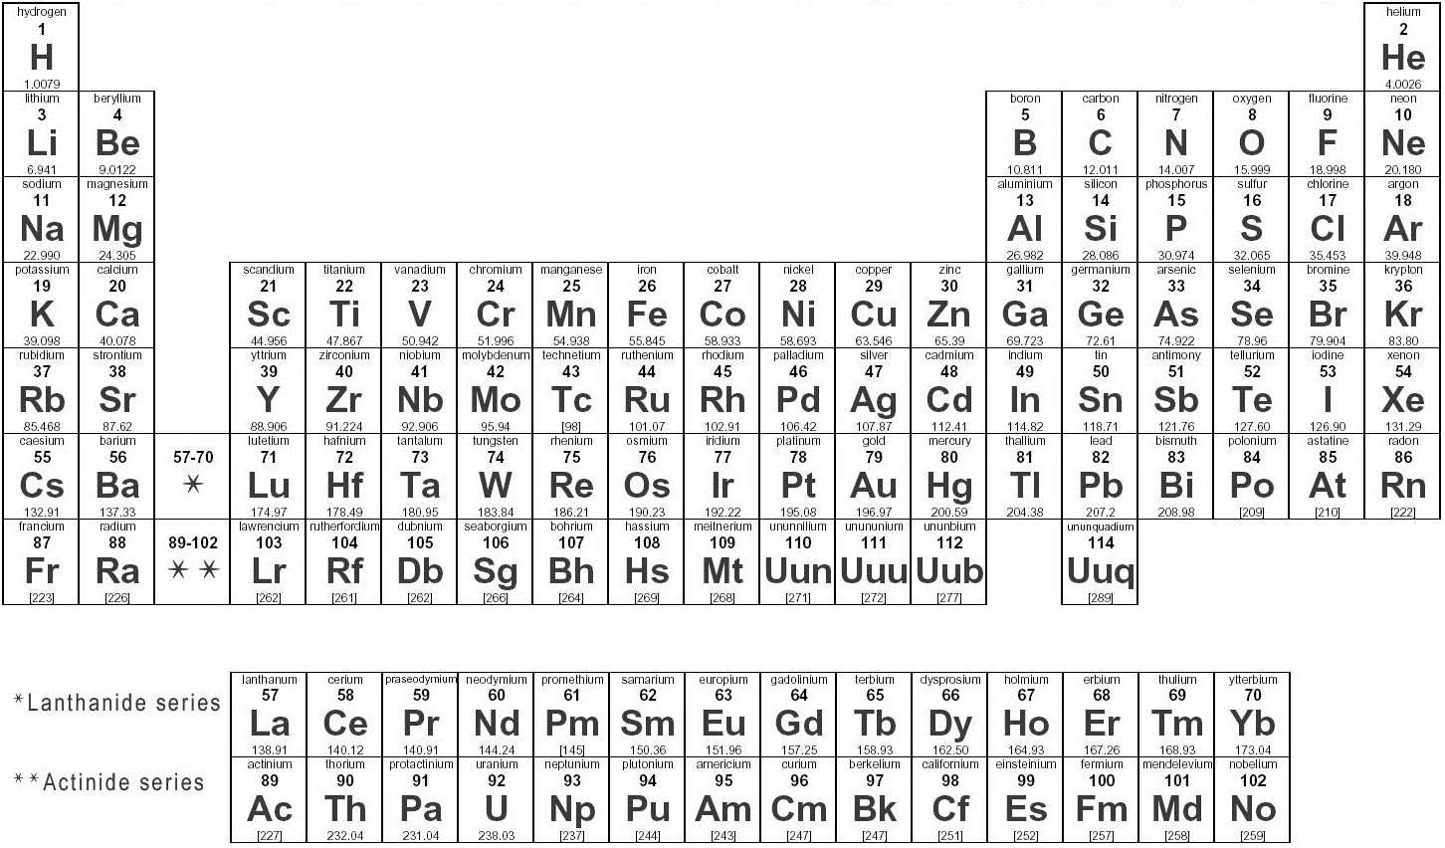
Constants:
1 atm = 760 torr = 101.325 kPa
R = 8.314 kPa L mol⁻¹ K⁻¹ = 0.0821 atm L mol⁻¹ K⁻¹ = 8.314 J mol⁻¹ K⁻¹
N_{A} (Avogadro’s Number) = 6.022 x 10²³ mol⁻¹
1 L atm = 101.325 J

