Slide 1
OSPF Protocol

Slide 2
What is OSPF ?
OSPF stands for Open Shortest Path First
OSPF considered as thired layer Protocol
OSPF is Industry Standard that means it is not monopoly for any company
OSPF is a link-state Protocol

Slide 3
What is link-state Protocol ?
developed to overcome the disadvantages of the distance vector protocols
Each router is responsible for meeting its neighbors and learning their names.
Each router constructs a link state packet (LSP) which consists of a list of names and cost for each of its neighbors.
The LSP is transmitted to all other routers. Each router stores the most recently generated LSP from each other router.
Each router uses complete information on the network topology to compute the shortest path route to each destination node.

Slide 4
How OSPF builds its routing table ?
OSPF chooses the best route depending on the cost using this formula on each link
Cost = 100,000,000/Line Speed

Slide 5
How OSPF builds its routing table ?
OSPF uses Dijkstra’s Algorithm to choose the best route then comparing it to its database to build the routing table .

Slide 6
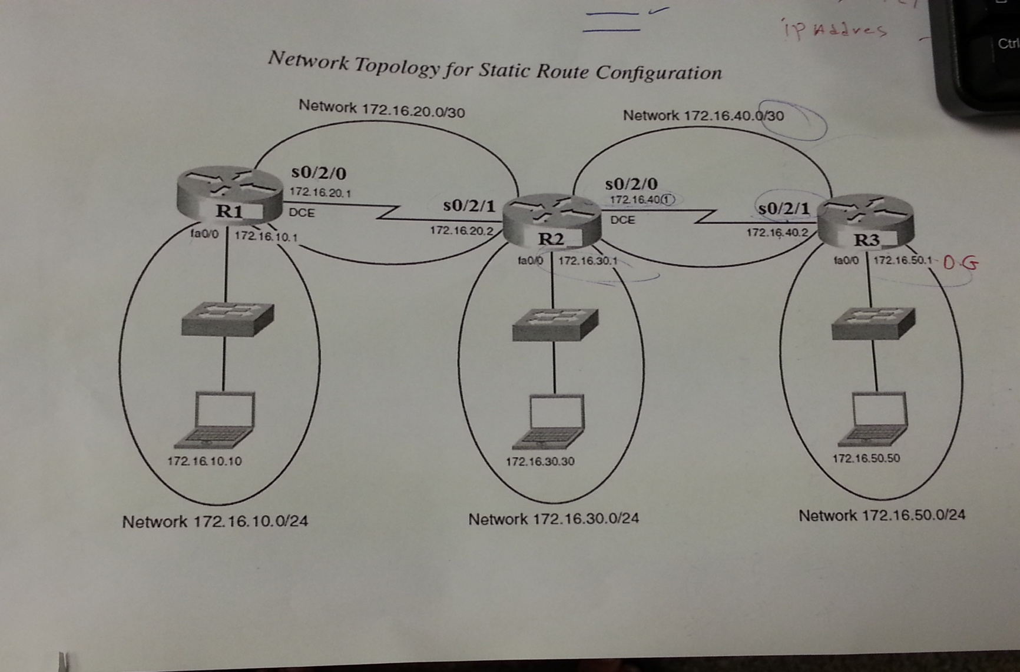
OSPF Routing tables

Slide 7
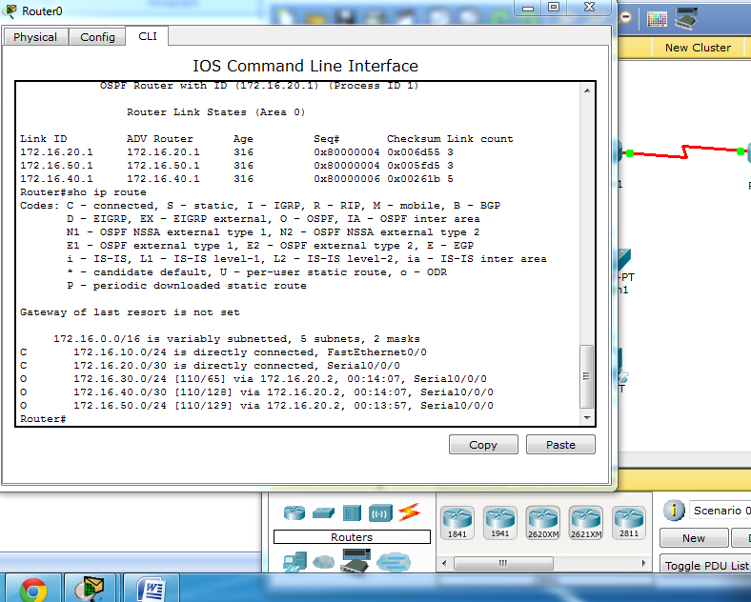
OSPF Routing tables
# show ip route

Slide 8
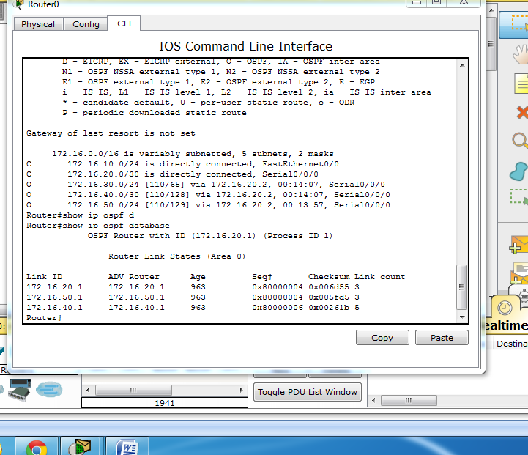
OSPF Routing tables
# show ip ospf database

Slide 9
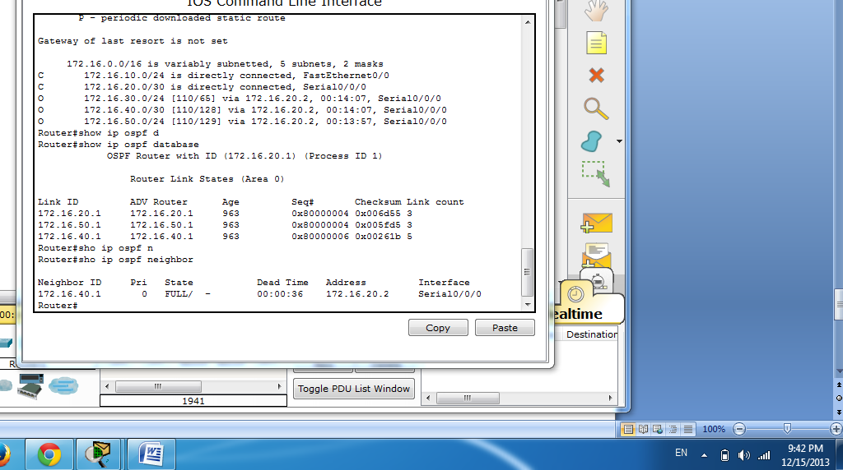
OSPF Routing tables
# show ip ospf neighbor

