Slide 1
OSPF
Interior Gateway Routing

Slide 2
Introduction:
Intra‐domain routing: inside an AS, org.
Also called interior gateway protocol.
Early protocols used distance vector.
RIP (Routing Information Protocol)
suffers from count‐to‐infinity problem

Slide 3
Advantages
Open (published), not proprietary.
Support variety of distance metrics: (Cost, distance, delay).
Dynamic, adapted to changes quickly
Support routing based on type of service
Must do load balancing, split multiple paths
Security, prevent spoofing false routing info

Slide 4
Definition
OSPF: is an abstract collection of actual networks
Has a directed graph, arcs with weights
Point‐to‐point link
pair of arcs ⥃ weights can be different
Broadcast network
node for network itself
arcs from this node to routers have 0 weight
Networks with hosts only (no routers)
one‐way arcs, route to hosts, not through them

Slide 5
Graph representation of OSPF
AS
Graph
representation for
OSPF

Slide 6
Terminology
Many Autonomous Systems are large, they can’t be managed.
OSPF allows dividing AS to numbered areas
Area: network or contiguous networks
Areas do not overlap
Internal routers: wholly within an area
Every AS has backbone area: area 0
Routers in area 0: backbone routers
Area border router: connect multiple areas
AS boundary router: injects routes to external destinations on other AS into the area

Slide 7
Autonomous Systems

Slide 8
Each router informs (floods) all other routers in.
its area of its links to other routers and networks.
Each router then runs Dijkstra to compute routes.
Routers in LAN elect designated router.
Avoid having all routers talk to all within LAN.
Description | Message Type
Used to discover who the neighbors are | Hello
Provides the sender’s cost to it’s neighbors | Link state update
Acknowledges link state updates | Link state Ack
Announces which updates the sender has | Database description
Requests information from the partner | Link state request

Slide 9
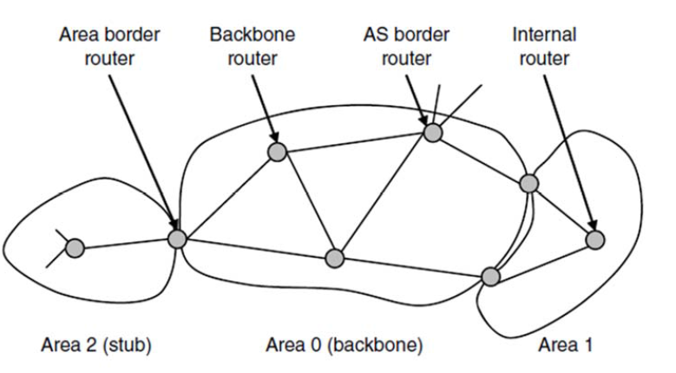
Example

Slide 10
Example (Cont)
Backbone routers accept information from area border routers.
Compute best route from each backbone router to every other router.
Info is propagated back to area border routers, which advertise it within their areas.
Internal routers can select the best route to a destination outside their area, including the best exit router to the backbone.

