Slide 1
Nurs 425: Part 3
Social, legal , ethical and cultural context of decision making

Slide 2
Learning objectives:
After completing this unit, students are expected to be able to:
  Discuss the social, legal, ethical, and cultural context of decision making
  Develop basis for making ethical decisions
  Communicate the importance of patient’s bill of rights
  Explain the concepts of autonomy, beneficence, veracity
  Apply the ethical principles embodied in the Nurses’ code of ethics by ICN (2012) and Nursing Code of Ethics – Saudi Arabia (2011).

Slide 3
Ethics
A set of rules and values that define right and wrong conduct.
They indicate when behavior is acceptable and when it is unacceptable.

Slide 4
Moral Principles
Moral principles prescribe rules of acceptable behavior that are intended to be impartial.

Slide 5
Ethical vs. Unethical Decisions
Ethical decision – reasonable and acceptable because it aids stakeholders, organization, and society.
Unethical decision- decision that a manager would prefer to disguise or hide from other people because of individual gain is placed above others needs.

Slide 6
Ethical Perspectives for Evaluating Behavior
Societal
Organizational
Legal
Individual

Slide 7
Societal Perspective
Societal Ethics – standards that govern how members of a society are to deal with each other on issues of fairness, justice, poverty, and individual rights.
The idea of what is ethical behavior is largely influenced by the society in which the behavior occurs.
Various public opinion surveys suggest a growing disenchantment with the lack of ethical behavior

Slide 8
Legal Perspective
Laws: society’s values and standards that are enforceable in the courts.
Employment-at-will: a traditional common-law concept holding that employers are free to discharge employees for any reason at any time and that employees are free to quit their jobs for any reason at any time.

Slide 9
Legal Perspective (Contd.)
Ethics are not laws by any means, simply beliefs about what is right or wrong.
Legality of actions and decisions doesn’t make them ethical
Laws move with the current culture and moral principles
  Lag behind because they are written and set
  Do not ensure or even promote ethical behavior
Often laws and ethics are in conflict

Slide 10
Organizational Perspective
To provide guidance for employees, an organization can define ethical and unethical behaviors.
Organizations can also guide employee actions both formally and informally.

Slide 11
Individual Perspective
Despite prevalent societal, legal, and organizational interpretations of what is ethical, individuals have their own values and a sense of what is right or wrong.
Lawrence Kohlberg
  Suggested people develop morally, much as they do physically, from early childhood to adulthood.
  As they develop, their ethical criteria and patterns of moral reasoning go through stages of moral development

Slide 12
Individual Perspective (Contd.)
Stages of moral development: according to Kohlberg, people develop morally by going through six stages of moral development: obedience and punishment, instrumental, interpersonal, law and order, social contract, and universal principles.

Slide 13
Kohlberg’s Stages of Moral Development
Universal Principles
Social Contract
Law & Order
Interpersonal
Instrumental
Obedience & Punishment
Childhood--------------Through-----------------Adulthood

Slide 14
Kohlberg’s Stages (Ctd.)
Obedience and punishment: person does the right thing mainly to avoid punishment or to obtain approval.
Instrumental: person becomes aware that others also have needs and begins to defer to them to get what the individual wants.
Interpersonal: person considers appropriate behavior as what pleases, helps, or is approved by friends or family.

Slide 15
Kohlberg’s Stages (Ctd.)
Law & Order: person recognizes that ethical behavior is not determined only by reference to friends, family, co-workers, or others whose opinions the individual might value.
Social Contract: person is aware that people hold a variety of conflicting personal views that go beyond the letter of the law.
Universal Principles: person views appropriate conduct as determined by a person’s conscience, based on universal ethical principles.

Slide 16
Ethical Models
Utilitarian
Justice
Moral Rights
IDEAL Outcome
Adapted from Fig 6.5

Slide 17
Utilitarian Model
Greatest good for the greatest number, but may hurt a few.
Milton Friedman is the best-known advocate of this approach.
All employees should strive to increase the company’s profits.

Slide 18
Parts to Utilitarian Model
(Organizational Goals): focusing on maximizing profits. Profits are seen as the reward for satisfying customers.
(Efficiency): achieved by both minimizing inputs (e.g. labor, land, and capital) and maximizing productive outputs.
(Conflicts of Interest): by having a financial interest in a supplier a purchasing agent might be more likely to buy from his supplier even if it’s not in the companies best interest.

Slide 19
Moral Rights Model
Judging decisions and behavior by their consistency with fundamental personal and group liberties and privileges.
(Life and Safety): Employees, customers, and public have the right not to have their lives and safety endangered.
(Truthfulness): They have the right not to be intentionally deceived on matters about which they should be informed.
(Privacy): Citizens have the right to control access to personal information.

Slide 20
Moral Rights Model (Contd.)
(Free Speech): Employees have the right to criticize the ethics or legality of their employers actions.
(Private Property): This right allows people to acquire, use, and dispose of shelter and have life’s basic necessities.

Slide 21
Justice Model (Contd.)
Fairness Principle: moral requirement that employees support the rules of the organization when certain conditions are met.
Natural Duty Principle: moral requirement that decisions and behaviors be based on a variety of universal obligations.

Slide 22
How to make an ethical decision
Jameton’s Model for resolving nursing ethics problems (1984)
1. Identify the problem | Nurse should clarify what is at issue: values, conflicts, matters of conscience
2. Gather additional information | Nurse should decide who the main decision maker is and what the clients or their surrogate decision makers want
3. Identify all options open to the decision maker. | All possible courses of action and their outcomes should be considered. The likelihood of whether future decisions might have to be made should be evaluated.
4. Think the situation through. | Consider the basic values and the professional obligations involved. Explore the ethical principles and relevant rules.
5. Make the decision | The decision maker should choose the course of action that reflects his or her best judgment.
6. Act and assess the decision and its outcomes | Nurse should compare the actual outcomes of the situation with the projected outcomes. Can the process of decision making be improved for further situations having similar characteristics? Can this decision be generalized to other client care situation?
.library.armstrong.edu

Slide 23
How to manage an Ethical Conflict
  Discuss the client care situation with the following:
    Another nurse
    Nursing leadership
    A representative from the Ethics Committee
    The patient or the patient’s family
    The patient’s physician
    A religious counselor
.library.armstrong.edu

Slide 24
Earliest known declaration of the right to health
  National Convention of the French revolution in 1793
    There should be only one patient to a bed in hospitals and that hospital beds should be placed at least 3 feet apart
.library.armstrong.edu

Slide 25
Patient’s Rights:
  Basic extensions of basic human rights
    Right to health
    Right to health care
  Aided by consumer groups and health care providers
    Right to informed consent
    Right to refusal of treatment
    Right to privacy
.library.armstrong.edu

Slide 26
Right to Health
Universal Declaration of Human Rights of the United Nations Assemble (UNESCO, 1949)
  Right of all persons to a standard of living adequate to provide for health and well-being and the right to “food, clothing, housing, and medical care”
  Persons are entitled to certain services, programs, and goods to maintain or achieve health as a basic human right.
.library.armstrong.edu

Slide 27
Right to Health Care
Defined as a ‘positive right’ to goods and services to maintain and improve whatever state of health.
A rights claim against the state or its agencies to provide specific health care services.
Examples: state sponsored immunization programs, kidney dialysis services, home health services, prenatal and family planning services
.library.armstrong.edu

Slide 28
Patient’s Bill of Rights (AHA, 1973)
Affirms the basic human rights of all clients who seek health care services to:
  Receive considerate and respectful care
  Obtain complete medical information
  Receive information necessary for giving informed consent
  Refuse treatment
  Request services
  Refuse participation in research projects
  Expect reasonable continuity of care
  Be informed of institutional regulations
  Have privacy
  Have personal information and medical records treated confidentially
  Be provided with information on other institutions and individuals related to care and treatment
  Examine and obtain explanations of financial charges
.library.armstrong.edu

Slide 29
Professional Code of Ethics
  Statements encompassing rules that apply to persons in professional roles.
Professional Codes of Ethics for Nurses
  Specific applications of more universal moral principles.
  Prescribes moral behavior and actions based on moral principles in response to patients’ rights (Fry, 1994)
  Professional nurse has a moral obligation to follow the rules in a code of ethics
.library.armstrong.edu

Slide 30
Veracity
  Duty to tell the truth and not lie or deceive others
  Truthfulness is regarded as fundamental to the existence of trust among human beings
  Code of Nurses states that… “Clients have the moral right to be given accurate information, and all the information necessary for making informed judgments” (ANA, 1985).
  The duty not to lie is a stronger moral duty than the duty to disclose information.
  The duty of veracity correlates with the client’s right to know and includes a strong moral obligation not to lie or deceive.
.library.armstrong.edu

Slide 31
Veracity: Arguments for
  Veracity is part of the respect that is owed other persons
    Example: being truthful to clients regarding the nature of the care they are receiving
  The duty of veracity is derived from or is a way of expressing the duty of keeping promises
    Communicating with the client creates and implicit contract to tell the truth and not lie or deceive.
  Relationships of trust are necessary for cooperation between clients and health care professionals
    Nurse has responsibility to maintain truthful relationships with clients to protect and strengthen other health care relationships in general.
.library.armstrong.edu

Slide 32
Confidentiality
  Principle of not revealing or divulging certain information and be treated as confidential
  Enables control of disclosure of personal information and limits the access of others to sensitive information (Fry, 1994)
  Privacy is recognized as a basic human right.
  Code for Nurses states that: “The nurse safeguards the client’s right to privacy by judiciously protecting information of a confidential nature” (ANA, 1985).
  Because of respect for persons, nurses respect clients’ rights to privacy by maintaining the moral rule of confidentiality.
.library.armstrong.edu

Slide 33
Reasons for overriding the duty to observe confidentiality:
  When in conflict with other duties toward the client.
    Ex: the duty to preserve life may outweigh the duty to respect confidential information concerning self-destructive wishes of the client.
  When in conflict with duties toward identified others.
    Ex: A mental health client tells the nurse of intent to harm or kill another member of the community
  When in conflict with duties toward unidentified others or the rights and interests of society in general.
    Ex: the law requires communicable diseases such as PTB or VD to be reported regardless of the confidential nature of that information
    Health records used for epidemiological research without the clients’ knowledge
    Duty to increase or protect the health of the community through research outweighs the duty to respect the confidentiality of health records
.library.armstrong.edu

Slide 34
Advocacy
  Nurse speaks for or in support of the best interests of the individual client or vulnerable client population not be harmed by providing health care services
  Code for Nurses states: “the nurse must be alert to and take appropriate action regarding any instances of incompetent, unethical, or illegal practice by any member of the health care team or the health care system, or any action on the part of others that places the rights or best interests of the client in jeopardy (ANA, 1985).
.library.armstrong.edu

Slide 35
Accountability
  Being answerable to someone for what has been done in the nursing role
  Includes providing an explanation to oneself, the client, the employing agency, and the nursing profession for what one has done in the role of nurse
  An obligation that has both moral and legal components and implies a contractual agreement between two parties.
.library.armstrong.edu

Slide 36
Accountability (contd)
  When a nurse enters into a contractual agreement to perform a service for a client, the nurse will be held answerable for performing this service according to agreed-upon terms, within an established time period, and with stipulated use of resources and performance standards.
  The nurse as contractor is responsible for the quality of the services rendered and is accountable to the individual client, the health service agency, the nursing profession, own conscience for what has been done (Fry, 1994).
.library.armstrong.edu

Slide 37
Accountability (contd)
  The moral obligation of accountability corresponds to the client’s right to an accepted level of competent nursing care and the right to self-determination in health care
  Directs the professional to act in a particular way according to moral norms (Fry, 1994)
.library.armstrong.edu

Slide 38
Beneficence
  The obligation that healthcare professionals have to act in a way that is of benefit to those for whom they care.
  Principle invoking that ‘we ought to do good and prevent or avoid doing harm’ (Frankena, 1973).
  Duty to help others gain what is of benefit to them but does not carry the obligation to risk one’s own welfare or interests in helping others.
  Nurses are only morally required to prevent harm
. (Beauchamp, 2008; library.armstrong.edu

Slide 39
Beneficence (contd)
  Rule of Utility
    Moral duty to weigh and balance benefits against harms to increase benefits and reduce the occurrence of harms (Beauchamp & Childress, 1994)
  Cost-benefit analysis
    Measures the harms and benefits of various health programs while figuring the costs of potential trade-offs in certain courses of actions
    Ex: factors taken into consideration include lives saved, costs averted, taxes saved, illness prevented.
    These are converted into common unit usually money, to measure the benefits and costs of alternative approaches to a problem
.library.armstrong.edu

Slide 40
Autonomy
  Refers to the capacity to think, decide and act on one's own free initiative and it is the ultimate right of all individuals.
  Freedom of action that an individual chooses
  Principle states that persons who are autonomous are capable of choosing and acting on plans they themselves have selected.
  To respect persons as autonomous individuals is to acknowledge their personal rights to make choices and act accordingly (Fry, 1994)
  Application:
    Respect for persons
    Protection of privacy
    Provision of informed consent
      Information, comprehension, voluntariness
    Freedom of choice, including treatment refusal
    Protection of diminished autonomy
.library.armstrong.edu

Slide 41
Justice
  Principle stating that ‘equals should be treated equally and that those who are unequal should be treated differently according to their differences (Beauchamp & Childress, 1994).
.library.armstrong.edu

Slide 42
Nursing Code of Ethics:
General Nursing Administration, MOH-KSA
Code of Ethics: a branch of philosophy dealing with standard of conduct and moral judgments
Purpose:
To provide basis for interpreting and analyzing clinical situations in decision making.
See pdf file.
Nursing Directorate, MOH-KSA,

Slide 43
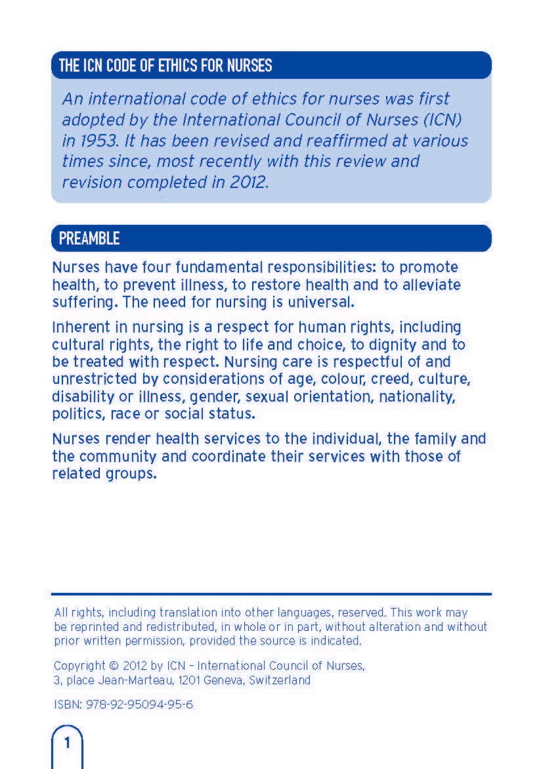
International Council of Nurses [ICN] (2012)

Slide 44
International Council of Nurses [ICN] (2012)

Slide 45
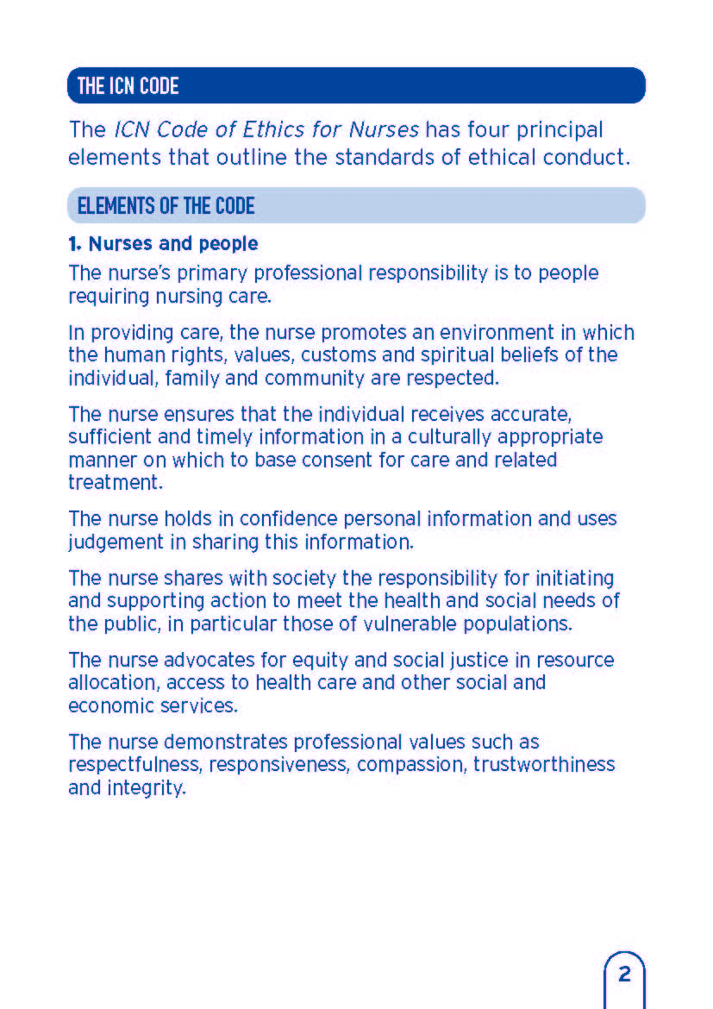
Elements of the Code
International Council of Nurses [ICN] (2012)

Slide 46
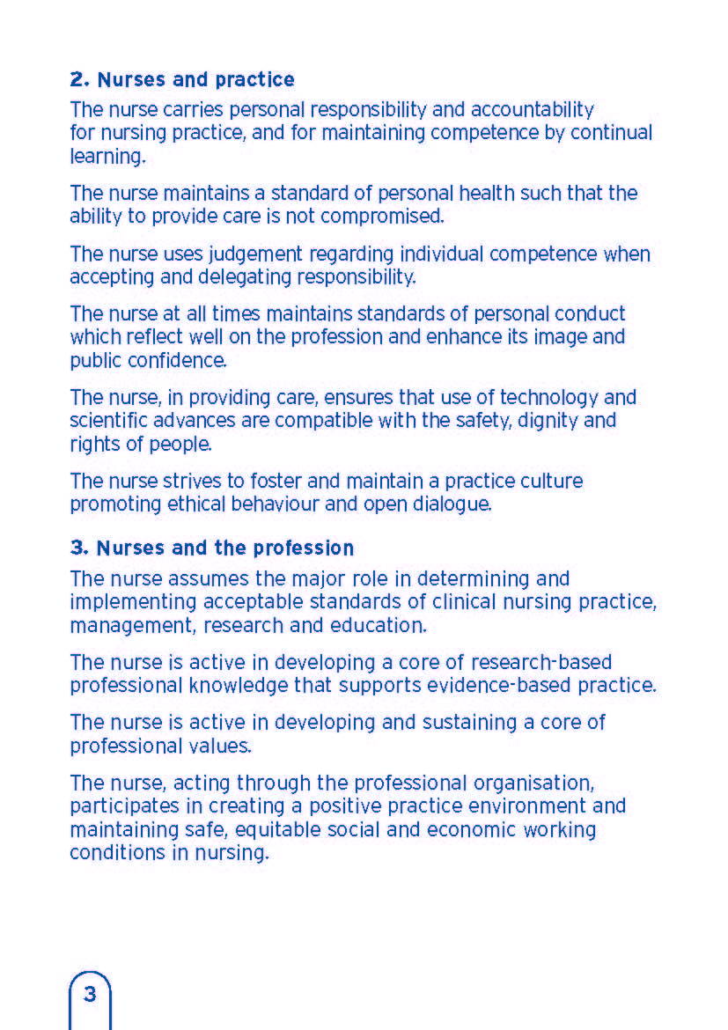
Elements of the Code (contd)
International Council of Nurses [ICN] (2012)

Slide 47
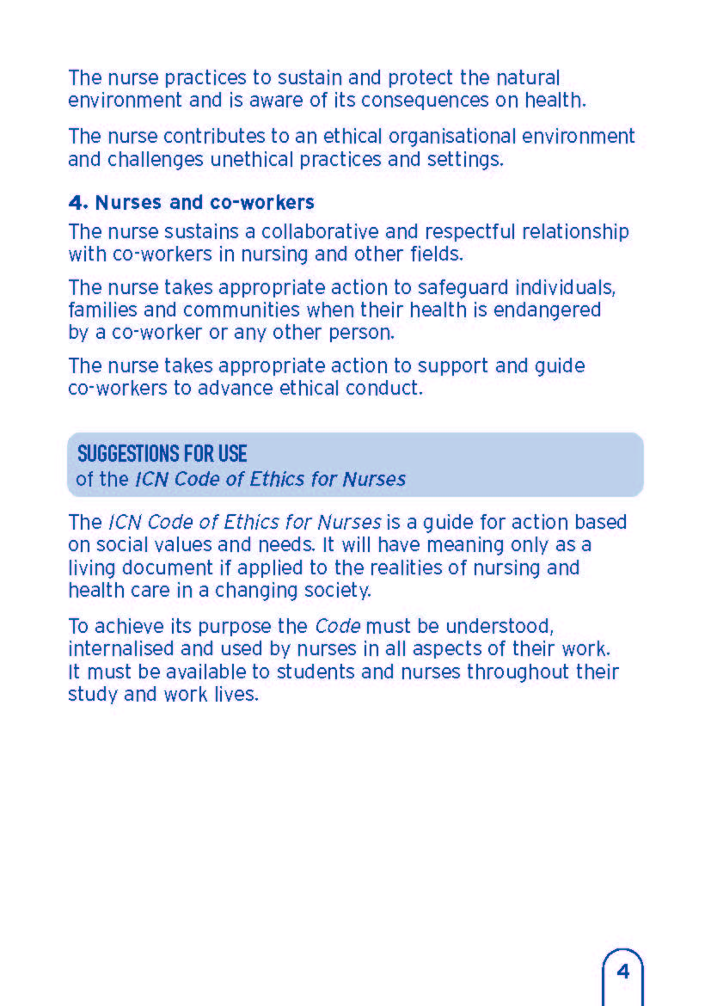
Elements of the Code (contd)
International Council of Nurses [ICN] (2012)

Slide 48
Elements of the Code (contd)
International Council of Nurses [ICN] (2012)

Slide 49
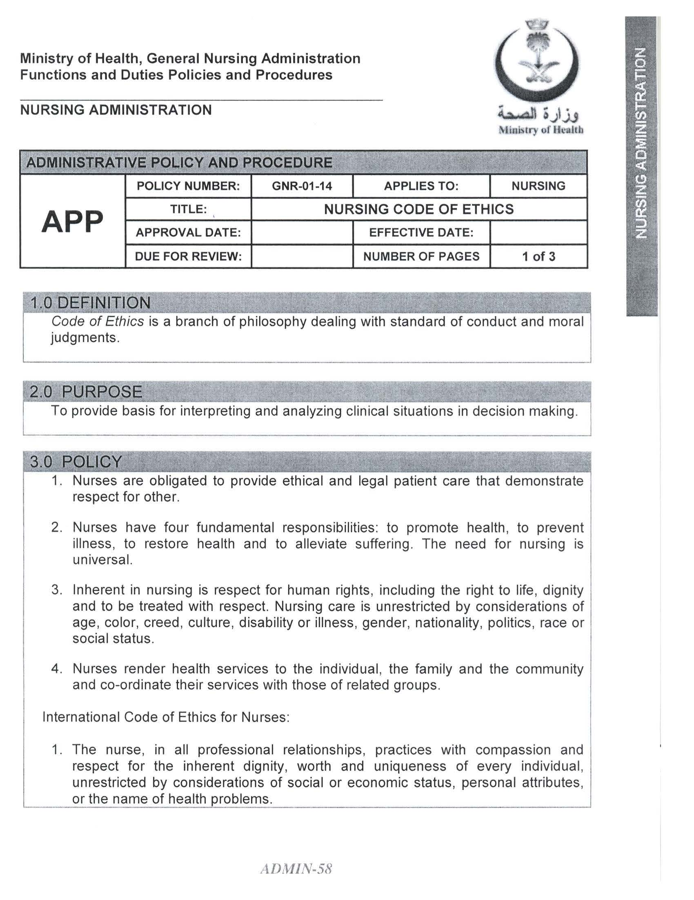

Slide 50
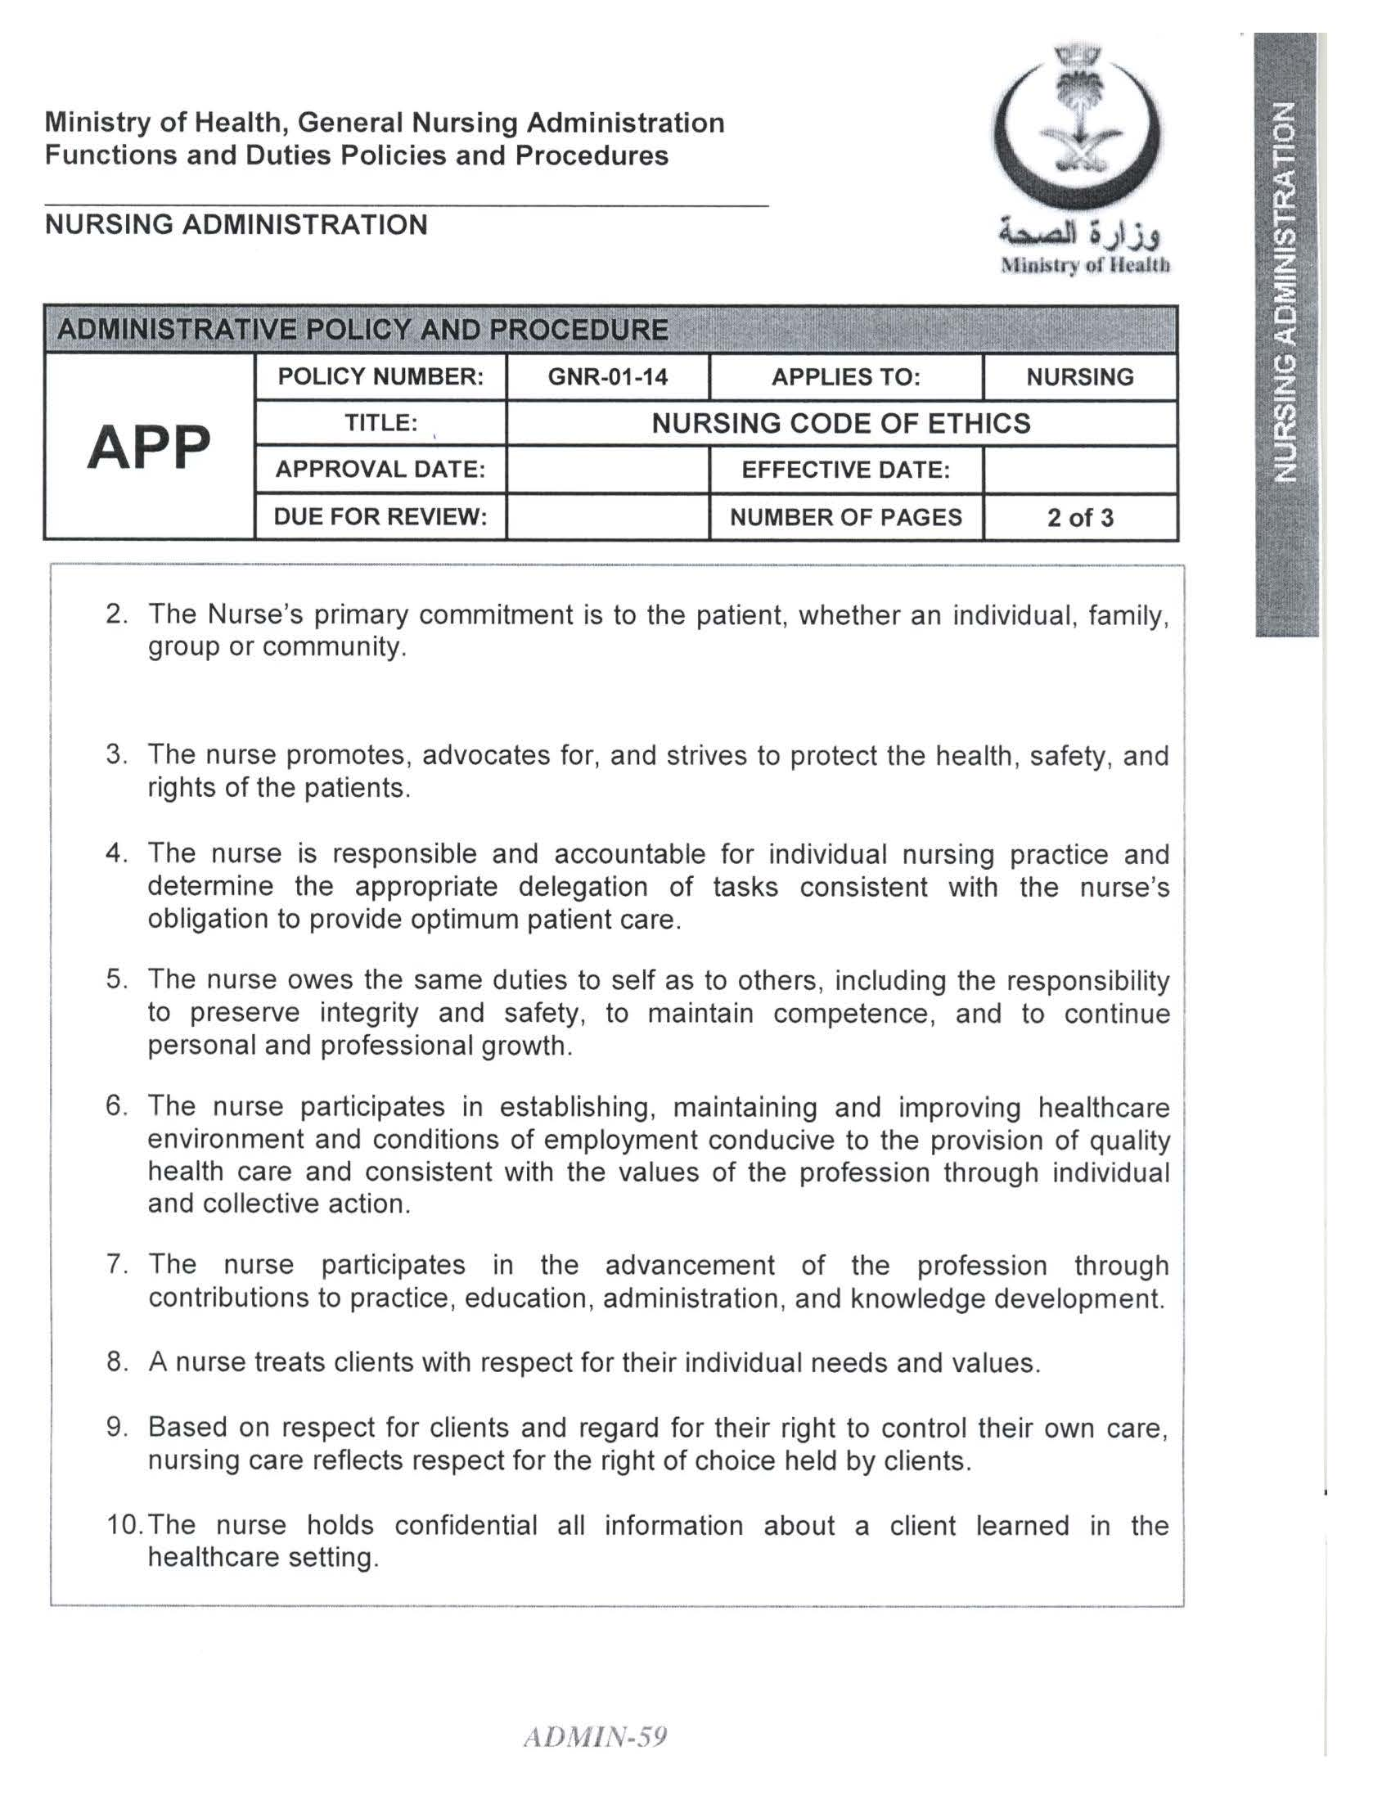

Slide 52
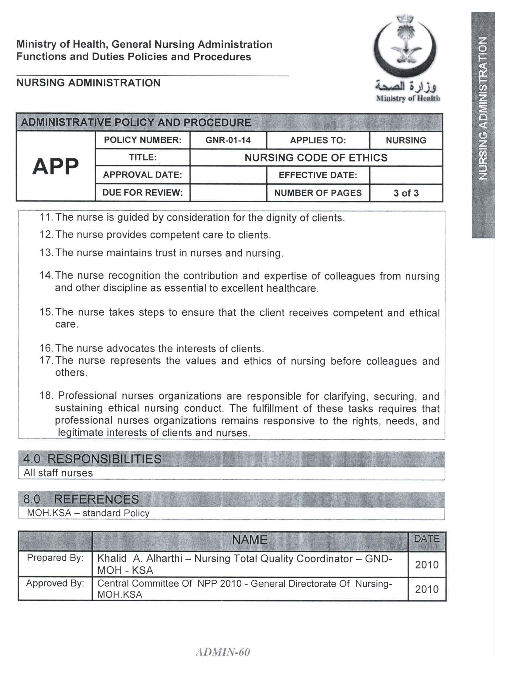

Slide 53
References
Ethics in Community-Oriented Nursing Practice. Chap 6. http://www.library.armstrong.edu/eres/docs/eres/NURS4005-1_MAHAN/500006dunCh6.pdf
International Council of Nurses [ICN] (2012). The ICN Code of Ethics for Nurses. Geneva, Switzerland.
MOH-KSA, General Directorate of Nursing. (2011). Manual of Nursing Policies and Procedures (2nd ed.).

