Slide 1
Nurs 430: Unit III Issues in Delivering Care
College of Nursing, King Saud University
Riyadh, Saudi Arabia

Slide 2
Learning Objectives:
After completing this lecture, students will be able to:
Define accreditation
Understand the elements of accreditation system
Explain benefits of accreditation
Discuss the objectives of accreditation
Describe the various chapters of Saudi hospital standards mandated by CBAHI
Know the different healthcare accreditation organizations
Understand the major drivers of health care costs
Comprehend the need to control health care costs
Differentiate complementary from alternative health care practices
Explain the different categories of complementary and alternative therapies
Understand the role of nurses when providing or recommending complementary and alternative practices to clients

Slide 3
What is Accreditation?
“self-assessment and external peer review process used by healthcare organizations to accurately assess their level of performance in relation to established standards and to implement ways to continuously improve the healthcare system” (CBAHI, 2006)
“public recognition by a health care accreditation body of the achievement of accreditation standards by a health care organisation, demonstrated through an independent external peer assessment of that organisation's level of performance in relation to the standards.” (Australian Council on Healthcare Standards [ACHS], 2015).

Slide 4
Accreditation systems are considered to comprise five key elements: (ACHS, 2015)
1. Governance or stewardship function
2. A standards-setting process
3. A process of external evaluation of compliance against those standards
4. A remediation or improvement process following the review
5. Promotion of continuous quality improvement.

Slide 5
Benefits of accreditation (Nicklin, Dickson, Accreditation Canada, 2008)
Enhancing patient safety by effectively managing and mitigating clinical and safety-related risks
Ensuring an acceptable level of quality among health care providers
Stimulating sustainable quality improvement (QI) and continuously raising the bar with regards to QI initiatives
Enhancing organizations’ understanding of the continuum of care by focusing on performance improvement and outcomes of care
Increasing reputation among end-users and enhancing their awareness and perception of quality care
Promoting capacity-building and organizational learning
Providing a framework that assists in the creation and implementation of systems and processes which improve operational effectiveness and enhance positive health outcomes

Slide 6
What are the objectives of Accreditation? (CBAHI, 2006)
“To ensure the quality of health care through the application of quality concepts”
“To foster a culture of patient safety and minimize the risk of medical errors”
“To achieve optimum organizational results with available resources”
“To increase accountability to patients and identified stakeholders”

Slide 7
The CBAHI Accreditation Standards
The CBAHI Accreditation Standards were developed by a consensus process of health care experts representing (MOH, national guards hospitals, KFSH&RC , University hospitals, Private hospitals, Security Forces hospital, Saudi Council for Health Specialties, MRQP team),
The standards have been approved by DR. HAMMED ALMANE (Minster of health) – National Standards Preparation committee on 21-24 May 2006.

Slide 8
Central Board of Accreditation for Healthcare Institutions - CBAHI
The CBAHI was formed based on the recommendation and approval of Council of Health Services on 1/3/1426 & 5/5/1426, meeting chaired by the Minister of Health, as Chairman of Council Of Health Services , according to the Authority delegated to him and reference to the Article NO.17 issued with a Royal Deed No.M/11 on 23/3/1423, and Article No.17L CBAHI was established based on the success of the Makkah Region Quality Program (MRQP) under the leadership of the late governor HRH Prince Abdulmajeed Bin Abdul Aziz Al-Saud.

Slide 9
Central Board of Accreditation for Healthcare Institutions - CBAHI
The current CBAHI standards were developed by teams of experts from the various healthcare sectors in the kingdom: ministry of health, National Guard healthcare services, armed forces healthcare services, Saudi ARAMCO, the private sector, King Faisal Specialist Hospital and Research Center, Saudi Commission for Health Specialties, Security Forces healthcare services and Civil Defense. CBAHI standard manual was approved by his Excellency the Minister of Health in 2006.

Slide 10
National Hospital Standards – Chapters (CBAHI, 2006)
The National Hospital Standards have been developed for the key services and functions and organized in the following chapters
Leadership (LD)
Medical Staff and Provision of Care (MS)
Nursing (NR)
Quality Management and Patient Safety (QM)
Patient & Family Education & Rights (PFE/PFR)
Different service units

Slide 11
Healthcare accreditation organizations:
ISQua is the umbrella organization responsible for accrediting the Joint Commission International accreditation scheme in the USA and Accreditation Canada International, as well as accreditation organizations in the United Kingdom and Australia.
Saudi Arabia:
Saudi Central Board for Accreditation of Healthcare Institutions (CBAHI), Jeddah. [Standards are ISQua Accredited)
United Kingdom:
QHA Trent Accreditation
UKAF (the United Kingdom Accreditation Forum) is responsible for accrediting accreditation schemes in the United Kingdom.
United States:
Joint Commission International (JCI)

Slide 12
Healthcare accreditation organizations: (continued)
Australia:
Australian Council on Healthcare Standards International (ACHSI)
Canada:
Accreditation Canada International (ACI)
France:
HAS (Haute Autorité de Santé)
India:
National Accreditation Board for Hospitals & Healthcare Providers (NABH)
New Zealand:
Quality Health New Zealand (QHNZ); QHNZ quality standards are based on those used in Australia and Canada. QHNZ is accredited by the international umbrella organization, the International Society for Quality in Healthcare (ISQua).

Slide 13
Cost Control and Evaluation of Health Care

Slide 14
Major Drivers of Health Care Costs (ACP, 2009)
Inappropriate utilization especially of advanced medical technology
Lack of patient involvement in decision-making
Payment system distortions that encourage over-use
High prices for health care services
A health care workforce that is not aligned with national needs
Excessive administrative costs
Medical liability and defensive medicine
Declining health status and chronic disease
Demographic changes including an increase in elderly persons

Slide 15
Why Do We Need to Control Health Care Costs?
Spending on health care continues to exceed economic growth at an unsustainable pace
Rate of growth in health care spending is the single most important factor undermining the nation’s long-term fiscal condition

Slide 16
Why Should Controlling Health Care Costs be Linked to Promoting Good Health Outcomes? (ACP, 2009)
Increasing pressure to control health care costs necessitates that limited healthcare resources be used equitably and judiciously.
Healthcare expenditures must be correlated with high quality and efficiency in the delivery of services to improve health outcomes.
This requires understanding the benefits and effectiveness of clinical procedures, recognizing the major drivers of health care costs, and identifying potential means for achieving savings.

Slide 17
Complementary and Alternative Health Care

Slide 18
COMPLEMENTARY AND ALTERNATIVE HEALTH CARE
includes modalities or interventions used to address clients’ health needs across the continuum of health care, but are not generally considered part of “mainstream” health care practice
“Complementary” practices are used alongside mainstream health care while
“Alternative” practices are used in place of mainstream health care practices

Slide 20
CONSIDERATIONS WHEN PROVIDING INFORMATION ABOUT, RECOMMENDING, INITIATING OR PARTICIPATING IN COMPLEMENTARY AND ALTERNATIVE PRACTICES WITH CLIENTS
Nurses assist clients to understand
Clients have a right to choose
Not all CAHC practices are within the scope of nursing practice
Collaboration, communication and documentation are important

Slide 21
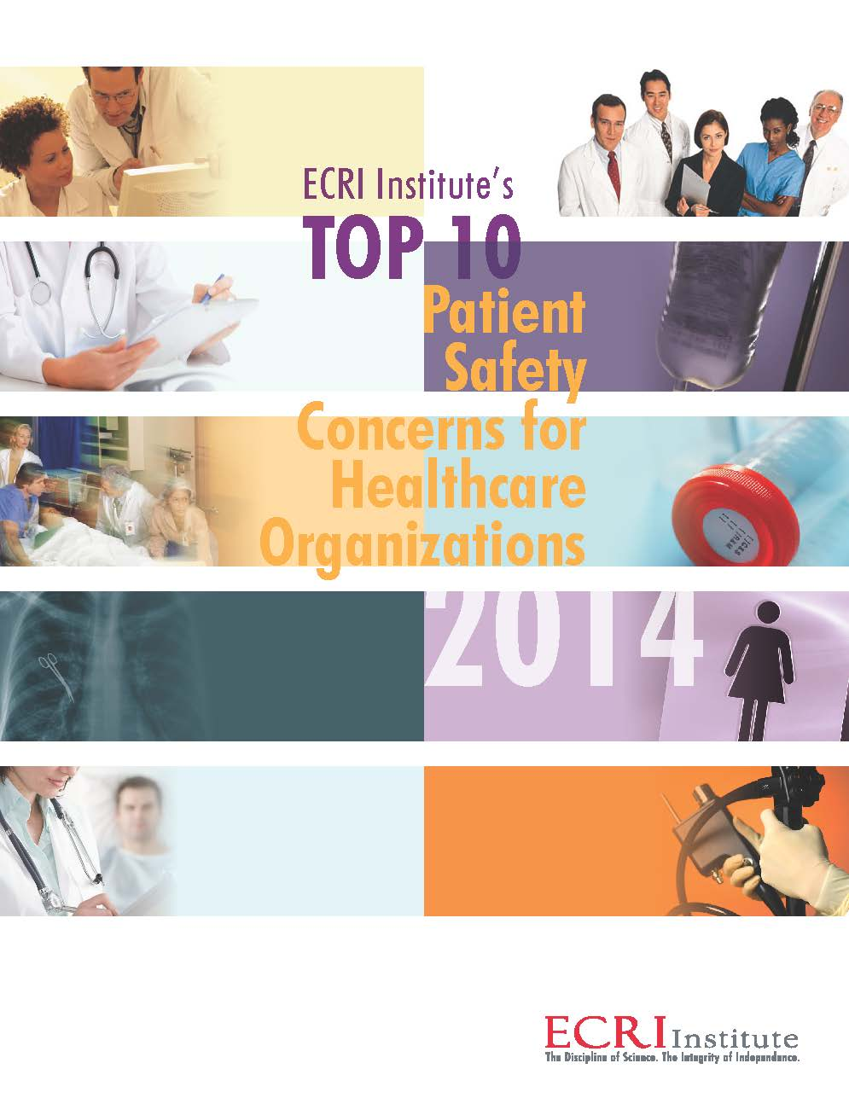

Slide 23
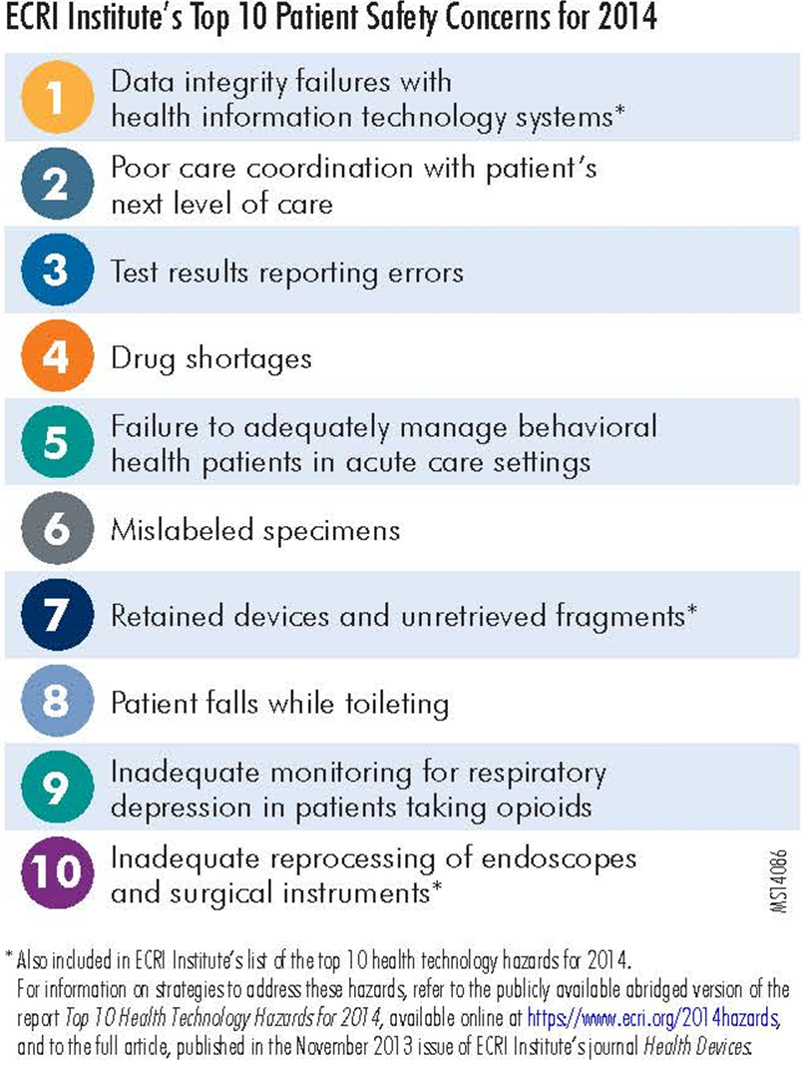

Slide 24
CBAHI- Hospital Accreditation guide
ACHS (2015). What is accreditation? http://www.achs.org.au/about-us/what-we-do/what-is-accreditation/
Nicklin, W., Dickson, S., Accreditation Canada (2008). The value and impact of accreditation in healthcare: A review of the literature. http://www.hadassah-med.com/media/2021761/thevalueandimpactofaccreditationinhealthcarearevie.pdf. Updated June 2009
College of Registered Nurses of British Columbia. Complementary and Alternative Health Care. https://www.crnbc.ca/Standards/Lists/StandardResources/437CompandAlternativeHealthCare.pdf
US Department of Health and Human Services. Talking about Complementary and Alternative Medicine with Health Care Providers: A Workbook http://cam.cancer.gov/attachments/workbook/talking_about_cam_workbook.pdf
ECRI Institute (2014). Top 10 Patient safety concerns for healthcare organizations 2014.
ECRI Institute (2015). Top 10 Patient safety concerns for healthcare organizations 2015.

Slide 25
Question?

