Slide 1
The Chromosomes and karyotype Phases of Mitosis and Meiosis
Unit 2

Slide 2
glossary
Chromatin - diffuse, long fibers of DNA with proteins attached
Single chromosomes - a chromosome which has not been duplicated (like ½ of an x)
Duplicated chromosomes - a chromosome which has been duplicated (a complete X)
Chromatid - one half of a duplicated chromosome, looks like a single chromosome
Centromere - a structure made of protein which holds the two halves of a duplicated chromosome together.

Slide 3
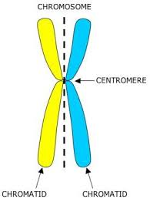
The Chromosomes

Slide 4
Male= XY Female= XX

Slide 5
Characteristics of Chromosomes
1. Location and Function
Located in the center of cells called the nucleus
Each chromosomes features protein and a single DNA molecule.
The DNA wrapped around histones (spool-like proteins)
A key part of the process of accurately copying DNA and distributing in many cell divisions

Slide 6
Characteristics of Chromosomes 2. Pairs (23)
Male
46 chromosomes
22 pairs of chromosomes
Different pattern of sex chromosomes (XY)
One of each pair autosomes and an X is maternal origin
The father contributes the Y and the remaining autosomes
Female
46 chromosomes
Two X chromosomes
One of each pair of the autosomes and one X is of maternal origin
The other 23 are of paternal origin

Slide 7
Characteristics of Chromosomes
3. Child Gender
The mother always contributes an X chromosomes to her child
The father of the contributes either an X chromosomes or a Y chromosomes
As a result, the father is the parent who determines the sex of a child. Still, a child inherits some traits from his mother and other traits from his father.

Slide 8
Characteristics of Chromosomes
4. Autosomal Types
1 to 22 = autosomal chromosomes
Reproductive cells such as eggs and sperm must have the right number of chromosomes in order to have offspring that develops correctly.
Example: Down Syndrome
3 copies of chromosome 21 instead of two copies
Autosomal abnormality

Slide 9
karyotypes
definition
Karyotyping
Uses
Refers to a picture of individual’s chromosomes.
A technique that uses a picture of an individual’s chromosomes to analyze and detect chromosomal abnormalities
Use to detect fetal abnormalities
Form of genetic screening conducted on potential parents.

Slide 10
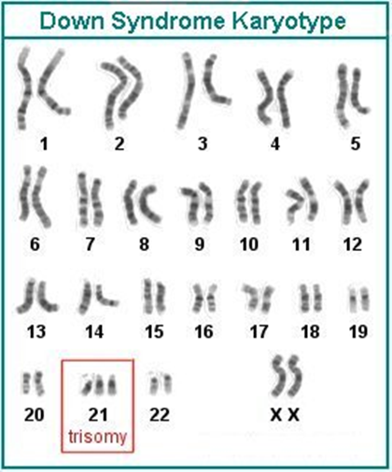
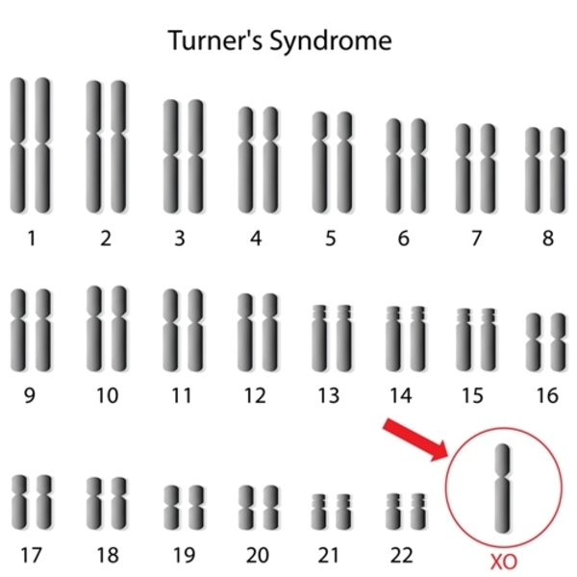
Examples of karyotypes

Slide 11
What is Mitosis?
is the process, in the cell cycle, by which a cell duplicates into two genetically alike daughter cells.
In mitosis, chromosomes in the cell nucleus are separated into two identical sets of chromosomes, each in its own nucleus.
Vital for tissue formation and maintenance

Slide 12
Phases of mitosis

Slide 13
Phases/steps of mitosis
Prophase
Metaphase
Anaphase
Telophase

Slide 14
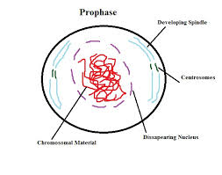
Prophase
The first stage of mitosis
Chromatin condenses to form duplicated chromosomes
The nuclear envelope breaks down (degenerate)
The spindle apparatus (made by microtubules) forms
The spindle attaches to the centromeres of the chromosomes and moves the chromosomes around during cell division

Slide 15
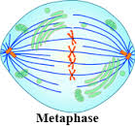
Metaphase
The second stage
The mitotic spindle moves the duplicated chromosomes so that they are lined up at the cell equator (middle of the cell) equidistant from the two poles (opposite ends) of the cell.

Slide 16
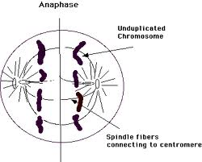
Anaphase
The third stage
Centromeres of duplicated chromosomes divide and split
The mitotic spindle pulls the sister chromatids separate from each other as they move to the opposite poles of the cell

Slide 17
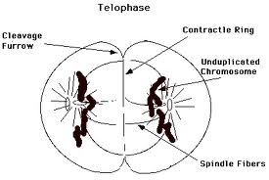
Telophase
The fourth stage
Duplicated chromosomes decondense back into chromatin
The nuclear envelope begins to form around the chromosomes so that the two separate daughter nuclei are created
The mitotic spindle breaks down
Two daughter cells are produced
Diploid cells (2N)- 46 chromosomes same as the mother cells

Slide 18
illustration

Slide 19
2 daughter cells are formed

Slide 20
Mitosis and Cancer
DNA, sometimes called a genetic blueprint, contains the hereditary material in nearly all organisms.
Two types of errors, or mutations, can occur when DNA is improperly copied: silent mutations, which have no impact on the DNA sequence, and "missense" mutations, which change a DNA sequence and often impact the associated function.
Missense mutations can multiply over time, leading to cell cycle disruption and formation of tumors -- cells that don't stop dividing.
Cancer occurs when the normal "checkpoints" regulating mitosis are ignored or overriden by a cancer cell, resulting in uncontrolled cell division.

Slide 21
What is Meiosis?
Types of cell division that creates egg and sperm cells
Ensures that humans have the same number of chromosomes in each generation.
A two step process that reduces the chromosomes number by half
46- 23 (to form sperm and egg cells)

Slide 22
Meiosis 1:
prophase 1, metaphase 1, anaphase 1, and telophase 1
Meiosis 2:
prophase 2, metaphase 2, anaphase 2, and telophase 2

Slide 23
In the first meiotic division, the number of cells is doubled but the number of chromosomes is not. This results in 1/2 as many chromosomes per cell.
The second meiotic division is like mitosis; the number of chromosomes does not get reduced.

Slide 24
Meiosis I

Slide 25
Prophase I of Meiosis i – crossing over
the DNA coils tightly and individual chromosomes becomes visible via microscope
Homologous chromosomes become closely associated in synapsis and they exchange segments by crossing over

Slide 26
Metaphase 1 of meiosis 1
The nuclear membrane has disappeared and the chromosomes move to equatorial plane.

Slide 27
Anaphase 1 of meiosis 1
Two members off each bivalent disjoin, one going to each pole
These bivalent are assorted independently to each pole
The cytoplasm divides
Each cell now has 23 chromosomes
Each of which has a pair of chromatids differing from one another as a result from crossing over

Slide 28
Telophase I of meiosis i
The nuclear membrane reforms around the daughter nuclei
Each daughter nucleus contain two sister chromatids for each chromosomes, attached to a common centromere
Because of crossing over, the two sister chromatid are not identical.

Slide 29
Meiosis II

Slide 30
Prophase 2 of meiosis 2
The nuclear envelope breaks down and a new spindle fiber forms

Slide 31
Metaphase 2 of meiosis 2
Spindle fibers bind to both sides of centromere

Slide 32
Anaphase 2 of meiosis 2
The spindle fibers contract and the sister chromatid move toward opposite poles.

Slide 33
telophase 2 of meiosis 2
Nuclear envelopes reform around the sets of daughter chromosomes

Slide 34
Daughter cells (4 haploid cells)

Slide 35
Meiosis thus has 3 important consequences
Gametes contain only one representative of each homologous pair of chromosomes.
There is a random assortment of paternal and maternal homologous.
Crossing- over ensures uniqueness by further increasing genetic variation.

Slide 36
4 daughter cells

Slide 37
Disorders due to Meiosis
Errors due during segregation (chromosomes segregates too many or few chromosomes in egg or sperm)
trisomy = an extra chromosome of a particular pair in each cell
monosomy = one chromosome fewer in each cell
For example
Trisomy 21 Down syndrome
cells have an extra copy of chromosome 21 (trisomy 21).
Turner syndrome
cells have only one X chromosome (monosomy X) and no Y chromosome

Slide 38
Summary

Slide 39
End!!!

