Slide 1
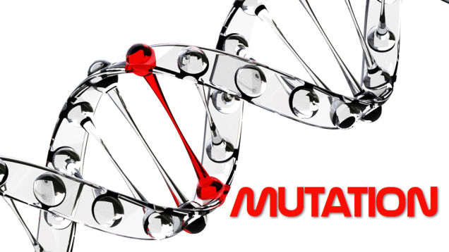
Unit 2

Slide 2
What is Mutation?
Is a natural process that changes a DNA sequence.
As a cell copies its DNA before dividing, a “typo” occurs every 100,000 or so nucleotides.
That’s about 120,000 typos each time one of our cells divides.
Mutant or Mutation – to describe something undesirable or broken.
Rarely cause death or disease
Generates new variations that can give an individual a survival advantage.
Most often, mutation gives rise to variations that are neither good nor bad, just “different.”

Slide 3
Mutation Generates New Alleles
The whole family is one species with the same genes.
Mutation creates slightly different versions of the same genes, called alleles.
These small differences in DNA sequence make every individual unique.
They account for the variation we see in human hair color, skin color, height, shape, behavior, and susceptibility to disease. Individuals in other species vary too, in both physical appearance and behavior.

Slide 4
What is the advantage of genetic variations?
It helps populations change over time.
Variations that help an organism survive and reproduce are passed on to the next generation.
Variations that hinder survival and reproduction are eliminated from the population.
This process of natural selection can lead to significant changes in the appearance, behavior, or physiology of individuals in a population, in just a few generations.

Slide 5
Types of Mutation 1. Base Substitution 2. Insertion and deletion 3. Frameshift

Slide 6
1. Base Substitution
The simplest type of gene-level mutation
Swapping of one nucleotide for another during DNA Replication.
Example: during replication, a thymine nucleotide might be inserted in place of a guanine nucleotide.
Only single nucleotide with a gene sequence is changed so only one codon is affected

Slide 7
Only a single codon in the gene sequence is changed in base substitution mutation.

Slide 8
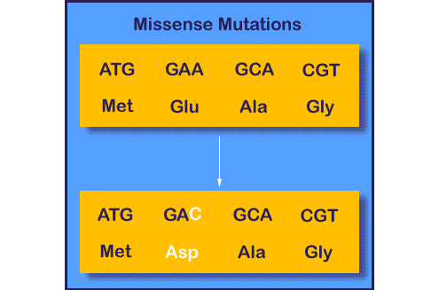
Sub-categories of mutations in base substitution
Missense Mutations
- The altered codon leads to insertion of an incorrect amino acid into a protein molecule during translation.
Illustration:

Slide 9
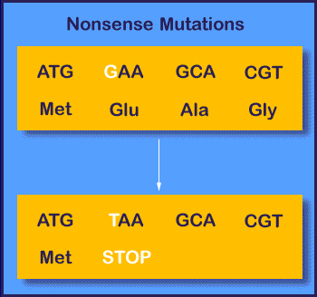
Sub-categories of mutations in base substitution
2. Nonsense Mutations
- altered codon prematurely terminates synthesis of a protein molecule.
Illustration:

Slide 10
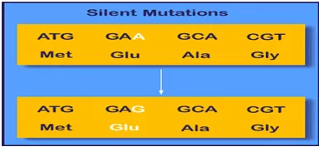
Sub-categories of mutations in base substitution
3. Silent Mutations
- altered codon codes for the same amino acids as the unaltered codon.
Illustration:

Slide 11
2. Insertion and Deletion
Are two other types of mutations that can affect cells at the gene level.
2.1. Insertion Mutation
Occurs when an extra nucleotide is added to the DNA strand during replication.
This can happened when the replicating strand “slips” or wrinkles, which allows the extra nucleotide to be incorporated

Slide 12
During an insertion mutation, the replicating strand [“slips”] or forms a wrinkle, which causes the extra nucleotide to be incorporated.

Slide 13
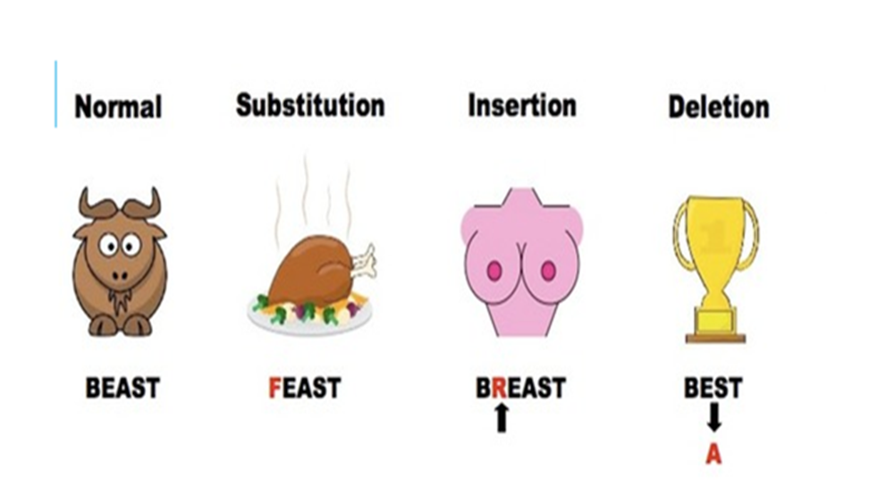
2.2. Deletion Mutation
- occurs when a wrinkle forms on the DNA template strand and subsequently causes a nucleotide to be omitted from the replicated strand. (see illustration below)

Slide 14
In deletion mutation, a wrinkle forms on the DNA template strand, which causes a nucleotide to be omitted from the replicated strand.

Slide 15
Frameshift Mutation
Is the type of mutation which is caused during insertion and deletion of one or more nucleotides during replication.
The outcome of a frameshift mutation is complete alteration of the amino acid sequence of a protein.
occurs during translation because ribosomes read the mRNA strand in terms of codons, or groups of three nucleotides.

Slide 16
cont. Frameshift Mutation
These groups are called the reading frame. Thus, if the number of bases removed from or inserted into a segment of DNA is not a multiple of three (Figure 4a), the reading frame transcribed to the mRNA will be completely changed (Figure 4b). (see next slide)
Consequently, once it encounters the mutation, the ribosome will read the mRNA sequence differently, which can result in the production of an entirely different sequence of amino acids in the growing polypeptide chain.

Slide 17
Figure 4a. If the number of bases removed or inserted from a segment of DNA is not a multiple of three Figure 4b. a different sequence with a different set of reading frames is transcribed to mRNA

Slide 18
Lets have a game: Pass the message!!!!
Mechanics:
- 5 students representatives for this game
- the teacher will give instruction to 5 students regarding the game
- Message will be open only by the teacher
- the rest of the students will observe
“the quick brown fox jumped over the lazy dog”
Click and Move me to reveal the message☺

Slide 19
To understand better
“THE BIG BAD FLY HAD ONE RED EYE AND ONE BLU EYE”.
Now, suppose that a mutation eliminates the sixth nucleotide, in this case the letter "G". This deletion means that the letters shift, and the rest of the sentence contains entirely new "words":

Slide 20
New message after deletion of G codon: “THE BIB ADF LYH ADO NER EDE YEA NDO NEB LUE YE”.
This error changes the relationship of all nucleotides to each codon, and effectively changes every single codon in the sequence.
Consequently, there is a widespread change in the amino acid sequence of the protein. Lets consider an example with an RNA sequence that codes for a sequence of amino acids:

Slide 21
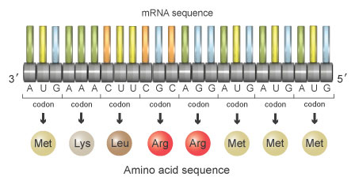
Normal codon: AUG AAA CUU CGC AGG AUG AUG AUG
With the triplet code, the sequence shown in the figure below corresponds to a protein made of the following amino acids:
Methionine-Lysine-Leucine-Arginine-Arginine-Methionine-Methionine-Methionin

Slide 22
Now…..
suppose that a mutation occurs during replication, and it results in deletion of the fourth nucleotide in the sequence. When separated into triplet codons, the nucleotide sequence would now read as follows (Figure 6): (see next slide)

Slide 23
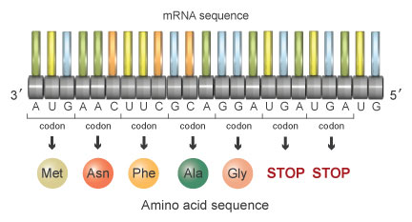
AUG AAC UUC GCA GGA UGA UGA UG
This series of codons would encode the following sequence of amino acids:
Methionine-Asparagine-Phenylalanine-Alanine-Glycine-STOP-STOP
Figure 6

Slide 24
Conclusion
Each of the stop codons tells the ribosome to terminate protein synthesis at that point.
Consequently, the mutant protein is entirely different due to the deletion of the fourth nucleotide, and it is also shorter due to the appearance of a premature stop codon.
This mutant protein will be unable to perform its necessary function in the cell.

Slide 25
What causes mutation?
Mutagens – external agents of genetic change
Chemicals, ultraviolet radiation, viral
Causes alterations in the molecular structure of nucleotides, ultimately causing substitutions, insertions, and deletions in the DNA sequence.

Slide 26
What are the consequences of mutations?
Genetic diversity in populations
Beneficial to an organism by making it better able to adapt to environmental factors.
Harmful in some instance; like increased susceptibility to illness or disease
Neutral proving neither beneficial nor detrimental outcomes to an organisms

Slide 27
Brain teaser activity!!!
What factors that causes mutation?
What type of mutation that causes entire shifts of RNA sequence?
Is insertion and deletion results frameshifting?
what will happen if mutation occurs in a gene?

Slide 28
End!!!

