Slide 1
Unit 2.2 RELATIONSHIP BETWEEN DNA, CHROMOSOMES AND GENES

Slide 2
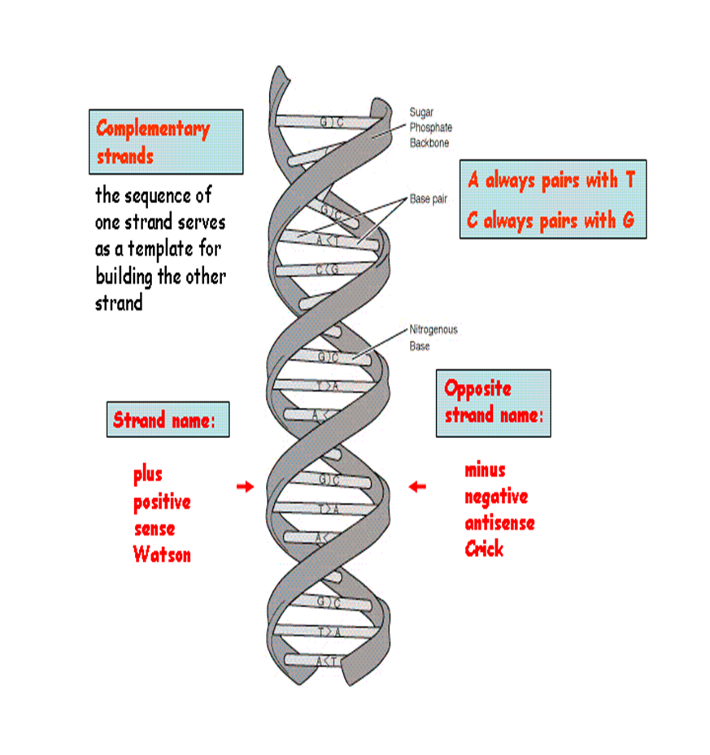
DNA
DNA: the chemical inside the nucleus of a cell that carries the genetic instructions for making living organisms.
The material inside the nucleus of cells that carries genetic information.
The scientific name for DNA is deoxyribonucleic acid.

Slide 3
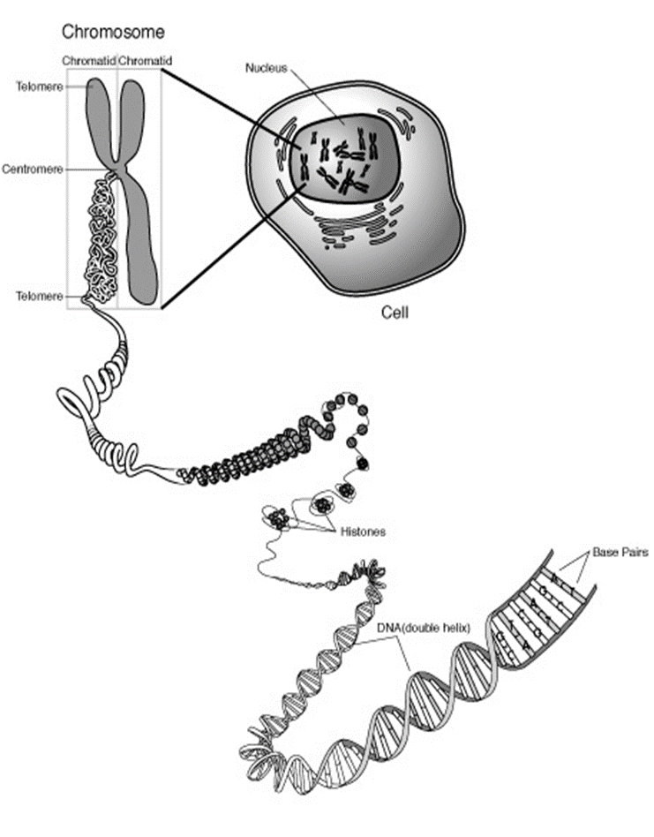
Chromosomes
A chromosome is one of the threadlike "packages" of genes and other DNA in the nucleus of a cell.
Different kinds of organisms have different numbers of chromosomes.
Humans have 23 pairs of chromosomes, 46 in all: 44 autosomes and two sex chromosomes.
Each parent contributes one chromosome to each pair, so children get half of their chromosomes from their mothers and half from their fathers.

Slide 4
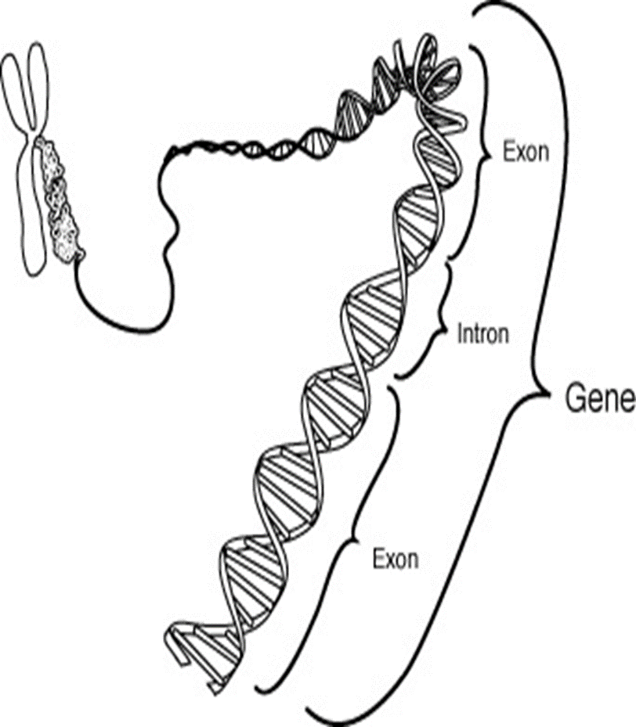
Gene
A gene is the functional and physical unit of heredity passed from parent to offspring.
Genes are pieces of DNA, and most genes contain the information for making a specific protein.

Slide 5
Genome
A genome is all the DNA contained in an organism or a cell, which includes the chromosomes plus the DNA in mitochondria (and DNA in the chloroplasts of plant cells).

Slide 6
Question: 1. Explain the relationship between genes, chromosomes and DNA

Slide 7
Answer!

