Slide 1
Normal Bacterial Flora
By:Afnan Bakhsh

Slide 2
Normal flora (N.F): it is an organism colonized in specific parts of body from the birth without causing
disease.
Found in: skin, mucus membranes that line the upper respiratory and gastrointestinal tract (GIT), nose, mouth, throat, outer ear and vagina. But all internal organs are sterile (blood, CSF, bladder, kidney, heart, lungs and brain).

Slide 3
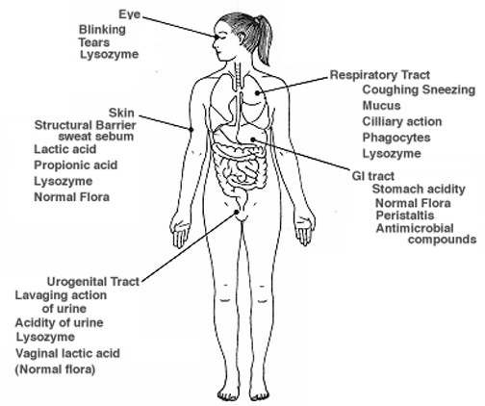

Slide 4
:Importance of N.F
1-Inhibit pathogenic organisms (protect from disease).
2-N.F in GIT help in absorption of Vitamin B₁₂, K,.
3-Keep the acidity level in vagina to prevent infection e.g. lactobacilli.

Slide 5
Harmful effect of N.F:
1-When N.F change place (move to sterile organ they cause disease). E.g. when N.F of upper respiratory tract move to the lower sterile respiratory tract it causes lung infection. Also, when insert I.V line without cleaning the skin by alcohol, N.F will go to blood stream causing septicemia.
2-When the immunity is low, the N.F can cause disease, also when we don’t care about cleanings the mouth or axilla, the N.F will increase causing infection and smell.

Slide 6
Skin Flora:
present in face, hand and axilla.
High number of N.F causes smell. Scrubbing will temporarily remove most N.F, and then organisms in follicles and sweat glands will reestablish the skin N.F.
e.g. Gram positive aerobic cocci ( staphylococci)
Gram positive anaerobic rods (propionibacteria)

Slide 7
Mouth normal flora:
the most proper place for the growth of bacteria. why?
1-Because the mouth is rich with nutrients from the diet.
2-Presence of gingival cervice fluid and salivary secretion.
So, this permit growth of wide spectrum of organisms including: aerobic and anaerobic Gram positive streptococci, aerobic and anaerobic gram negative rods, spirochetes & fusiform bacilli.

Slide 8
Processing of clinical specimen

Slide 9
Processing of clinical specimen
1-Collection
2-Transportation
3-Processing
Clinical sample can be: urine, stool, blood, sputum, CSF or other fluid, throat swap, wound swap.

Slide 10
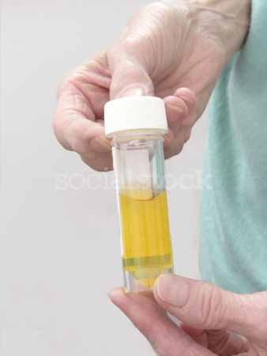
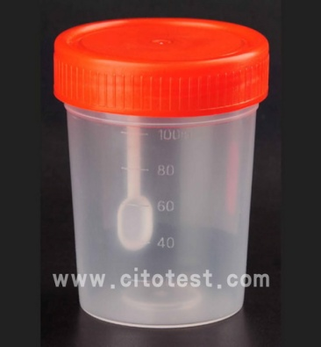
Collection
We use:
1-Universal container: for urine and sputum.
2-Container with wide neck: for stool
3-Blood culture bottle: for blood because the blood contains delicate organisms so, immediately we put the blood in the bottle to enhance organism surviving. It contains broth that allows growth of aerobic and anaerobic organisms.

Slide 11
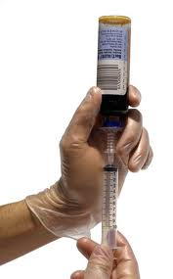
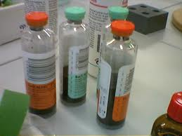
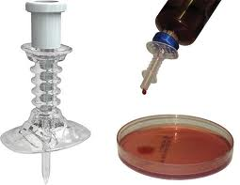

Slide 12
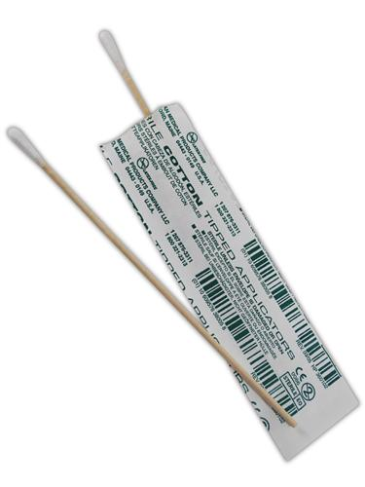
4-Swabs: for throat, wound and skin at the site of infection (eye, ear, axilla, ….etc). It contains general media to keep the organism wet and support survival. The cotton swap is sterile.
Note: all the containers should be sterile.

Slide 13
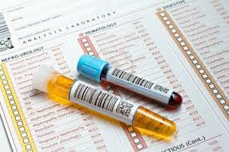
Transportation
1-Sample should be labeled (name, age, number).
2-Sample should sent to the lab as soon as possible to be processed (why?)
#To survive pathogenic organisms and not die.
# Prevent contaminants growth especially urine and this will give false results (masking results).

Slide 14
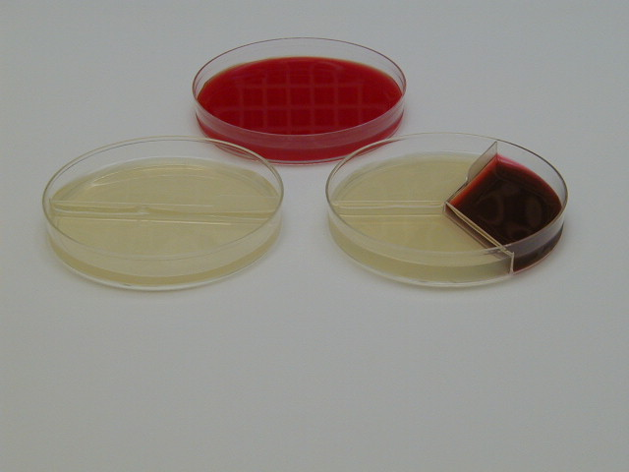
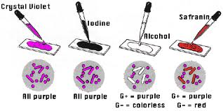
Processing
From sample we do:
1-Culturing on media (NA, BA, CLED).
2-Staining: gram stain, spore stain or capsule stain.

Slide 15
3-Antibiotic sensitivity (either for identification or treatment). E.g. for identification :
#novobiocin that differentiates between staphylococcus epidemidis (sensitive) and staphylococcus saprophyticus (resistant).
#Optochin that differentiates between streptococcus pneumonia (sensitive) and streptococcus viridance (resistant).
#Bacitracin differentiates between streptococcus group A (sensitive)from other groups (B,C,D) (resistant).

Slide 16
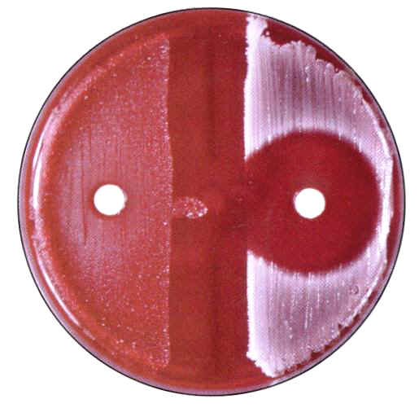
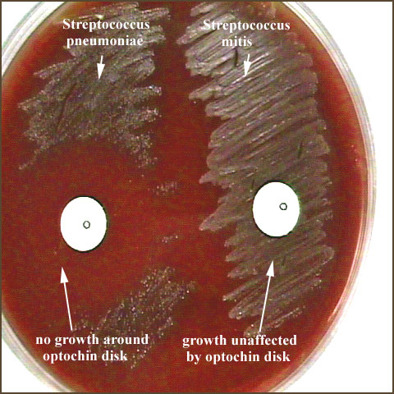
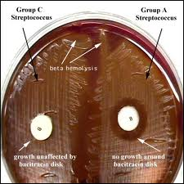
Novobiocin plate
Optochin plate
Bacitracin plate

Slide 17
4-Biochemical reaction:
API 20 E: It is strip contains 20 test in one strip, each one in tubules. used for identification of organisms. Each tubule has specific test (either glucose to check glucose fermentor ‘color’ or non fermntor ‘colorless’, lactose to check LF ‘color’or NLF ‘colorless’ or enzyme production ‘color’ if produce or ‘colorless’ if not). First we add organism to saline then, add one drop of this to each tubule. Then incubate for two hours. If the color of tubule changed that means it is positive. If not it is negative.

Slide 18
+ + - /+ - +/+ - -/- + -/ + + +
1 2 0/ 1 0 4/1 0 0 / 0 2 0/ 1 2 4
3 5 1 2 7
We will look for the number 35127 in the index then, we will identify the organism name and species.

Slide 19
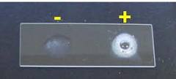
5-Catalase test:
catalase is enzyme produced from some organisms. When we add H₂O₂ catalase will break it down.
H₂O₂ + catalase (If organism produce)…………H₂+O₂ (bubbles) that means the organism is catalase positive.
H₂O₂ + no catalase …………no change (no bubbles) that means the organism is catalase negative.

Slide 20
Thank You

